Slide 1
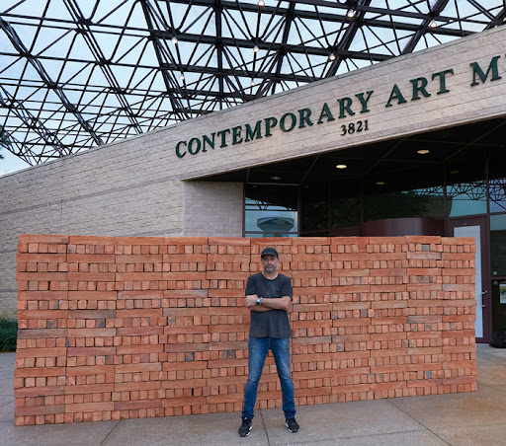
Bosco Sodi: An Introduction
Who is Bosco Sodi?

Slide 2
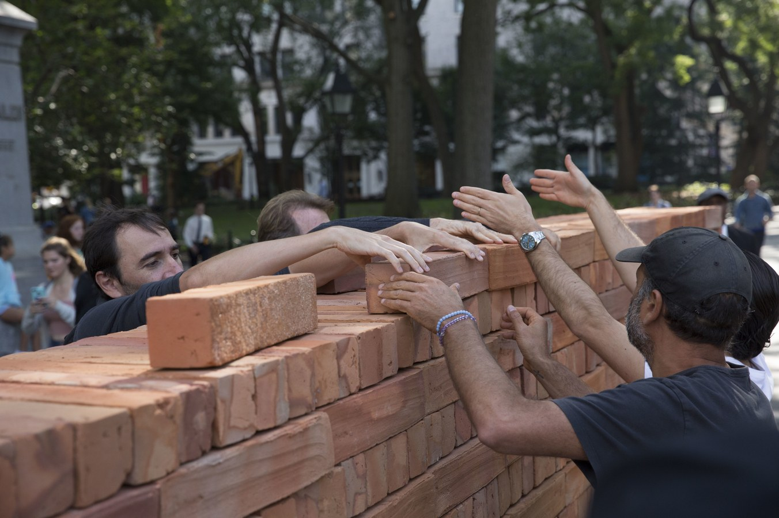
Do Now
-What do you see?
-What do you think is happening?
-Where do you think this is taking place?

Slide 3
Muro (2017)
Notes:
This is an art piece from artist Bosco Sodi called Muro. It was erected in NYC’s Washington Square Park in 2017.
We will learn more about Bosco Sodi and Muro today!

Slide 4
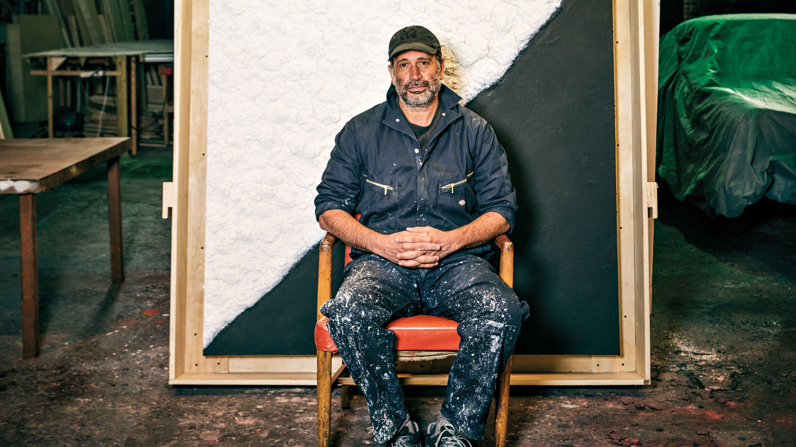
Who is Bosco Sodi?

Slide 5
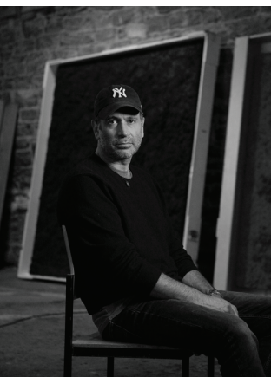
Bosco Sodi Biography
b. 1970, Mexico City
known for richly textured, vividly colored large-scale paintings
explores materials, the creative gesture, and the spiritual connection between artists and their work
leaves many of his paintings untitled, to remove any predisposition or connection beyond the work’s immediate existence
Notes:
Source: https://www.boscosodi.com/bio
Bosco Sodi (b. 1970, Mexico City) is known for his richly textured, vividly colored large-scale paintings. Focusing on material exploration, the creative gesture, and the spiritual connection between the artist and his work, Sodi seeks to transcend conceptual barriers. Sodi leaves many of his paintings untitled, with the intention of removing any predisposition or connection beyond the work’s immediate existence. The work itself becomes a memory and a relic symbolic of the artist’s conversation with the raw material that brought the painting into creation.

Slide 6

An interview with the artist

Slide 7
                While you watch the video about Bosco Sodi, answer these questions:
Why did Sodi’s mother put him in art therapy classes?
From what artists does Sodi take inspiration?
What do you think “Land Art” means?
What materials did Sodi use to create the art shown in the video? How is this different from other artists you have learned about?
What is wabi-sabi? How do you think it impacts Sodi’s work?
What is Casa Wabi?

Slide 8
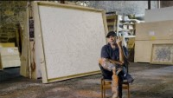
Notes:
6-minute Video Link: https://www.youtube.com/watch?v=kIRN8gJZ1pk

Slide 9
Bosco Sodi:
Selected Works
Notes:
We will look at two different styles of art from Bosco Sodi’s body of work and understand how their meaning and how they were created.

Slide 10
Mixed Media
Notes:
Definition of Mixed Media: Mixed media is a term used to describe artworks composed from a combination of different media or materials.
Source: https://www.tate.org.uk/art/art-terms/m/mixed-media

Slide 11
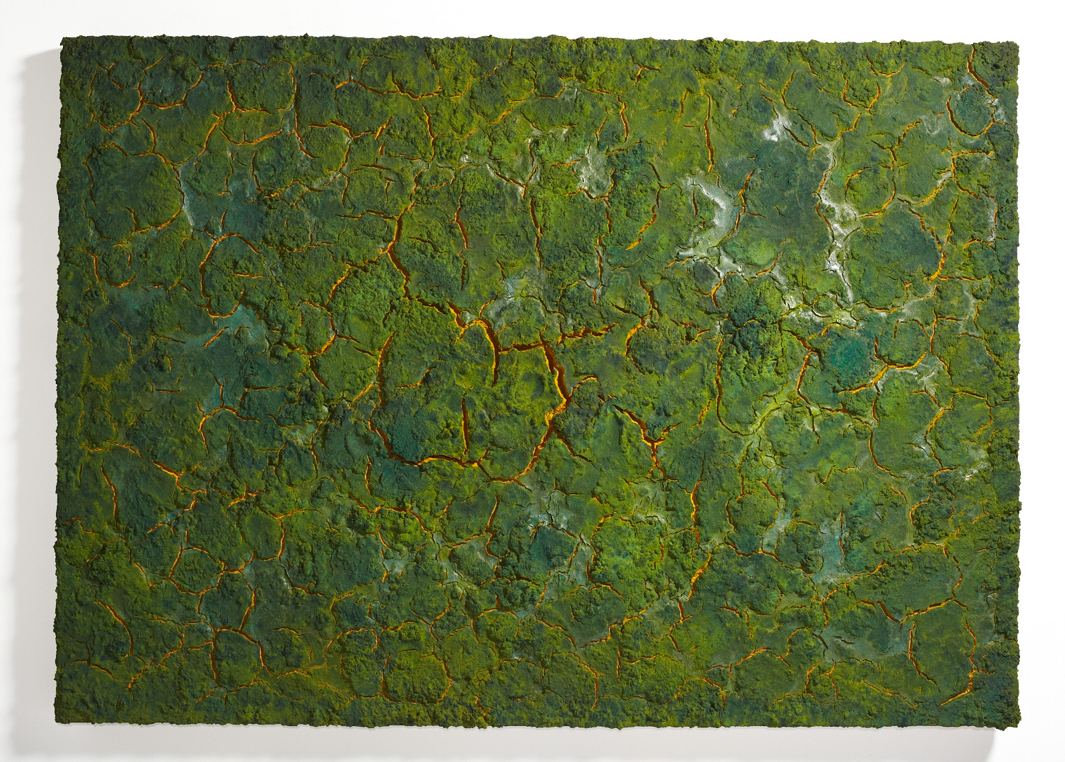
Mixed media over canvas
(2013)
Sodi mixes sawdust, wood, pulp, and natural fibers to create his Mixed Media series of art.
Notes:
https://www.boscosodi.com/work

Slide 12
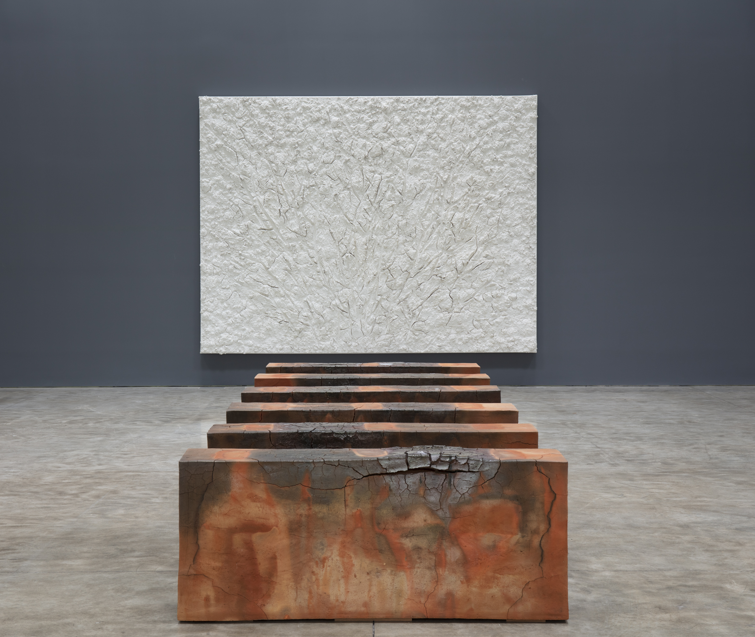
Vers L’Espagne (2019)
“Vers L’Espagne” translates to ‘To Spain’.
This work takes inspiration from various Spanish artists who influenced Sodi.
Notes:
Art Information: https://www.kasmingallery.com/exhibition/bosco-sodi--vers-lespagne/showroom
https://cfileonline.org/feature-bosco-sodi-vers-lespagne-is-a-love-letter-to-spanish-art/

Slide 13
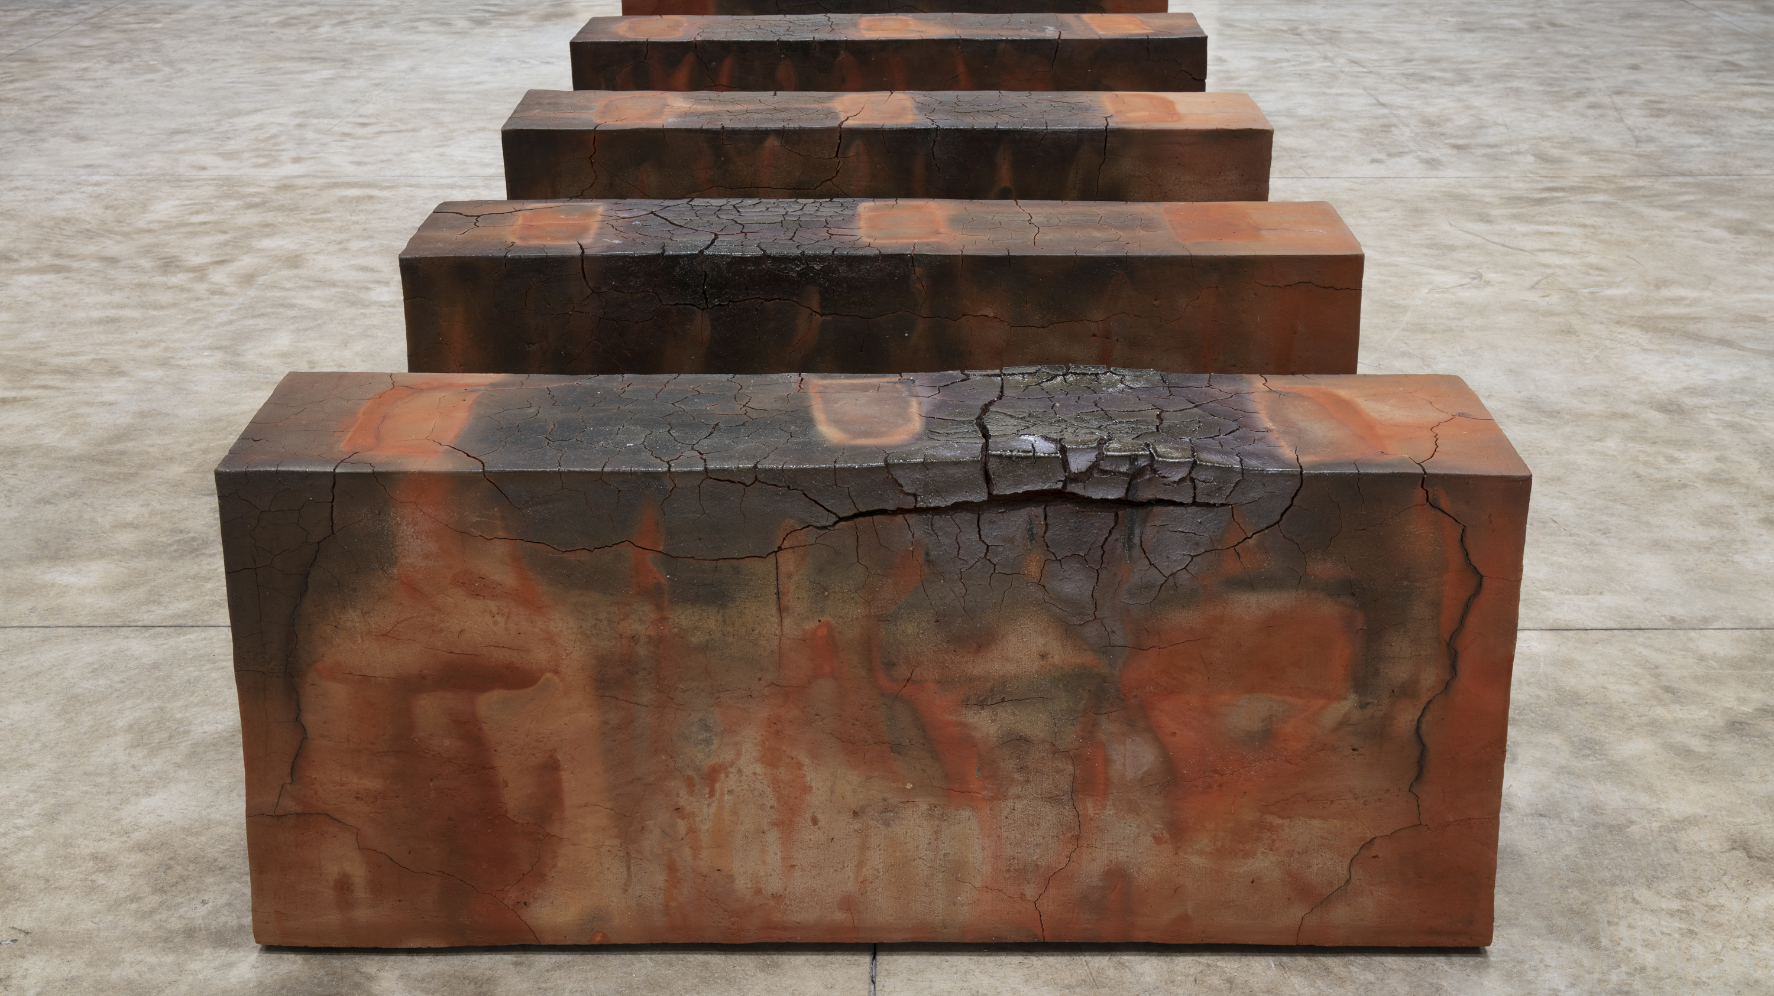
Notes:
Art Information: https://www.kasmingallery.com/exhibition/bosco-sodi--vers-lespagne/showroom
https://cfileonline.org/feature-bosco-sodi-vers-lespagne-is-a-love-letter-to-spanish-art/

Slide 14
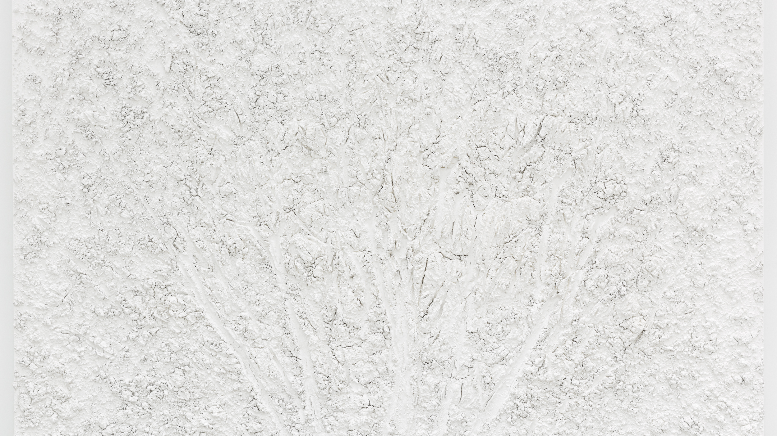
Notes:
Art Information: https://www.kasmingallery.com/exhibition/bosco-sodi--vers-lespagne/showroom
https://cfileonline.org/feature-bosco-sodi-vers-lespagne-is-a-love-letter-to-spanish-art/

Slide 15
Installation Art
Notes:
The term installation art is used to describe large-scale, mixed-media constructions, often designed for a specific place or for a temporary period of time.
Source: https://www.tate.org.uk/art/art-terms/i/installation-art

Slide 16
Muro: Washington Square Park, NY
September 8, 2017
Notes:
Sodi has erected Muro several times and in various locations. The images on slides 16-19 are from the Muro installation in Washington Square Park in New York City.
Source: https://www.kasmingallery.com/news/bosco-sodi--at-washington-square-park

Slide 17
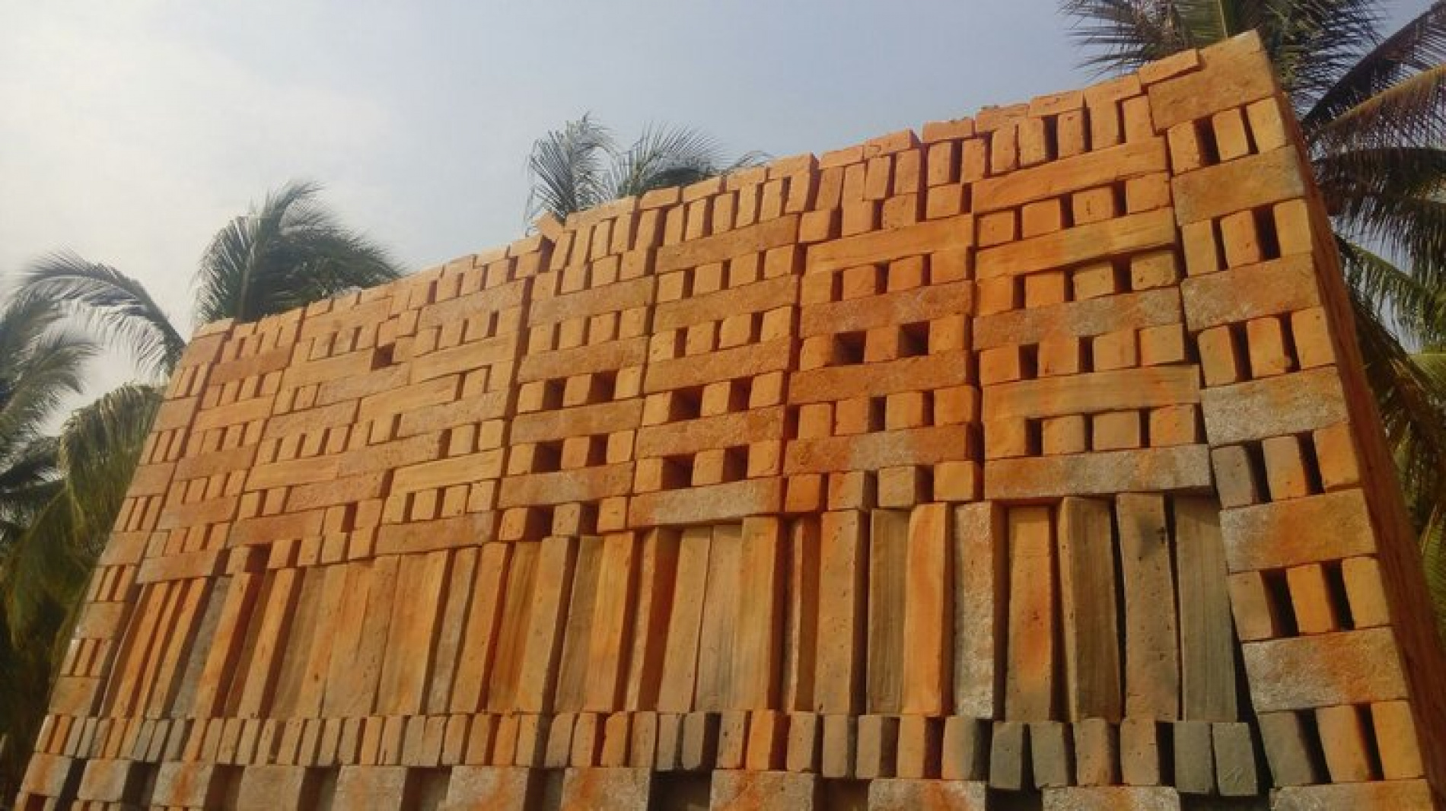
Notes:
Bosco Sodi: Muro
Washington Square Park, New York
September 7, 2017
Performance begins at 3 PM
Dismantling concludes by 8 PM
Paul Kasmin Gallery is pleased to present Bosco Sodi’s Muro in Washington Square Park, the artist’s first public installation in New York. Muro is a 2-meter high by 8-meter long wall, constructed with 1,600 unique clay timbers that Sodi fired by hand at his studio in Oaxaca, México, with the help of local craftsman. Muro will be erected in the early morning on September 7 for one day, at the end of which visitors are invited to remove one timber, each one sealed by the artist with his signature, to take home with them. At the conclusion of the piece, Muro will endure as a communally co-owned work of art. The project expands upon Sodi’s ongoing interest in organic processes beyond the artist’s control. The impermanent nature of Muro further underscores the sentiment that all obstacles have the potential to be dismantled through united forces.
Source: https://www.kasmingallery.com/news/bosco-sodi--at-washington-square-park

Slide 18
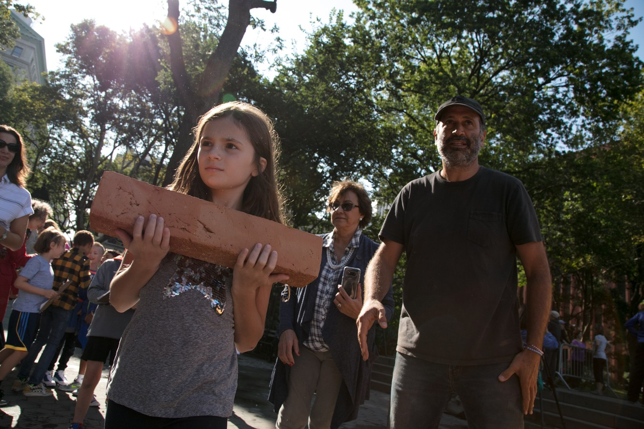
Meant to be dismantled
Notes:
Sodi’s installation, Muro, was comprised of a wall of bricks made in Mexico. It is meant to be dismantled the same day by passers-by who each take a brick.
Source of images: https://observer.com/2017/09/mexican-artist-bosco-sodi-built-a-wall-faster-than-trump/

Slide 19
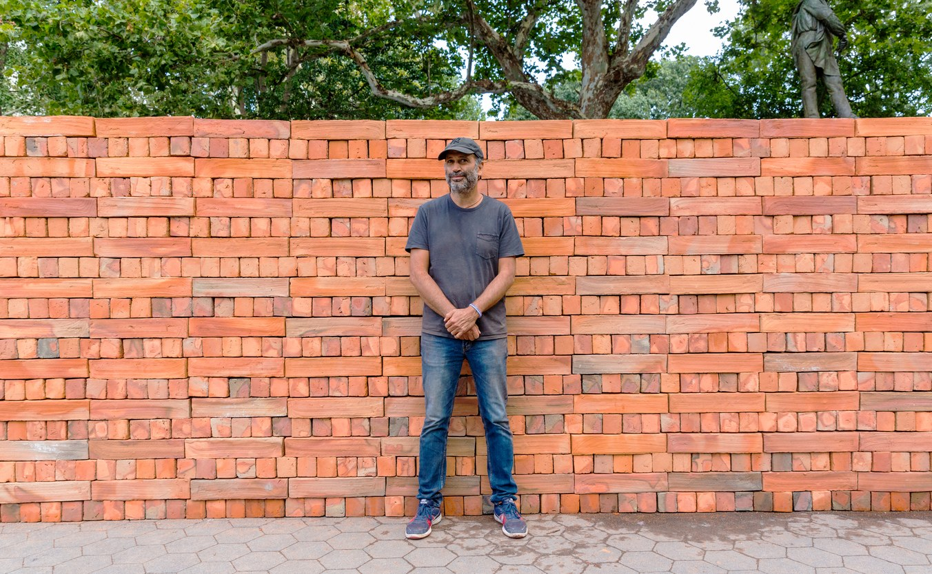
“The impermanent nature of Muro further underscores the sentiment that all obstacles have the potential to be dismantled through united forces.”

Slide 20
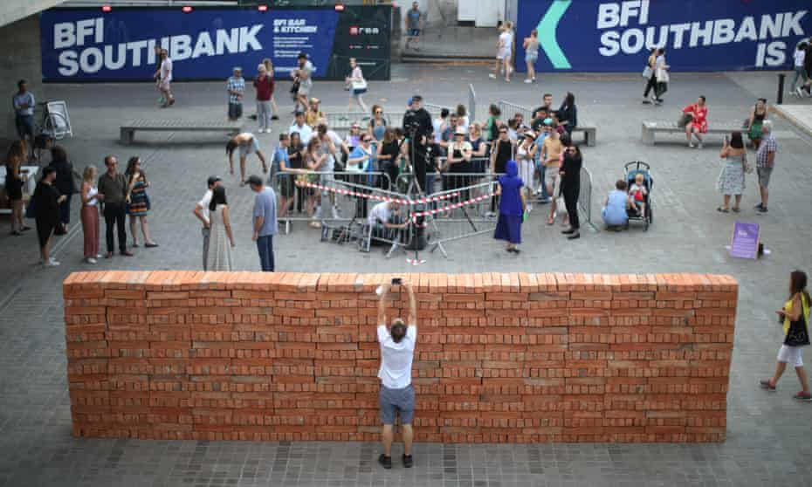
Muro: South Bank, London, England
July 6, 2018
Notes:
This Muro installation was erected in London.
Image source: https://www.theguardian.com/us-news/2018/jul/09/donald-trump-to-face-carnival-of-resistance

Slide 21
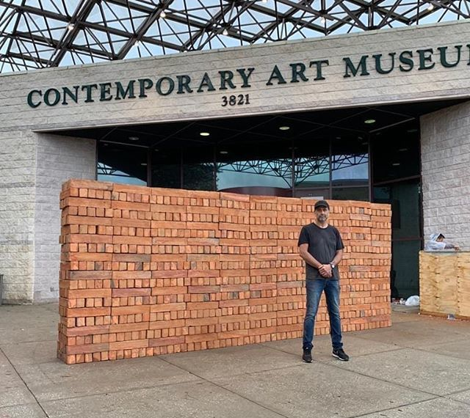
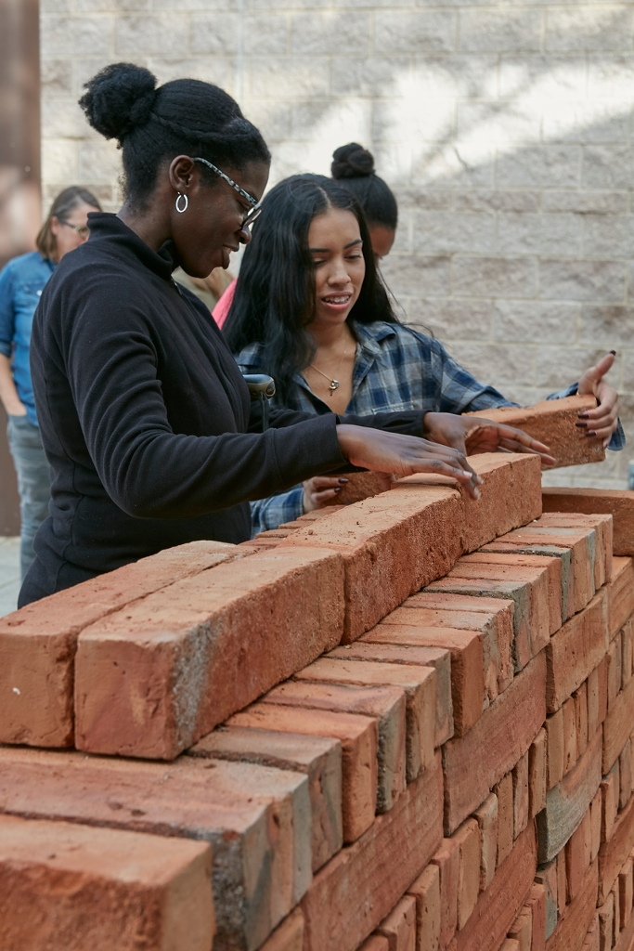
Muro: University of South Florida, Tampa, Florida
January 24, 2019
Notes:
It was also featured iat the University of south Florida.

Slide 22
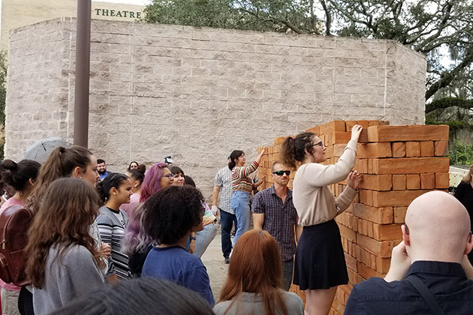
Notes:
Blake High School (Tampa, Florida) students and others in attendance begin to dismantle Muro.
Source: https://www.usf.edu/arts/news/2019/0219-artist-bosco-sodis-installation-muro-sparked-public-participation-and-discourse-on-the-usf-campus.aspx

Slide 23
Final Reflection

Slide 24
Your Thoughts
Share with your group one fact you learned about Bosco Sodi and your favorite piece of art you saw today.

Slide 25
Assessment
Step 1: Imagine that you had the opportunity to interview Bosco Sodi --- what questions would you ask him?
Step 2: Solo Work -- Compose two questions you would want to ask Bosco Sodi. It can be about his life, his inspiration, or his artistic process.
Step 3: Group Work – In pairs or small groups, create an interview protocol you would use to interview Bosco Sodi.

