Slide 1
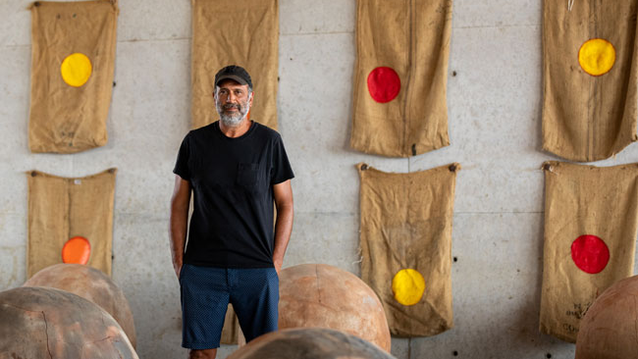
Bosco Sodi: Bάsico
The Arte Povera Movement

Slide 2

Lesson Learning Objectives
Today I will be able to:
1) Identify Characteristics of the arte povera movement
2) Identify social, economic, political, & cultural developments in Italy 1960’s
3) Examine relationships between art movements and historic contextualization

Slide 3
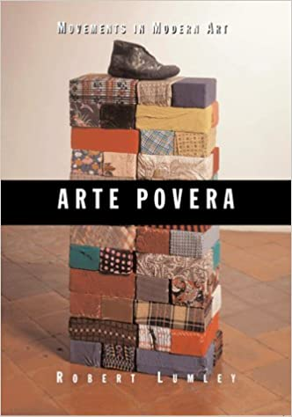




What is arte povera?
Arte Povera [ahr-teh pō-veh-rah]
NOUN
a style and movement in art originating in Italy in the 1960s combining aspects of conceptual, minimalist, and performance art, and making use of worthless or common materials such as stones or newspapers, in the hope of subverting the commercialization of art.
ORIGIN
1960s: Italian, literally ‘impoverished art’, from arte ‘art’ + povera (feminine of povero; ‘needy’).

Slide 4
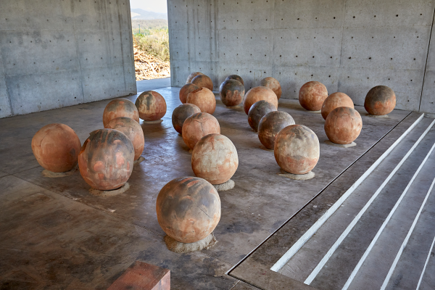
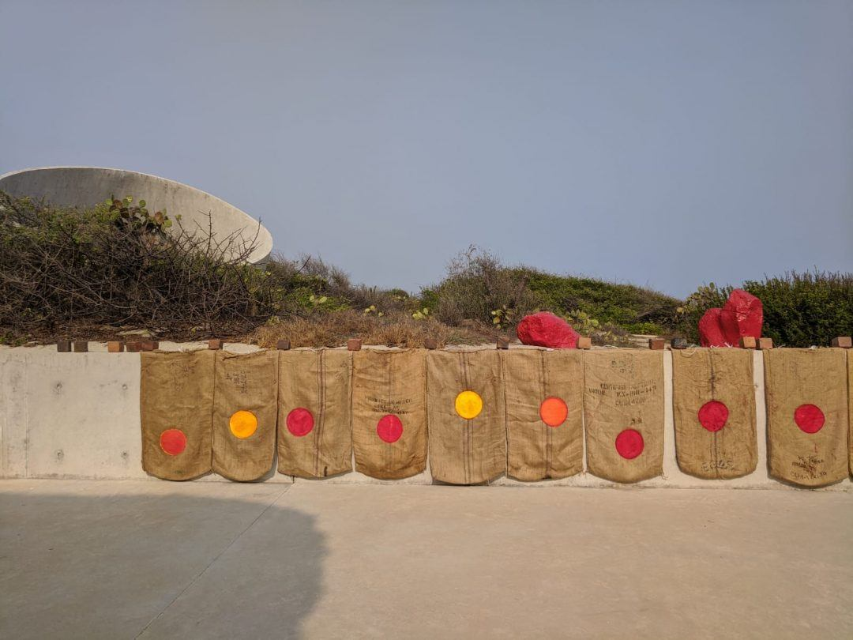
Bosco Sodi: Bάsico

Slide 5
Bosco Sodi: Bάsico
Bosco Sodi: Básico brings together Bosco Sodi’s various sources of artistic inspiration as examples of sustainable art making. The exhibition includes a powerful group of paintings titled “Vers l’Espagne”, whose rough surfaces recall creek beds and the footpaths trod by Mexican and Central American immigrants on their way north, as well two new series Sodi made in Mexico in 2020 during pandemic lockdown: large spherical clay sculptures he has called “perfect bodies” and a series of “Sun Paintings” on chili pepper sacks, both fashioned with materials that were readily available at his studio in Oaxaca, Mexico. Also included in the exhibition are small clay sculptures made by local children, the hands-on output of a community art program developed by Sodi’s Casa Wabi Foundation, the non-profit art and community-education complex the artist founded eight years ago on Mexico’s Oaxacan Coast. Among the messages of the exhibition: challenging times demand a return to what is Básico—art, community, and education.
For full description of Basico: http://usfcam.usf.edu/CAM/exhibitions/2022_01_Bosco_Sodi_Basico/Bosco_Sodi_Basico.html

Slide 6
Italy (1960s)
https://www.britannica.com/place/Italy/Italy-from-the-1960s
What are three SOCIAL, ECONOMIC, POLITICAL, & CULTURAL developments in Italy during the 1960s?
Social | Economic | Political | Cultural
1)
2)
3)

Slide 7
Examining relations between art and historic context
Between 1960 and 1970 there were many social, economic, political, and cultural developments in Italy that influenced the rise of the arte povera movement. One social development was _______ which influenced arte povera by ________. One economic development was ______. This shaped the arte povera movement because ______. One political development was ______ which caused ______ in the arte povera movement. Finally, one cultural development was ______. This development was significant to the arte povera movement because ______.

Slide 8
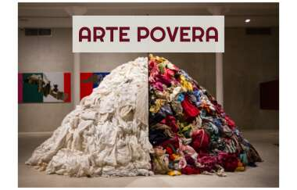
Bosco Sodi: Bάsico
Why might the arte povera movement influence Bosco Sodi in 2020 and 2021?
What might Bosco Sodi be trying to say by creating art associated with arte povera?
Notes:
Image source: https://prezi.com/u7djf51slr5-/arte-povera/

