Slide 1
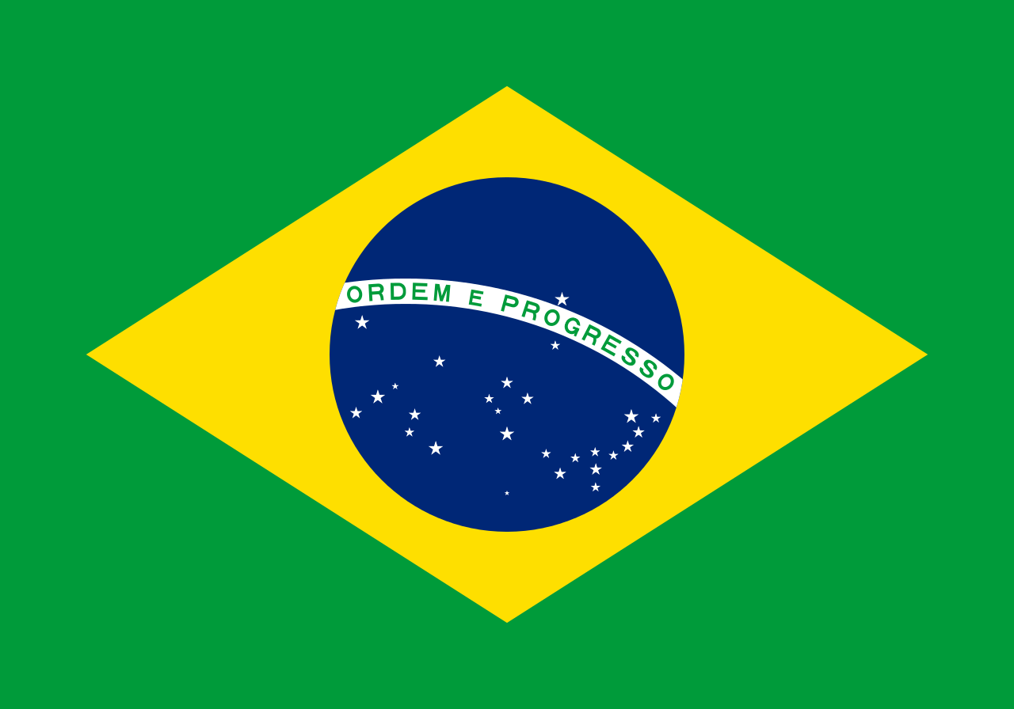
Histórias/Histories:
An Introduction to Brazil

Slide 2
Mental Cartography
Close your eyes
Envision the Western Hemisphere in your mind
What does it look like?
What natural features do you see
What human-made structures are there?
Open your eyes, pick up your pencil, and draw your mental map of the Western Hemisphere, labeling as many places and features as you can

Slide 3
With a shoulder partner…
…Share your maps, noting:
What places or features did both of you draw?
What places or features did you both label?
What do you know about the features you drew?
What differences are there between the two maps?
What generalizations can you make about your maps?

Slide 4
Discussion
What generalizations can you make about your maps?
What are some things your maps had in common?
What were some differences?
What are some possible explanations for the commonalities and differences?
How accurate do you think your maps are?

Slide 5
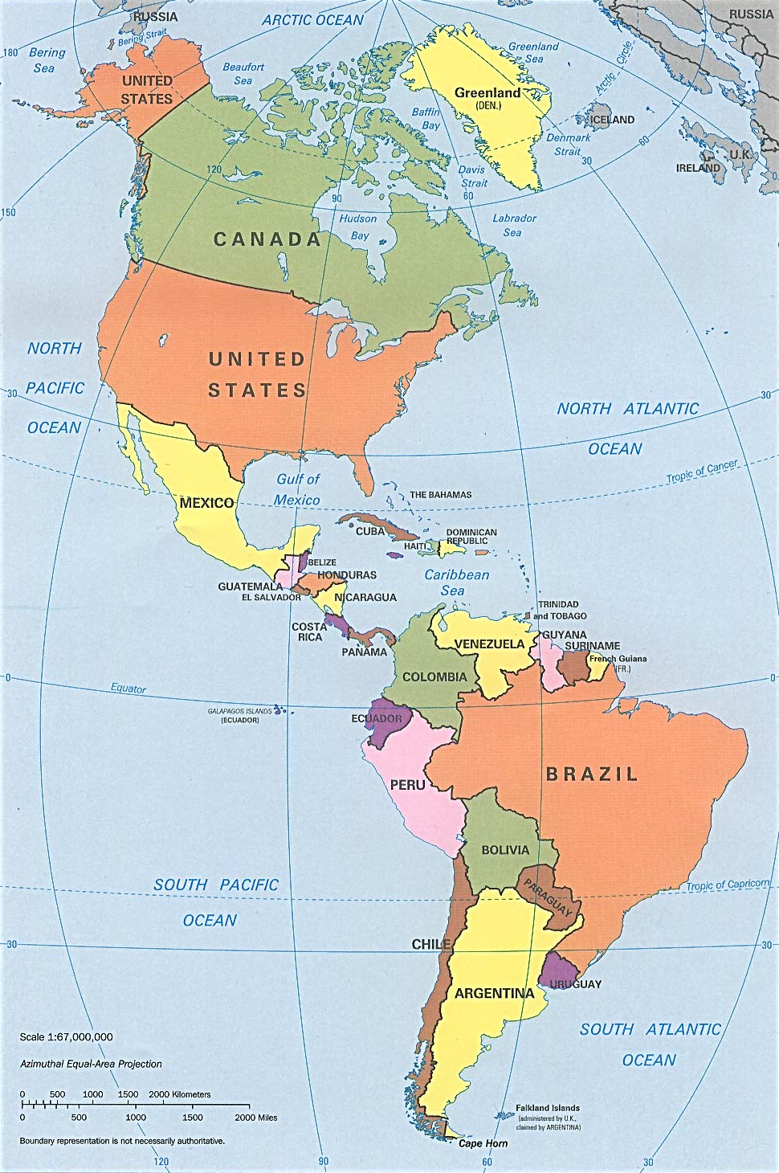
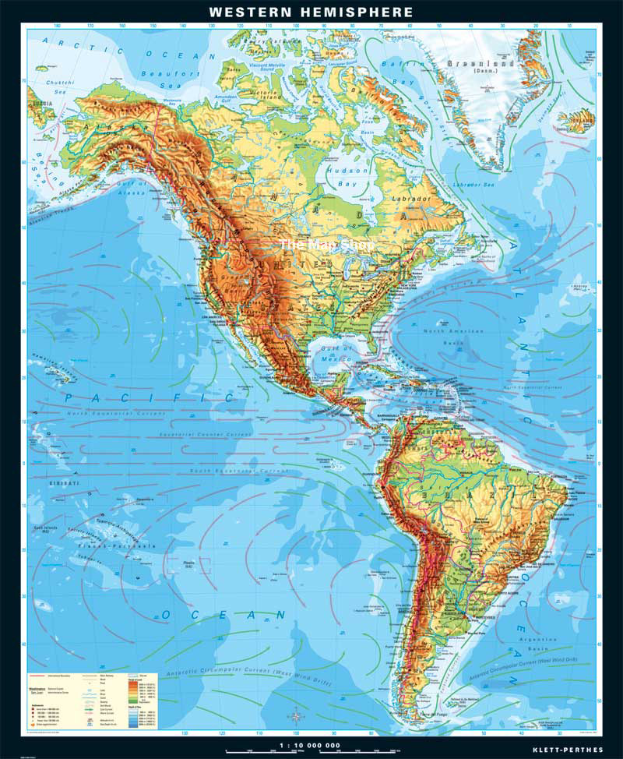

Slide 6
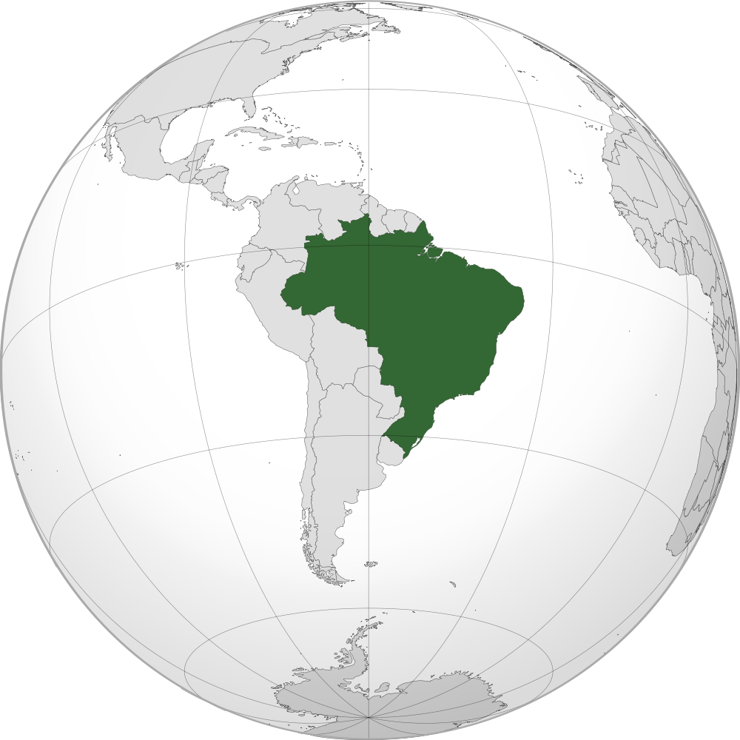
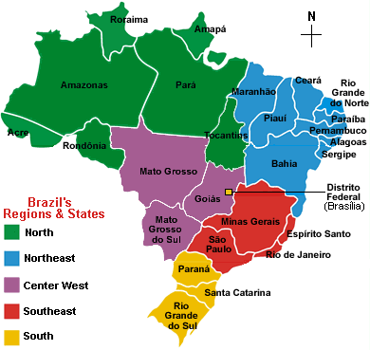
Facts about Brazil
5th largest country in the world (both geographic size and population)
Largest Portuguese-speaking country in the world
Has the world's largest population of Roman Catholics
It is a federal republic, composed of the Federal District, 26 states, and 5,570 municipalities
Capital is Brasília

Slide 7
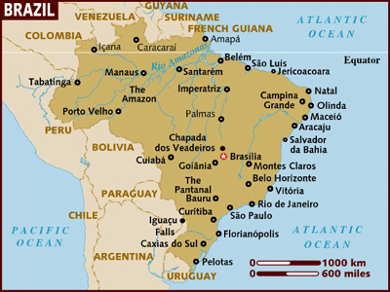
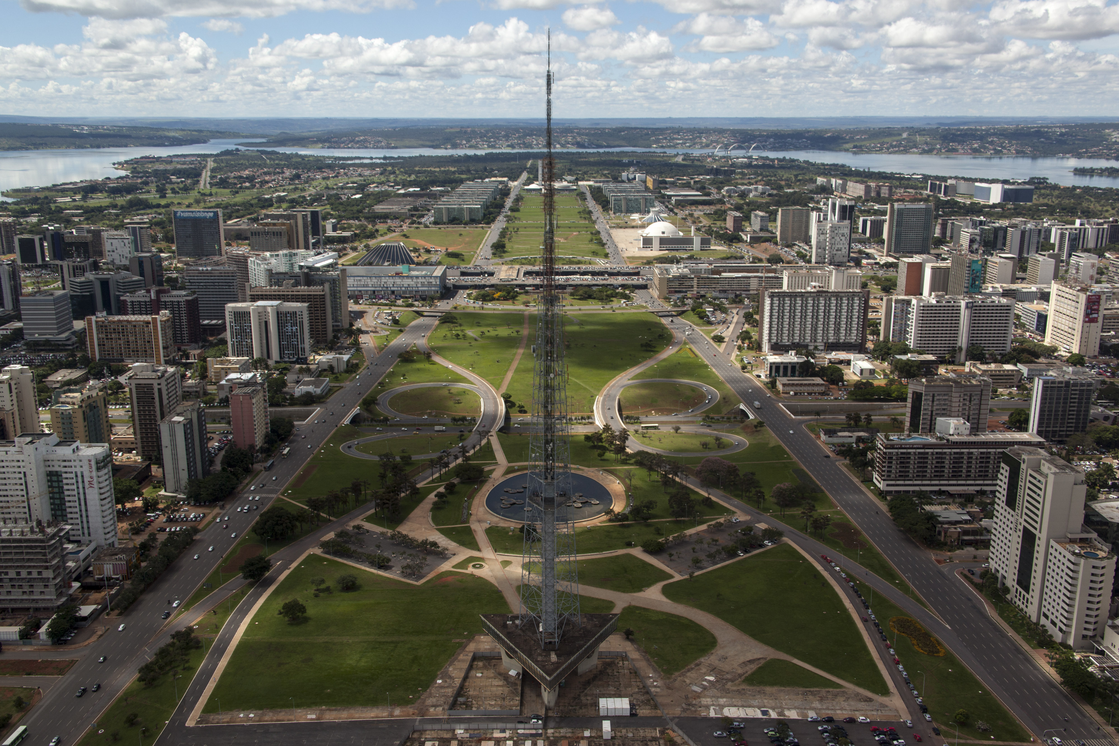
Brasília, capital of Brazil

Slide 8
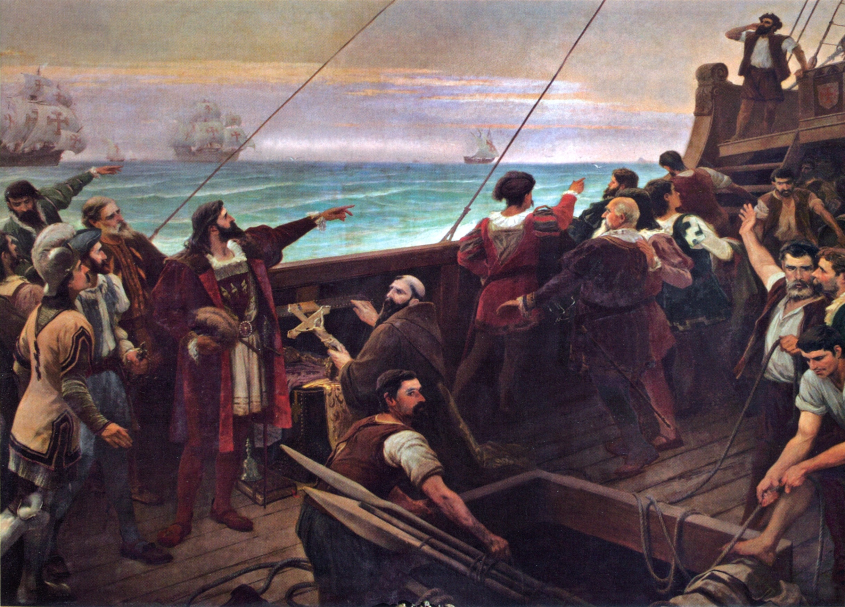
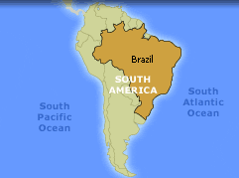
A Brief History of Brazil
Brazil was inhabited by indigenous peoples
1500: Portuguese explorer Pedro Álvares Cabral claimed the area for Portugal
1822: independence from Portugal, with the creation of the Empire of Brazil
1889: became a presidential republic following a military coup d'état
1964: a military junta came to power
1985: a civilian government was instituted

Slide 9
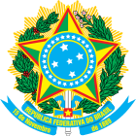
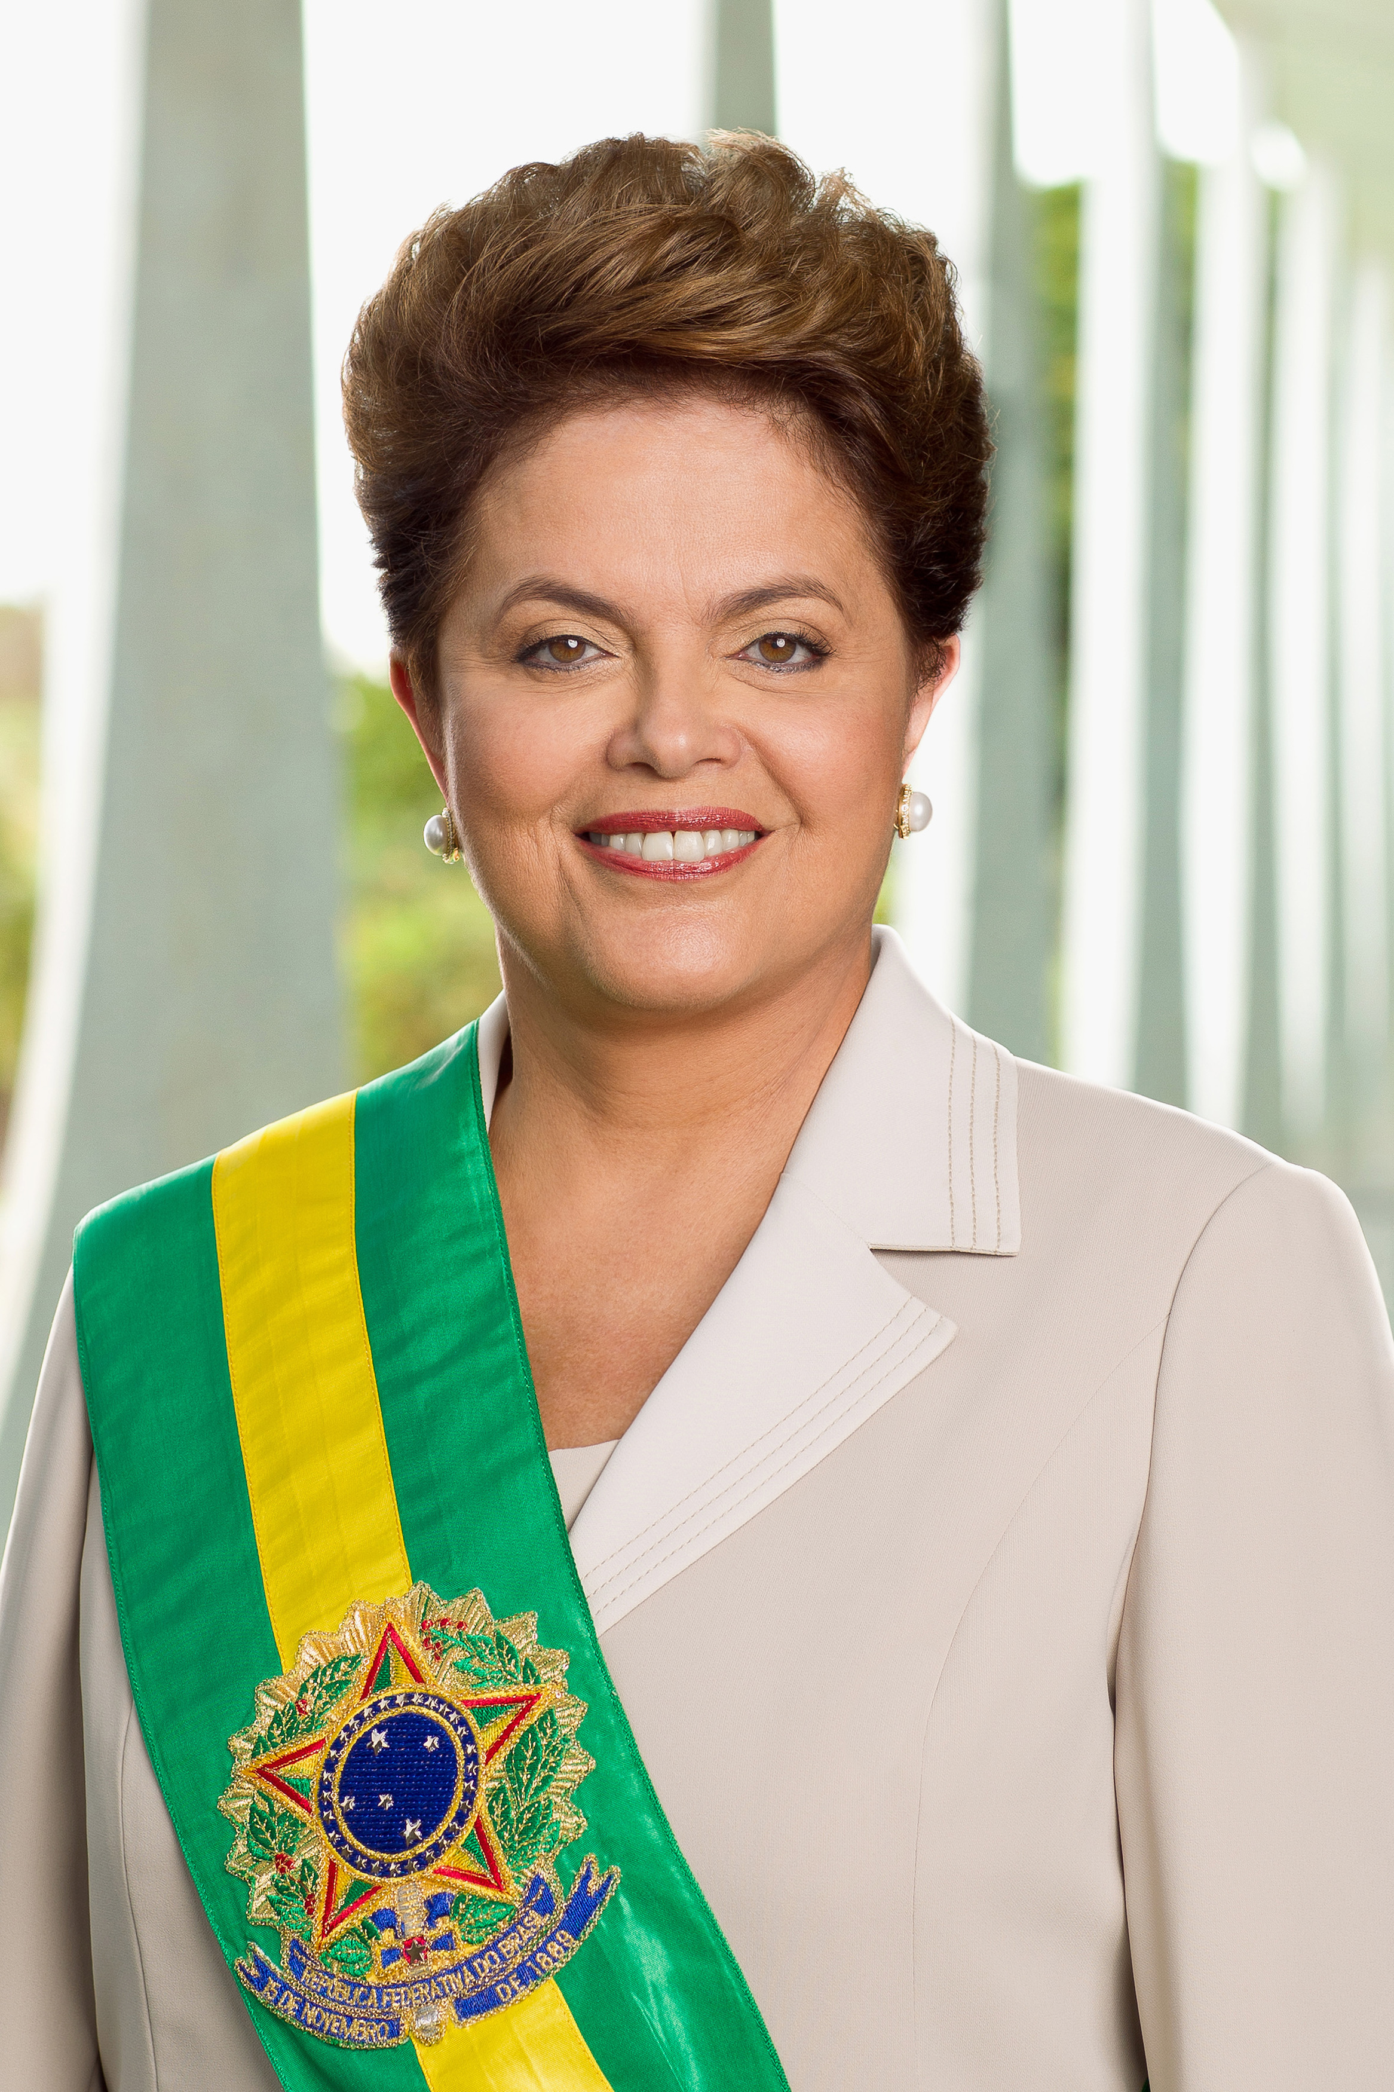
Current Government
Voting: voluntary 16-18 years and over 70; compulsory 18 to 70 years of age
Chief of state: President
Cabinet: appointed by the President
President Dilma Rousseff (assumed office January 1, 2011)

Slide 10
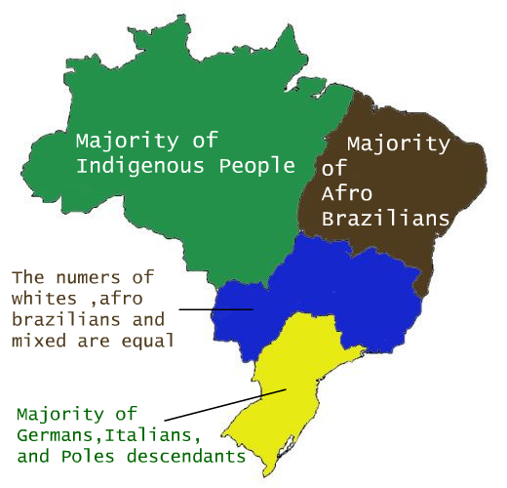
Languages & Cultures
The official language of the country is Portuguese
180+ Amerindian languages
Mandatory to learn at least one second language
Brazil is a multiethnic nation made up of Amerindians, Europeans, Africans, and immigrants
Brazil is believed to have the largest number of ”uncontacted peoples” in the world
Notes:
In the 12 mandatory grades in the Brazilian educational system, it is mandatory to learn at least one second language (most often it is either English or Spanish).
Uncontacted peoples are communities who live without contact with the larger society or global civilization.
Map source: https://storify.com/branbis709/racial-inequality-in-brazil

Slide 11
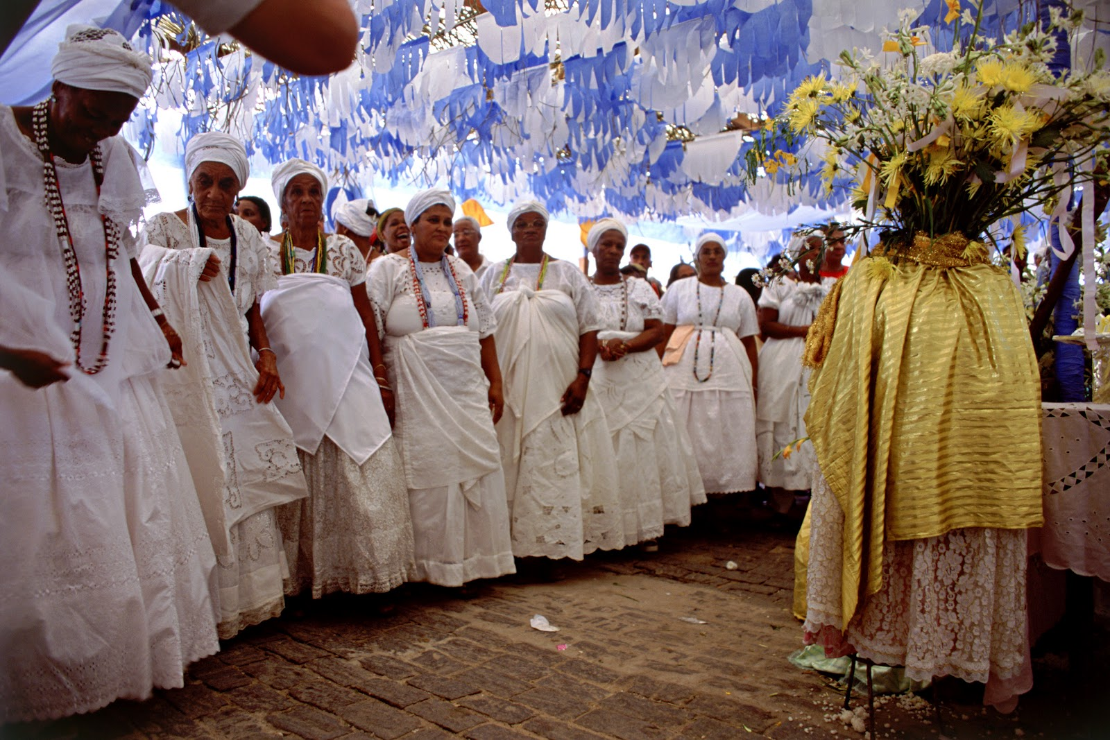
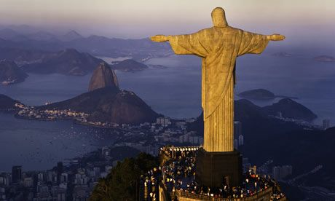
Religion
The most practiced religion is Christianity, with the majority being Roman Catholic
Indigenous & Afro-Brazilian religions also practiced

Slide 12
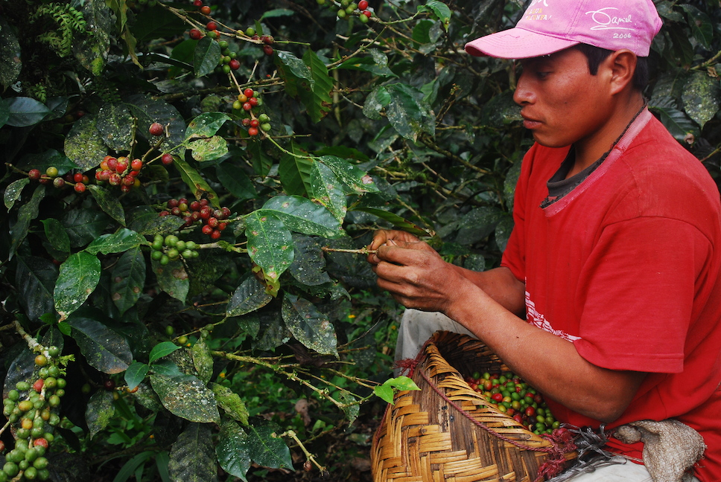
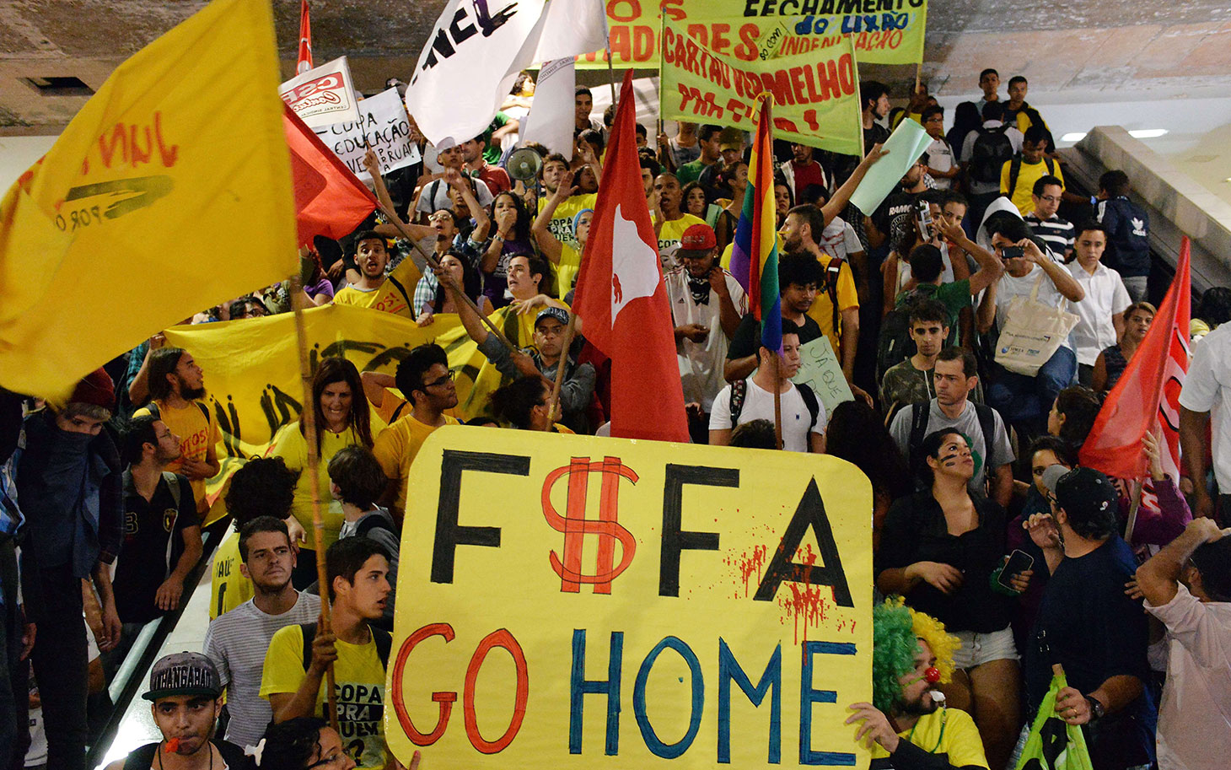
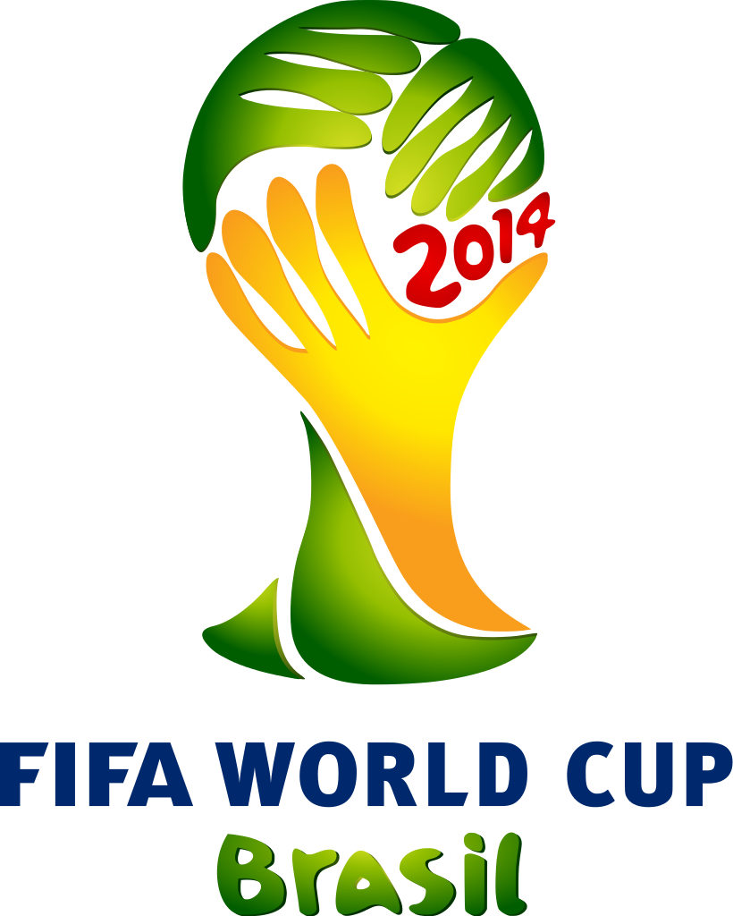
Economy
Largest economy in Latin America
Major economic activity: agriculture, mining, manufacturing, and tourism
2014 FIFA World Cup failed to bring the economic prosperity promised
Notes:
Top photo: harvesting coffee beans. Brazil has been the largest producer of coffee worldwide for over 150 years.
Photo source: http://www.globalenvision.org/2014/03/17/beyond-fair-trade-portland-roaster-and-coffee-farmers-make-family
FIFA protests photo source: http://america.aljazeera.com/opinions/2014/6/brazila-s-fifa-worldcupbrazilashomelessworkersamovement.html

Slide 13
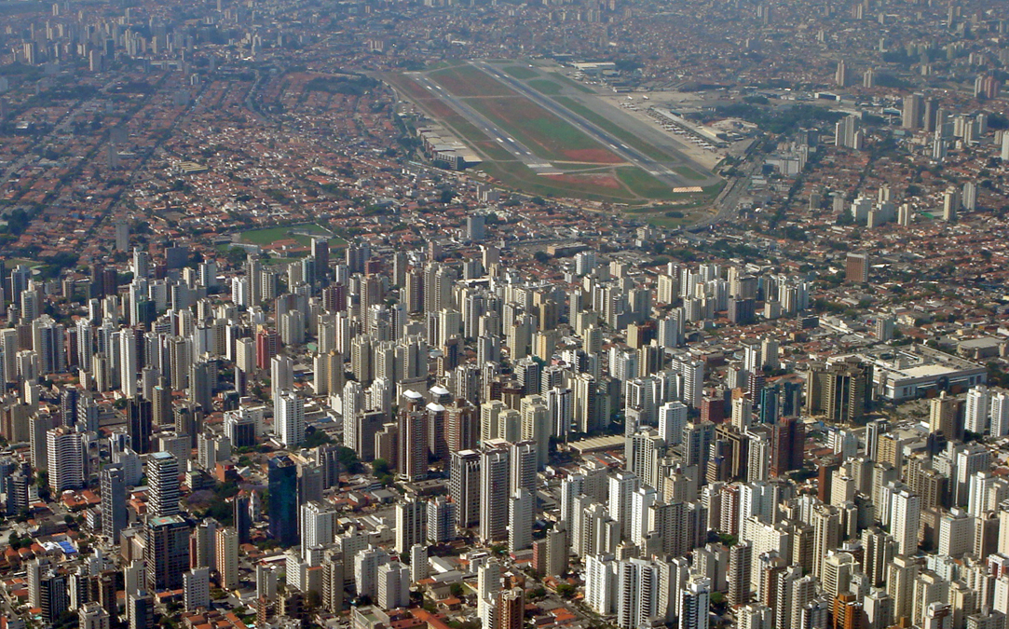
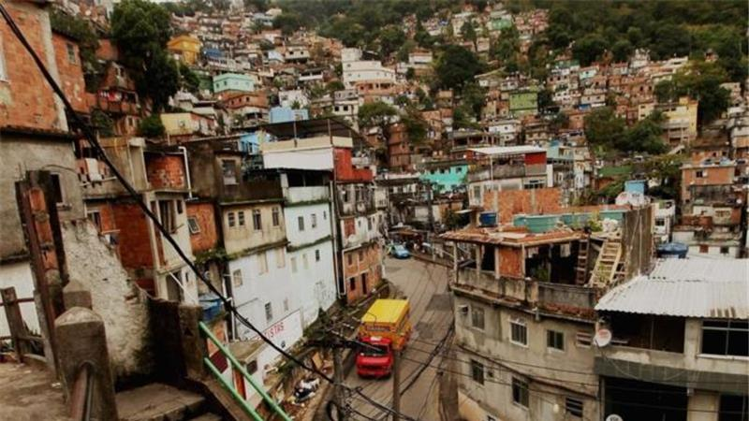
Urbanization
About 85% of the population lives in urban areas
Largest metropolitan areas are São Paulo, Rio de Janeiro, and Belo Horizonte (Southeast)
Favelas are urban slums where about 6% of the population (11.5 million people) live
São Paulo, Brazil
Notes:
Photo source: http://www.aljazeera.com/indepth/features/2013/08/2013810173944707701.html

Slide 14
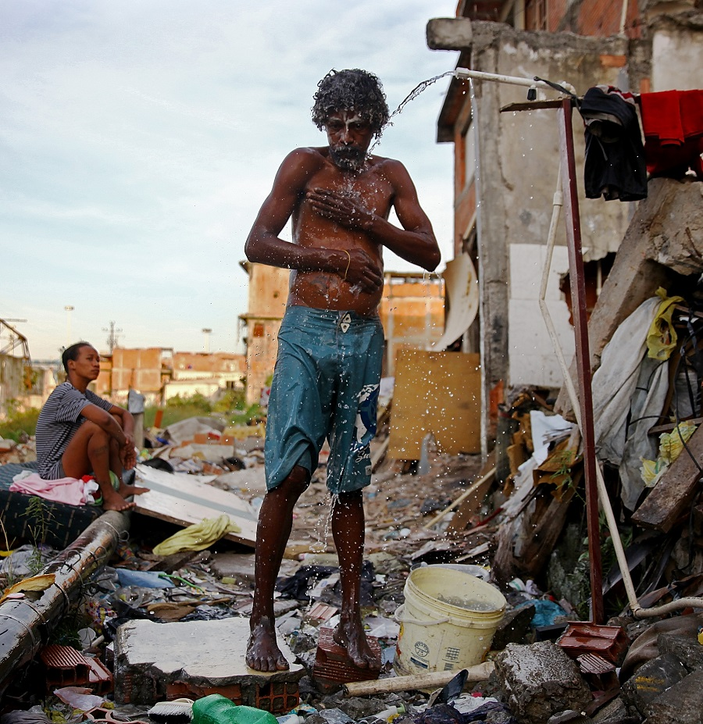
Water
Improved access to water and sanitation in recent years
Remaining challenges:
access in favelas
water scarcity, especially in the Northeast
water pollution, especially in the Southeast
Notes:
Photo source: http://www.sbnation.com/longform/2014/6/4/5776888/brazil-favela-profile-world-cup-soccer-2014

Slide 15
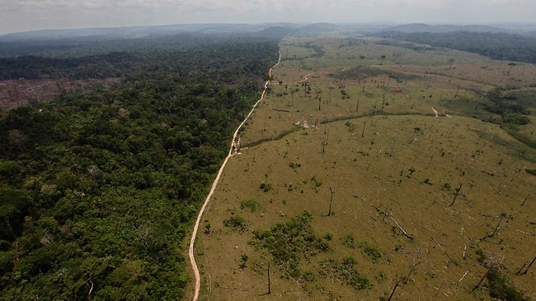
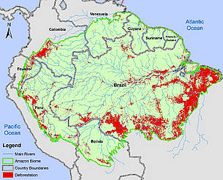
Environmental Concerns
Water supply
Amazon degradation
Deforestation
Notes:
Photo source: http://www.theaustralian.com.au/news/world/deforestation-of-brazils-amazon-at-24-year-low/story-e6frg6so-1226525515536
Graphic source: http://wwf.panda.org/?208511/Keeping-an-eye-on-deforestation

Slide 16
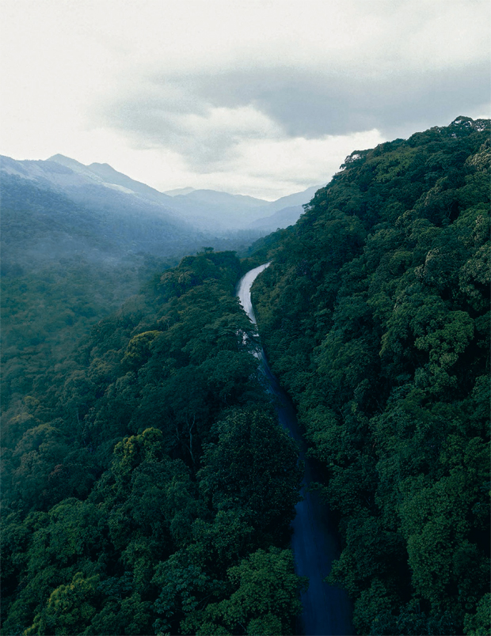
Histórias/Histories Artist Introduction: Caio Reisewitz
Notes:
Historias/Histories: Contemporary Art from Brazil
Artist Biography: Caio Reisewitz (São Paulo, Brazil, 1967)
Image retrieved from: http://aperture.org/blog/caio-reisewitz-christopher-phillips/
One of Brazil's leading contemporary photographers, Caio Reisewitz has produced a remarkable body of work during the past 15 years, concentrating almost exclusively on Brazilian subjects. His large-scale color photographs explore the changing relation of the city and the countryside in a period of feverish economic development. Many of Reisewitz's photographs testify to his fascination with the architectural heritage of Brazil's colonial period, as well as its innovative 20th-century modernist architecture. Other imposing works portray the pristine landscapes and dense forests around his hometown of São Paulo—areas that are now threatened by urban sprawl. His smaller-format photocollages take a very different direction, employing a playful, jazz-like visual approach. In these works, tiny photographic images of urban environments are scattered within scenes presenting the green expanses of Brazil's forests. Reisewitz has frequently exhibited in South America and in Europe, and represented Brazil at the 2005 Venice Biennale. This is his first major solo show in the U.S. It is organized by ICP Curator Christopher Phillips.

Slide 17
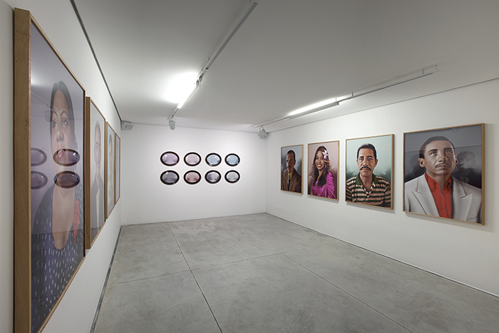
Histórias/Histories Artist Introduction: Virginia de Medeiros
Notes:
Historias/Histories: Contemporary Art from Brazil
Artist Biography: Virginia de Medeiros (Bahia, Brazil, 1973)
Image retrieved from: http://www.pipaprize.com/pag/virginia-de-medeiros/
Virginia de Medeiros lives and works in São Paulo. In 2006 “Studio Butterfly” was selected for the Programa Rumos Itaú Cultural, and, that same year, was selected for the 27th São Paulo Biennial. In 2009, she participated of the residency program “ International Women for Peace Conference” in Dili, East Timor and, in 2007, of the residency at Centro de Artes La Chambre Blanche, in Quebec, Canada. Recipient of the award Rede Nacional Funarte Artes Visuais in 2009, with the video “Fala dos Confins” which was later acquired, in 2013, by the Centro Cultural São Paulo. In 2010, she participated of the 2a Trienal de Luanda “Geografias Emocionais, Arte e Afectos” and, in 2011, of the 32o Panorama da Arte Brasileira at MAM, in São Paulo. She was the recipient of the Rede Nacional Funarte Visuais award (2009) with “Jardim das Torturas” and the Prêmio de de Residência ICCo (In- stituto de Cultura Contemporânea) residency award at Residency Unlimited

Slide 18
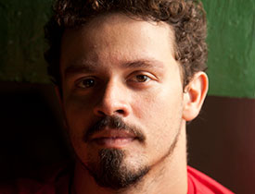
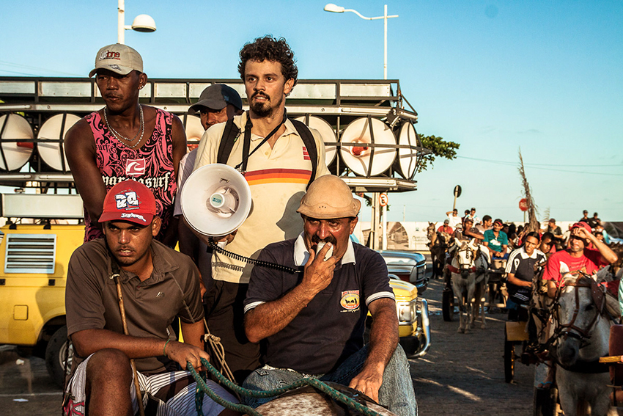
Histórias/Histories Artist Introduction: Jonathas de Andrade
Notes:
Historias/Histories: Contemporary Art from Brazil
Artist Biography: Jonathas de Andrade (Maceió, Brazil, 1982)
Image of Andrade retrieved from: http://www.guggenheim.org/guggenheim-foundation/collaborations/map/latinamerica/artist/jonathas-de-andrade
Image from Andrade’s movie, The Uprising: http://cargocollective.com/jonathasdeandrade-eng/uprising
Bioraphy: Jonathas de Andrade lives and works in Recife, Brazil. He works with installation, photography, and video to explore constructs of love, power structures and tensions between the rural and the urban, with particular emphasis on Brazil’s vibrant but often overlooked northeast region..He has had solo exhibitions at Galeria Vermelho and at the Centro Cultural, São Paulo, Brazil (both 2010). His work was also included in the 29th São Paulo Biennial, in 2010, and in the 12th Istanbul Biennial, Turkey, in 2011. Other exhibitions include Under the Same Sun, Guggenheim NY; 11th Dakar Biennial – Senegal; 12e Biennale de Lyon; and 2nd New Museum Triennial, New York.

Slide 19
Exit Ticket
3… Things you learned from today’s lesson
2... Questions you have about the content
1... Thing you would like to learn more about

