Slide 1
“Manipulation of Law” in Recife, Brazil The Work of Jonathas de Andrade
Notes:
Image retrieved from: https://flagspot.net/flags/br-pe-re.html
Essential Questions
In what ways may bureaucracy and the manipulation of the law in Recife, Brazil decide who is in charge of what?
In what ways may bureaucracy and the manipulation of the law in Recife, Brazil decide who and what is important?
Instructional Objective
Students will:
Contemplate the purpose of laws by thinking about and discussing a series of questions via a think-pair-share activity.
Unpack, via small group and whole class discussion, in what ways bureaucracy and the manipulation of the law decides who is in charge of what as well as who and what is important?
Write thoughts and feelings evoked from the words and images of Andrade’s The Uprising via a gallery walk.
Demonstrate their comprehension of the ways the government and laws of Recife affect the daily lives and livelihood of the carters via an exit card
Show their comprehension of the ways Andrade’s work is important to the carters via an exit card

Slide 2
Think-Pair-Share
What is the purpose of a law?
Notes:
Image retrieved from: http://cargocollective.com/jonathasdeandrade-eng/uprising
Notes:
Have students engage in a Think-Pair-Share centered on the question, “What is the purpose of a law?” Have each group share their response/s with the entire class and write down all responses on the whiteboard. Have students examine all responses and engage in a whole class conversation on the topic. Additional questions to ask, “Who creates laws?” “For whom are laws created?” “In what ways may laws favor and/or limit certain groups of people?” “How does something become a law in the United States?” “Do you think laws are created in the same manner in Brazil as they are in the United States?”
Here it may be helpful to review the term bureaucracy with students and explain Andrade’s use of the term, carters (individuals whose mode of transportation is a horse-drawn carriage/cart).

Slide 3
Brazil
https://www.google.com/maps/place/Recife,+State+of+Pernambuco,+Brazil/@-8.0432874,-35.0766305,11z/data=!4m2!3m1!1s0x07ab196f94e5408b:0xe5800ef782bde3a6.
Notes:
Image of Brazil retrieved from: http://www.interbras.eu/region/
Linked website: Image retrieved from: https://www.google.com/maps/place/Recife,+State+of+Pernambuco,+Brazil/@-8.0432874,-35.0766305,11z/data=!4m2!3m1!1s0x7ab196f94e5408b:0xe5800ef782bde3a6
Notes on Brazil taken from: http://www.nationsonline.org/oneworld/map/brazil-map.htm
Notes on Recife taken from:
Overview: http://www.brazil.org.za/recife.html
Introduction: http://www.geographia.com/brazil/recife/recife04.htm
Business: http://www.geographia.com/brazil/recife/business.htm
Useful Facts: http://www.geographia.com/brazil/recife/usefulfacts.htm
Article on economy: http://articles.latimes.com/2012/may/24/world/la-fg-brazil-migration-20120524
History of Recife: http://www.recifeguide.com/basics/history.php
Notes:
Use the map of Brazil to introduce/reintroduce the country of Brazil (see notes below and also Day 1 of Histórias curriculum). Tell the students that today we are going to learn more about the city of Recife, Brazil and the work of artist Jonathas de Andrade (An-DRAH-je). Point to Recife on the map as you share the information about this area (see notes below). Click on the map of Brazil to go to a Google image map of Recife that outlines the boundary and images of the city.
Notes on Brazil:
Brazil, the fifth largest country in the world and the larges country in South America, is located in the east-central part of South America. It is bordered by French Guiana, Suriname, Guyana, and Venezuela in the north, by Colombia in the north west, by Peru, Bolivia, and Paraguay in the west, by Argentina in the south west, and by Uruguay in the south. Brazil has a population of about 203 million people (2014 statistic).
Notes on Recife:
Recife, meaning reef in Portuguese, is located in Northeast Brazil. Northeast Brazil has grown four times as fast as the richer states of Sao Paulo and Rio, said Marcelo Neri. This is partially due government investments and projects to advance this area. Recife is, however, less modern than other large Brazilian cities. Today it is Brazil’s 4th largest city. It is referred to as the Venice of Brazil due the number of canals, bridges, and one-way streets. The weather is tropical (temp between 28 and 34 degrees Celsius). Recife is a major trading center today due its ports. Industries include textile, chemical, food and drink, and minerals processing as well as software development.

Slide 4
Jonathas de Andrade
Notes:
Image: Jonathas de Andrade
Retrieved from: http://www.guggenheim.org/guggenheim-foundation/collaborations/map/latinamerica/artist/jonathas-de-andrade
Statement taken and slightly modified from: http://blogs.guggenheim.org/map/on-the-map-jonathas-de-andrades-political-practice-map-artists-at-the-biennale-and-sara-razas-curatorial-approach/
Introduce the artists (notes below).
Notes on Jonathas de Andrade:
Born in 1982 in Maceió, Brazil, Jonathas lives and works in Recife, Brazil. In his multimedia practice, artist Jonathas de Andrade often confronts sociopolitical issues, including those he encounters in his home city of Recife. On the next slide we w ill watch a short video clip where Jonathas discusses his performance The Uprising (2012–13) where he describes the complex process of bringing the work into being. The Uprising consisted of a race held between local carters who drove their horses and vehicles through the streets of Recife at de Andrade’s invitation. The artist notes that the city government has imposed restrictions on the movements of carters as part of an ongoing wave of gentrification, and only gave him a permit for the race because he framed the event as a film shoot.

Slide 5
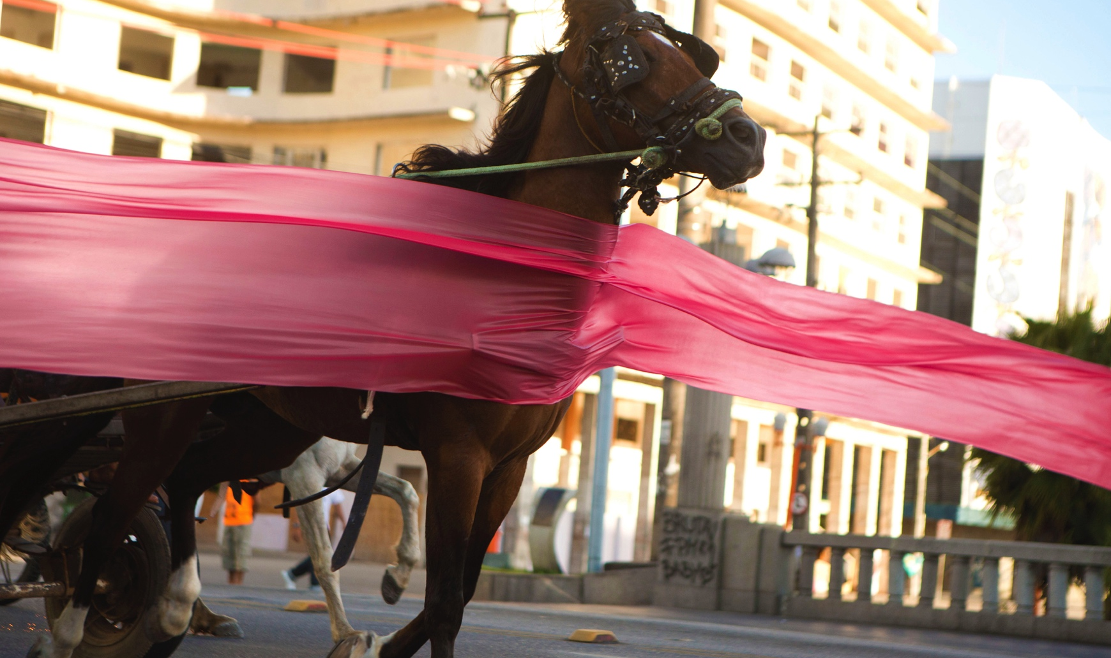
Jonathas de Andrade on History, Fiction, and Power
http://blogs.guggenheim.org/map/on-the-map-jonathas-de-andrades-political-practice-map-artists-at-the-biennale-and-sara-razas-curatorial-approach/
Notes:
Video retrieved from:
http://blogs.guggenheim.org/map/on-the-map-jonathas-de-andrades-political-practice-map-artists-at-the-biennale-and-sara-razas-curatorial-approach/
Notes:
VTS Class Discussion & Video Viewing: Advance to slide 5. Tell students that they will preview an excerpt from a video highlighting Jonathas de Andrade, an artist whose work focuses on his hometown of Recife, Brazil. Use the link below (also listed on slide 5) to access a video.
http://blogs.guggenheim.org/map/on-the-map-jonathas-de-andrades-political-practice-map-artists-at-the-biennale-and-sara-razas-curatorial-approach/
Prior to showing the video excerpt, advance to 2:19 in the video and ask students the following questions:
What's going on in this picture?
What do you see that makes you say that?
What more can we find
Rewind the video to 1:55 and show through to the end. As students watch the short video, ask them to think about what they believe is the purpose/intent of this work of art.
Stand and Share: Have students stand and share their thoughts. Once a student shares, s/he sits down. If one student shares what another was going to say, both students sit down once the statement is shared.
Once complete, tell the students that during the next class they will explore images of Andrade’s work from The Uprising along with quotes that outline the intent and process of his work.

Slide 6
The Uprising
The Work of Jonathas de Andrade
Notes:
Image and notes retrieved from: http://cargocollective.com/jonathasdeandrade-eng/uprising
Gallery Walk: Advance to slide 6. The next nine slides contain images of Jonathas de Andrade’s work from The Uprising with a quote from Andrade about the intent and process of this work. Using a gallery walk, print out the attached file of pictures and quotes and display them on walls throughout the room in numbered order along with a large sheet of white paper (see supplemental file labeled Gallery Walk for images and quotes). In groups of 2-3, students will start at an image and write their responses to the images and the artist’s words. Possible prompts to guide student responses include:
What feelings does the image evoke?
What feelings does the artist’s words evoke?
What message is the artist trying to convey in the image?
What message is the artist trying to convey through his words?
Once all groups have previewed and written their response to each image and artist’s words, reconvene the class and go through slides 7-15 together (in order), sharing group responses and engaging in a class discussion on the manipulation of laws using the essential questions highlighted above.
Notes:
The idea of the project was to undertake whatever would be needed to make it possible to hold the 1st Horse-Drawn Cart Race in the Center of Recife.

Slide 7
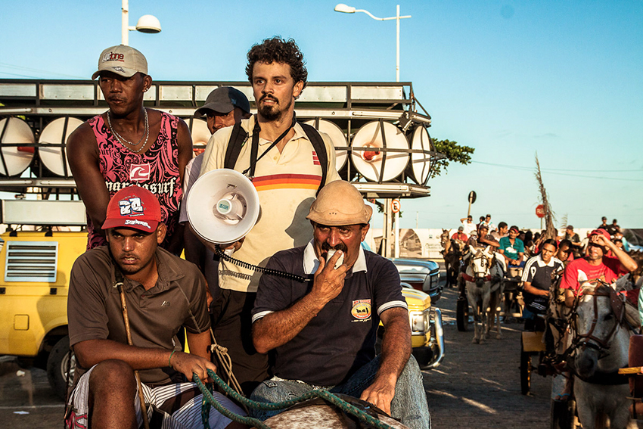
“As farm animals are prohibited anywhere in Recife, everyone who gets about by horse is made invisible from the point of view of the law. Only by dealing with the race as if it were scene from a movie – by being able, therefore, to have it considered as being to some extent a piece of "fiction" - is what would make the event feasible and fit to obtain the authorizations needed to make it happen from the official point of view.”
Notes:
Image and quote taken directly from: http://cargocollective.com/jonathasdeandrade-eng/uprising
Quote:
“As farm animals are prohibited anywhere in Recife, everyone who gets about by horse is made invisible from the point of view of the law. Only by dealing with the race as if it were scene from a movie – by being able, therefore, to have it considered as being to some extent a piece of "fiction" - is what would make the event feasible and fit to obtain the authorizations needed to make it happen from the official point of view.”

Slide 8
“Two things about the presence of men and horses pulling carts in every part of the city. On the one hand, they are apart from the ongoing developmental logic of the city (and the Country), their presence contrasting with the traffic, the asphalt, the 40-storey towers and, on the other, an entire design for civilization that runs in the opposite direction, the men with carts and their horses are echoes of rurality which point to the origins of this region.”
Notes:
Image and quote taken directly from: http://cargocollective.com/jonathasdeandrade-eng/uprising
Quote”
“Two things about the presence of men and horses pulling carts in every part of the city. On the one hand, they are apart from the ongoing developmental logic of the city (and the Country), their presence contrasting with the traffic, the asphalt, the 40-storey towers and, on the other, an entire design for civilization that runs in the opposite direction, the men with carts and their horses are echoes of rurality which point to the origins of this region.”

Slide 9
“Little by little it dawned on me that these men, carts, and nags are just other pieces of ballast from a much greater circuit of rurality, which cuts across the city and contains within itself a design for civilizing that is underpinned by another paradigm – all of its own and non-hegemonic: a rural parallel civilization that coexists in the proto-urban Recife of a super-under-developing Brazil.”
Notes:
Image and quote taken directly from: http://cargocollective.com/jonathasdeandrade-eng/uprising
Quote:
“Little by little it dawned on me that these men, carts, and nags are just other pieces of ballast from a much greater circuit of rurality, which cuts across the city and contains within itself a design for civilizing that is underpinned by another paradigm – all of its own and non-hegemonic: a rural parallel civilization that coexists in the proto-urban Recife of a super-under-developing Brazil.”

Slide 10
“Alongside this panorama, from the point of view of legality, having farm animals within the urban perimeter is not on. Recife is officially regarded as an entirely urban city, unlike several others which combine rural stretches with urban ones. Therefore, all this rural circuit is illegal: the carts, the horses, the fairs, everything has to be invisible to the eyes of the authorities and, as absolutely concrete fact, it does exist in the marginalization and by virtue of a certain pact of cynicism.”
Notes:
Image and quote taken directly from: http://cargocollective.com/jonathasdeandrade-eng/uprising
Quote:
“Alongside this panorama, from the point of view of legality, having farm animals within the urban perimeter is not on. Recife is officially regarded as an entirely urban city, unlike several others which combine rural stretches with urban ones. Therefore, all this rural circuit is illegal: the carts, the horses, the fairs, everything has to be invisible to the eyes of the authorities and, as absolutely concrete fact, it does exist in the marginalization and by virtue of a certain pact of cynicism.”

Slide 11
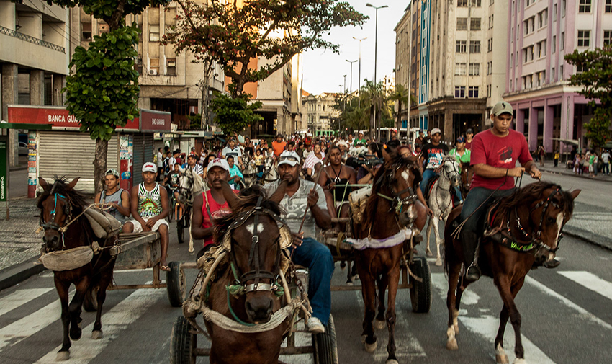
“I have always thought that this contradiction is tantamount to a madness that is very revealing of the forces and ideologies present in the city. That is, what is understood, in silence, is that laws do not need to be exactly complied with, but they are there as reminders of who the real owner of the land is, and are used with a false legitimacy and the façade of democracy, to evict anyone who makes a nuisance of himself when it suits the owner.”
Notes:
Image and quote taken directly from: http://cargocollective.com/jonathasdeandrade-eng/uprising
Quote:
“I have always thought that this contradiction is tantamount to a madness that is very revealing of the forces and ideologies present in the city. That is, what is understood, in silence, is that laws do not need to be exactly complied with, but they are there as reminders of who the real owner of the land is, and are used with a false legitimacy and the façade of democracy, to evict anyone who makes a nuisance of himself when it suits the owner.”

Slide 12
“The idea of the project was to celebrate the giving of existence to the carts and horsemen by having them take the city by storm, the means being a cart race in the center of Recife. What would be impossible from the point of view of officialdom became possible because a movie was being shot. That is, the race would exist in movie and fictional terms and therefore could be authorized by the administration of the city/ the authorities. As to the men driving the carts, for them, the movie barely existed, what existed in concrete terms were precisely the race and the prizes.”
Notes:
Image and quote taken directly from: http://cargocollective.com/jonathasdeandrade-eng/uprising
Quote:
“The idea of the project was to celebrate the giving of existence to the carts and horsemen by having them take the city by storm, the means being a cart race in the center of Recife. What would be impossible from the point of view of officialdom became possible because a movie was being shot. That is, the race would exist in movie and fictional terms and therefore could be authorized by the administration of the city/ the authorities. As to the men driving the carts, for them, the movie barely existed, what existed in concrete terms were precisely the race and the prizes.”

Slide 13
“In this case, art was what made it possible to have the node that meshed concreteness and invisibility, marginality and celebration, impossibility and insurrection, illegality and fiction. It was art that sparked off something that was absolutely uncertain and quite risky which would bring the men with carts and horses for a race through the city. It took place. After a long delay and being darned scared that no-one would turn up, 40 carts and various horsemen appeared and it all swelled to massive proportions that were difficult to control. Despite the difficulties in managing and organizing it all, the race was run and 10 carts won goats as a prize.”
Notes:
Image and quote taken directly from: http://cargocollective.com/jonathasdeandrade-eng/uprising
Quote:
“In this case, art was what made it possible to have the node that meshed concreteness and invisibility, marginality and celebration, impossibility and insurrection, illegality and fiction. It was art that sparked off something that was absolutely uncertain and quite risky which would bring the men with carts and horses for a race through the city. It took place. After a long delay and being darned scared that no-one would turn up, 40 carts and various horsemen appeared and it all swelled to massive proportions that were difficult to control. Despite the difficulties in managing and organizing it all, the race was run and 10 carts won goats as a prize.”

Slide 14
“And before the prize-giving ceremony, a procession moved through the city with all those present. In a huge mélange of people, horses, carts, everyone got mixed up, climbed on the carts, got on to the sidewalks, and mass and action kept on being added to the procession. The cavalcade began on the route set; after a gallop, a cry went up; anarchy; and when it arrived in the final straight of Guararapes Avenue, it took on a life of its own that spurred the center into party spirit; burst through the original route and flew out of control in a magnificently autonomous way.”
Notes:
Image and quote taken directly from: http://cargocollective.com/jonathasdeandrade-eng/uprising
Quote
“And before the prize-giving ceremony, a procession moved through the city with all those present. In a huge mélange of people, horses, carts, everyone got mixed up, climbed on the carts, got on to the sidewalks, and mass and action kept on being added to the procession. The cavalcade began on the route set; after a gallop, a cry went up; anarchy; and when it arrived in the final straight of Guararapes Avenue, it took on a life of its own that spurred the center into party spirit; burst through the original route and flew out of control in a magnificently autonomous way.”

Slide 15
“The 1st Horse-Drawn Cart Race in the Centre of Recife took place in a context of imported rules, taken from boxes and whisked away when this fits in with developing the power of those who pronounce on rules. The asphalt city, the prohibition on carts disguising the backwardness. The backdrop is a system with a development plan, the power structure of which is cemented by the total dependence on the looseness of its own structures. This same spirit of underdevelopment with all its cosmetics and looseness offers up its constituent breaches as a space for the new invertedness, for other forms of permanence so that experimental freedom might be exercised within the oppression that it protagonizes.”
Notes:
Image and quote taken directly from: http://cargocollective.com/jonathasdeandrade-eng/uprising
Quote:
“The 1st Horse-Drawn Cart Race in the Centre of Recife took place in a context of imported rules, taken from boxes and whisked away when this fits in with developing the power of those who pronounce on rules. The asphalt city, the prohibition on carts disguising the backwardness. The backdrop is a system with a development plan, the power structure of which is cemented by the total dependence on the looseness of its own structures. This same spirit of underdevelopment with all its cosmetics and looseness offers up its constituent breaches as a space for the new invertedness, for other forms of permanence so that experimental freedom might be exercised within the oppression that it protagonizes.”

Slide 16
“For me, the mechanism of negotiating with the administration of the city . . . was interesting because it had to do so much [with] how bureaucracy and the manipulation of the law decides who is in charge of what—what is the limit or what is the borderline of being an outcast in society.”
--Jonathas de Andrade
Notes:
Quote taken directly from: http://www.guggenheim.org/video/jonathas-de-andrade-on-history-fiction-and-power
Think-Pair-Stand and Share: Have a student volunteer read aloud the statement made by Andrade in the video, “For me, the mechanism of negotiating with the administration of the city . . . was interesting because it had to do so much [with] how bureaucracy and the manipulation of the law decides who is in charge of what—what is the limit or what is the borderline of being an outcast in society.” Tell the class that they will be engaging in a think-pair-stand and share process. In pairs, have students reflect on and share their insights regarding the statement based on what they learned in this lesson. Have each group come to a consensus. Each group will select a representative to stand and share their response with the class using the stand and share process. If students need a prompt, read aloud the remainder of the statement from Andrade (listed below and also stated in the video clip earlier).
Quote:
“Which makes the idea of law completely, explicitly, class-based. So I think the project is also speaking about this issue of the carters—they’re being prohibited by the city from going around—where they are so much a part of the local landscape. They make their living from the horse, through the transportation of goods. By law, they are invisible, also because of a lot of issues that are happening in Brazil with cities being totally gentrified and socially cleaned up in a very heavy way.”

