Slide 1
Virginia de Medeiros
Crossing Boundaries

Slide 2
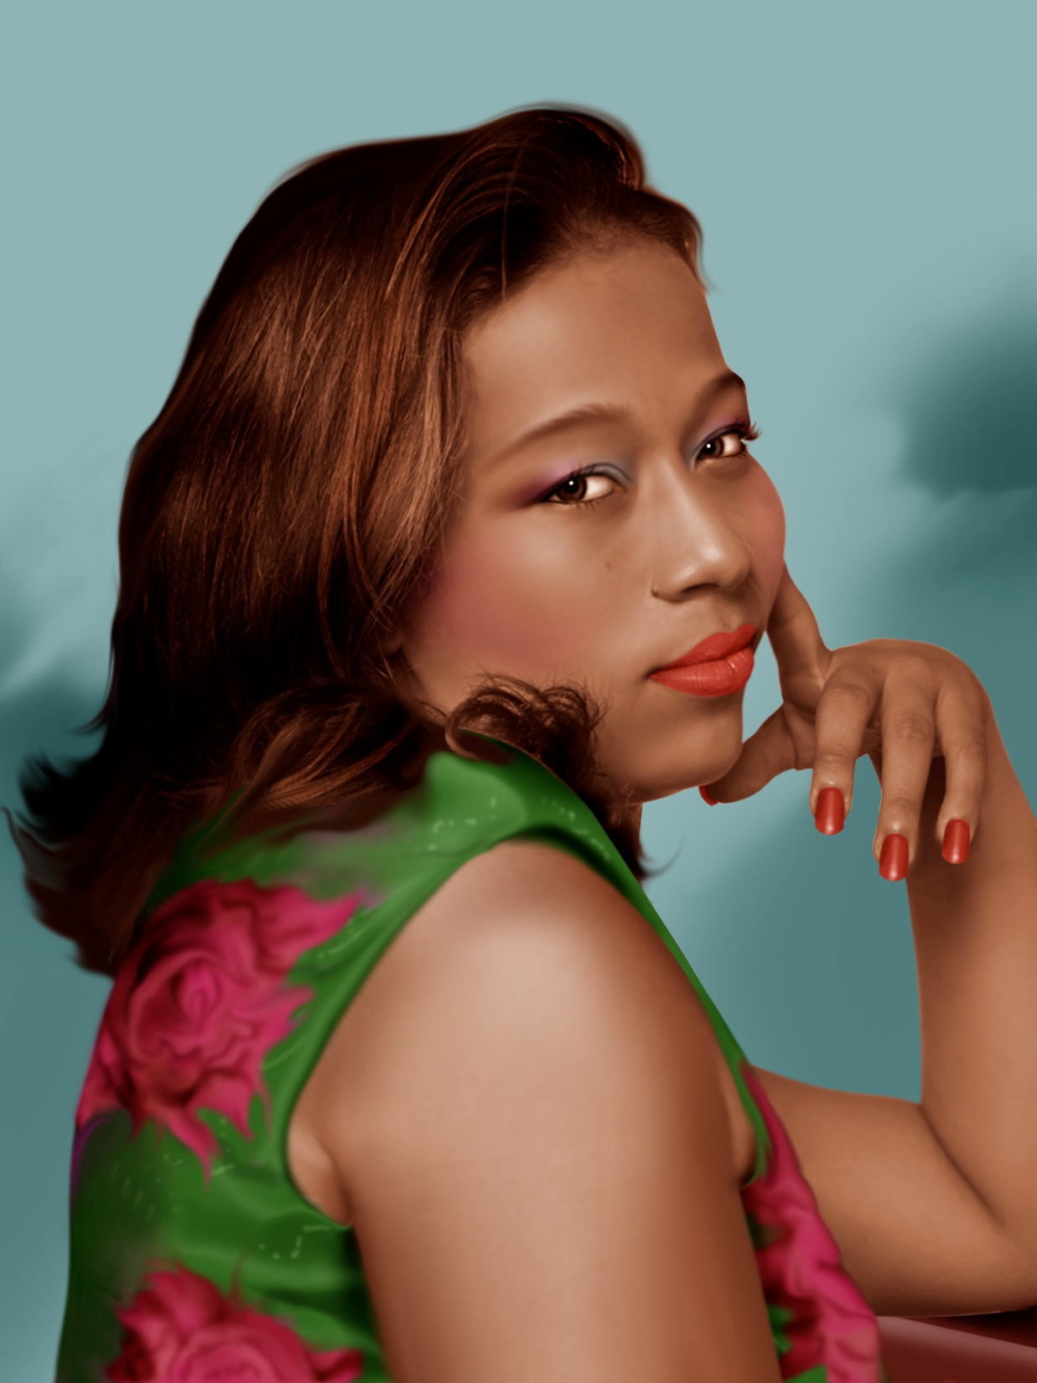
Meirelle

Slide 3
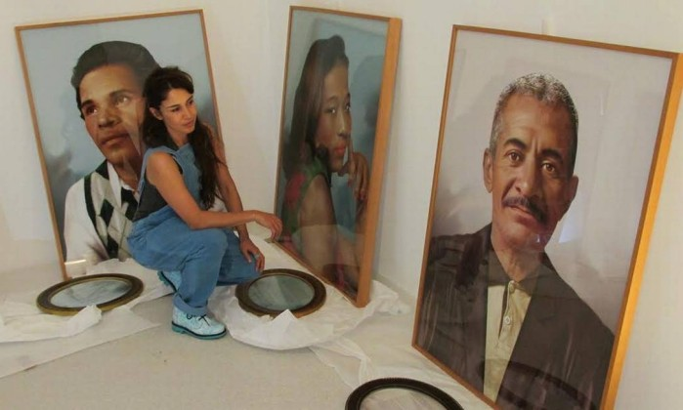
Virginia de Medeiros Fábula do olhar (2012/2013)
Notes:
The artist is shown here with her work. The objects on the ground are the framed, corresponding testimonies of the subjects.
“Fábula do olhar” translates roughly as “Fable of Looking.”

Slide 4
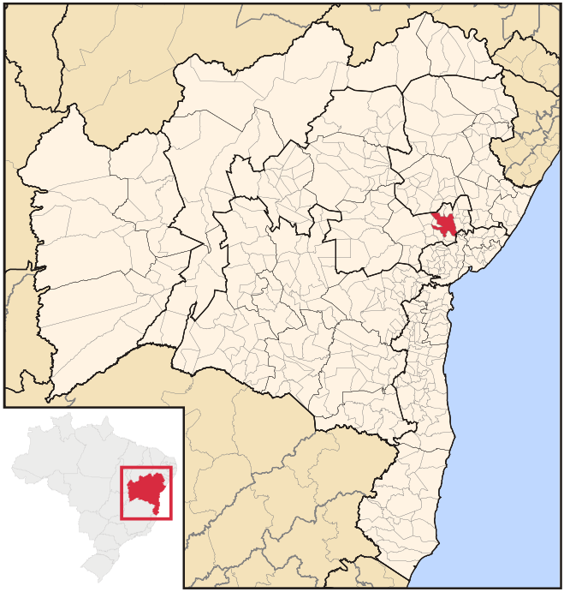
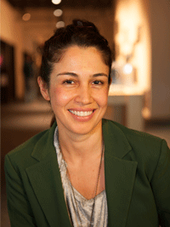
Virginia de Medeiros (Bahia, Brazil, 1973)
Born in Feira de Santana, Bahia, 1973
Notes:
Virginia de Medeiros (Bahia, Brazil, 1973)
Feira de Santana is a city in Bahia, Brazil. It is the second-most populous city in the state, with a population of 612,000 according to IBGE's estimate. It is located 100 km northwest of Salvador, Bahia's capital city.

Slide 5
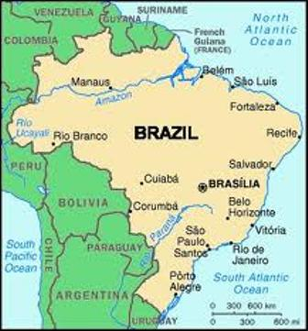
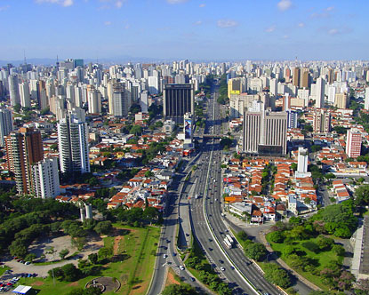
Today
Lives and works in São Paulo

Slide 6
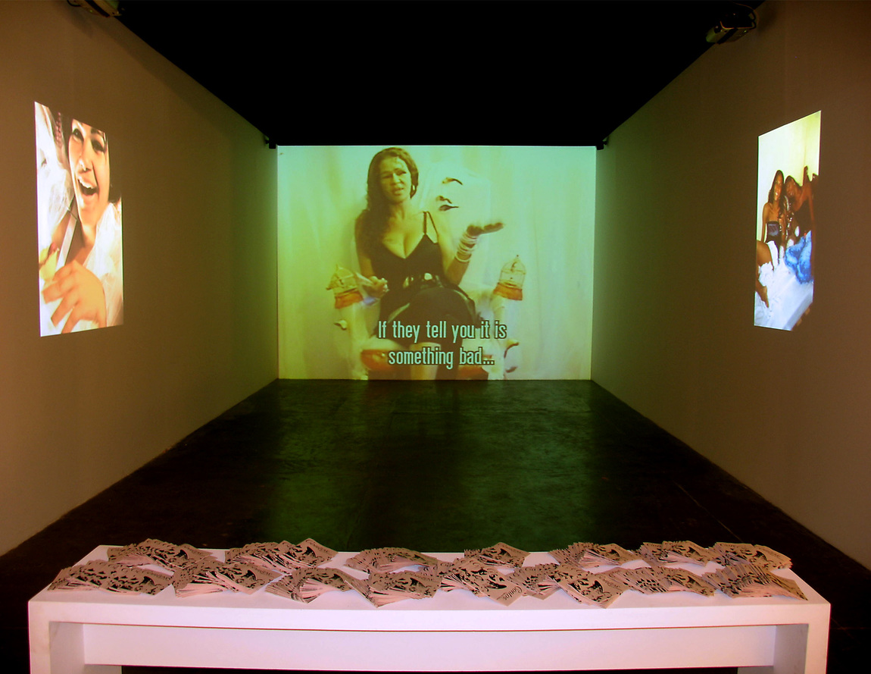
Current Work
works primarily with video and audiovisual installations
PIPA 2015 Winner PIPA 2015 Popular Vote Exhibition

Slide 7
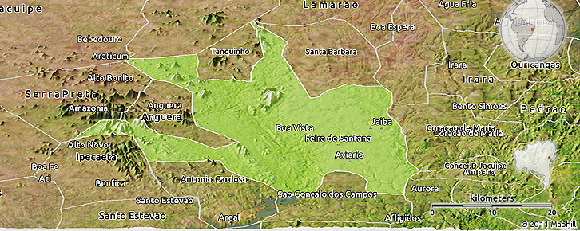
Artist Biography
Virginia de Medeiros: In her own words…

Slide 8
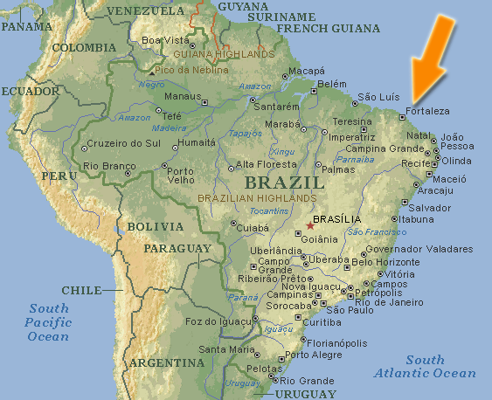
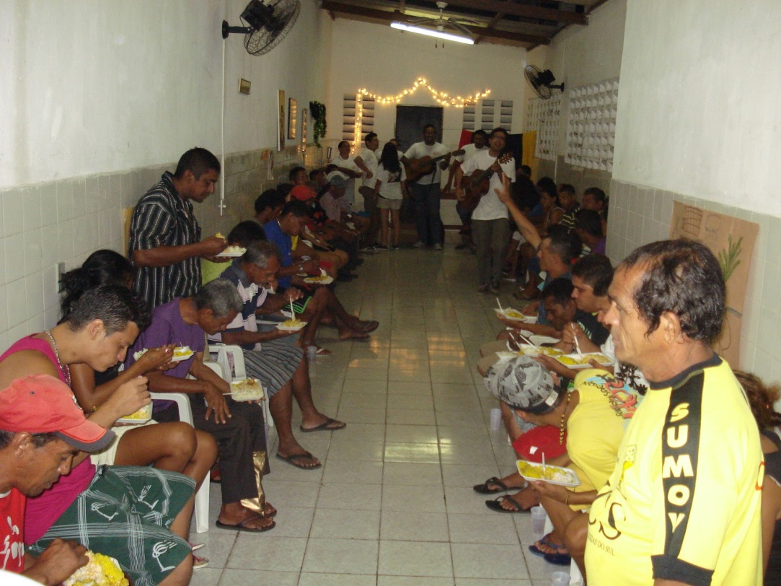
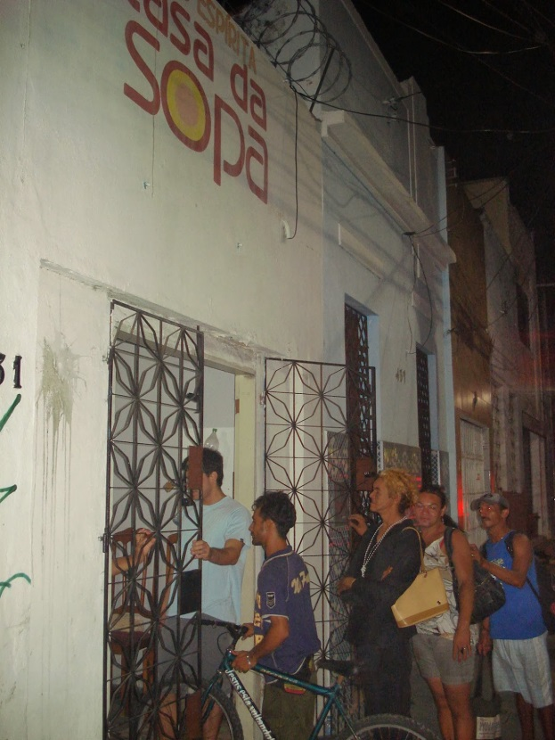
Fábula do olhar (2012/2013)
Notes:
In Fábula do olhar, the artist explores the lives of the homeless. Reviving the traditional art of photo-painting from Northeastern Brazil, over the course of six weeks, de Medeiros set up a photographic studio at two cafeterias for homeless people in the city of Fortaleza, Brazil. One of these cafeterias, Casa da Sopa, is shown here.
Photo, top right: http://grupoespiritacasadasopace.blogspot.com/2011/12/natal-com-populacao-de-rua-na-casa-da.html
Photo, lower left: http://grupoespiritacasadasopace.blogspot.com/2013/12/natal-2013-casa-da-sopa-com-moradores.html

Slide 9
Guiding question for Fábula do olhar (2012/2013):
How would you like to see yourself or be seen by society?
Notes:
de Medeiros took black-and-white photographs of homeless people, recorded video statements of their personal histories, and asked a key question which directs and identifies the nature of the work:
How would you like to see yourself or be seen by society?

Slide 10
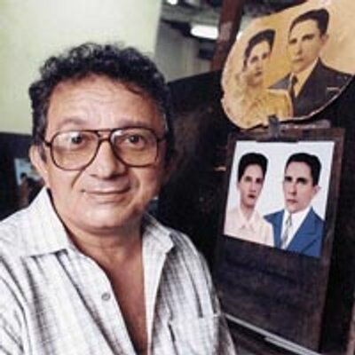
“fotopintura”
Mestre Júlio dos Santos
traditional photo-painting technique
colored the black-and-white portraits taken by de Medeiros
added details to reflect the individuals’ testimonies
Notes:
Photo of Mestre Júlio dos Santos: https://twitter.com/fotopintura

Slide 11
Meirelle

Slide 12
Meirelle
AGE: 23
HOMELESS: 8 years
PHOTO PAINTING REQUEST:
Dressed as a cultured, intellectual woman

Slide 13
Andrade

Slide 14
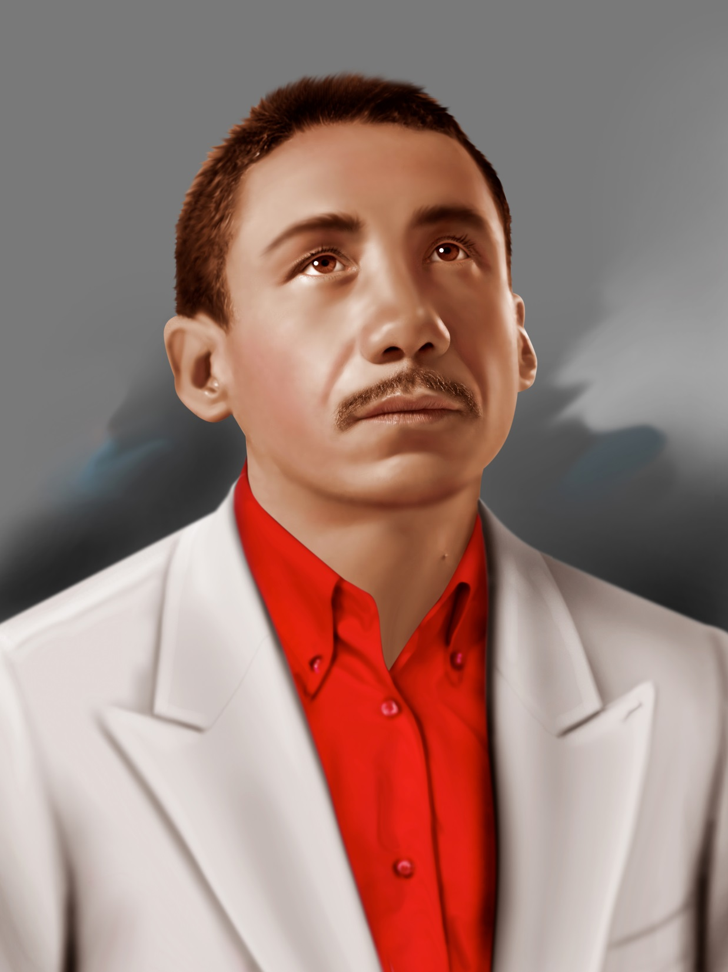
Andrade
HOMELESS: 2 years
PHOTO PAINTING REQUEST: Elegant, business-like attire

Slide 15
Jessica

Slide 16
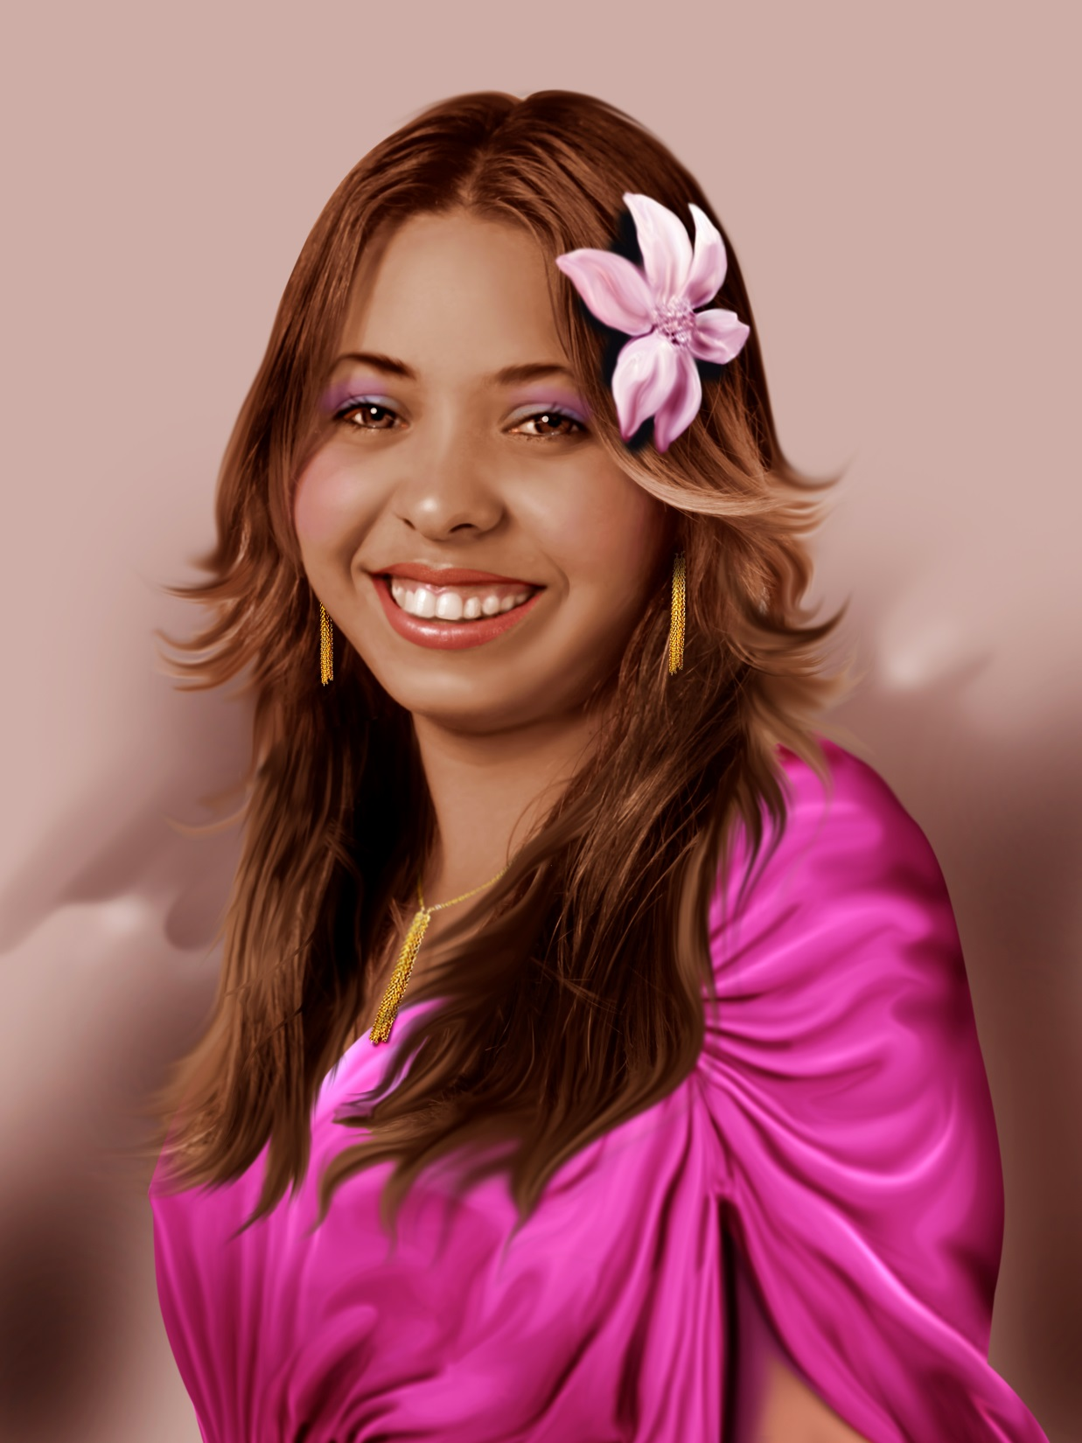
Jessica
AGE: 20
HOMELESS: 4 years
PHOTO PAINTING REQUEST:
Debutante outfit

Slide 17
Maria da Penha

Slide 18
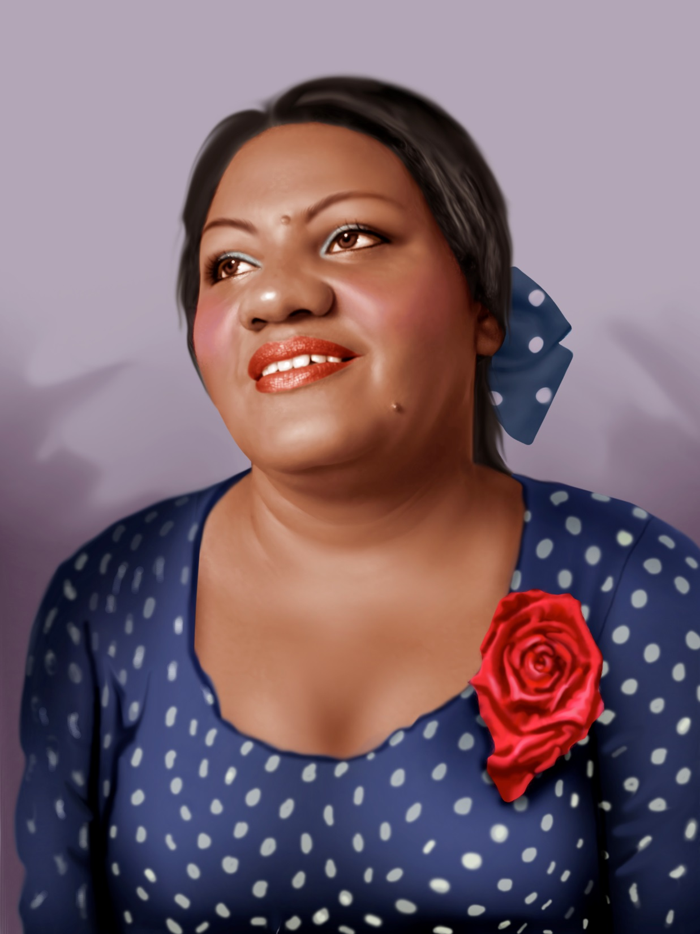
Maria da Penha
AGE: 44
PHOTO PAINTING REQUEST: a colorful outfit

Slide 19
Seu Marcos

Slide 20
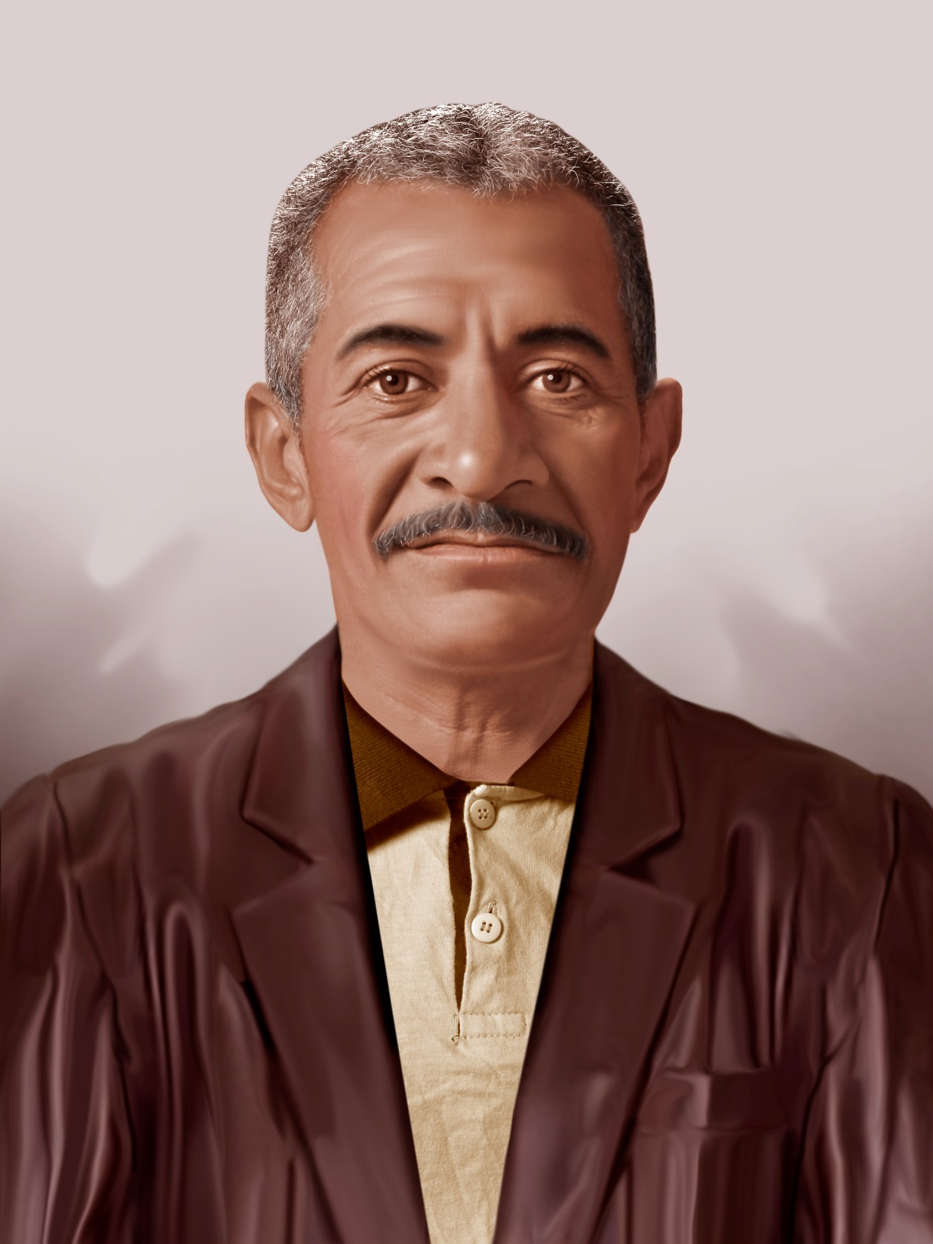
Seu Marcos
AGE: 52
HOMELESS: 3 ½ years
PHOTO PAINTING REQUEST: original

Slide 21
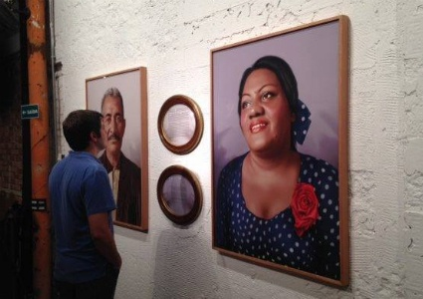
Notes:
Image source: http://www.cultura.rj.gov.br/materias/lugar-de-encontro-entre-arte-e-cidade

Slide 22
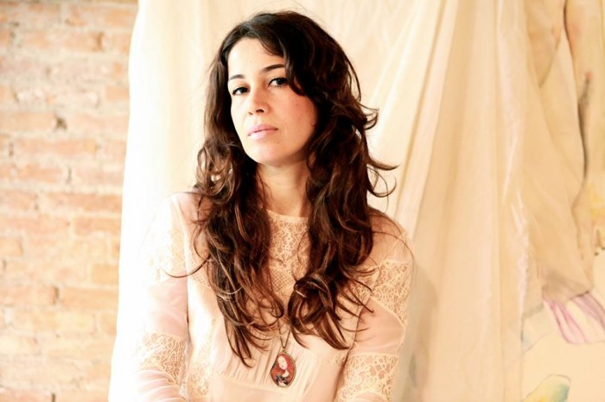
What would you make visible that is currently imperceptible?
“I believe that recording what is imperceptible in the eyes of many, like a vital sign of the power of otherness, is also a function of art. As it enables the recognition of different ways of seeing and positioning oneself in the world, configuring a distinctive feature of the human experience, we discover a field that is open to the possibilities of encounter and the promotion of dialogue. “
– Virginia de Medeiros

