Slide 1
Artists Claire Pentecost
Doris Salcedo and Ai Weiwei
And
The Artist Activist

Slide 2

Claire Pentecost
Claire Pentecost is an artist/activist focusing on food, soil, and bio-engineering
born 1956, Baltimore, Maryland
education: B.A., Smith College; M.F.A., Pratt Institute, NY
Professor of photography at SAIC (School of the Art Institute of Chicago)
Notes:
Image source: http://fnewsmagazine.com/2015/01/5-questions-claire-pentecost/

Slide 3
What is Art Activism?
The ability of art to function as an arena and medium for political protest and social activism.
Art activists strive to be useful and make the world a better place: for example, raising ecological concerns, improving access to education and culture, drawing attention to the plight of illegal immigrants, etc.
Notes:
From Boris Groys, On Art Activism, http://www.e-flux.com/journal/on-art-activism/. Accessed July 26, 2016.

Slide 4
The Art Activist’s Toolbox
A pressing political or social issue that the artist really cares about and wants to affect /change through art
Rigorous research on the issue, whether it be political, social, ecological, scientific, etc.
A practice that can express this real world information into the language of art and poetics

Slide 5
Claire Pentecost
Soil-erg (2012)
Four components:
I. Sculptural Objects: proposal of a new system of value based on living soil
II. Drawings: oversize paper “currency” depicting historical figures, soil-food web creatures, and environmentalists
III: Inside Installation: cabinet with composting bed and list of “land grabs”
IV: Outside Installation: vertical growing systems
Notes:
Give an overview of the individual components first. The following slides describe each more specifically.

Slide 6
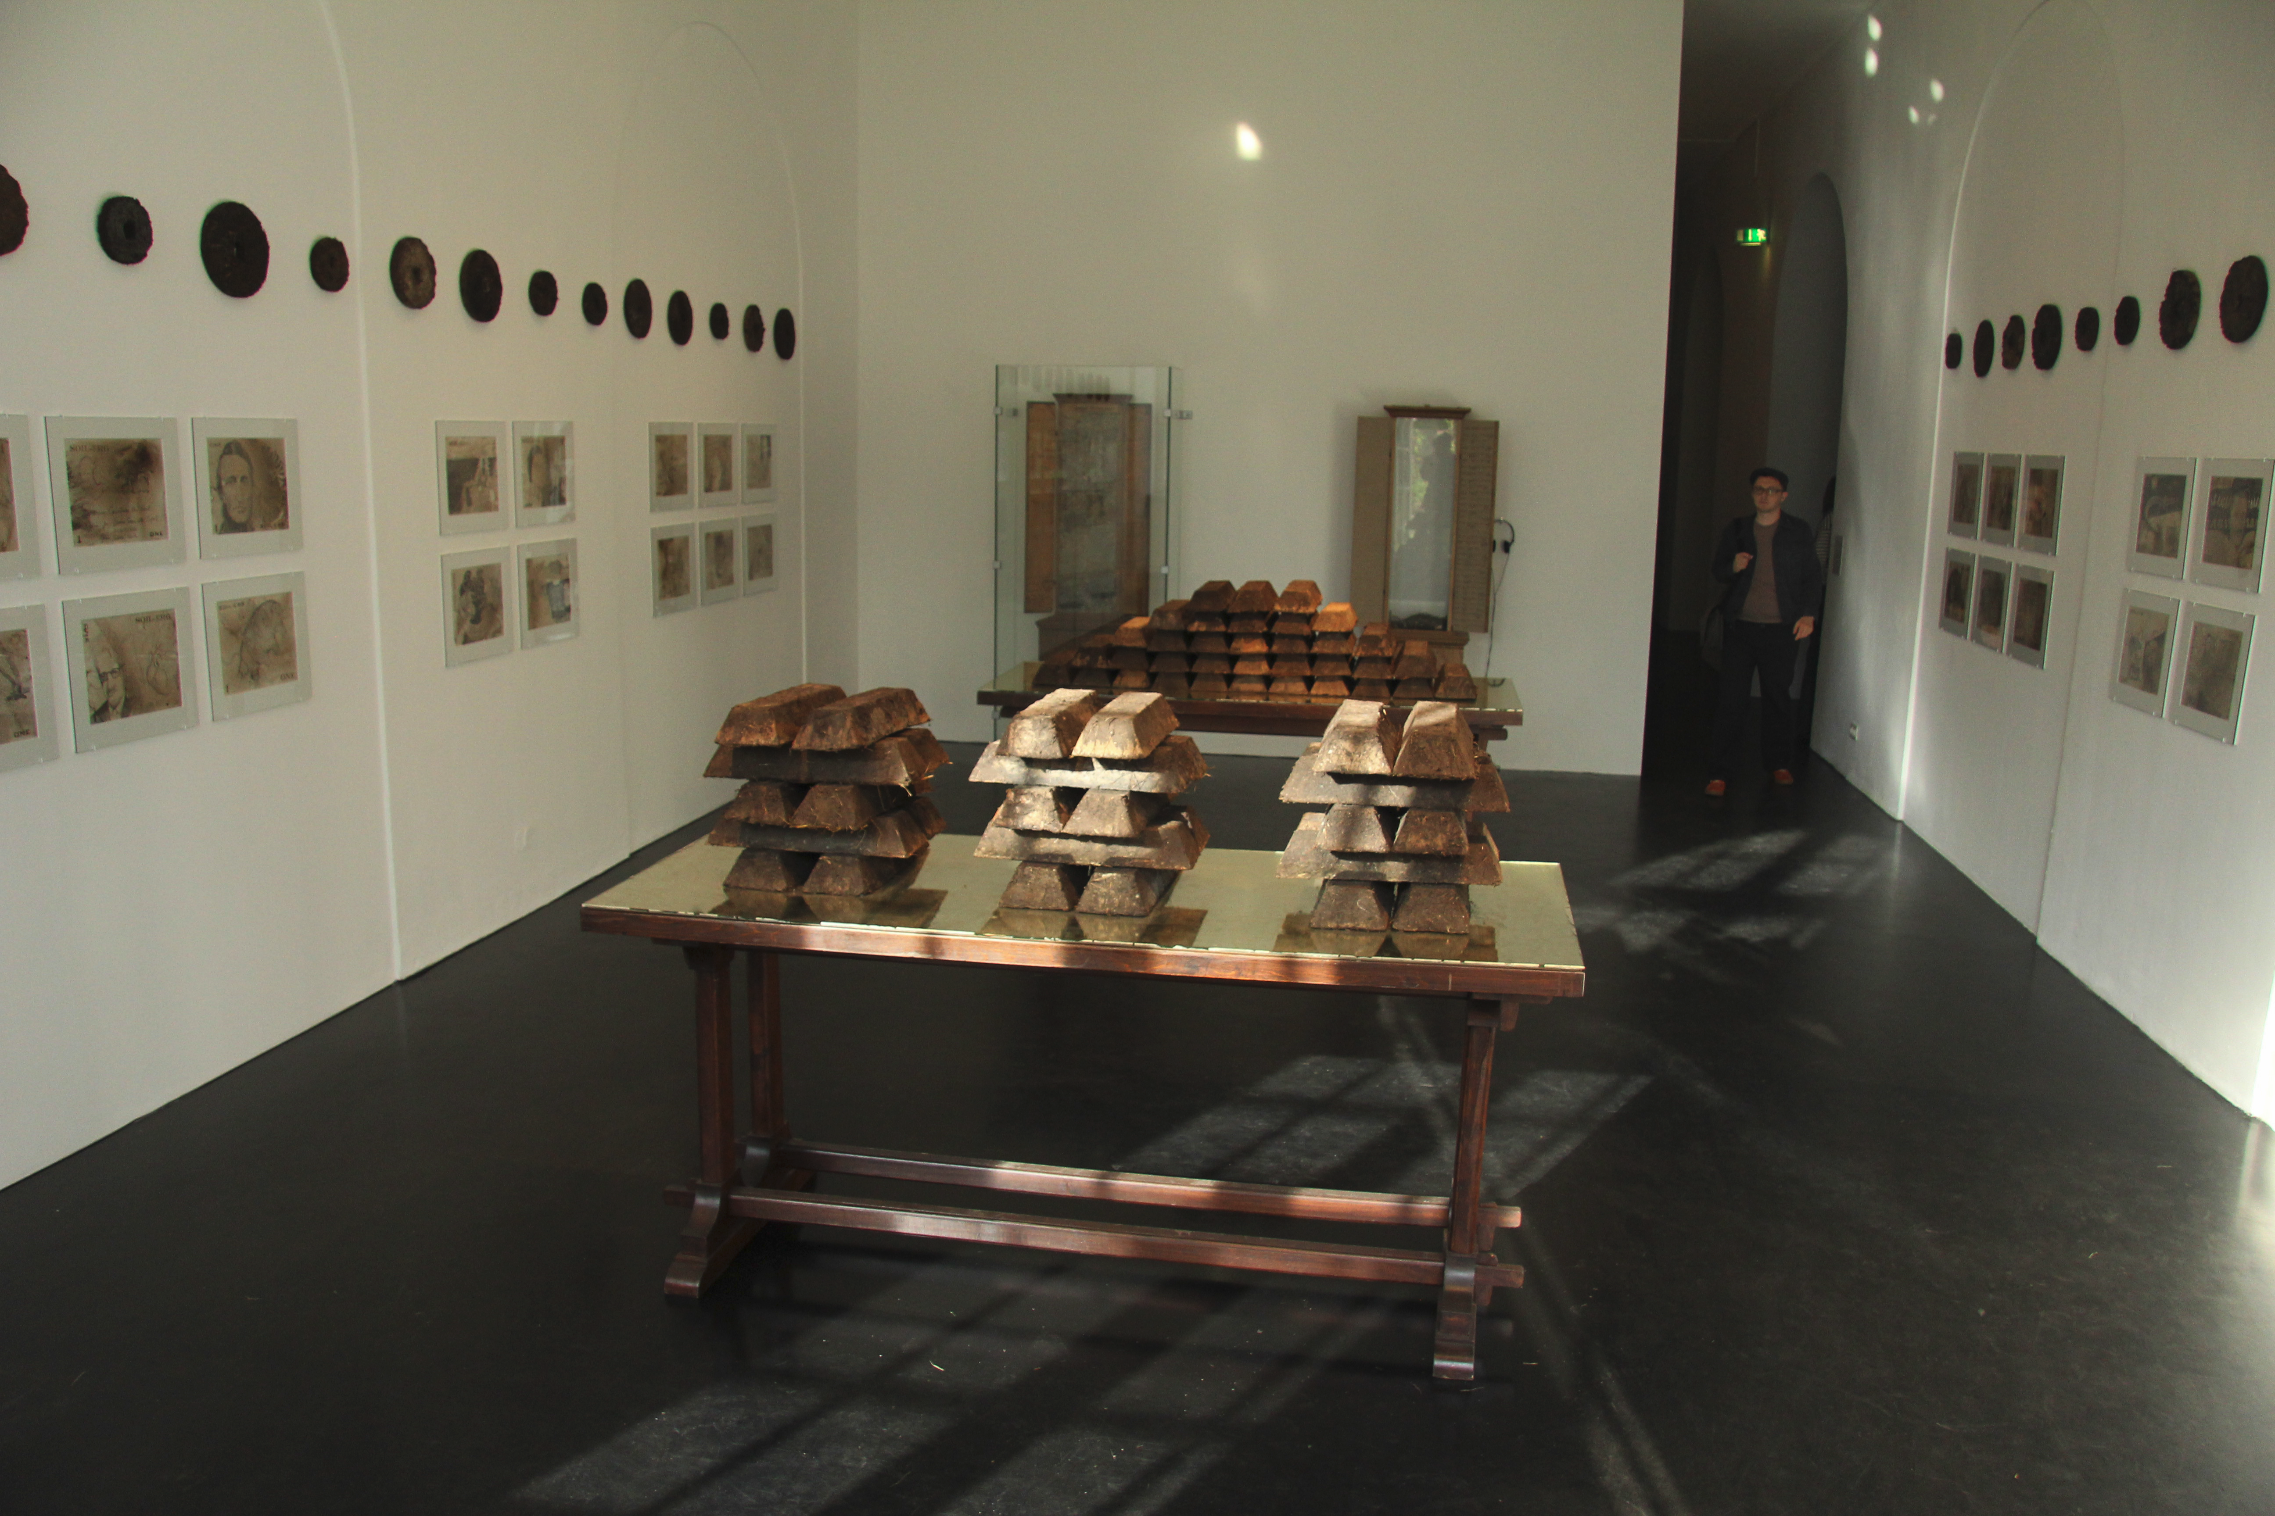
Notes:
In Claire Pentecost’s words:
The important thing about the soil-erg is that it both is and is not an abstraction. Symbolically it refers to a field of value, but that value is of a special nature: it must be
produced and maintained in a context. It is completely impractical to circulate it. It is heavy, and because of the loose structure required of good soil, it falls apart. It only
makes sense when located in a place.

Slide 7
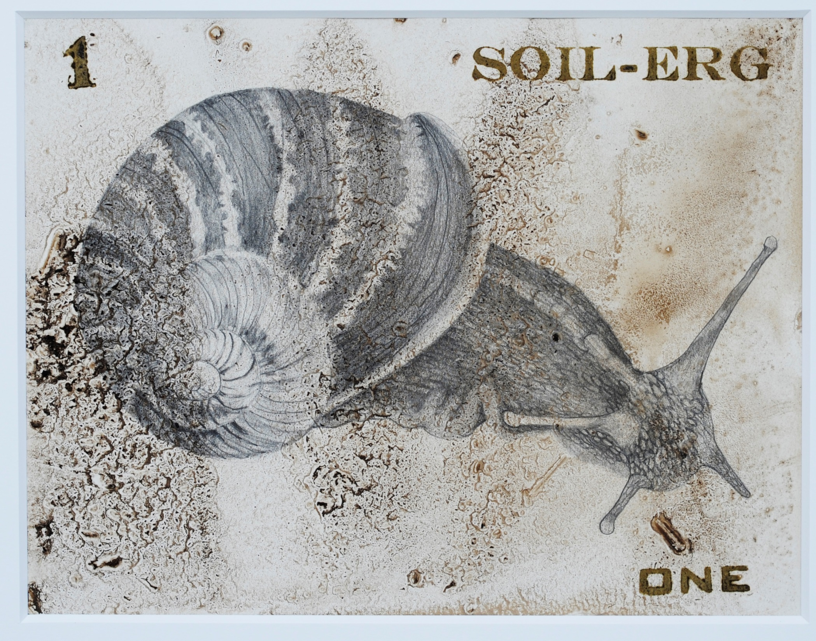
Notes:
The drawings depict creatures from the soil–food web, historical figures who have played significant roles in our understanding of ecological approaches to agriculture, and people whose thinking has helped to decenter the human, enhancing our understanding of ourselves as one part of an immense and complex ecology.
This drawing is of a snail, an important creature in the soil-food web.

Slide 8
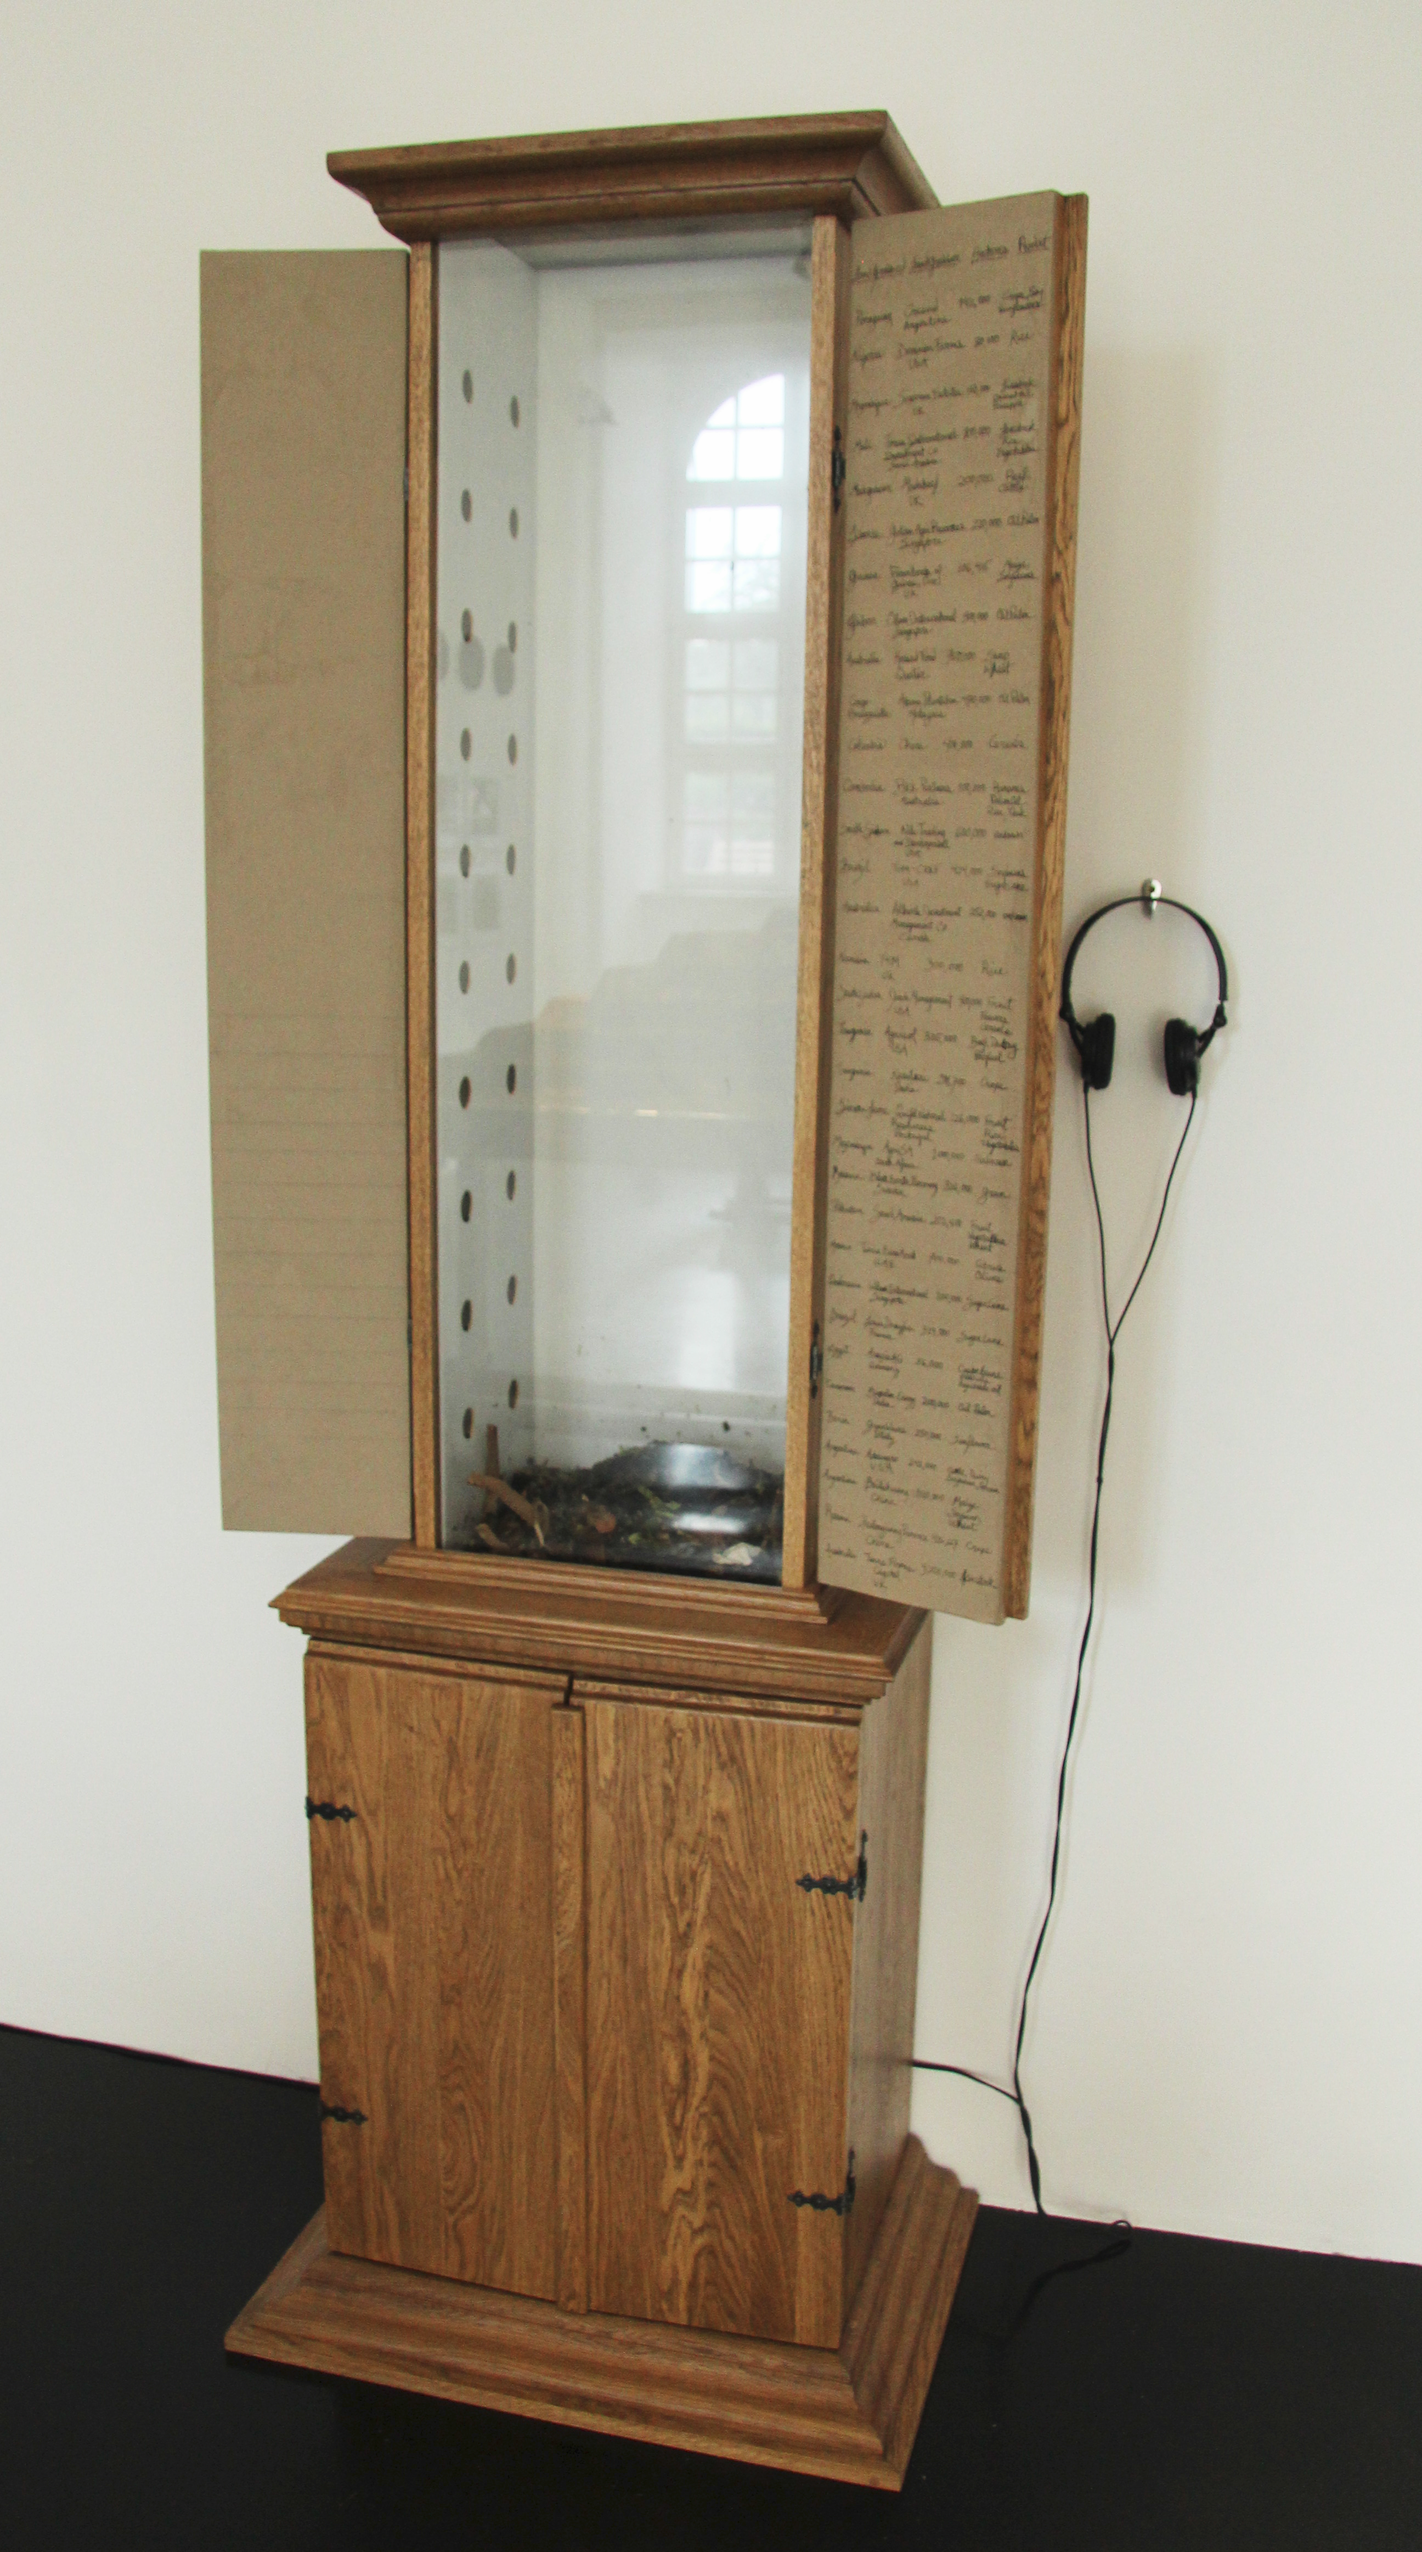
Notes:
In Claire Pentecost’s words: For the d(13) installation of the project in the Ottoneum Museum, I borrowed a piece from the museum’s collection, the Richelsdorfer Mountain Cabinet, 1783. This constitutes the oldest geological section of Hessia; the upper compartment opens to show the vertical section of the sequence of layers of the Richelsdorfer mountain chain with natural stone material. This geological profile is an incunabulum of the geological research in Hessia in the 18th century. The mountain was originally cut in a search for
copper. Stone was extracted for this cabinet by miners of the mountain, and I used the cabinet to reference the age of extraction. Beside the original cabinet I placed a copy of it. But in the new piece the doors open to reveal a worm composting bed with living worms. The worms were fed kitchen scraps throughout the 100 days of d(13) and in that time were literally making soil. I think of this soil-making machine as a representative of a new era of restoration of the earth’s surface. Written on the inside of the cabinet’s doors are the details of just a few of the land deals currently being referred to as “land grabs” in which sovereign nations, corporations and investment funds are buying or leasing huge tracts of arable land in Africa, Asia and South America to grow crops for export. See http://farmlandgrab.org/ and http://oaklandinstitute.org

Slide 9
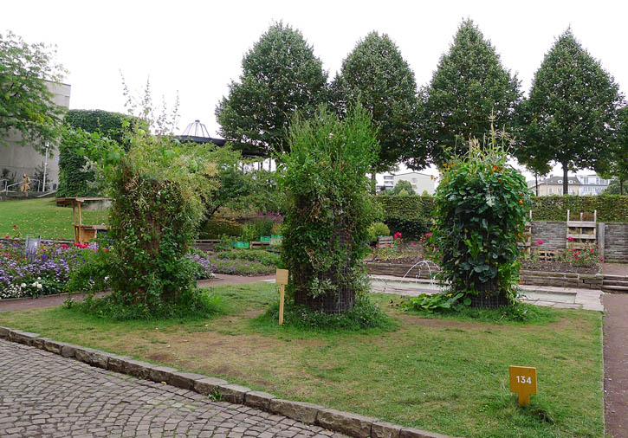
Notes:
In Claire Pentecost’s words:
Can soil be distinguished from real estate? If people can make soil from organic waste but they have no land, what are the options for growing food in limited space? To address this question… I constructed vertical growing systems. These pillar forms are simple and inexpensive and easily adapted to dense urban spaces where people are land-poor.

Slide 10
Art-Based Research
Art-based research can be defined as the systematic use of the artistic process, the actual making of artistic expressions in all of the different forms of the arts, as a primary way of understanding and examining experience by both researchers and the people that they involve in their studies.
-- Shaun McNiff
Notes:
http://www.moz.ac.at/files/pdf/fofoe/ff_abr.pdf, 7/25/2016

Slide 11
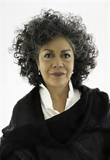
Doris Salcedo
Doris Salcedo is an artist/activist whose sculptures and installations embody the silenced lives of the marginalized, from individual victims of violence to the disempowered of the Third World
Born in 1958 in Bogotá, Colombia
Education: BFA at Universidad de Bogotá Jorge Tadeo Lozano and an MA from New York University
Lives and works in Bogotá, Colombia

Slide 12
Doris Salcedo
“I don’t work based on imagination, on fiction,” she explains, characterizing her role as a “secondary witness” to the victims of violence whose testimonies she collects as research for her pieces, such as "Atrabiliarios" at SFMoMA, the "Unland" series of tables, the ephemeral installation "Noviembre 6 y 7," and "Shibboleth"—a 160 meter crack in the foundation of Tate Modern in London.
Notes:
http://www.art21.org/videos/segment-doris-salcedo-in-compassion

Slide 13
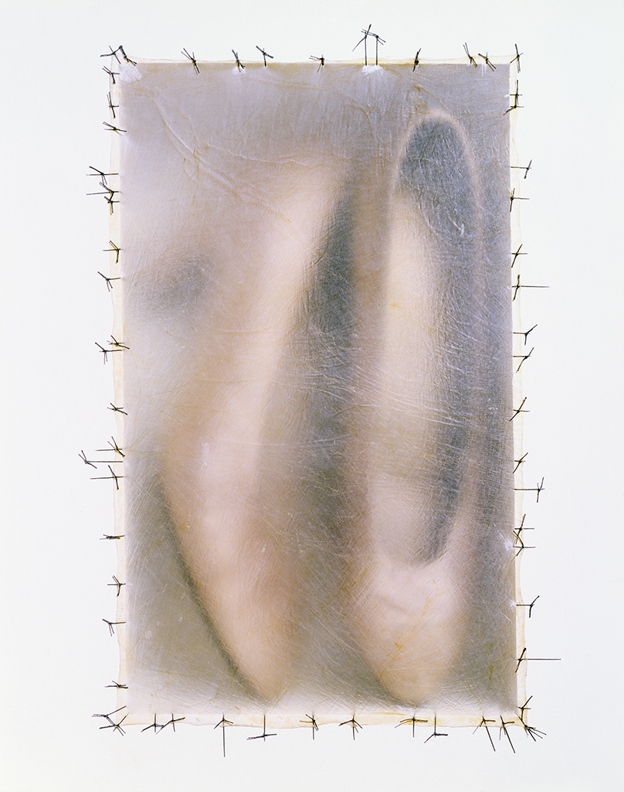
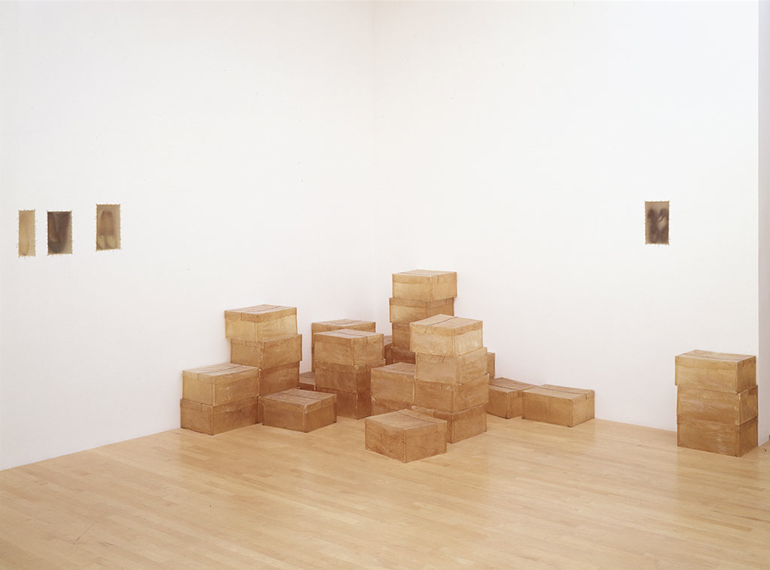
Atrabilarios, 1992/2004
In the early 1990s, Salcedo researched the lasting effects of violence through extensive fieldwork across Colombia. During this time, she learned that female victims were treated with particular cruelty and that shoes were often used to identify remains—especially in the context of los desaparecidos (the disappeared).
Notes:
In Atrabiliarios, worn shoes—primarily women’s—are encased in niches embedded into the gallery wall, covered by a layer of stretched and preserved animal fiber, and affixed to the wall with medical sutures. The empty boxes are also made of animal fiber and seem to anticipate more deaths to come. The semitranslucent surfaces of the niches obscure their contents, alluding to the fraught relationship between memory and time.
http://www3.mcachicago.org/2015/salcedo/works/atrabiliarios/

Slide 14
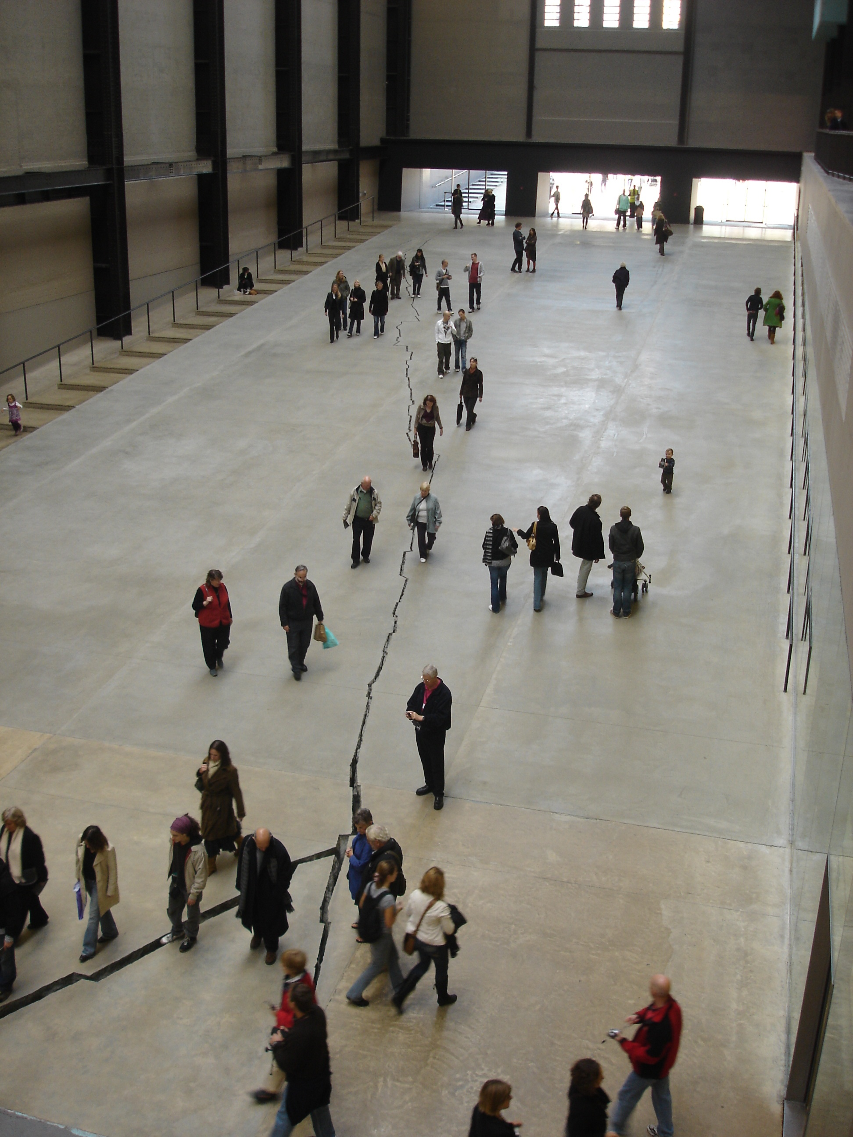
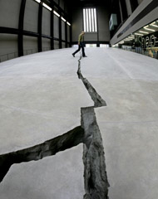
Doris Salcedo, “Shibboleth” 2007
Turbine Hall, Tate Gallery, London
Notes:
What does “shibboleth” mean and how do you think it relates to this piece?
“Salcedo is addressing a long legacy of racism and colonialism that underlies the modern world. A ‘shibboleth’ is a custom, phrase or use of language that acts as a test of belonging to a particular social group or class. By definition, it is used to exclude those deemed unsuitable to join this group.
‘The history of racism’, Salcedo writes, ‘runs parallel to the history of modernity, and is its untold dark side’. For hundreds of years, Western ideas of progress and prosperity have been underpinned by colonial exploitation and the withdrawal of basic rights from others. Our own time, Salcedo is keen to remind us, remains defined by the existence of a huge socially excluded underclass, in Western as well as post-colonial societies.
In breaking open the floor of the museum, Salcedo is exposing a fracture in modernity itself. Her work encourages us to confront uncomfortable truths about our history and about ourselves with absolute candidness, and without self-deception.”
http://www.tate.org.uk/whats-on/tate-modern/exhibition/unilever-series-doris-salcedo-shibboleth

Slide 15
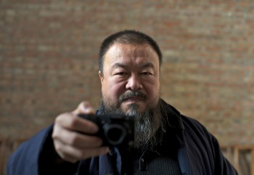
Ai Weiwei
• Ai Weiwei is a multidisciplinary artist who addresses through his work some of the social, political and economic injustices that exist under oppressive governmental rule in China.
• His art functions as a form of resistance and activism.
• Born in 1957 in Beijing, China
• Educated at the Parsons New School for Design and Art Students League in New York, and the Beijing Film Academy
Notes:
Image:
http://b.vimeocdn.com/ts/305/510/305510200_640.jpg

Slide 16
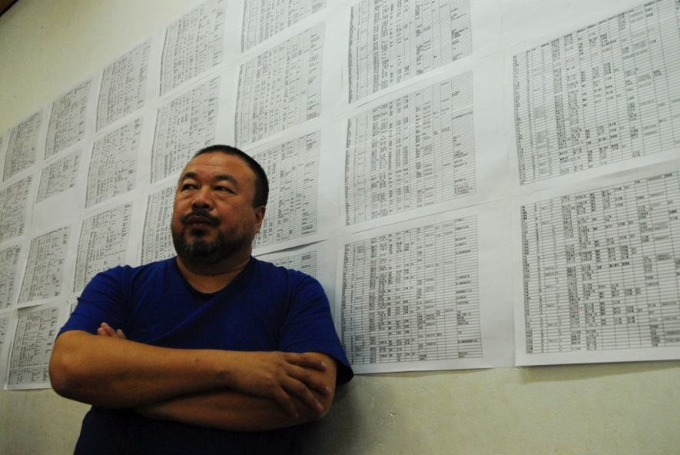
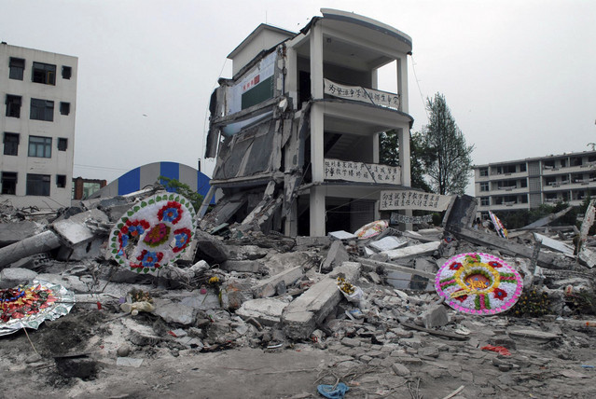
Earthquake in Sichuan (2008-2010)
Notes:
Ai used photography to also chronicle some of the damage from the 2008 earthquake in China, especially to schools built by the government. As part of his ongoing investigation into the consequences of the earthquake, Ai conducts painstaking research that culminates in a memorial listing the names of the dead as well as 3 hour, 41 minute voice recording in which the names of the children are read off in Chinese. This presentation is viewed as insubordination of government authority. Ai is consequently assaulted by Chinese officers. It is later discovered that he had internal bleeding in his brain and required emergency surgery.
Images:
Ai Weiwei with the list of names of the dead from the earthquake: http://artasiapacific.com/Magazine/64/AiWeiweiChallengesChinasGovernmentOverEarthquake
Earthquake wreckage, photographed by Ai Weiwei: http://www.bloomberg.com/image/ibtt9Bu5QEpQ.jpg

Slide 17
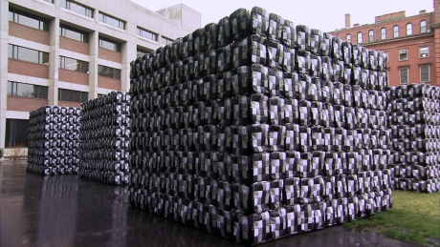
Untitled, 2011
Notes:
Untitled (2011) is another installation that includes multiple backpacks as well as audio documentation of the names of the children who died in the earthquake.
Questions for Students: Untitled (2011): Each child killed in the 2008 earthquake is memorialized by a backpack in this work. How is the organization and presentation of the backpacks significant? Ai titles most of his works; why do you think this one might be untitled?
Image:
http://www.pbs.org/art21/images/ai-weiwei/production-still-from-change-2012-4?slideshow=1

Slide 18
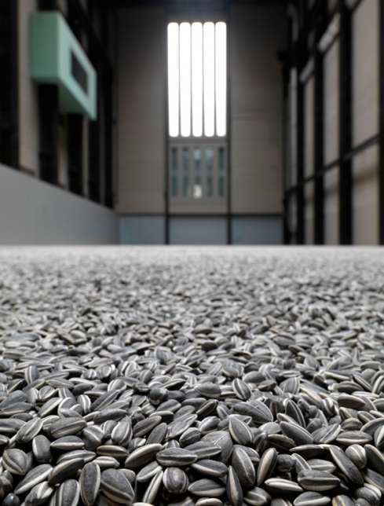
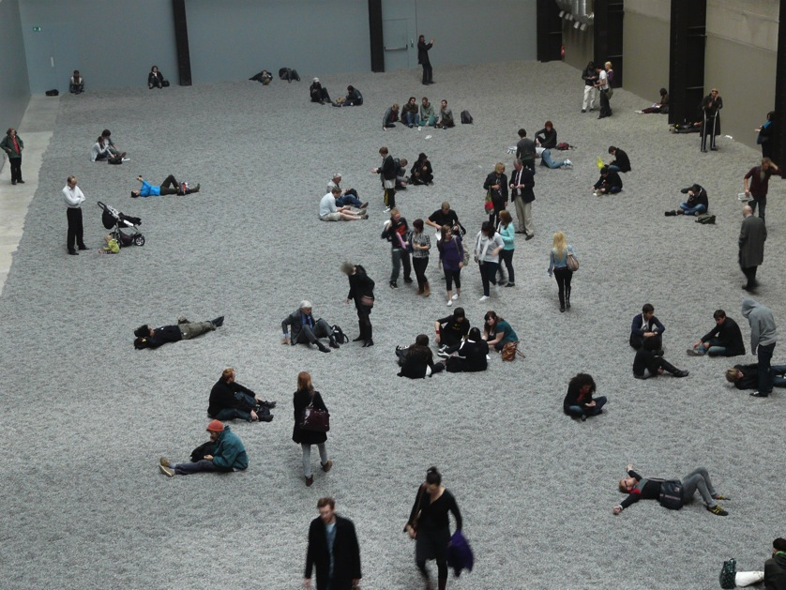
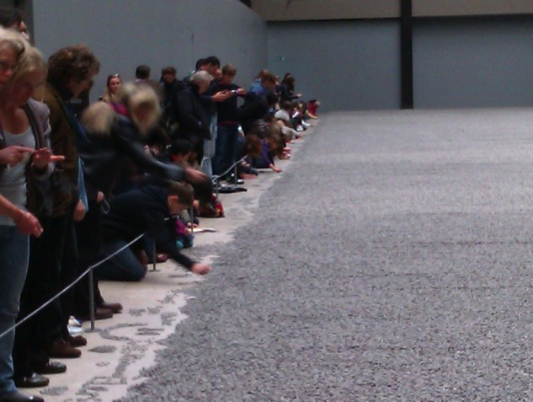
Sunflower Seeds (2010)
Notes:
Sunflower Seeds (2010) was an installation of 100 million hand-painted porcelain sunflower seeds. The work was initially presented so that people could walk over the seeds and touch the seeds, but was later closed off from public interaction and only available for observation. This work has multiple layers of meaning as the sunflower seed contains much symbolism for China. First of all, the sunflower seed is a popular snack in China. Further, the sunflower itself has been utilized as a symbol in propaganda images for the Chinese people under Mao Zedong’s Communist rule (Mao was presented as the sun and the people as sunflowers who faced the sun and thrived in the sun.) (See this site for an example: http://www.candygourlay.com/2010/10/health-and-safety-or-clever-comment-ai.html). On another level, the production of these sunflowers draws attention to the concept of “Made in China,” whereby Chinese workers produce much of the world’s commodities, often in an exploitative way for Western consumers. The seeds, thus, represent not only these commodities, but also Chinese workers themselves in the context of the global marketplace. The seeds (and the workers, in the eyes of the West) are seemingly homogenous, yet upon closer examination, it is evident that each one is unique and carefully crafted.
Questions for Students: Imagine that you could walk through this exhibit, describe your experience. What do the sunflower seeds represent to you?
Images:
Sunflower Seeds, 2010, Ai Weiwei: http://commons.wikimedia.org/wiki/File:%27Sunflower_Seeds%27_by_Ai_Weiwei,_Tate_Modern_Turbine_Hall.jpg
Sunflower Seeds, 2010, Ai Weiwei: http://www.tate.org.uk/whats-on/tate-modern/exhibition/unilever-series-ai-weiwei-sunflower-seeds
Sunflower Seeds, 2010, Ai Weiwei: http://paintingofmodernlife.blogspot.com/2010/10/ai-wei-wei-more-than-just-sunflower.html
References:
Hancox, S. (n.d.). Art, activism, and the geopolitical imagination: Ai Weiwei’s ‘Sunflower Seeds.’ Academia [Web Page]. Retrieved from http://www.academia.edu/765748/Art_Activism_and_the_Geopolitical_Imagination_Ai_Weiweis_Sunflower_Seeds
Radio Free Asia. (2011). Seeds of change? Radio Free Asia [Web Page]. Retrieved from http://www.rfa.org/english/news/china/artist-01032011111244.html
Tate Modern. (2010). The Unilever Series: Ai Weiwei: Sunflower Seeds [Web Page]. Retrieved from http://www.tate.org.uk/whats-on/tate-modern/exhibition/unilever-series-ai-weiwei-sunflower-seeds

Slide 19
Art Challenge –
Be an Artist Activist
Claire Pentecost, Doris Salcedo and Ai Weiwei are artists who strive to be useful and make the world a better place. Their art works are very diverse in media and techniques, and incorporate extensive research into the political or social issues they are passionate about.
Your challenge is to be an art activist, to choose an issue that you are passionate about, conduct research, and create a work of art of any medium and technique that expresses your views and advocates for change.
Be ready to explain your work in terms of your interest in your issue, the research you conducted, and your choice of materials, the aesthetic decisions you made in assembling them, and the conceptual basis for the work as a whole. Please reflect on how it relates to your life and experiences.

