Slide 1
Unmonumental sculpture
The Art Work of
Mary Mattingly

Slide 2
Mary
Mattingly
Pull (2013)
Notes:
Mary Mattingly is an artist working in varied forms of sculpture and photography focusing on environmental, economic and political change. She investigates and critiques her personal consumer footprint through sculptures, performances and photographs.
This work, Pull (2013) is one of her recent sculptures. It is created from objects that she has owned, and she has explored the “journey” of each object from its making to her purchase and use.

Slide 3
Mary Mattingly
Drum (2014)
Notes:
This sculpture, and the prior slide, is of a kind called “unmonumental,” defined as a sculpture of fragments that defies traditional limits of sculptural form, incorporating found materials, artificial objects, second hand images or even waste.

Slide 4
About Unmonumental Sculpture
“Outside of the white box, today’s most innovative, essential sculpture is testing all the limits. One of its strongest characteristics is the inherent ability to camouflage itself from any formal hierarchies. Traditional sculptural materials (e.g., wood, marble, bronze, steel) have sustained a long residency in the realm of the approved, the salable and the competitive. […] What is immediately contemporary is sculpture that does its best to insinuate itself into the texture of the world. “
Richard Flood, “Not About Mel Gibson,” in the Catalogue to the exhibition Unmonumental: The Object in the 21st Century. New York and London: Phaidon Press, 2007, p. 13.

Slide 5
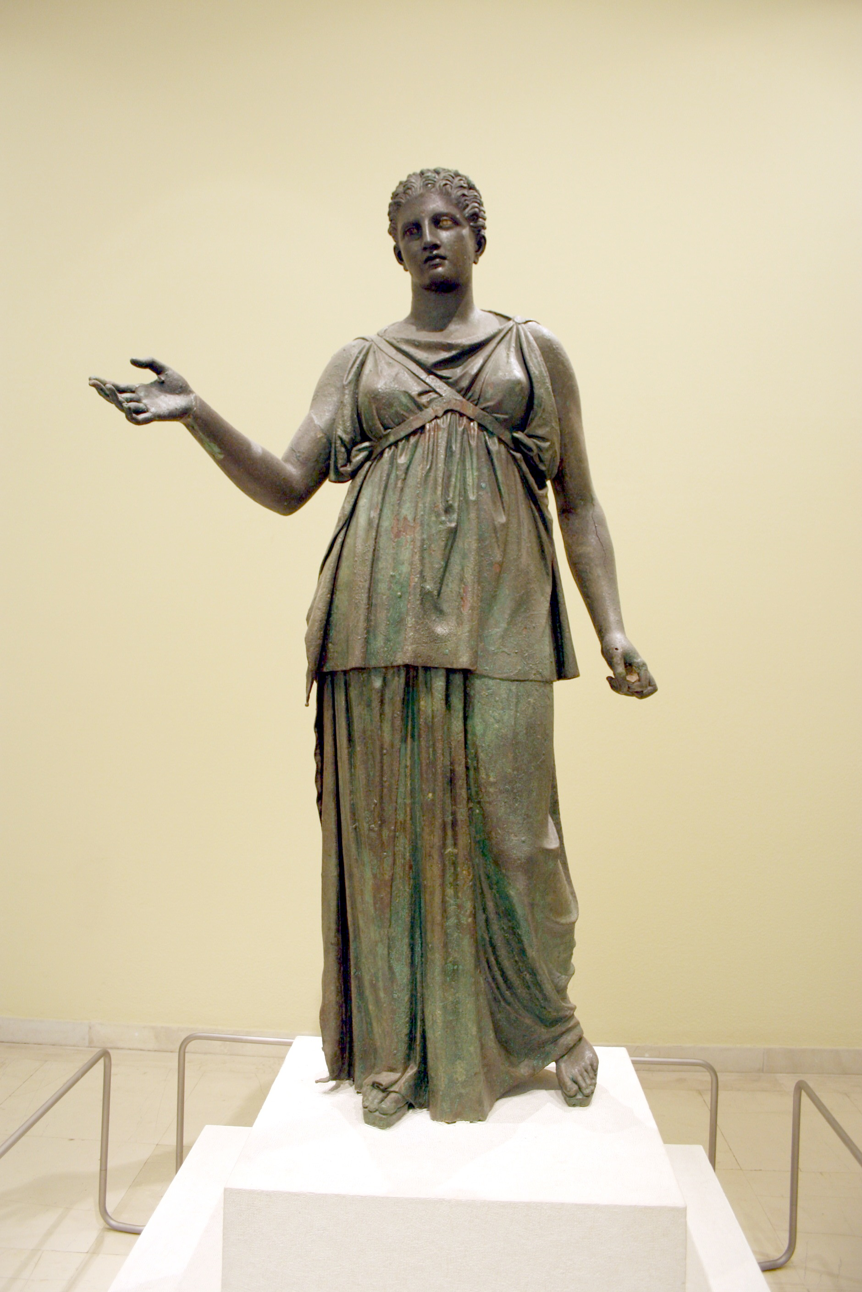
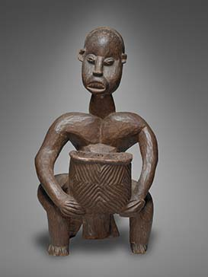
Examples of Traditional,
“Monumental” Sculpture
Ateu-Atsa, Male Seated Figure with Bowl, Cameroon, Bangwa, late 19th century. Wood and metal. Yale University Art Gallery, Charles B. Benenson, B.A. 1933, Collection
Piraeus Artemis, Greek, late classical, 2nd half 4th century BCE. Bronze, 1.94 meters. Excavated in 1959. Piraeus Archaeological Museum, Greece.

Slide 6
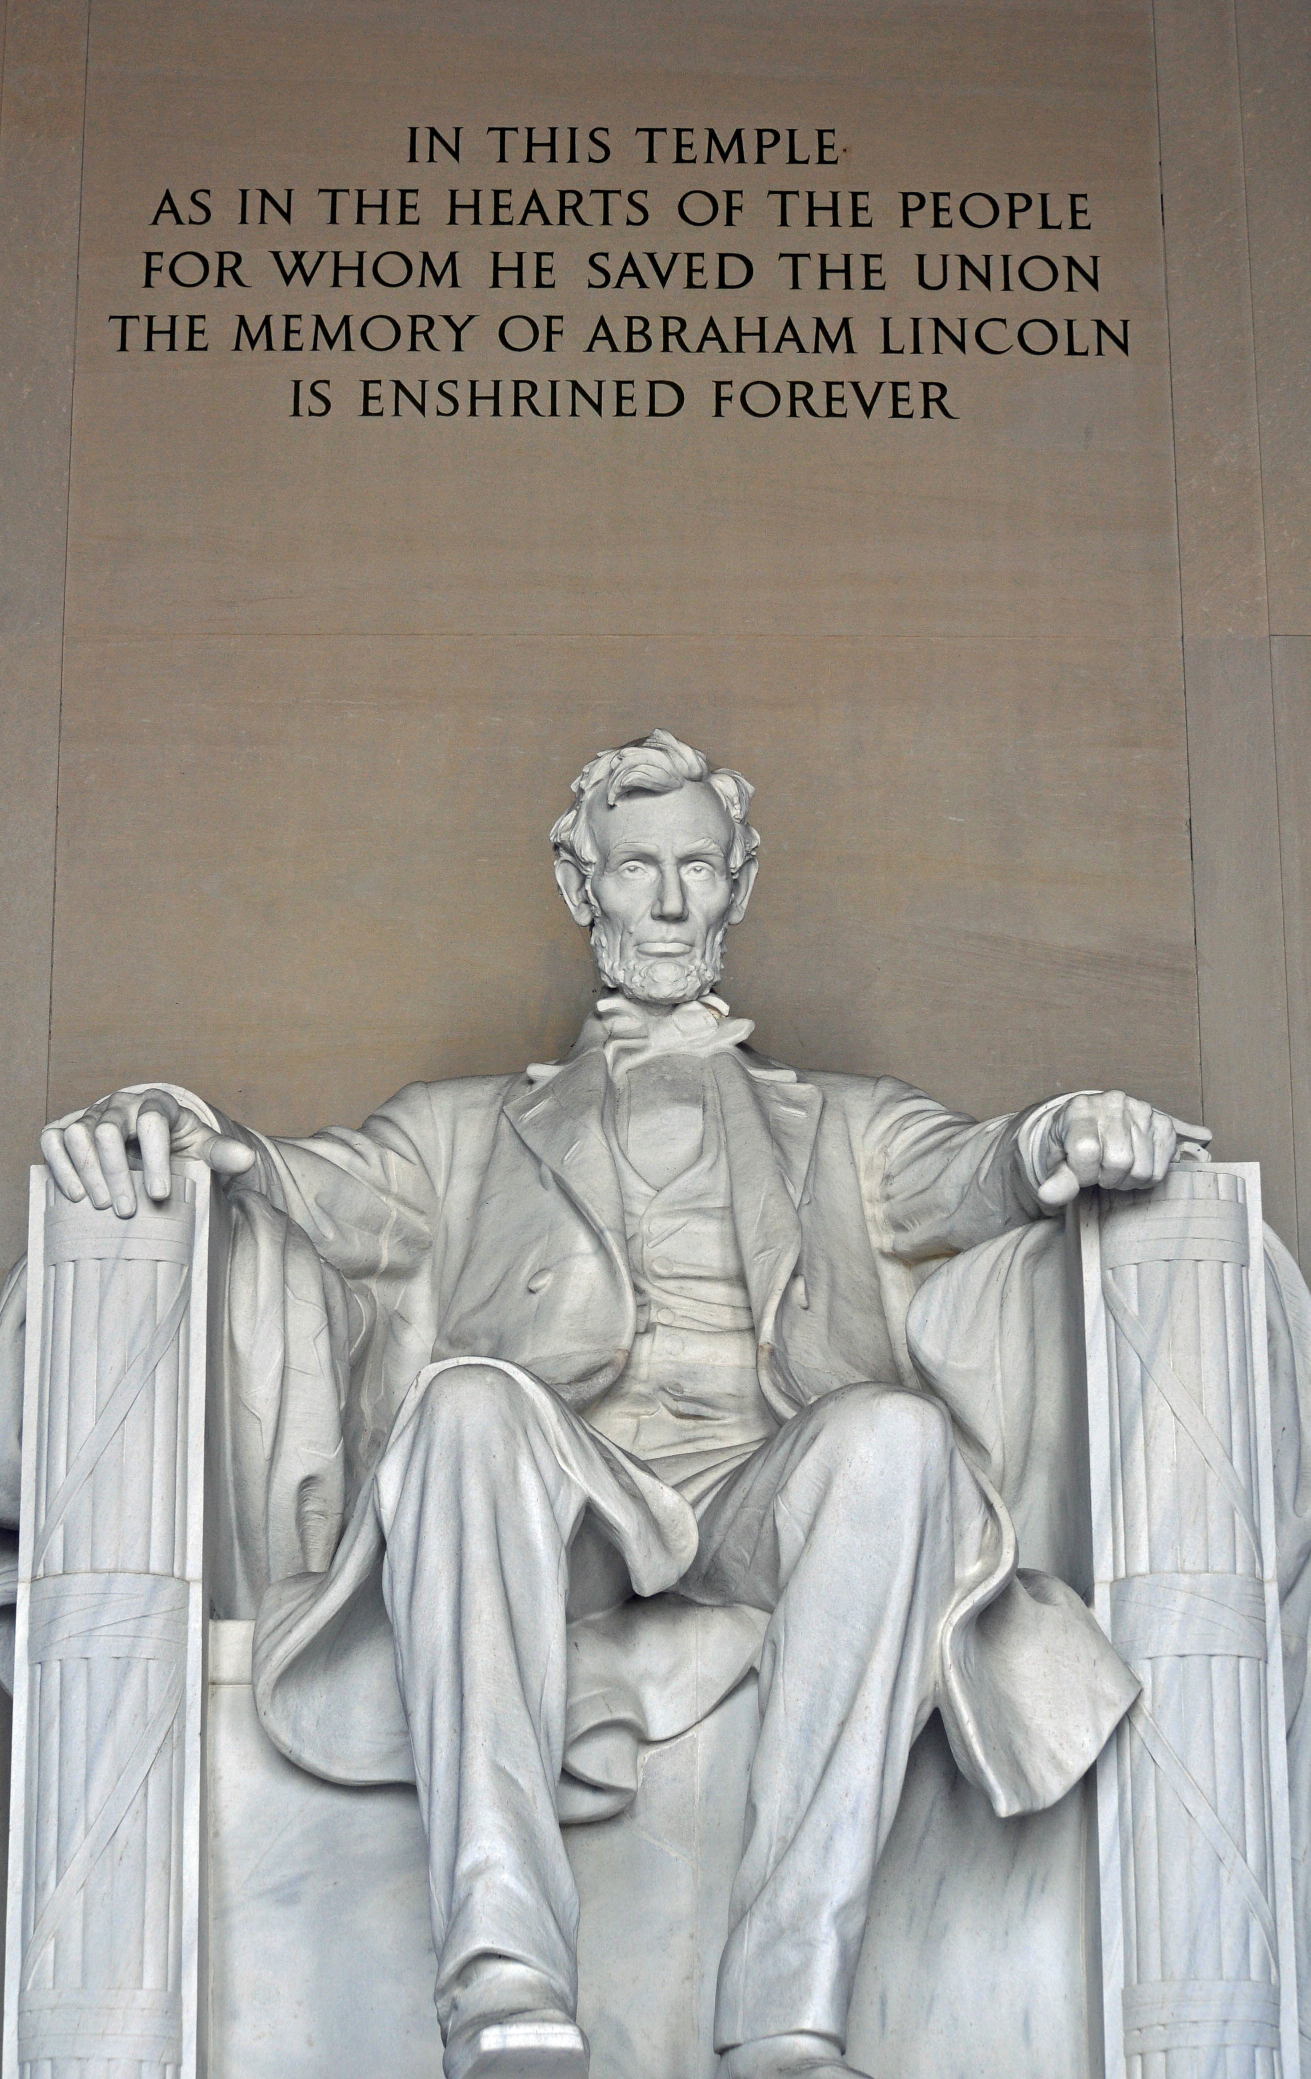
Lincoln Memorial, Washington D.C.
Notes:
Slides 5 and 6: Apart from being crafted from “traditional” materials such as wood, metal, stone and bronze, why would these works be “monumental” as opposed to “unmonumental”?
Think about permanency—preserving the past-- and memorializing, inciting a sense of awe and kinship. For example, what is the purpose of the Lincoln Memorial, and what role does the sculpture play? How does its size and the material affect its reception? What does it say about the period of time in which it was created, in terms of its stability and cultural hegemony?

Slide 7
Mary
Mattingly
Pull (2013)
Notes:
How does Mary Mattingly create a sculptural whole from a disparate collection of objects?
Does she “borrow” traditional sculptural forms to create an unmonumental work?
How do the form and the content work together to make an integral work of art?
Is one more important that the other?
How is she activating this work outside of the traditional gallery or museum setting? Could this be also considered a work of social practice?

Slide 8
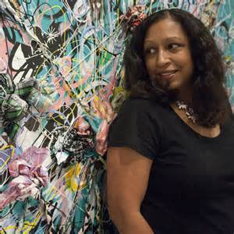
Shinique Smith
Born 1971 in Baltimore, Maryland, Shinique Smith now lives and works in Upstate New York. Her work is inspired by the vast nature of ‘things’ that we consume and discard, which resonate on a personal and social scale. The Graffiti of her youth, Japanese calligraphy, and Abstraction are influences from which she extracts “the graceful and spiritual qualities in written word and the everyday.”
Notes:
http://shiniquesmith.com/ss/

Slide 9
Shinique Smith
Black Cluster, 2010-2015
Plastic bags, used clothing,
Cord, tape
Dimensions variable
Notes:
http://shiniquesmith.com/#filter=.hanging

Slide 10
Shinque Smith
Quickening, 2016
Fabric, paint, found objects, used clothing
Dimensions variable
Installation at Project Atrium,
Museum of Contemporary Art, Jacksonville
Notes:
“VIBRANT AND MATERIALLY INVENTIVE, Shinique Smith’s signature bundles of tied clothing hang in the forty-foot-high Atrium Gallery against a backdrop of painted calligraphy and mirrored surface. Made with fabric, paint, found objects, and used clothing, her work incorporates elements of graffiti, Japanese calligraphy, and collage. The energetic patterns and rich textures conjure tactile sensations and emotional connections based on our relationship with clothing. As the cascading sculptures twirl and perform like dancers, the intersection of material, motion, and reflection creates a thought-provoking visualization about personal identity and individual style. Blossoming into the space, Smith’s installation radiates energy outward to the rest of the Museum.”
http://shiniquesmith.com/quickening-in-project-atrium-at-moca-jacksonville/

Slide 11
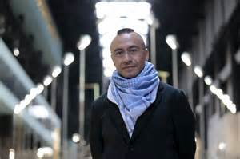
Abraham Cruzvillegas
Abraham Cruzvillegas was born in Mexico City in 1968. Inspired by the harsh landscape and living conditions of Colonia Ajusco, his childhood neighborhood in Mexico City where houses were built on inhospitable land in ad hoc improvisations according to personal needs and economic resources, Cruzvillegas assembles sculptures and installations from found objects and disparate materials.
Notes:
http://www.art21.org/artists/abraham-cruzvillegas
http://www.elfinanciero.com.mx/fotogalerias/abraham-cruzvillegas-se-instala-en-la-tate-modern-de-londres.html

Slide 12
Abraham Cruzvillegas
Pending Sculpture, 2008
Found objects, plastic, netting
Dimensions variable
Notes:
http://es.paperblog.com/abraham-cruzvillegas-autoconstruccion-y-accion-social-738032/

Slide 13
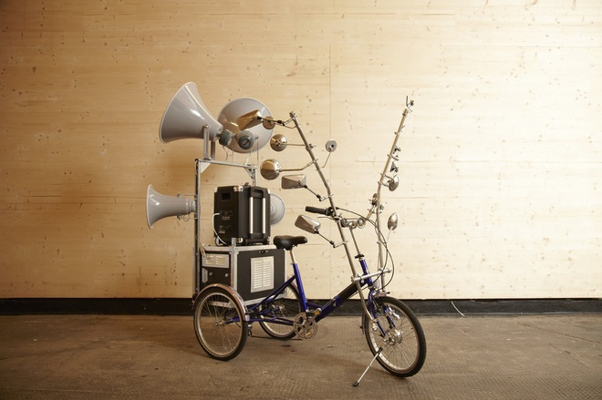
Abraham Cruzvillegas
The Simultaneous Promise, 2011
Tricycle, portable PA, horn speakers, amplifier, metal tubing, mirrors
Notes:
http://www.thomasdanegallery.com/artists/33-Abraham-Cruzvillegas/works/

Slide 14
Art Challenge:
Create your own unmonumental sculpture out of found objects and other materials that matter in your life.
• Mary Mattingly, Shinique Smith and Abraham Cruzvillegas all create sculptural works that connect intimately to their own histories, lives, identities, and artistic and social concerns. They also reflect upon society and its pressing issues.
• In creating assemblages, they use found objects that relate to their lives and their concerns.
• Consider this statement when choosing your materials:
“As opposed to casual recycling, the found object is a form of historical recovery that activates highly charted aspects of the past in the service of the present. “*
• Be ready to explain your work in terms of your choice of materials, the aesthetic decisions you made in assembling them, and the conceptual basis for the work as a whole, including how it relates to your life and experiences.
Notes:
• Eva Diaz, A Critical Glossary of Space and Sculpture, in the Catalogue to the exhibition Unmonumental: The Object in the 21st Century, Phaidon Press New York and London, 2007.

