Slide 1
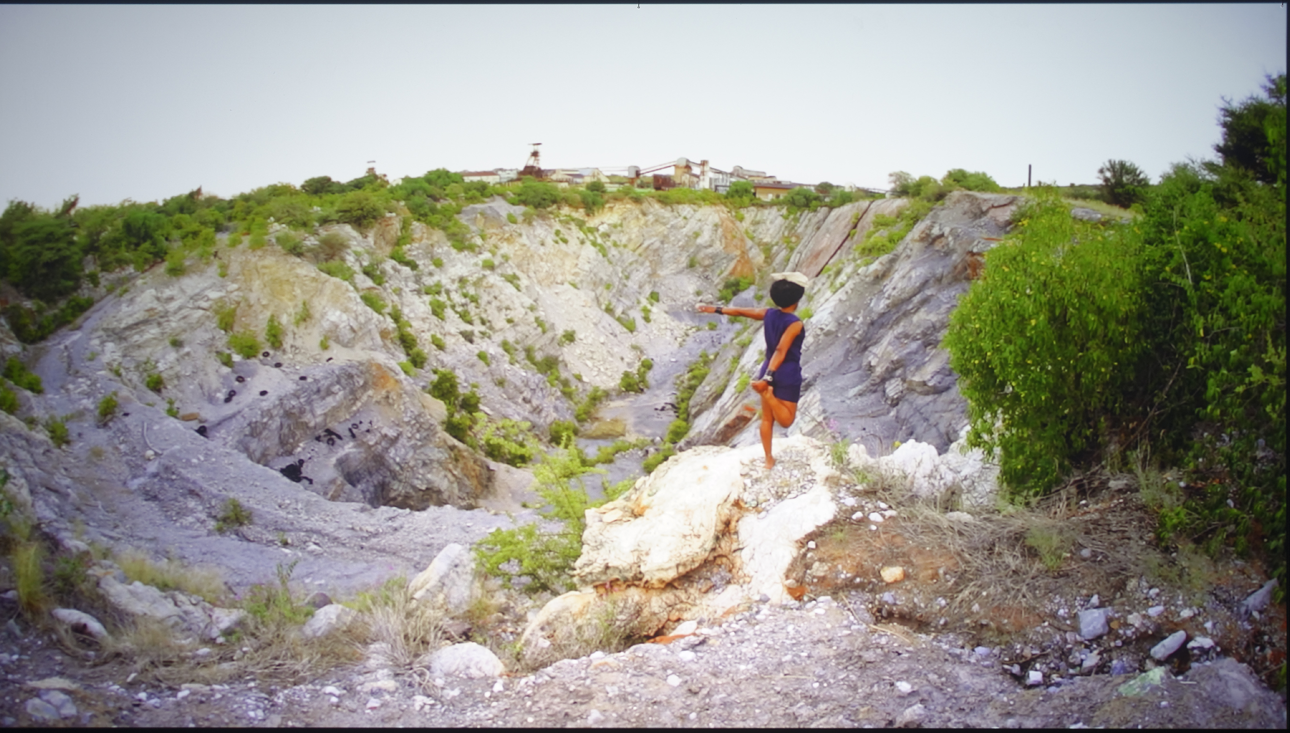

Slide 2
Remnants of the Past
The work of Otobong Nkanga

Slide 3
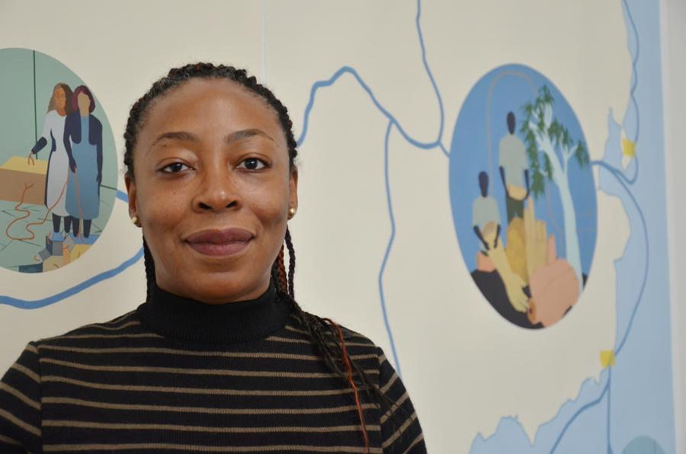
Otobong Nkanga
Visual artist
  Performance
  Painting
  Photography
  Sculpture
  Installation
Narrative approach
  Memory
  Environment
  Postcolonial histories
Notes:
Otobong Nkanga is a visual artist and live performer born in Kano, Nigeria. She currently lives and works in Paris and Antwerp. Nkanga began her art studies at the Obafemi Awolowo University in Ile- Ife, Nigeria and continued at the Ecole Nationale Supérieure des Beaux-Arts, Paris, France. She was at the residency program at the Rijksakademie van beeldende kunsten, Amsterdam, The Netherlands. In 2008 she obtained her Masters in the Performing Arts at Dasarts, Amsterdam. The Netherlands. She has exhibited widely internationally.
Using drawing, sculpture, installation, photography, and other media, she combines a variety of approaches and techniques to create her works. Many of these works deal with the environment, human influence, and land ownership. Nkanga frequently involves herself in her art, whether physically as part of a performance, or by exploring issues close to herself and her history.
Information retrieved from: http://www.contemporaryand.com/person/otobong-nkanga/

Slide 4
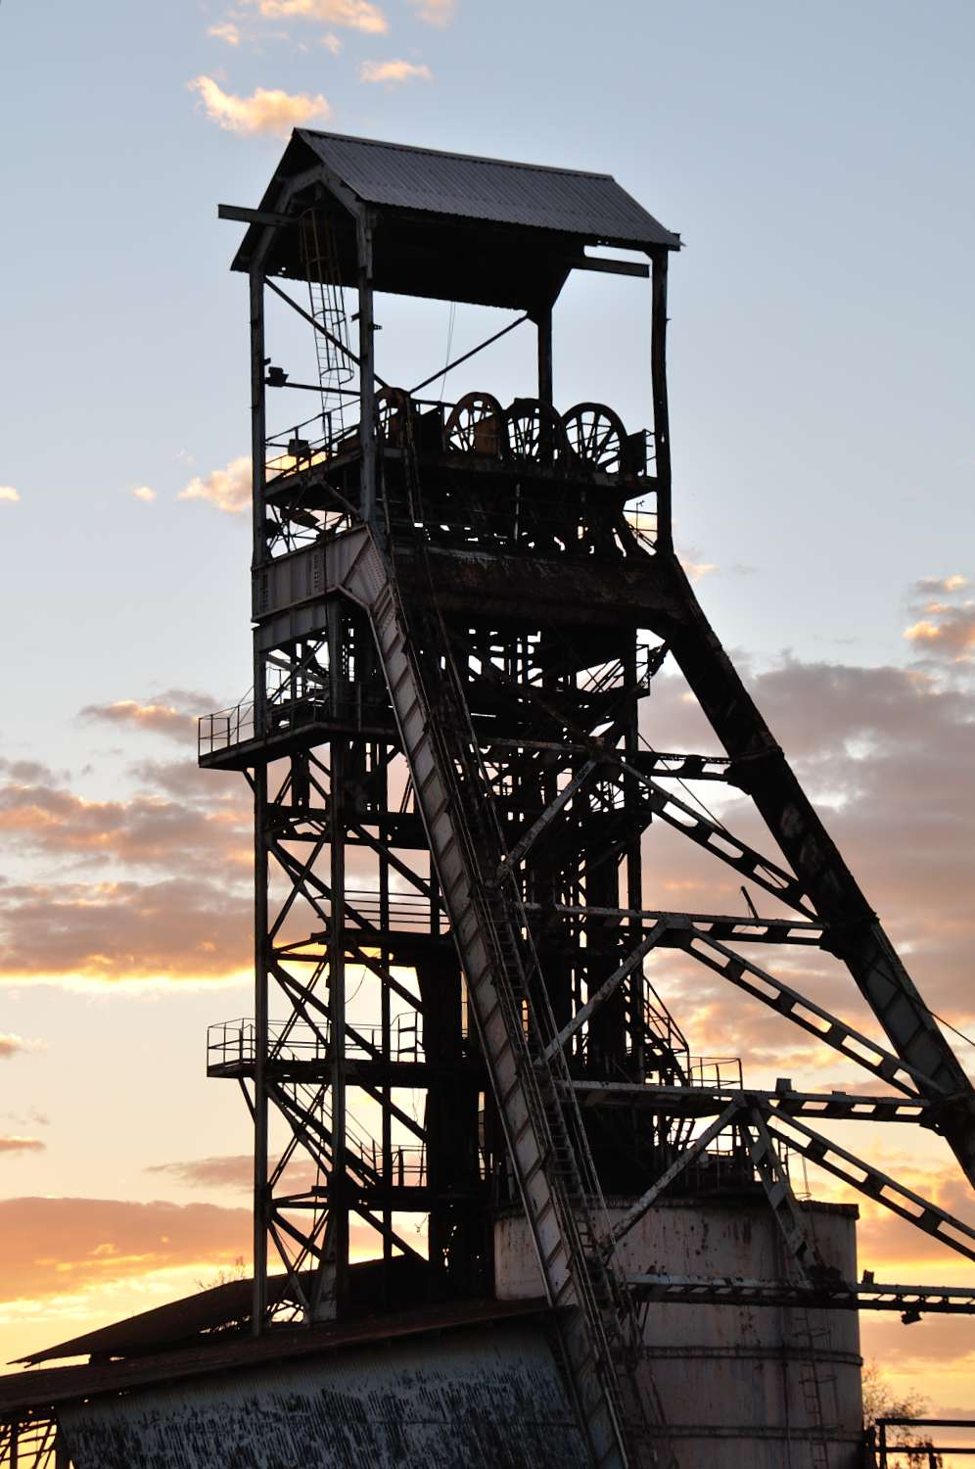

What is mining?
The extraction of minerals and metals from the earth
Notes:
Ask students:
What is mining?
Mining is the extraction of minerals and metals from the earth.
In the Spring of 2015, Nkanga travelled to Namibia intent on reaching The Green Hill in Tsumeb, an area renowned for its minerals, crystals, and copper deposits. This hill had been hand-mined by the Ovambo people for generations. However, when Namibia became German South West Africa, the colonial regime began to mine The Green Hill industrially, extracting and exporting tons of minerals each year. The Green Hill got its name from the green tint of malachite (pictured) one the most abundant minerals at the Tsumeb site.
Information retrieved from: http://www.kadist.org/en/programs/all/2141
Images from: tsumeb.com

Slide 5
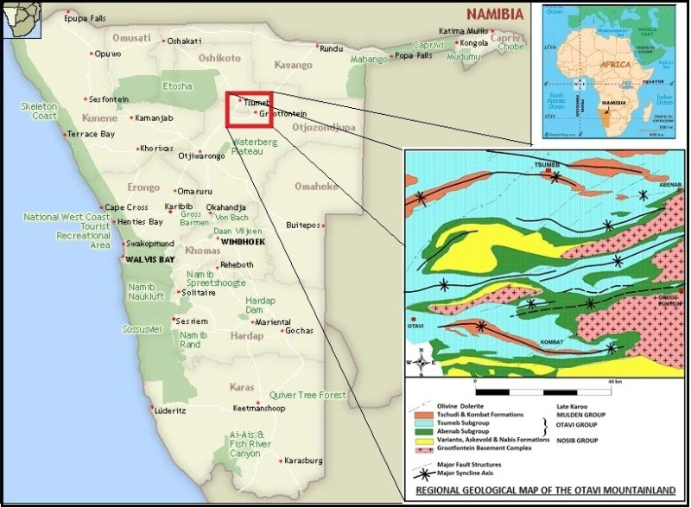
Mining in West and South Africa
Notes:
Image from: tsumeb.com

Slide 6
Remains of the Green Hill (2015)
Otobong Nkanga
Notes:
Tell students:
When Nkanga arrived in Tsumeb, The Green Hill was no longer a hill, but a dormant hole in the ground, fenced-off from public access.
In her work, Remains of the Green Hill (2015), Nkanga performs a spontaneous yoga-like routine while an interview with the last Managing Director of the Tsumeb mine is overlaid as audio. The interview describes the exploitation of colonial powers, while also looking forward into a hopeful future in which the Tsumeb community makes both industrial and environmental progress.
Ask students:
Given this new information, would you like to revise any of the claims you made about this image at the start of the lesson?
What do you think Nkanga was feeling at the time of this performance?
What makes you say that?

Slide 7
Take a Stand Activity
Where do you stand on the following statements?
Notes:
Introduce students to the activity by posting the signs: “Strongly Agree”, “Agree”, “Disagree”, and “Strongly Disagree” in the four corners of the room (Appendix A). Ask students to consider whether or not they agree with the statements to follow and move to appropriate corner of the room when prompted. Students may stand in the middle of the room if they are unsure. Students should be prepared to defend their responses in the four corners. As students from the “Agree” and “Disagree” positions share, students in the middle of the room are invited to move to either side when presented with reasoning.

Slide 8
Mining companies have a responsibility to maintain the integrity of the environments in which they mine.

Slide 9
The people of Tsumeb have a responsibility to protect the remains of The Green Hill.

Slide 10
Consumers have a responsibility to consider where the crystals, metals, and other “bling” comes from before making a purchase.

Slide 11
“Nature does not reveal its secrets until we acquire the knowledge to decipher it. The appearance of something is not necessarily the truth of what it is, or the reality of what it was.”
--Otobong Nkanga
Notes:
Ask to students to reflect on the quote, “Nature does not reveal its secrets until we acquire the knowledge to decipher it. The appearance of something is not necessarily the truth of what it is, or the reality of what it was.” How does this quote relate to the Remains of the Green Hill (2015)? How does it apply to relationship of people to the environment?

