Slide 1
Artists who Map
Cartography in the work of
Otobong Nkanga, Alighiero e Boetti, Olafur Eliasson, Kathy Prendergast, Nikki Rosato and Ibrahim Miranda

Slide 2
Otobong Nkanga, also known as
“Oto” is a performer and visual artist born in Kano, Nigeria.
She works in a broad spectrum of media, including performance, installations, photography, drawing and sculpture. According to Nkanga, the various media she employs “interrogate our mental and physical identities in varied environments and contexts.”
.
Nkanga began her art studies at the Obafemi Awolowo University in Ile-Ife, Nigeria, and later continued in Paris at the Ecole Nationale Superieure des Beaux-Arts, and she has finished her Masters Program at Dasarts, Amsterdam
Notes:
.According to Nkanga, the various media she employs “interrogate our mental and physical identities in varied environments and contexts.”
Image and text: http://www.mediamatic.net/33549/en/also-known-as-oto

Slide 3
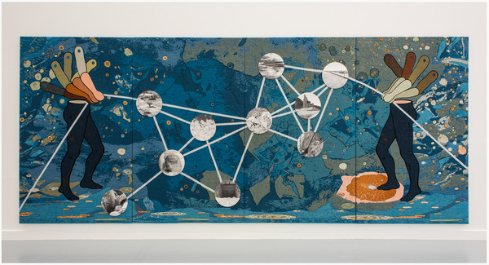
Otobong Nkanga
The Weight of Scars, 2015
Woven textile and Photography, inkjet print on viscose, wool, mohair, bio cotton and
laser cut forex 10 plates
253 x 612 cm
© M HKA & Galerie in situ-Fabienne Leclerc, Paris
Notes:
Otobong Nkanga explores the presences and remnants of colonial and post-colonial mining projects in West and South Africa, and their echoes in the migration of people.
The photographs are images of the remains left behind of abandoned and emptied mines in Namibia, which caused significant changes to the physical landscape with their construction in the early 20th century. These changes are like scars that not only are inscribe in the landscape, or bodies, but also become the legacy and weight that is inherited.
What do you think the figures mean? Do they remind you of marionettes? How would that idea connect to the overall composition and concept of the work?
How does she use the idea of the map to establish the terrain for her concept and work?
Why do you think she used a tapestry for the background instead of a painting or another photograph?
What do you think she means by the “weight” of scars?
Image: http://www.fiac.com/galeries/in_situ_fabienne_leclerc

Slide 4
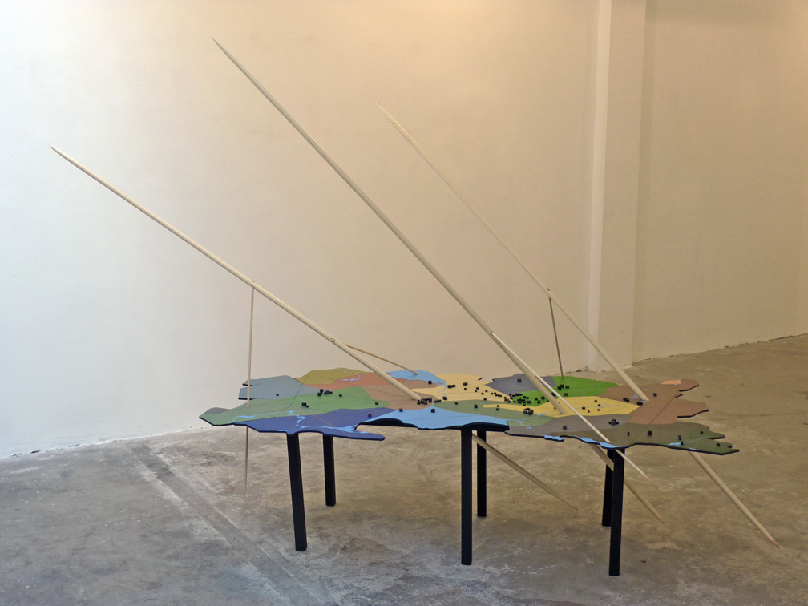
Otobong Nkanga, The Limits of Mapping, 2010
Mixed media, sculpture and photographs
Notes:
In this slide and the next, Nkanga constructs a kind of three dimensional map with topographical features such as trees and buildings.
Why do you think that she included the long wooden “toothpicks” to the work. Does this connect to the title “the limits of mapping”?
Image: http://www.lumentravo.nl/wp/?p=449

Slide 5
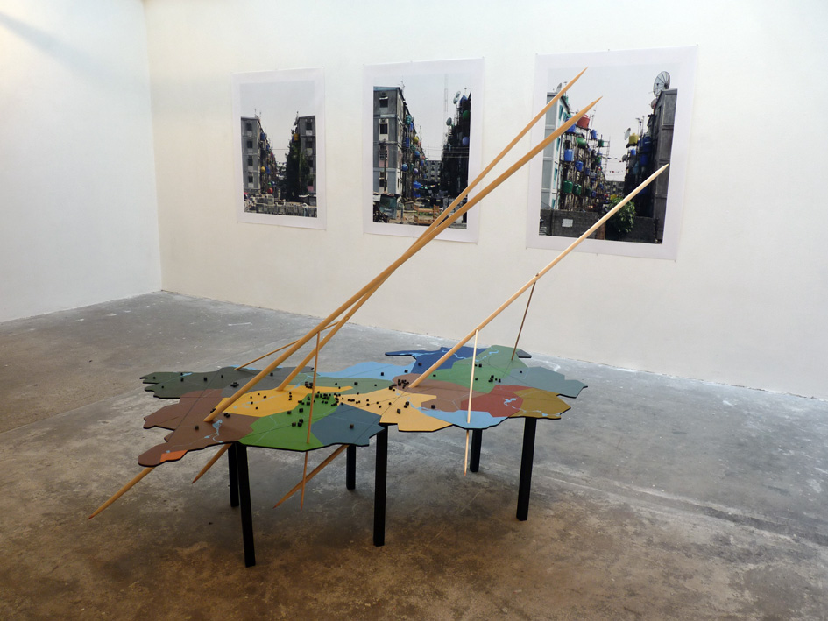
Otobong Nkanga, The Limits of Mapping, 2010
Mixed media, sculpture and photographs
Notes:
In this image, the wooden pieces appear to connect to photographs of city streets. Do you think that she is trying to construct a kind of three dimensional map, one that tells a much fuller story about a place and its people than a two dimensional map?
Do you have any ideas about what area/city/people she is dealing with here?
Image: http://www.lumentravo.nl/wp/?p=449

Slide 6
What is a Map?
Maps are common objects. We see them every day, we use them when we travel, and we refer to them often, but what is a map?
Map Defined
A map is defined as a representation, usually on a flat surface, of a whole or part of an area. The job of a map is to describe spatial relationships of specific features that the map aims to represent.
There are many different types of maps that attempt to represent specific things: political boundaries, population, physical features, natural resources, climates, topography, economic activities, etc.
Notes:
http://geography.about.com/od/understandmaps/a/whatisamap.htm

Slide 7
Cartography
Cartography is the art and science of making maps. Humans have been creating maps since ancient times: The earliest map is thought to be a schematic of the night sky found in the caves of Lascaux, France, dating to 16,5000 BCE. While we often consider maps to be objective representations of physical space, they are laden with subjective views of the world.
Notes:
https://www.moma.org/learn/moma_learning/themes/maps-borders-and-networks

Slide 8
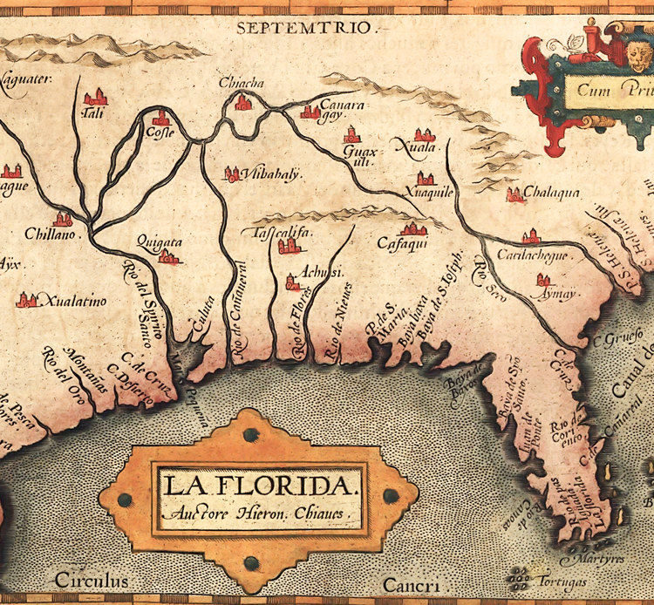
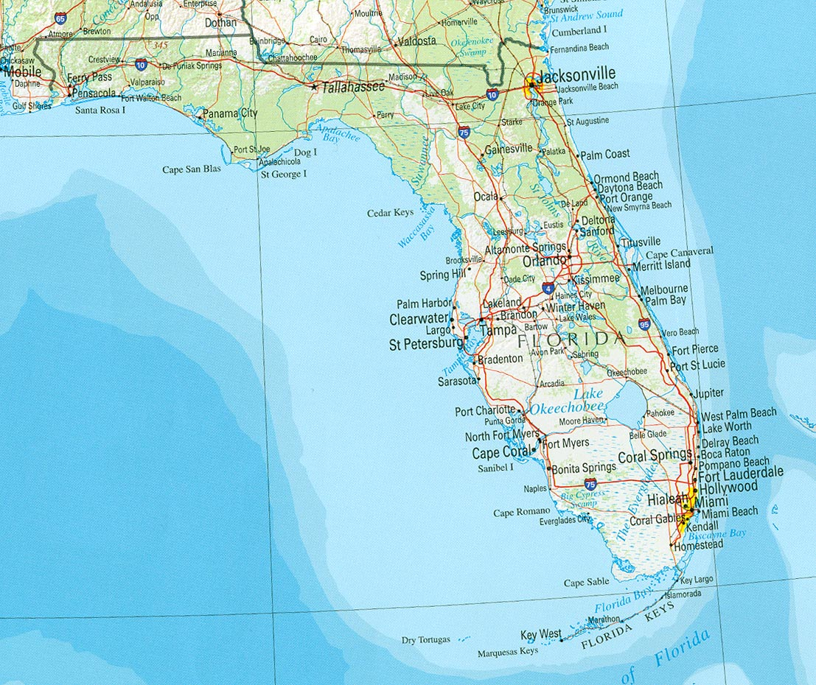
Contemporary Map of Florida
1584 Map of Florida
Notes:
Two maps of Florida, made some 400 years apart. What do the differences tell you about Florida and its history? Who do you think the cartographers were/are? Can you imagine the differences in technical resources that the mapmakers had at their disposal?
http://www.vintage-maps-prints.com/products/old-map-of-america-florida-discoveries-1584
http://www.yellowmaps.com/map/florida-reference-map-482.htm

Slide 9
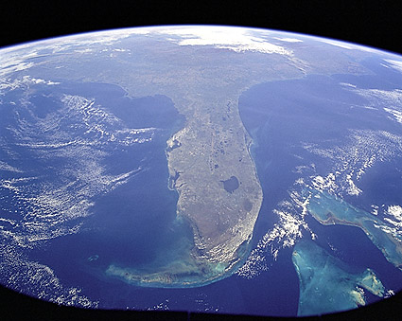
Florida & Bahamas Seen from Space
Photo from STS-95 mission's view of Earth from Space. The point over Cuba shows a foreshortened view of the Florida Peninsula, with the seafloor of both the Florida Keys (curving across the bottom of the view) and the Bahama banks (right). Photo credit: NASA
PHOTOGRAPHER / CREDIT: NASA
Notes:
A view of Florida from space. What does a comparison of the three maps of Florida tell you about map making? What kinds of subjective views can you interpret from viewing the different maps? Does any one of them give you a complete picture of Florida, its geography and flora and fauna. its people, its history?
http://www.mcmahanphoto.com/ns163.html

Slide 10
Artists use maps to tell stories about themselves and their views of the world
Additionally, maps change over time: Borders and boundaries are constantly in flux, shifting along political lines and in response to changes in international relationships. Many artists have used maps to tell wide-ranging stories about conflict, migration, identity, and social, cultural, or political networks.
Notes:
https://www.moma.org/learn/moma_learning/themes/maps-borders-and-networks

Slide 11
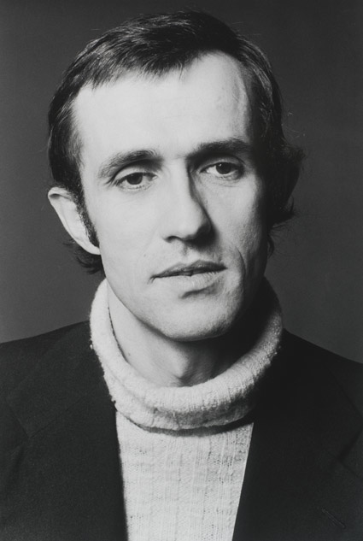
Alighiero e Boetti
Italian, 1940-1994
One of the chief artists of the avant garde Arte Povera movement (1960s-1970s), meaning ‘poor art’ art made of simple everyday materials evoking a pre industrial age
Diverse interests in philosophy, alchemy, esoterics, non western cultures, travel
Worked with women embroiders in Afghanistan
Work in prestigious public and private collections worldwide
Notes:
http://brothersartgallery.com/alighiero-boetti/

Slide 12
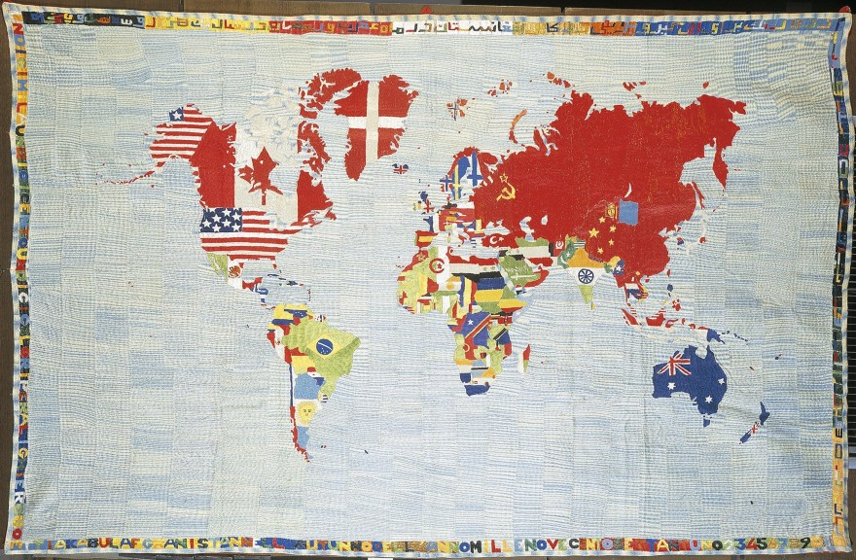
Alighiero e Boetti
Mappa del mondo (Map of the World), 1971-72
Embroidery on cloth
Notes:
http://publicdelivery.org/tag/1988/
In 1971 upon his departure from Italy and his arrival in Afghanistan, Alighiero Boetti began a continuous collaboration with local weavers to produce embroidered tapestries, using himself only as the referential artist but considering the works a creation of a combined effort. Mappa del Mundo is a colorful, beautiful crafted tapestry showing each country emblazoned with its own flag, examining borders, frontiers, nationalism, and patriotism. The borders are emblazoned with Italian and Persian texts, selected by Boetti and the craftswomen. Over the next two decades, more than 150 Mappe of different colors and sizes were created in this way. From this, geopolitical changes were tracked throughout the world, transforming a simple idea into a political vision by visualizing territory disputes and regime changes.

Slide 13
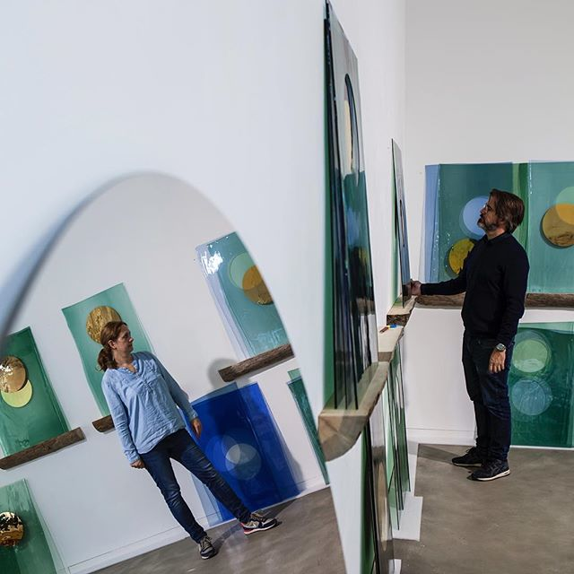
Olafur Eliasson
B. 1967 Copenhagen, Denmark
Studied at Royal Danish Academy of Art
Professor Berlin University of the Arts
Throughout the past two decades, Olafur Eliasson’s installations, paintings, photography, films, and public projects have served as tools for exploring the cognitive and cultural conditions that inform our perception.
Notes:
Ranging from immersive environments of color, light, and movement to installations that recontextualize natural phenomena, his work defies the notion of art as an autonomous object and instead positions itself as part of an exchange with the actively engaged visitor and her individualized experience. Described by the artist as “devices for the experience of reality,” his works and projects prompt a greater sense of awareness about the way we engage with and interpret the world.
http://www.tanyabonakdargallery.com/artists/olafur-eliasson/series
http://www.olafureliasson.net

Slide 14
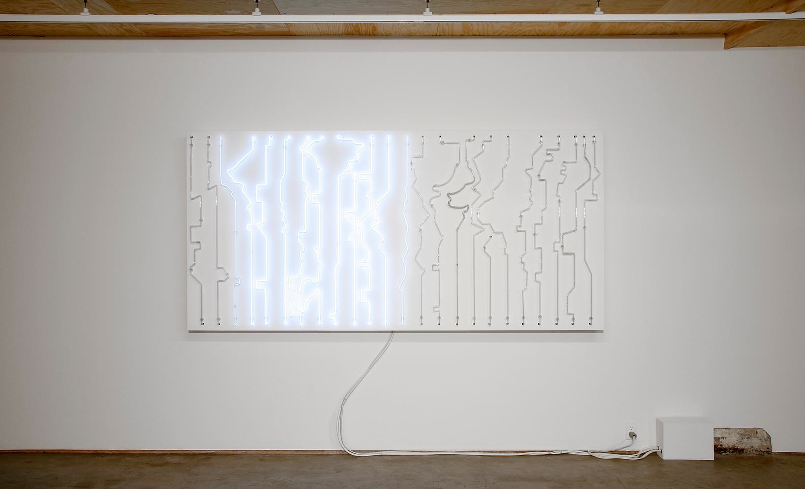
Olafur Eliasson, Daylight Map, 2006
Neon, sintra box, transformers, controllers, sequencer, timers
Notes:
Consisting of neon tubes formed to resemble a chart of international time zones, this work is a real-time map of global light conditions. On the map, the zones in which it is daytime are illuminated. When the sun sets in these zones, the neon light is turned off-while being turned on in the zones where the sun is rising.
http://olafureliasson.net/archive/artwork/WEK100679/daylight-map

Slide 15
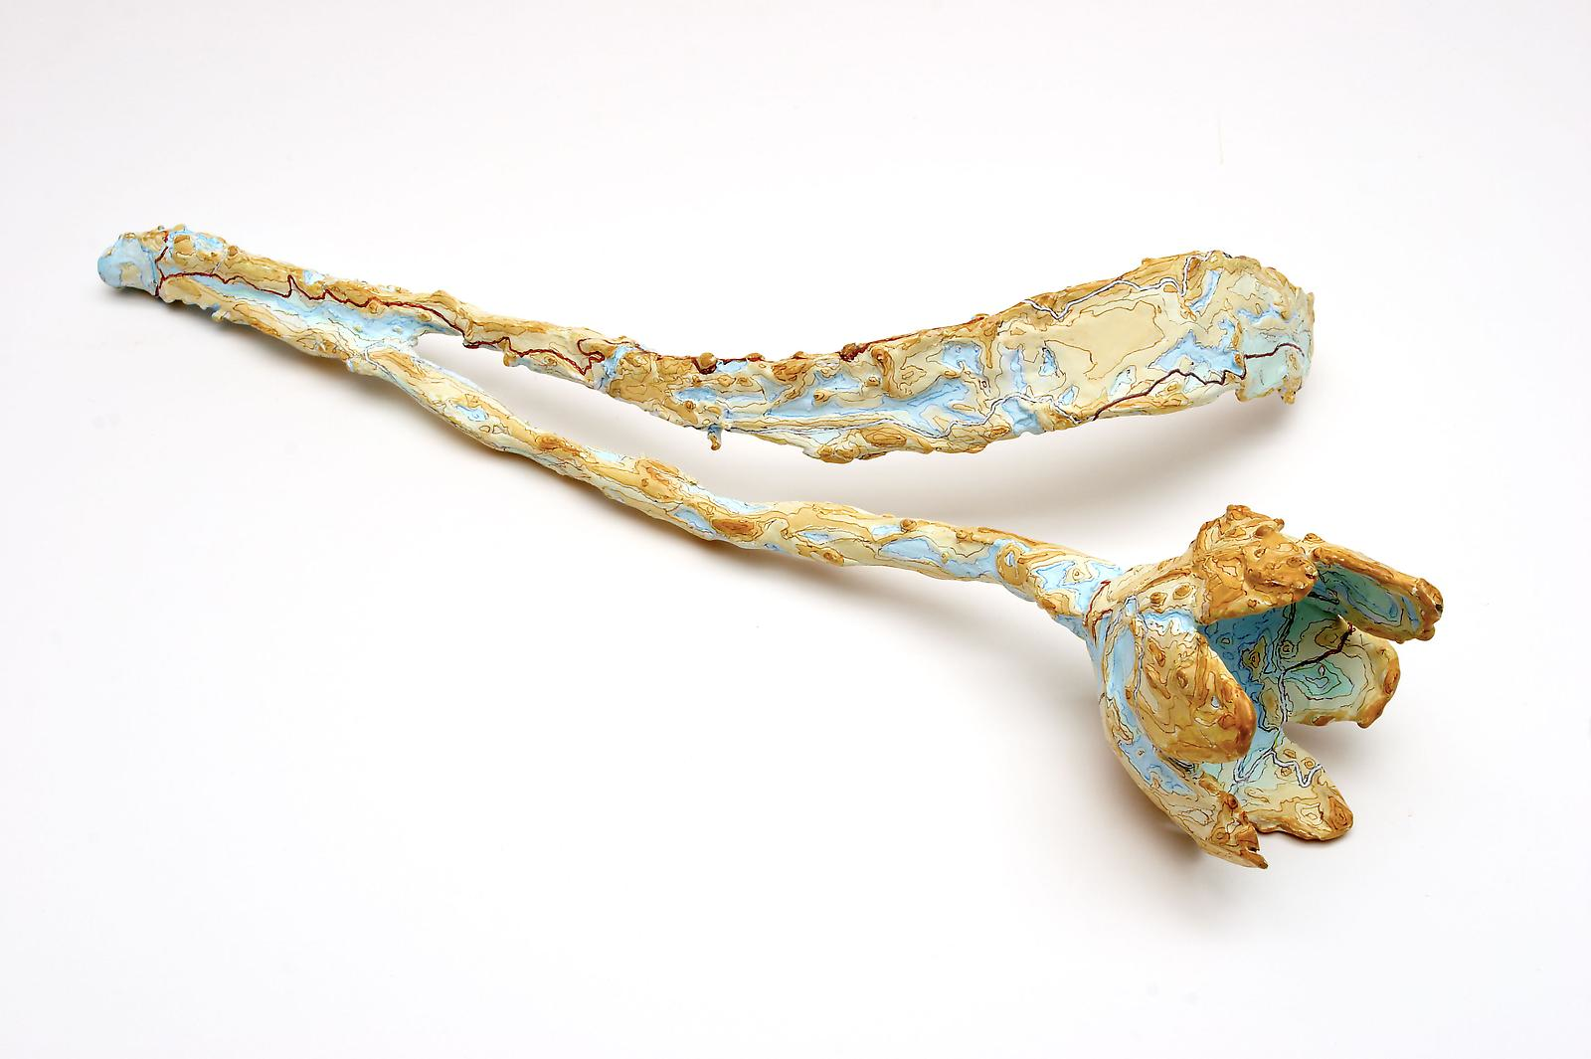
Kathy Prendergast
Born 1958, Dublin, Ireland.
Educated at National Academy of Arts Dublin and Royal Academy of Art, London
Her work has persistently revolved around a potent cluster of issues chief among which are sexuality, identity, landscape, mapping and power. She came to widespread attention for her monumental project, ‘City Drawings’ for which she won the Best Young Artist Award at the Venice Biennale 1995.
Little Universe 2, 2006
Painted bronze
3.5 x 15.7 x 7.9 in
Notes:
http://www.kerlingallery.com/artists/kathy-prendergast#selected-works

Slide 16
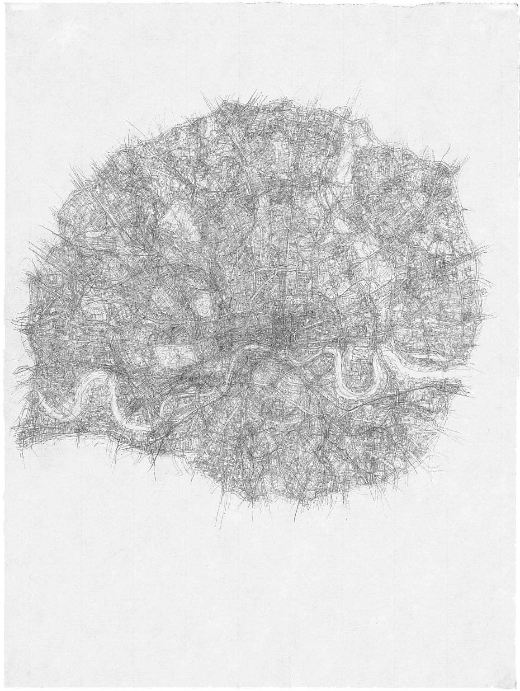
Kathy Prendergast
City Drawing Series: London-n13, 1997
Pencil on paper
12.2 in x 8.3 in
Notes:
http://www.kerlingallery.com/artists/kathy-prendergast/selected-works
Does this map of London look like other maps you have seen of that city? What does its shape look like in terms of human anatomy? Can you connect the representation of the city to its function in the United Kingdom and the world?

Slide 17
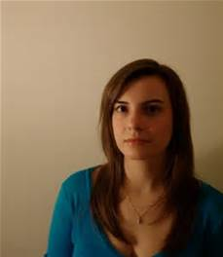
Nikki Rosato
Born 1986 in New York City. Lives and works in Washington, DC
MFA from School of the Museum of Fine Arts, Boston
Numerous exhibitions nationally and internationally
The visual aspects of a road map are remarkably human. A map is a symbol of a living, breathing, moving body—the land is just as alive as we are. A map’s lines carve the pathways for the rhythms and movements that undulate across the surface of the earth. (Nikki Rosato)
Notes:
http://www.jonathanferraragallery.com/artists/nikki-rosato
Image: http://as16online.blogspot.com/2012/01/featured-artist-nikki-rosato.html

Slide 18
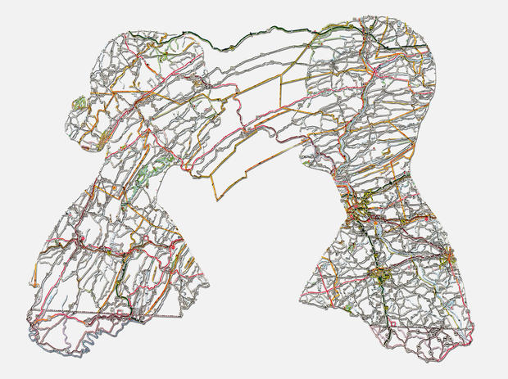
Nikki Rosato
Untitled (Connections), 2014
Hand cut road map, 11” x 14”
Notes:
http://www.nikkirosato.com/cut-road-map/
How do you think this work is created? What do the connecting lines mean in terms of human connectedness?

Slide 19
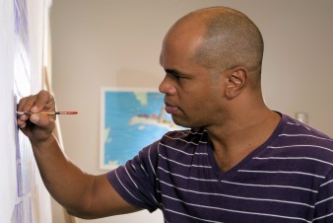
Ibrahim Miranda
Born in Pinar del Rio, Cuba
Graduated from the Superior Institute of Arts, Havana
Studied printmaking at the National School of Visual Arts, Havana
His prints, paintings and textile works on cartography, the island of Cuba and its spirituality have been exhibited all over the world in solo and group exhibitions

Slide 20
Ibrahim Miranda
Evolution (Version III), 1999
Woodcut over map 52 x 126 cm
Notes:
What sites does this map indicate? Answer: mineral deposits on the island of Cuba. How does the artist use the shape of the island to create his image? What kind of creature does it appear to be? What do you think its environment is—water, air, land? Do you think the map says anything about how the artist views his native country?
http://ibrahimmiranda.com/catalog-menu/mixed-media-menu/event/mixed-1999#0

