Slide 1
Consumers of Toxins
The Work of Marina Zurkow
Notes:
Powerpoint background retrieved from: www.free-ppt-templates.com

Slide 2
What is a Petrochemical?
What is a Manga?
Notes:
Definition of Petrochemical obtained from: http://www.dictionary.com/browse/petrochemical
Definition of Manga obtained from: http://www.dictionary.com/browse/manga
Engage the class in a conversation on what they think a petrochemical is.
Petrochemical: a chemical substance obtained from petroleum or natural gas, as gasoline, kerosene, or petrolatum.
Engage the class in a conversation on what they think a manga is.
Manga: A Japanese graphic novel, typically intended for adults, characterized by highly stylized art.

Slide 3
The Petroleum Manga 2012
Notes:
Introduce the artist’s work by sharing the name of her 2012 collection.

Slide 4
“My work is about the networked stories we tell ourselves about our place in the larger world, the interwoven and often conflicted threads of this, and how these are represented in mediated form” -Marina Zurkow
Notes:
Quote Retrieved from: https://www.artsy.net/artist/marina-zurkow

Slide 5
Marina Zurkow
Visual artist
Media technology
Animation
Video
Researches “Wicked Problems”
Individual narratives
Environmental concerns
Relationship between humans, animals, plants and weather
Notes:
Information retrieved from: https://en.wikipedia.org/wiki/Marina_Zurkow & http://o-matic.com/about/about.html
Zurkow is a media artist focused on near-impossible nature and culture intersections, researching “wicked problems” like invasive species, superfund sites, and petroleum interdependence. She has used life science, bio materials, animation, dinners and software technologies to foster intimate connections between people and non-human agents. Her work spans gallery installations and unconventional public participatory projects. Currently, she is working on connecting toxic urban waterways to oceans, and researching the tensions between maritime ecology and the ocean’s primary human use as a capitalist Pangea. Recent solo shows include Chronus Art Center, Shanghai, bitforms gallery, NY, Montclair Museum of Art, and Diverseworks, Houston, and exhibitions at Sundance New Frontiers, FACT, Liverpool, SFMOMA, Walker Art Center, Smithsonian American Art Museum, Museum of Fine Arts, Houston, Wave Hill, NY, and the National Museum for Women in the Arts. She has collaborated with Social Science and Humanities scholars at Rice University, New York University, and the University of Minnesota. Zurkow is a 2011 Guggenheim Fellow, and received grants from NYFA, NYSCA, the Rockefeller Foundation, and Creative Capital. She is a full time faculty member at ITP / Tisch School of the Arts, New York University, and is represented by bitforms gallery.

Slide 6
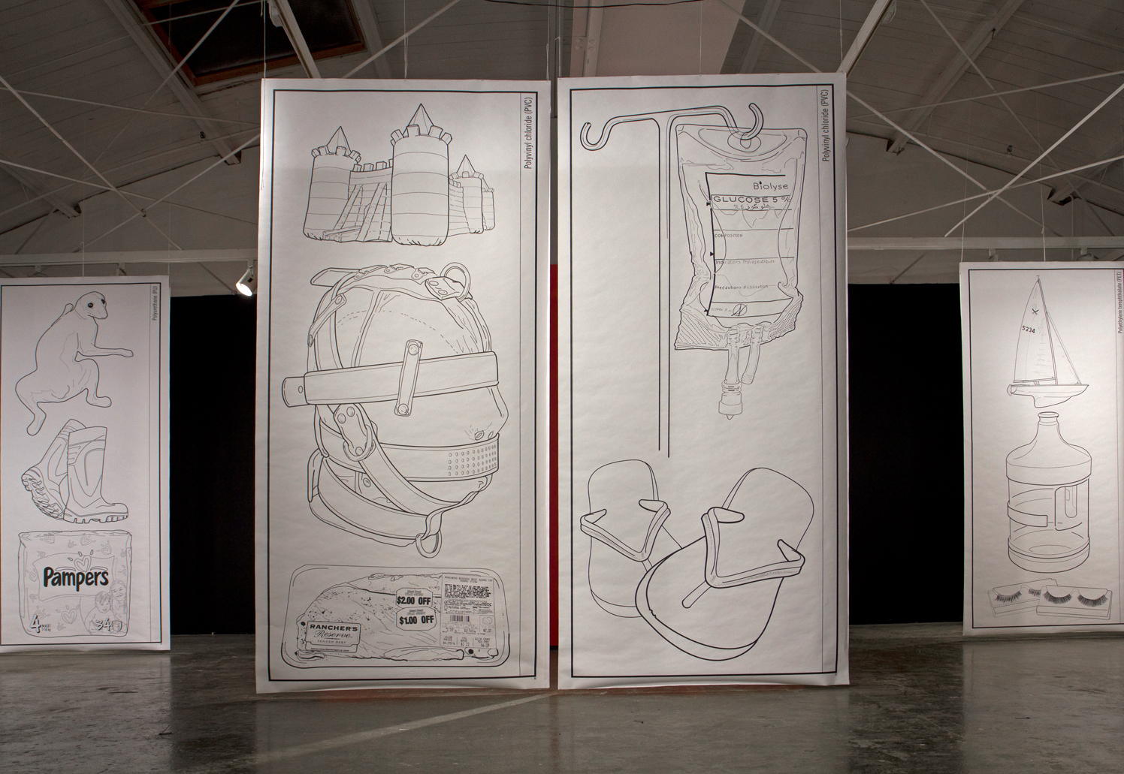
The Petroleum Manga 2012
Notes:
Ask students:
What do you see in these panels?
What's going on in these panels?
What do you see that makes you say that?

Slide 7
“The convenience and the good that plastics provide human lives is indisputable, and the collection does not try to look away from this fact.” –Michael McLane
Notes:
Quote retrieved from: https://tarpaulinsky.com/2016/02/marina-zurkow-2/
Have a student read aloud the quote.
“The convenience and the good that plastics provide human lives is indisputable, and the collection does not try to look away from this fact.” –Michael McLane
Ask:
What do you think this reviewer of Marina Zurkow’s collection is suggesting?

Slide 8
The Petroleum Manga 2012
Notes:
Rad the following explanation of the collection to students:
The Petroleum Manga (2012) is a collection of works that emulate the simplified Japanese drawing style called manga. Rather than taking inspiration from contemporary comics, Zurkow calls on the works of Hokusai, a Japanese artist best known for his woodblock print, The Great Wave Off Kanagawa. Zurkow takes the usually miniature format of the drawings and super-sizes them, creating grids reminiscent of manufacturing diagrams. The pictured objects are all manufactured from petroleum and arranged according to chemical composition. Viewers are encouraged to reflect on these objects and their use by humans. NeoGeo I-IV (2012), part of the Necrocracy series, are meant to represent the process of oil drilling. Using a common video program called QuickTime, Zurkow collaborates with Dan Shiffman to create a seemingly infinite process emulating the circumstances of drilling. The videos are programmed according to rules and specific particles behave according to real world fixtures: "cap rock" builds up over time, which is eventually pierced to gush oil. Through this continuing drilling, the audience witness the fluidity and change of the earth, and how it's shaped over unfathomable stretches of time. Jellyfish are common within Zurkow's works. This animal becomes a favored signal because of its adaptability to theoretical future oceans. As oceans warm and become more acidified, jellyfish become some of the only creatures able to thrive. They overtake the niches of other animals unable to tolerate these changes. Jellyfish Sorbet is a response to this and a method to deal with overpopulated jellyfish. Eating invasive and out of control species is a practical response that helps reduce numbers. Zurkow has previously prepared food with jellyfish in other works, like Not an Artichoke, Nor from Jerusalem (2012).

Slide 9
“It is the place where the desire and the love of an individual comes most into conflict with the ability of petrochemicals to save a single life, at the potential cost of many more. At that moment, environmental social justice, global warming, and binaries fall apart…” –Michael McLane
Notes:
Quote retrieved from: https://tarpaulinsky.com/2016/02/marina-zurkow-2/
Have a student read aloud the quote.
“It is the place where the desire and the love of an individual comes most into conflict with the ability of petrochemicals to save a single life, at the potential cost of many more. At that moment, environmental social justice, global warming, and binaries fall apart…” –Michael McLane
Ask students:
Are petrochemicals bad?

Slide 10
Activity: Petrochemicals
PET
PVC
HDPE
PMMA
Polystyrene
Polyurethane
Ammonia
Nylon
Paraffin
What is it?
How is this chemical used?
What products contain this chemical?
What makes this chemical harmful to the environment and/or toxic to humans and animals?
Notes:
Have each student choose one petrochemical highlighted in Marina Zurkow’s work: PET, PVC, HDPE, PMMA, polystyrene, polyurethane, ammonia, nylon, and paraffin.
Have students spend the rest of class researching this petrochemical:
What is it?
How is this chemical used?
What products contain this chemical?
What makes this chemical harmful to the environment and/or toxic to humans and animals?
Have each student create a powerpoint slide to share his/her findings with the class.

