Slide 1
Marina Zurkow’s
The Petroleum Manga and the Work of
Katsushika Hokusai

Slide 2
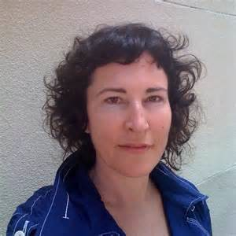
Marina Zurkow
Visual artist
  Media technology
  Animation
  Video
Researches “Wicked Problems”
  Individual narratives
  Environmental concerns
  Relationship between humans, animals, plants and weather
Notes:
Information retrieved from: https://en.wikipedia.org/wiki/Marina_Zurkow & http://o-matic.com/about/about.html
Zurkow is a media artist focused on near-impossible nature and culture intersections, researching “wicked problems” like invasive species, superfund sites, and petroleum interdependence. She has used life science, bio materials, animation, dinners and software technologies to foster intimate connections between people and non-human agents. Her work spans gallery installations and unconventional public participatory projects. Currently, she is working on connecting toxic urban waterways to oceans, and researching the tensions between maritime ecology and the ocean’s primary human use as a capitalist Pangea. Recent solo shows include Chronus Art Center, Shanghai, bitforms gallery, NY, Montclair Museum of Art, and Diverseworks, Houston, and exhibitions at Sundance New Frontiers, FACT, Liverpool, SFMOMA, Walker Art Center, Smithsonian American Art Museum, Museum of Fine Arts, Houston, Wave Hill, NY, and the National Museum for Women in the Arts. She has collaborated with Social Science and Humanities scholars at Rice University, New York University, and the University of Minnesota. Zurkow is a 2011 Guggenheim Fellow, and received grants from NYFA, NYSCA, the Rockefeller Foundation, and Creative Capital. She is a full time faculty member at ITP / Tisch School of the Arts, New York University, and is represented by bitforms gallery.
Image:http://movies.pics/biography/zurkow,_marina

Slide 3
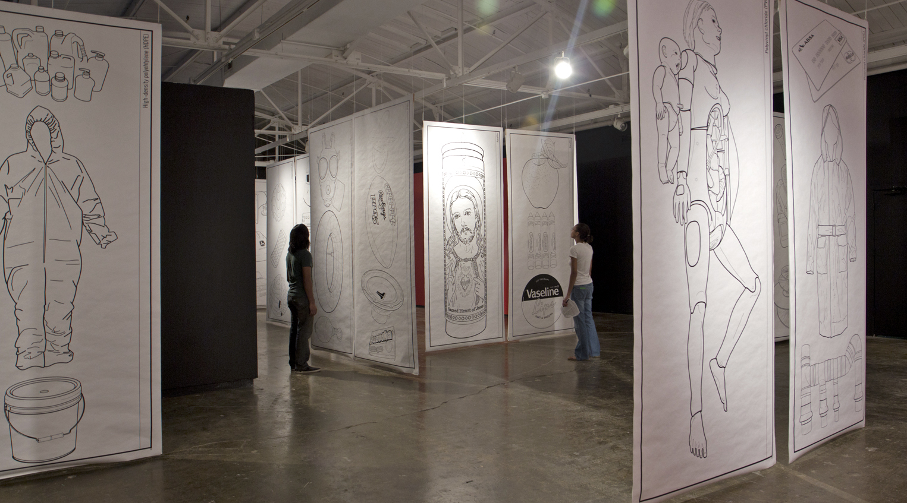
The Petroleum Manga 2012
Notes:
Introduce the artist’s work by sharing the name of her 2012 collection. The Petroleum Manga (2012), 50 banners, Solvent ink on Tyvek, 10 ‘ x 54”

Slide 4
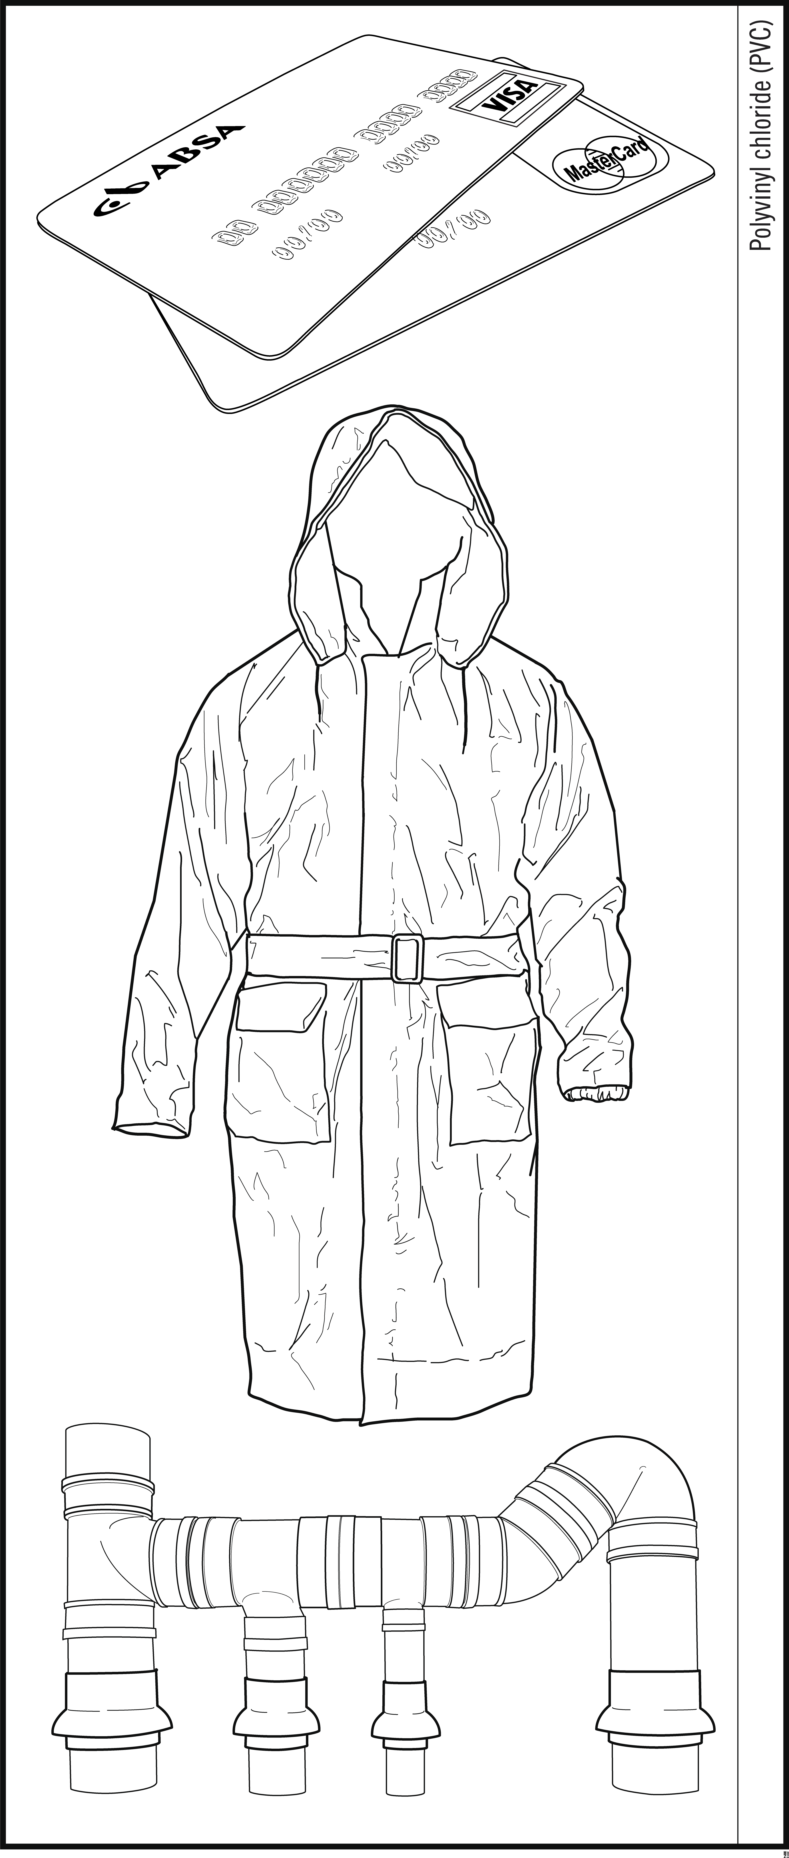
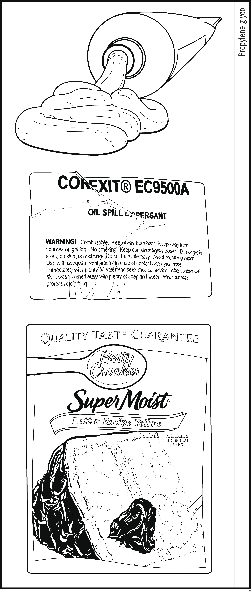
Propylene glycol
Polyvinyl chloride PVC
Notes:
Banners from The Petroleum Manga.

Slide 5
The Petroleum Manga (2012) is a collection of works that emulate the simplified Japanese drawing style called manga. Rather than taking inspiration from contemporary comics, Zurkow calls on the works of Hokusai, a Japanese artist best known for his woodblock print, The Great Wave Off Kanagawa.
Zurkow takes the usually miniature format of the drawings and super-sizes them, creating grids reminiscent of manufacturing diagrams. The pictured objects are all manufactured from petroleum and arranged according to chemical composition. Viewers are encouraged to reflect on these objects and their use by humans.

Slide 6
Katsushika Hokusai (1760-1849)
The Great Wave Off Kanagawa, ca 1830-31
Woodblock print; ink and color on paper
Notes:
Japanese artist Hokusai’s most famous work is The Great Wave Off Kanagawa, one of many ukiyo-e style woodblock prints he created in the 18th and 19th centuries in Japan. Ukiyo-e prints were very popular and depicted images of the “Floating World” of actors, geishas and city life among other themes.
http://www.mfa.org/exhibitions/hokusai

Slide 7
Katsushika Hokusai
Katsushika Hokusai (1760–1849) was a Japanese master artist and printmaker of the ukiyo-e school (“the floating world” that depicted the Tokyo world of geishas, actors, samurai and also of daily life).
Of Hokusai’s thousands of books and prints, his “Thirty-six Views of Mt. Fuji” is particularly notable. Published from about 1826 to 1833, this famous series marked marked a summit in the history of the Japanese landscape print; in grandeur of concept and skill of execution there was little approaching it and nothing to surpass it later. “The Great Wave Off Kanagawa” is the most famous of the series.
The work of Hokusai and other Japanese ukiyo-e artists profoundly influenced French and American artists of the second half of the 19th century, including Toulouse-Lautrec, Utrillo, Mary Cassatt and others. His work continues to be a source of inspiration.
Notes:
https://www.britannica.com/biography/Hokusai

Slide 8
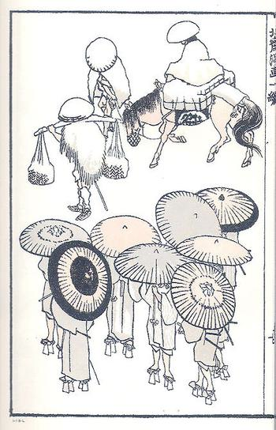
Hokusai also created the Hokusai Manga, a multi-volume compilation of whimsical sketches that depict a very wide range of topics from everyday life. First published in Tokyo (then called Edo) in 1814, it was an immediate success due to the vitality of the sketches and the humor and variety that it offered. They were reproduced as woodblock prints.
Page from Hokusai’s Manga
Notes:
Hokusai also created the Hokusai Manga, a multi-volume compilation of whimsical sketches that depict a very wide range of topics from everyday life. First published in Tokyo (then called Edo) in 1814, it was an immediate success due to the vitality of the sketches and the humor and variety that it offered. They were reproduced as woodblock prints.
Image: http://landn-stem-academy-art.wikispaces.com/16.+katsushika+hokusai+(1760-1849)

Slide 9
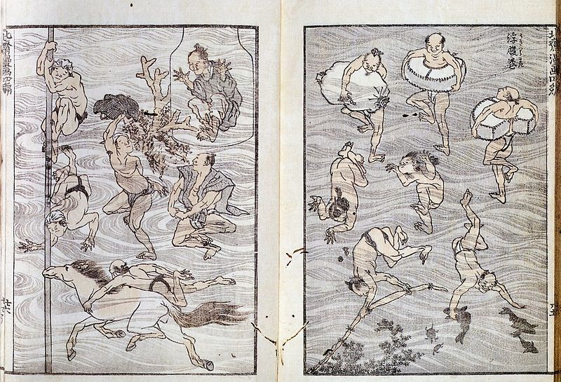
Notes:
Hokusai also created the Hokusai Manga, a multi-volume compilation of whimsical sketches that depict a very wide range of topics from everyday life. First published in Tokyo (then called Edo) in 1814, it was an immediate success due to the vitality of the sketches and the humor and variety that it offered. They were reproduced as woodblock prints.

Slide 10
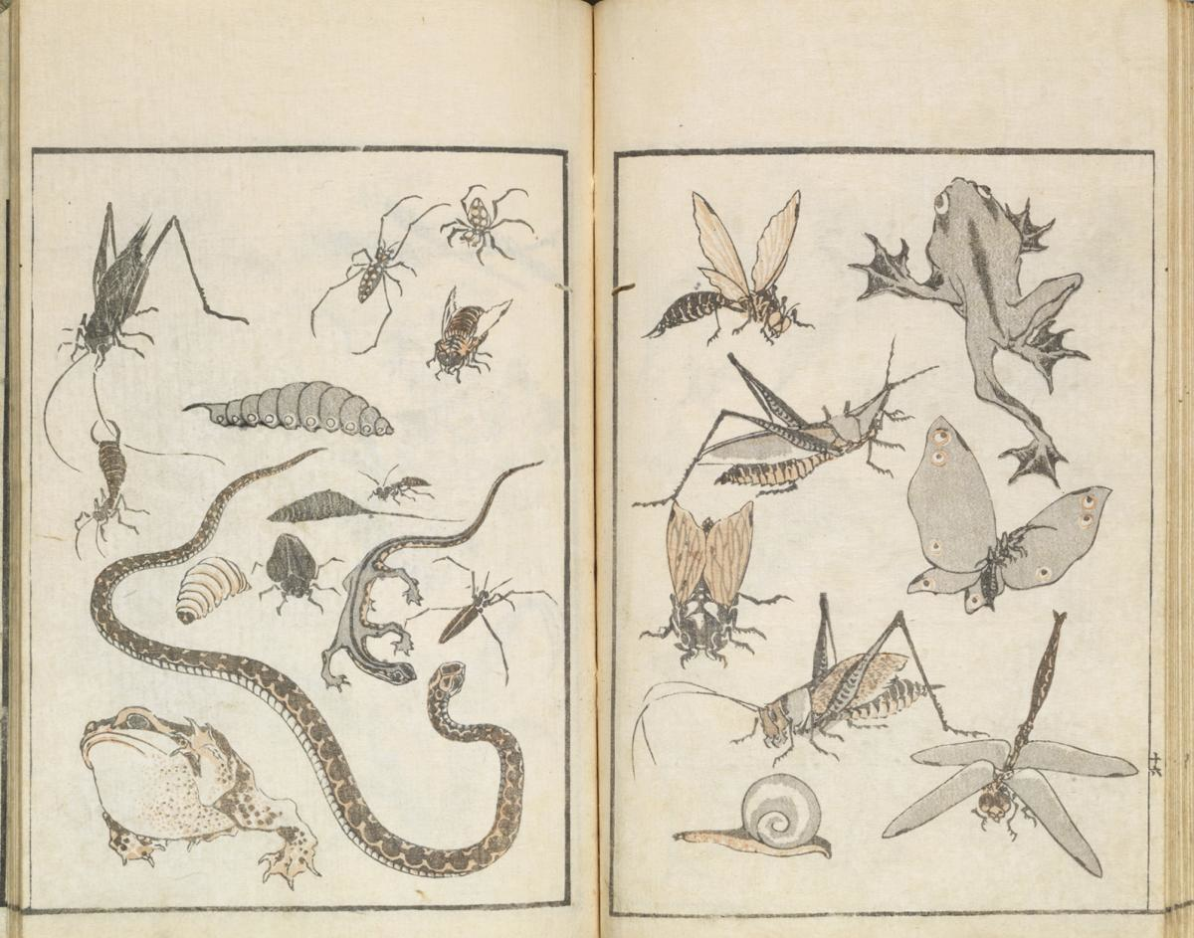
Notes:
The drawing style of the Hokusai Manga was very simple and clear, an outline with some coloring added
Also note the manner in which animals, people and things are grouped together by theme, for example, people swimming as in the prior slide, or small insects, frogs and other animals in this one.

Slide 11
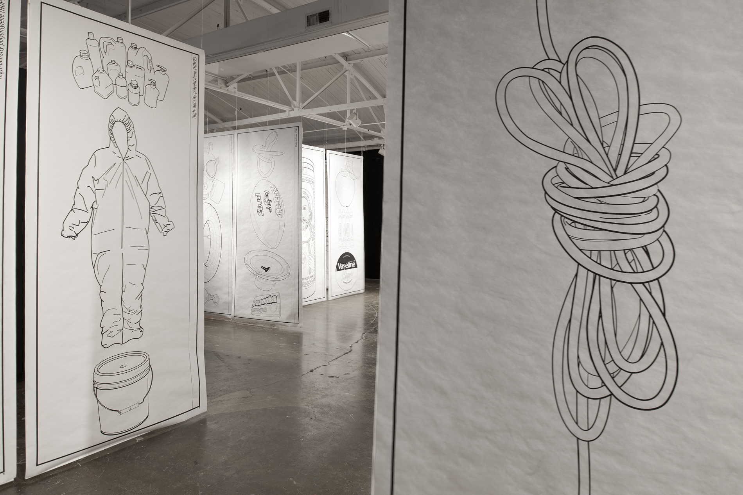
Notes:
In what ways has Marina Zurkow adapted aspects of the Hokusai Manga for her Petroleum Manga?

Slide 12
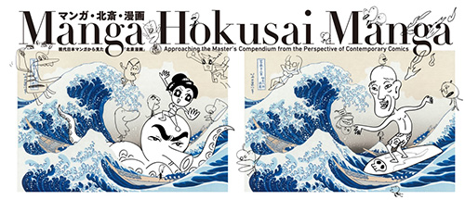
Shiriagari Kotobuki 2015 © Adachi Institute of Woodcut Prints
Notes:
Here is another example of another contemporary artist adapting Hokusai’s work. Discuss the use of the image in this context and in Zurkow’s work.
Image: Manga Hokusai Manga: Approaching the Master’s Compendium from the Perspective of Contemporary Comics
By introducing some of the similarities and differences between modern Japanese manga, which now enjoy worldwide popularity, and Hokusai Manga, a collection of sketches by the ukiyo-e artist Katsushika Hokusai (1760-1849), this exhibition sets out to introduce the charms of this unique field of Japanese culture. Focusing on pictorial storytelling and participatory culture of “manga” from different periods, the exhibits include panels, books, videos, and a group of new works by contemporary manga artists.
https://www.jpf.go.jp/e/project/culture/exhibit/traveling/manga_hokusai.html

Slide 13
To appropriate is to take possession of something. Appropriation artists deliberately copy images to take possession of them in their art. They are not stealing or plagiarizing. They are not passing off these images as their very own. Not at all. Appropriation artists want the viewer to recognize the images they copy, and they hope that the viewer will bring all of his/her original associations with the image to the artist's new context, be it a painting, a sculpture, a collage, a combine or an entire installation.
The deliberate "borrowing" of an image for this new context is called "recontextualization." Recontextualization helps the artist comment on the image's original meaning and the viewer's association with the original image or the real thing.
Notes:
http://arthistory.about.com/od/glossary_a/a/a_appropriation.htm

Slide 14
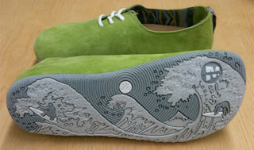
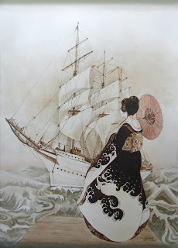
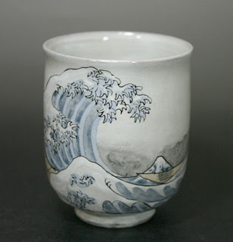
Notes:
Images: http://lidiaalinaartstuff.blogspot.com/2012/05/great-wave-of-kanagawa-hokusai.html

