Slide 1
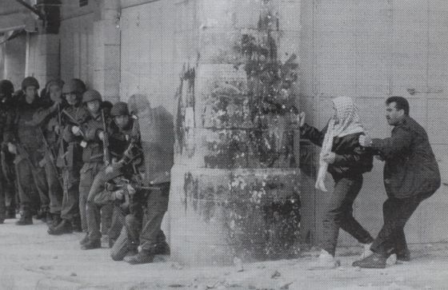
Notes:
Title: The Archive (1985) by Miki Kratsman.
Source: https://elpais.com/cultura/2012/06/04/actualidad/1338826879_576880.html

Slide 2
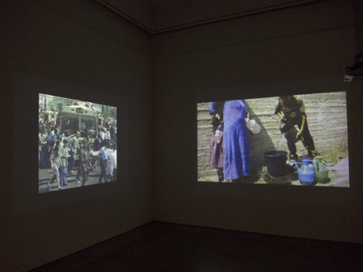
The Archive (1985-2012)
"Photography as an isolated object did not interest me for a long time, that's why I wanted to create a graphic file with all my works to publish them as a whole. The problem was how to show it, how to give a sense to 4,000 images.”
Notes:
Quote source: Fernández-Santos, E. (2012). Anxiety, photo by photo. El País. Retrieved from: https://elpais.com/cultura/2012/06/04/actualidad/1338826879_576880.html
Image source: http://www.chelouchegallery.com/newsItem.php?id=510
Ask: Why do you think it was important for Kratsman to share all 4,000 images rather than a selection from his collection?

Slide 3
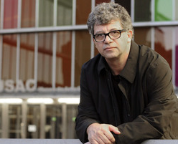
Miki Kratsman
An Introduction
Notes:
Image source: http://www.nenjp.org/calendar/2016/5/3/talk-booksigning-the-israeli-palestinian-conflict-work-in-progress-cambridge-ma

Slide 4
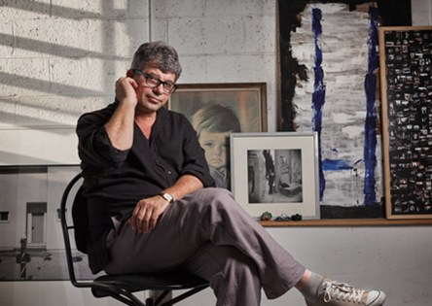
Brief Biography
born to a Jewish family in Buenos Aires, Argentina in 1959
moved to Israel in 1971 at the age of 12
began attending political demonstrations at the age of 16
served in the Israeli military
studied photography in college
worked as a photojournalist
known for his work documenting Palestinian life
Notes:
By פרס א.מ.ת (אתר פרס א.מ.תSource: CC BY-SA 3.0 (https://creativecommons.org/licenses/by-sa/3.0), via Wikimedia Commons

Slide 5
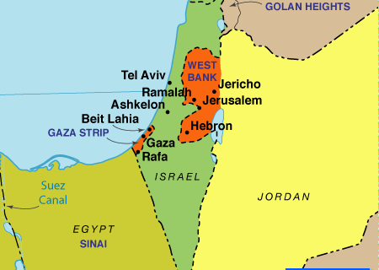
Occupied Territories
The Golan Heights
The West Bank
East Jerusalem
The Gaza Strip
Notes:
Map source: http://www.pbs.org/frontlineworld/stories/palestine503/additional.html
Explain that the vast majority of Kratsman’s work is done in the area known as the Occupied Territories.
Both Jews and Arabs consider the land between the Jordan River and the Mediterranean and Egypt to the south as part of their holy homeland. The area has seen mass migrations of people and decades of violent conflict.
In 1967, as Arab threats against Israel mounted, Israel launched a preemptive war against its Arab neighbors. In what is known as the Six-Day War, Israel took control of the Gaza Strip, the Sinai Peninsula, the West Bank, the Golan Heights and East Jerusalem.

Slide 6
Selected works

Slide 7
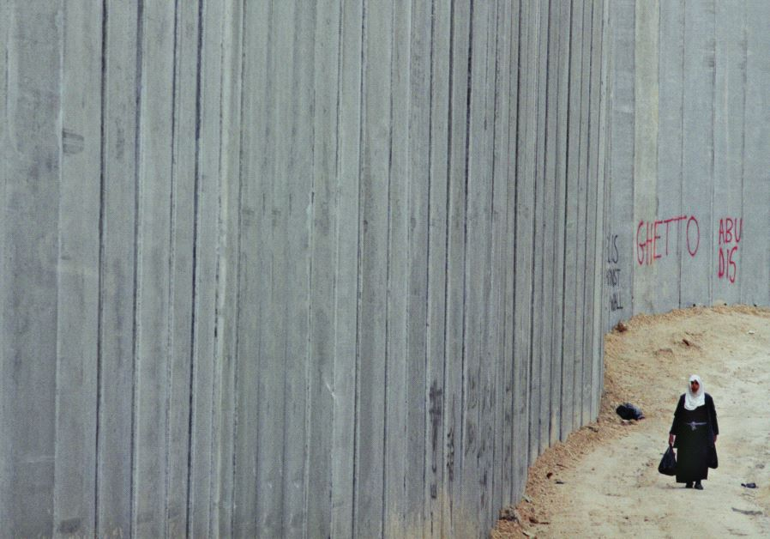
Abu Dis 2003
Kratsman has said:
“The catastrophe is the daily life for Palestinians, not a specific event.”
How does this image reflect his sentiment?
Notes:
Miki Kratsman’s photo ‘Abu Dis 2003’ shows a Palestinian woman walking along the separation barrier in east Jerusalem.
Source: https://www.jpost.com/Jerusalem-Report/Out-of-focus-497696
Kratsman has said: “The catastrophe is the daily life for Palestinians, not a specific event.”
Background: the Israeli West Bank Barrier is a wall that separates the West Bank and East Jerusalem. Construction began in 2002. The concrete wall is defended by Israel as a necessary measure against terrorism. Palestinians consider it a form of apartheid and charge that it is a racist, discriminatory practice.

Slide 8
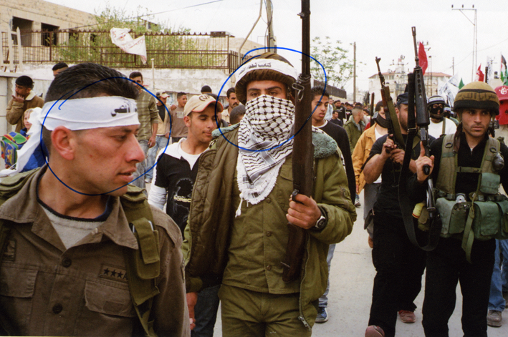
People I Met (2011 - )
Why do you think the faces of these individuals are circled?
Notes:
Source: http://mondoweiss.net/2016/04/an-israeli-journalist-asks-what-happened-to-the-people-in-the-photographs/
In this photo, the faces of the deceased are circled in Kratsman's images from Jenin refugee camp in 2007.
In 2011, Kratsman attended the wedding of a friend’s son at the densely populated the Jenin refugee camp. Kratsman brought with him 200 photographs taken throughout the West Bank and Gaza during a decades-long career as a photojournalist with Hadeshot and Ha’aretz. Kratsman explained that he wanted to identify people in his images.
As the Palestinians pored over the images taken during a 2007 parade of militia, Kratsman handed out pens and they circled the faces of those they knew were dead.

Slide 9
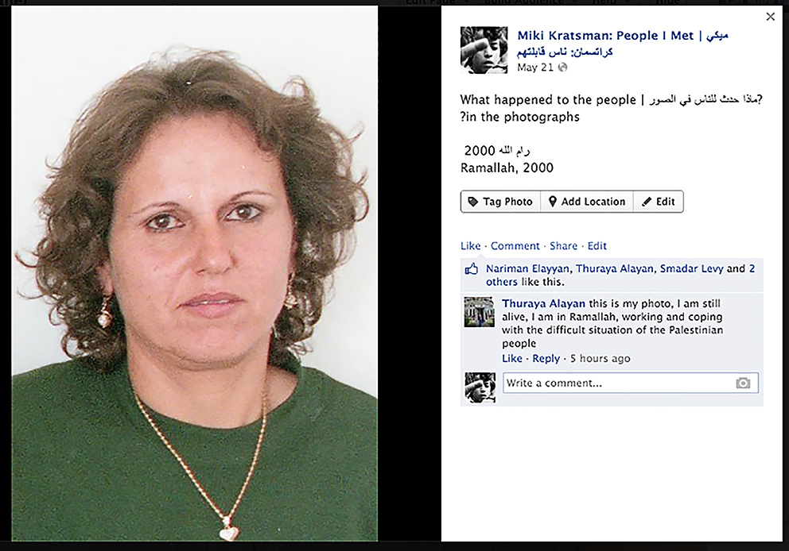
People I Met (2011 - )
Notes:
Source: http://mondoweiss.net/2016/04/an-israeli-journalist-asks-what-happened-to-the-people-in-the-photographs/
Returning home with 20 people identified and keen to locate more Palestinians in his archive of thousands of images, Kratsman’s wife suggested the potential Facebook had to help in his quest. Since 2011, Kratsman has uploaded thousands of images of Palestinians he has met and photographed. The Facebook page he maintains (https://www.facebook.com/kratsman.people.i.met/?fref=ts) includes approximately 2,000 photos, comments, and information about the whereabouts of the people in the portraits. The FaceBook page has over 9,000 followers.

Slide 10
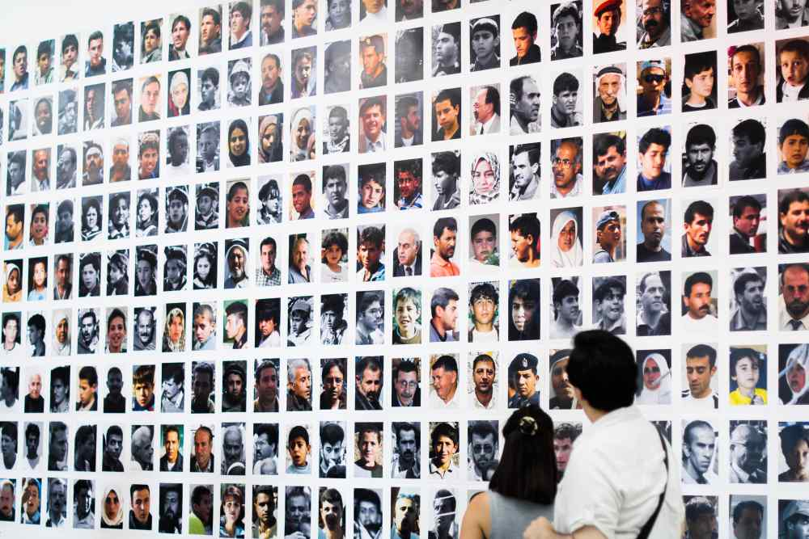
People I Met (2011 - )
Notes:
Source: http://artis.art/grantees/miki-kratsman-people-i-met/
In art galleries and museums, the many images are cropped to only show the faces of individuals.

Slide 11
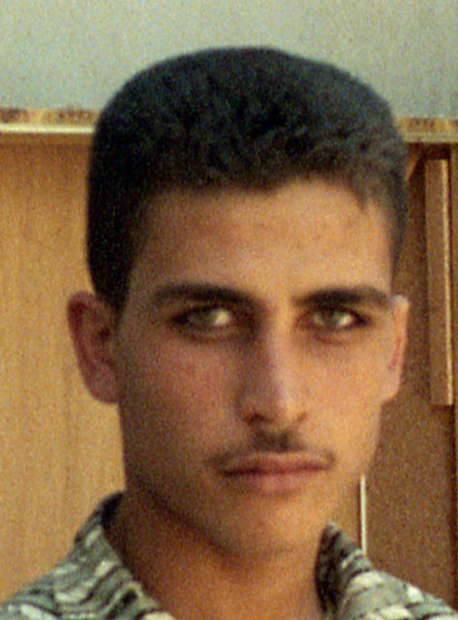
Kratsman (2018)
Miki Kratsman:
  “I don’t take photos of people, I give photos. The meaning of the photo is the most important thing.”
  Question: How does Kratsman’s People I Met embody this belief?
Notes:
Image source: https://www.artsy.net/artwork/miki-kratsman-gaza-2001-from-people-i-met-project-as-part-of-robert-gardner-fellow

Slide 12
The Bedouin Visual Archive (2015-2016)
Notes:
Source: http://www.chelouchegallery.com/artistWorks.php?id=49
The Bedouin Visual Archive Project is aiming to use narrative and visual literacy to raise awareness to the rights violations of the Bedouin and give voice to their silenced histories and claims on the land. The Archive is an ambitious step in the Negev Coexistence Forum (NCF) Human Rights Campaign. The archive platform will be trilingual and one of a kind in terms of its contribution to activism, research, the art world and policymaking. The aim is to produce a comprehensive and user-friendly database of photographs, maps and stories that make public a history of the region that respects the experience of its Bedouin inhabitants. The Bedouin communities living in the Negev-Naqab today have a long and complex relationship with the region. They are formally Israeli citizens and many are a part of the broader Palestinian Arab minority who stayed within Green Line Israel after the establishment of the state in 1948. It is important to note, however, that although Palestinians and Bedouins share an ancestry, not all Bedouins consider themselves Palestinians. There are roughly 240,000 Bedouins living in the Naqab-Negev region of what is today southern Israel; 60% of Naqab-Negev Bedouin live in six state-designed towns and one city, while the rest live in 11 recognized villages and 35 unrecognized villages. The communities living in the unrecognized villages are resisting this state-sponsored policy of house demolition, forced relocation and land expropriation.

Slide 13
The Bedouin Visual Archive (2015-2016)
Notes:
Source: http://artis.art/grantees/miki-kratsman-people-i-met/

Slide 14
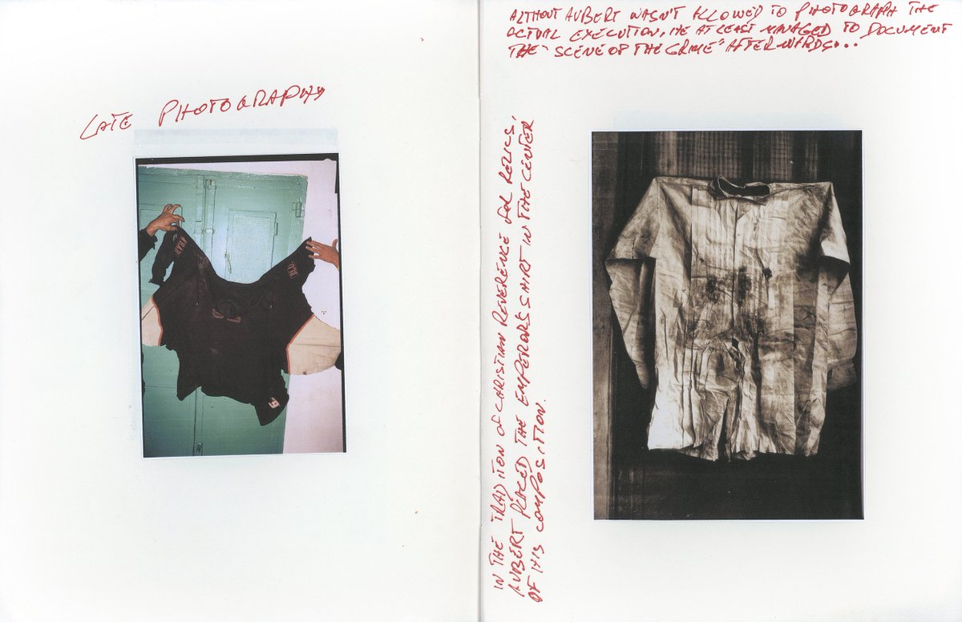
Diptych from The Resolution of the Suspect (2016)
Notes:
Source: https://mavcor.yale.edu/mavcor-journal/miki-kratsman-diptych-from-the-resolution-of-the-suspect .
Diptych: a two-part art work; can be painting, photography, drawing, etc.
In this work, Kratsman takes inspiration from Francois Aubert's photograph of the shirt of Maximilian, ruler of Mexico, just after his execution in 1867 (right-hand side); on the left-hand side is the last piece of clothing worn by an unnamed Palestinian before he was killed.

Slide 15
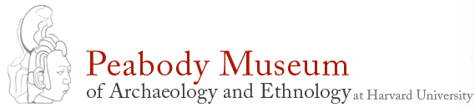
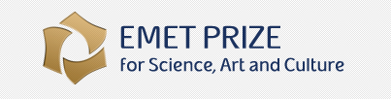
Awards
Gardner Fellowship in Photography , Peabody Museum of Archaeology & Ethnology, Harvard University (2011)
Emet Prize for Science, Art, and Culture (2011)
Notes:
For his work, Kratsman has received two prestigious awards.
Source: https://www.peabody.harvard.edu/Gardner%20fellowship
Named after documentary filmmaker Robert Gardner, the Robert Gardner Fellowship in Photography funds an “established practitioner of the photographic arts to create and subsequently publish through the Peabody Museum a major book of photographs on the human condition anywhere in the world.”
Source: http://en.emetprize.org/
The Emet Prize for Art, Science and Culture is awarded annually for excellence in academic and professional achievements that have far-reaching influence and make a significant contribution to society. According to Alberto Moscona Nissim: “The intention of the A.M.N. Foundation, through the award of the EMET Prizes, is to acknowledge those who view excellence as a way of life and the fulfillment of human potential as essential to creating a better world for future generations..”

Slide 16

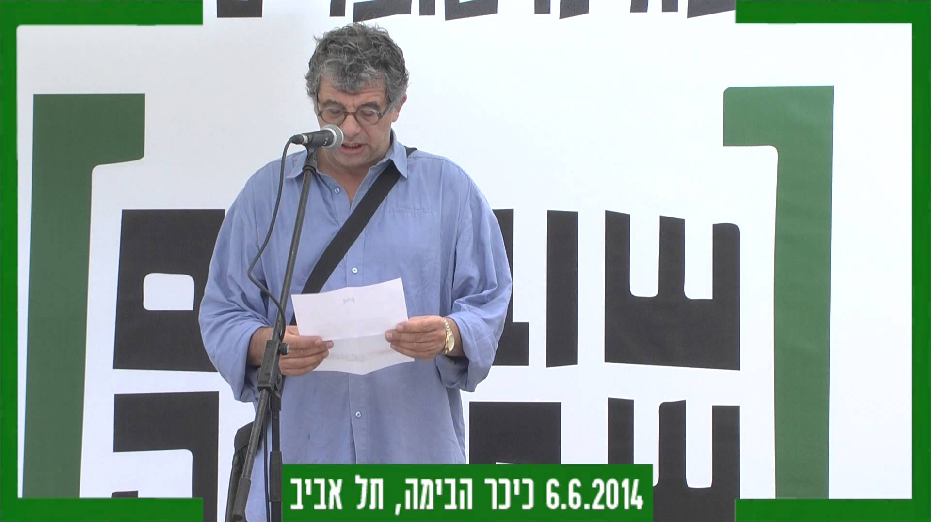
Controversy: Breaking the Silence
Breaking the Silence is a nonprofit organization made up of Israeli military veterans opposed to the occupied territories
Kratsman is the chairman of Breaking the Silence
Notes:
Source: http://www.breakingthesilence.org.il/about/organization
Kratsman is the chairman of Breaking the Silence, a nonprofit organization made up of Israeli military veterans opposed to the occupied territories.
Ask students: ”Why do you think an Israeli Jew is speaking out against the Israeli government?” Probe further by asking: “Why might this be considered controversial?”

Slide 17
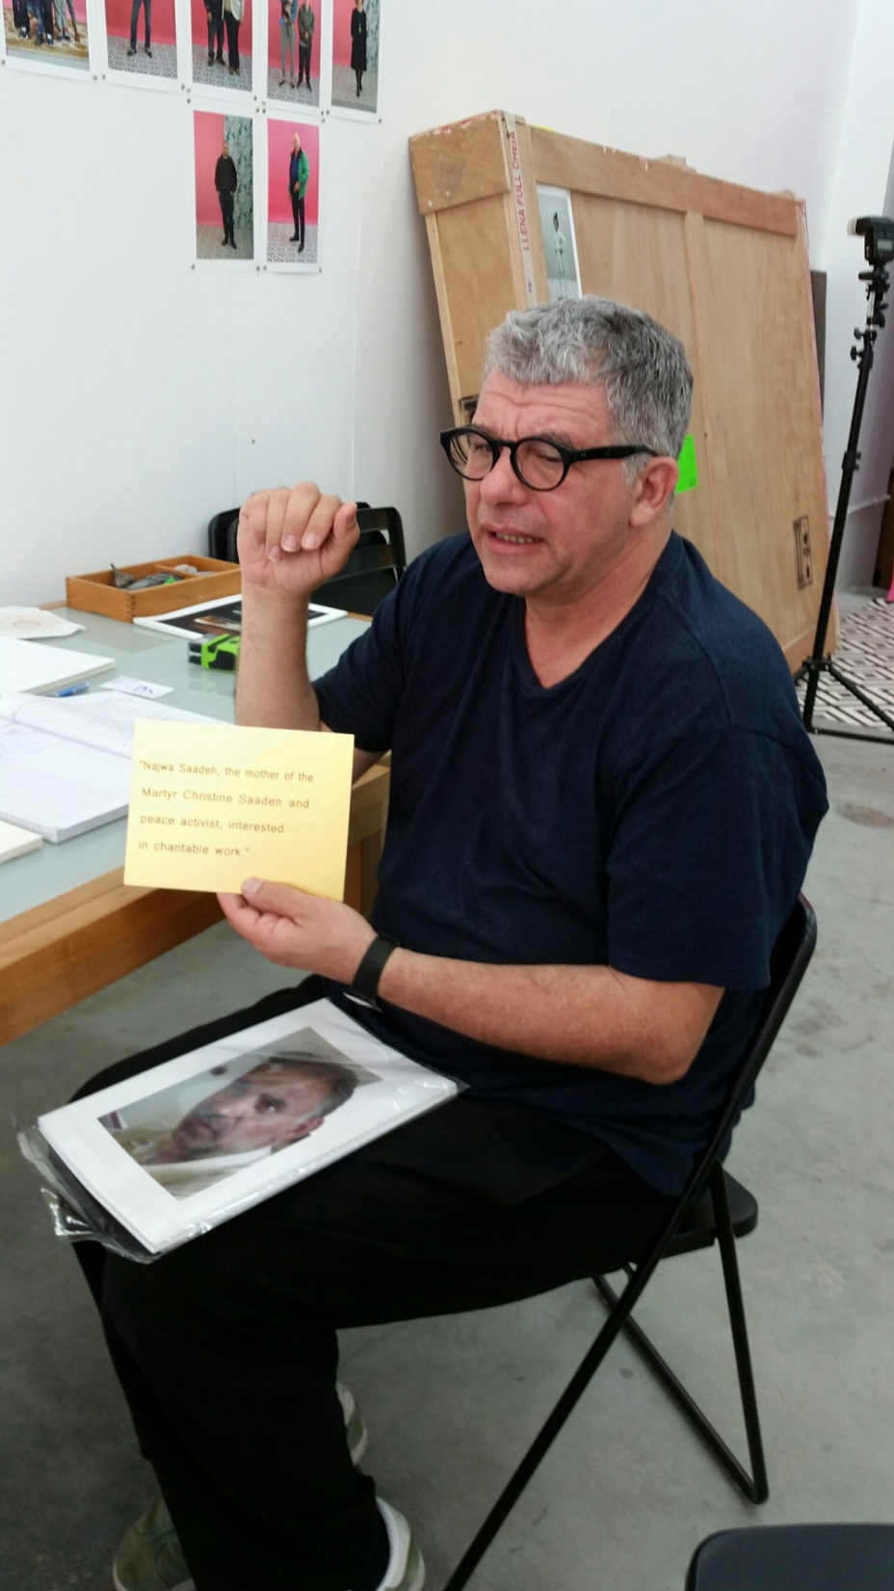
Divided Loyalties
Despite Kratsman’s activism on behalf of Palestinians, he is deeply loyal to Israel.
He says: “I would prefer to boycott only the settlements and not boycott all of the country. I cannot boycott myself. I wake up every morning. The problem is that I am an optimist. I can’t live in any other place.”
Notes:
Have a volunteer to read the quote by Kratsman. If necessary, define the term “boycott.”
Ask students to offer a possible explanation of Kratsman’s divided loyalties.
Background info on Israeli settlements: https://www.npr.org/sections/parallels/2016/12/29/507377617/seven-things-to-know-about-israeli-settlements

