Slide 1
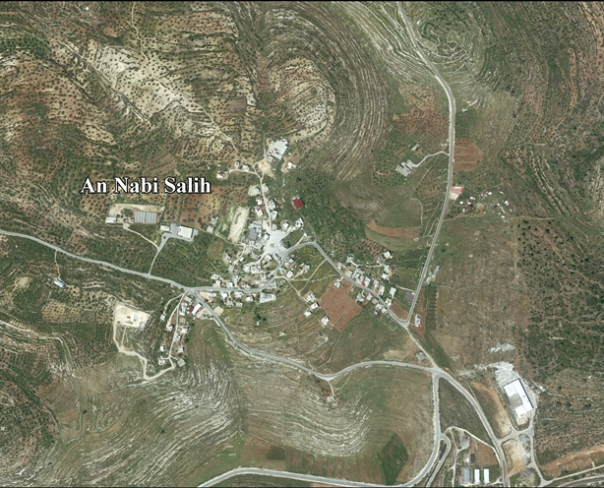
70 Meters…White T-shirt by: Miki Kratsman
Notes:
To access the video: “70 Meters…White T-shirt” (8 minutes 42 seconds) --- https://vimeo.com/232083644; password: miki70.

Slide 2
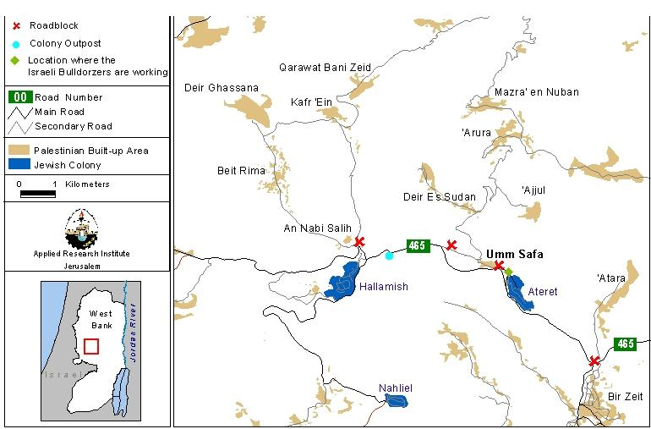
Nabi Salih
(map of region)
Notes:
Teacher Notes:
The West Bank: Israel gained the West Bank after a successful pre-emptive war against Egypt, Jordan, and Syria. The Six Day War took place from 5-10 June 1967. As a result, Israel became the governing authority of approximately 600,000 Arabs, mostly Palestinians.
Nabi Salih (also spelled Nabi Saleh): A Palestinian Village in central West Bank. Palestinians in Nabi Saleh village have held protests since 2009. Villagers oppose the Israeli government’s confiscation of a large portion of village land for the establishment and expansion of the Israeli settlement of Halamish and the seizure of the village’s natural spring, which has historically been its only water source.
Halamish (also spelled Hallamish): An Israeli settlement established in 1977.
Israel claims the West Bank area as disputed territory, while organizations such as the United Nations and Amnesty International have declared it occupied territory.

Slide 3
Contextualization
Miki Kratsman visited Friday demonstrations in the Palestinian village of Nabi Salih from 2015-2016
Palestinians protest the Halamish settlement
Israeli Defense Forces (IDF) are sent to disperse protestors
Notes:
Teacher will explain Miki Kratsman visited the Palestinian protests from 2015-2016 and created a video to capture the reality of the protests. The video comprises a year’s worth of protests and shootings in a Palestinian village, condensed into 8 minutes and 42 seconds. Young people were especially present at the events, which occurred approximately once per week. Miki Kratsman edited the work based on sound; that is, every time a shot is heard, he made an editorial cut. The work features approximately 1,000 shots that can be heard. The title of Kratsman’s work comes from the audible words of an Israeli officer as he identifies a sniper being targeted: “[at] 70 meters…white t-shirt.”

Slide 4
References
Maps. (2011, April 12). Retrieved from https://nabisalehsolidarity.wordpress.com/maps/
Paul, J. (n.d.). Land and Settlement Issues. Retrieved from https://www.globalpolicy.org/security-council/index-of-countries-on-the-security-council-agenda/israel-palestine-and-the-occupied-territories/land-and-settlement-issues.html
Sachs, N. (2016, December 28). What’s new and what’s not in the UN resolution on Israeli
settlements. Retrieved from: https://www.brookings.edu/blog/markaz/2016/12/26/whats-new-and-whats-not-in-the-u-n-resolution-on-israeli-settlements
Trueman, C. N. (n.d.). The Six Day War. Retrieved from http://www.citationmachine.net/bibliographies/336528626?new=true

