Slide 1
Photographer of the Yup’ik People
Nalikutaar Jacqueline Cleveland

Slide 2
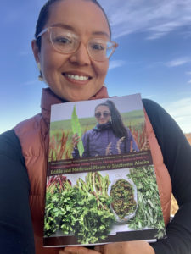
Who is Nalikutaar Jacqueline Cleveland?
Alaskan Native of Yup’ik descent
Lives in the coastal village of Quinhagak, AK
A subsistence forager-fisher-hunter
Filmmaker and photographer
Bachelor’s, Montana State University; Media & Theater Art; Minor in Native American Studies
Notes:
Photo credit: https://alaskarefugefriends.org/tag/native

Slide 3
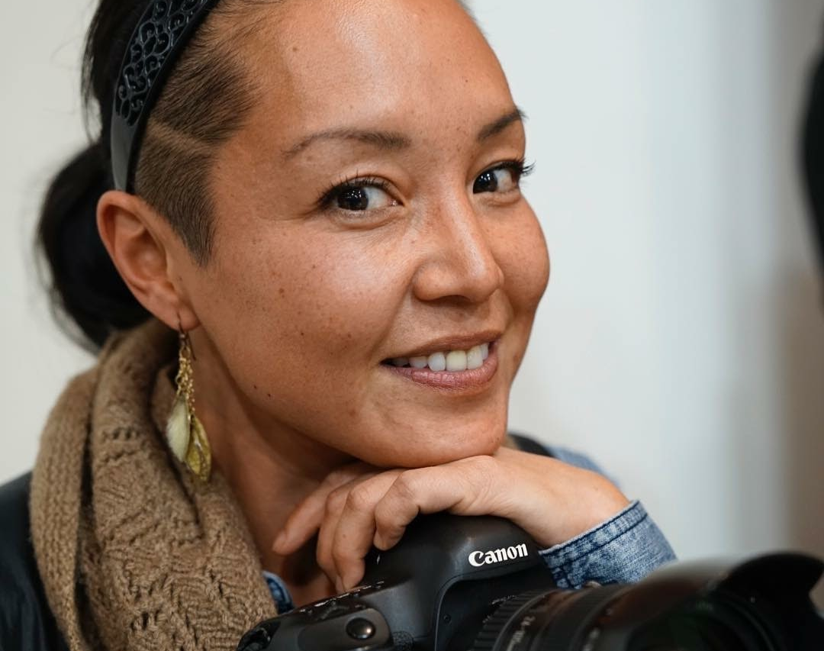
In her own words…
“I’ve been foraging since I can remember.
I grew up with a taste for these plants.
I grew up knowing these plants and collecting them every season.”
Notes:
Photo credit: https://aywaa.org/who-we-are/
Think-Pair-Share:
THINK: Read the quote aloud (pausing to define “foraging” if needed for your students). Ask students to write down any initial thoughts in their student notebooks. What might Nalikutaar Jacqueline Cleveland want to express about her lived experience and culture?
PAIR: Have students pair up and discuss their ideas.
SHARE: Then, in whole class format, have each pair share their thoughts and engage in a class discussion.

Slide 4
Who are the Yup’ik?

Slide 5
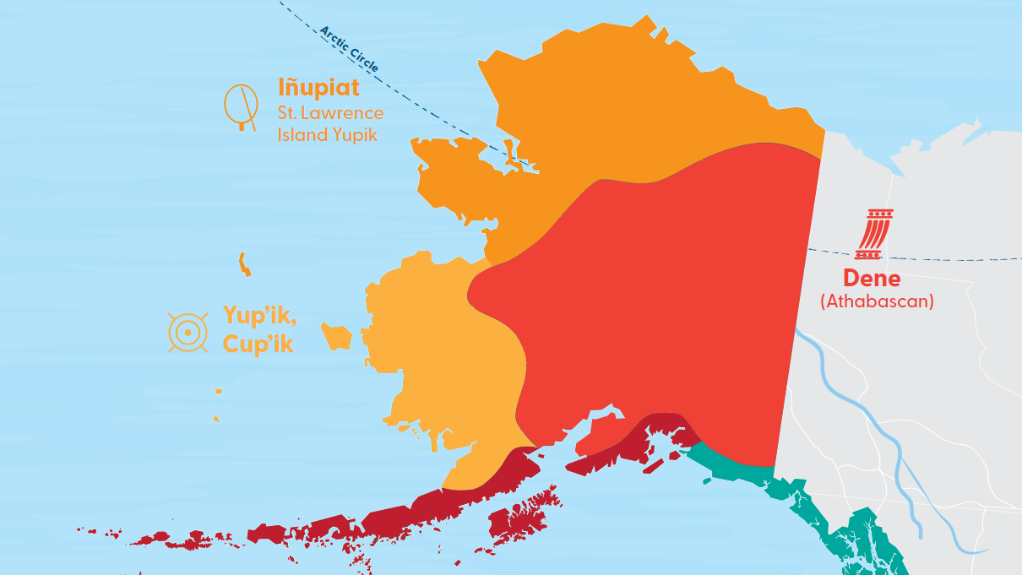
Notes:
Where the Yup’ik live in Alaska.
Map source: https://www.travelalaska.com/Things-To-Do/Alaska-Native-Culture/Cultures/Yupik

Slide 6
Notes:
Video from: https://youtu.be/4hzcV52FtoA?t=383
Starts at 6:22, discussion about land.

Slide 7
Explore more of the Yup’ik Culture and People
https://nunalleq.org/
Notes:
Digital interactive exhibit on the Yup’ik peoples found here: https://nunalleq.org/
Explore this interactive exhibit together on your main screen or allow students time to explore on their own.

Slide 8
Nalikutaar Jacqueline Cleveland: Art and Activism

Slide 9
Her work and service…
Work focuses on honoring the languages and cultures of Alaska Native peoples
Serves on the Kuskokwim River Intertribal Fish Commission, the Yukon-Kuskokwim Regional Advisory Council, and the Central Bering Sea Advisory Council
Co-Chairperson of the Quinhagak Heritage, Inc. which runs the Nunalleq Culture and Archaeology Center
Currently working on a documentary that features the impacts of climate change on the people and community of Quinhagak
Notes:
Image credit:: https://www.facebook.com/photo.php?fbid=286128740470201&set=pb.100072192321803.-2207520000.&type=3
Quote from: https://aywaa.org/who-we-are/
Additional information from AVF:
AVF Project Manager of the Kuinerraq Sustainable Future Project Nalikutaar, Jacqueline Cleveland was born and raised in the AYK region and lives in the Native Village of Quinhagak. In addition to serving on Quinhagak’s Tribal Council, Jacqueline’s seasonal work includes river runs as a Fish and Wildlife Refuge Information Technician in the Togiak National Wildlife Refuge, acting as a liaison between federal agency policy and community-led management. Jacqueline is working to develop community-based monitoring projects that emphasize co-responsibility relationships between the Native Village of Quinhagak, the Alaska Department of Fish and Game, and federal agencies to co-manage tribal, refuge, and state lands and waters that are impacted by the lack of salmon data. She is a subsistence hunter, fisherwoman, and gatherer, and is also a skilled filmmaker and photographer focused on elevating the languages and cultures of Alaska Native peoples.

Slide 10
Recent work…
Book
Yungcautnguuq Nunam Qainga Tamarmi/All the Land's Surface is Medicine: Edible and Medicinal Plants of Southwest Alaska (2021)
Documentary
Ellavut Cimirtuq:
Our World Is Changing
(2023)
Notes:
Share the book and documentary descriptions with the students. Ask them how these works connect to the quotes on the previous slide.
Book description: In this book, close to one hundred men and women from all over southwest Alaska share knowledge of their homeland and the plants that grow there. They speak eloquently about time spent gathering and storing plants and plant material during snow-free months, including gathering greens during spring, picking berries each summer, harvesting tubers from the caches of tundra voles, and gathering a variety of medicinal plants. The book is intended as a guide to the identification and use of edible and medicinal plants in southwest Alaska, but also as an enduring record of what Yup’ik men and women know and value about plants and the roles plants continue to play in Yup’ik lives.
Documentary description: As an archeological team digs to save cultural artifacts from rising sea levels in her coastal village, a Yupik filmmaker explores her tribe’s relationship with its language, subsistence hunti
Book cover from: https://images-na.ssl-images-amazon.com/images/I/71iqpTjJEDL._AC_UL600_SR600,600_.jpg
Documentary poster from: https://trimtab.media/films/#:~:text=Ellavut%20Cimirtuq%3A&text=(Yupik%20%E2%80%93%20Pronounciation%3A%20Shla%2D,and%20cultural%20traditions%20in%20Alaska.

Slide 11
Notes:
Video from: https://vimeo.com/116089834
Clip of artist speaking about a documentary to be made about their land and resources.

Slide 12
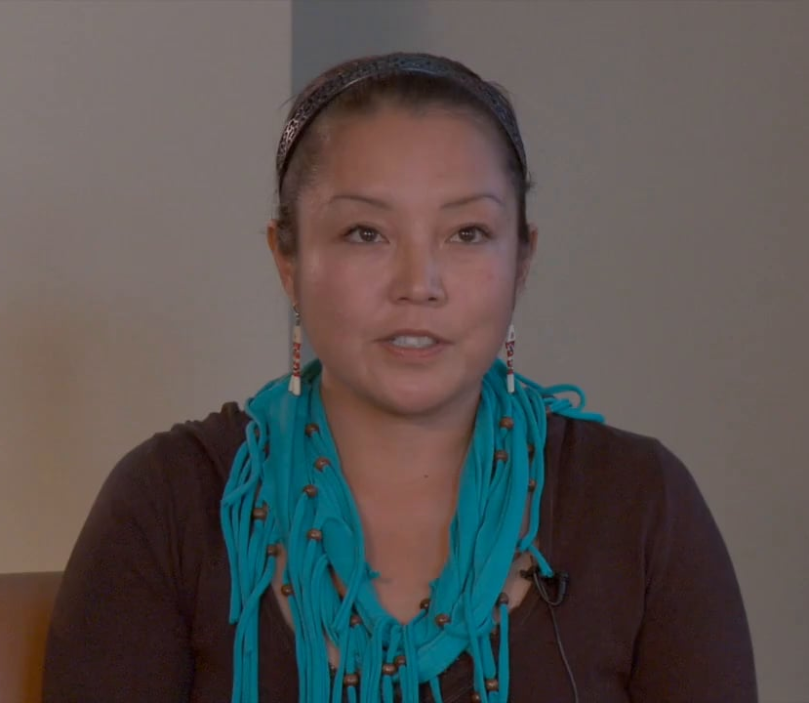
“My audience is the people of the villages I shoot and students of ethnobotany. I identify myself as a subsistence hunter-fisher-gatherer. (That includes foraging, first and foremost.) And next, as a documentary filmmaker and photographer.”
Nalikutaar Jacqueline Cleveland

Slide 13
Create an infographic
Using what you have learned about the Yup’ik people and the work of Nalikutaar Jacqueline Cleveland, create an infographic that:
teaches others about these native peoples, and
why their land is so important to them.

Slide 14
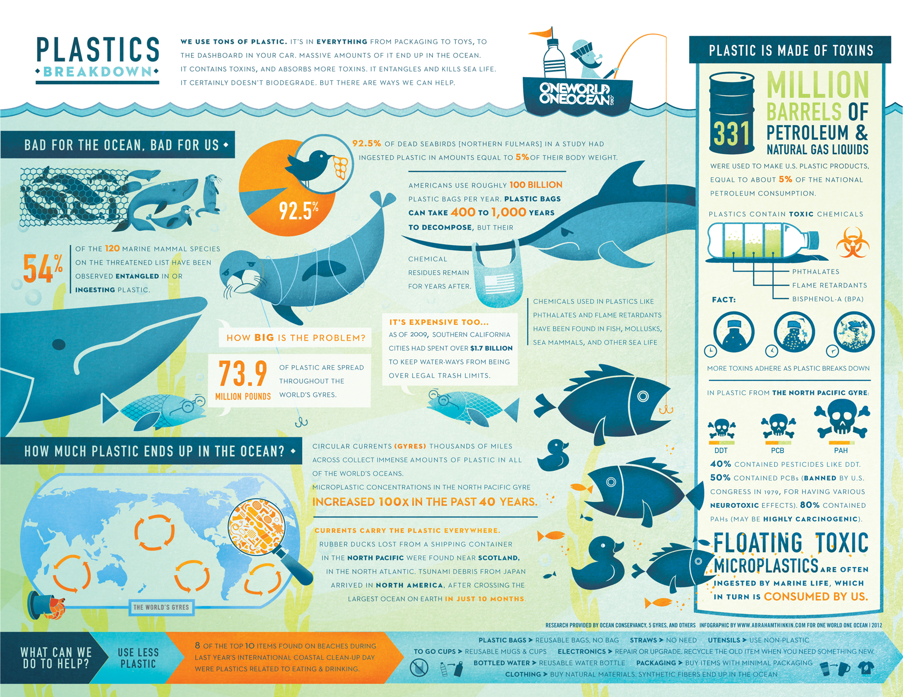
Example 1
Notes:
Infographic 1 from: https://oneworldoneocean.com/blog/the-plastics-breakdown-an-infographic/

Slide 15
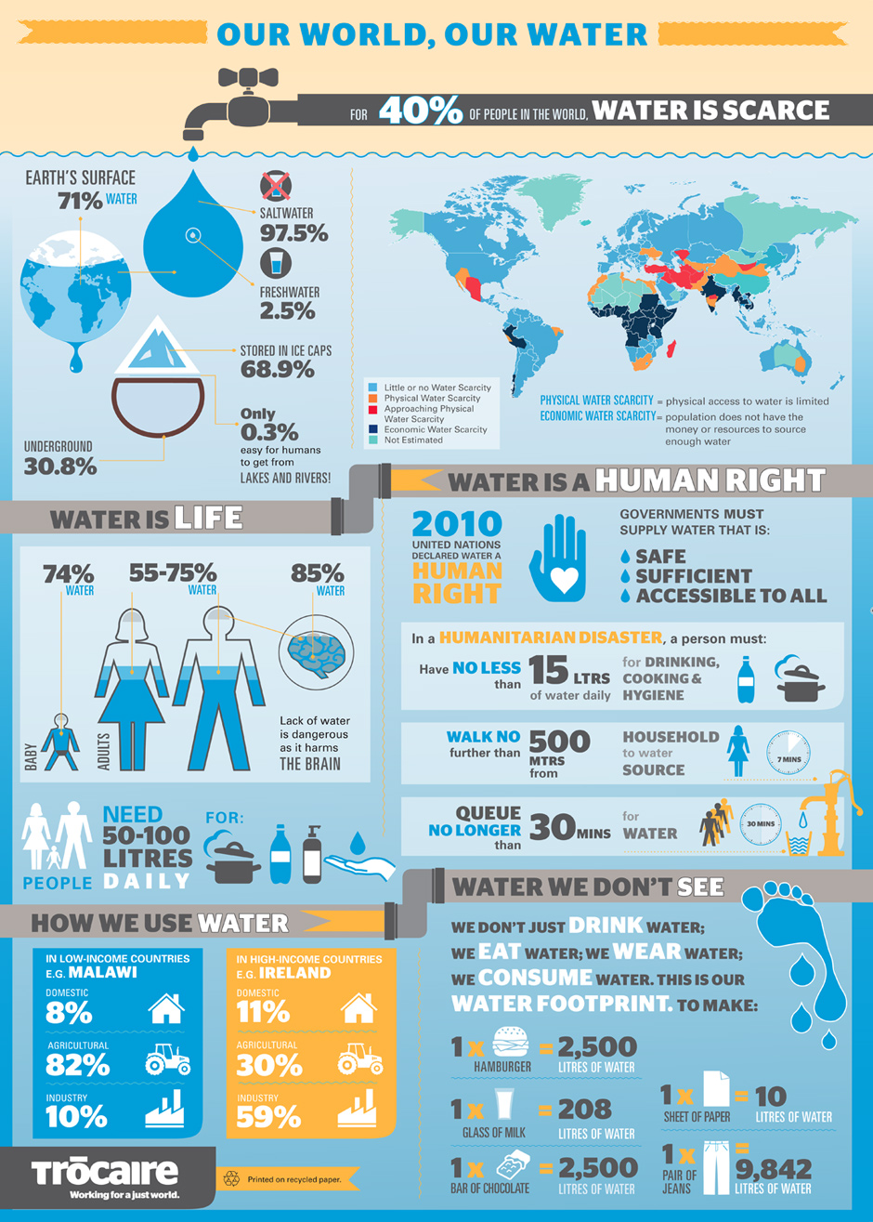
Example 2
Notes:
Infographic 2 from: https://www.irishtimes.com/polopoly_fs/1.1755714.1397049819!/image/image.jpg

