Slide 1
Through my Eyes:
The photography of
Nalikutaar Jacqueline Cleveland

Slide 2
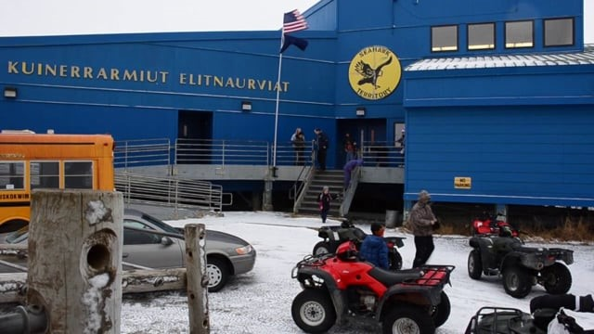
Notes:
Play from 1:25 to 2:29
Video source: https://vimeo.com/89062001

Slide 3
See
Think
Wonder

Slide 4
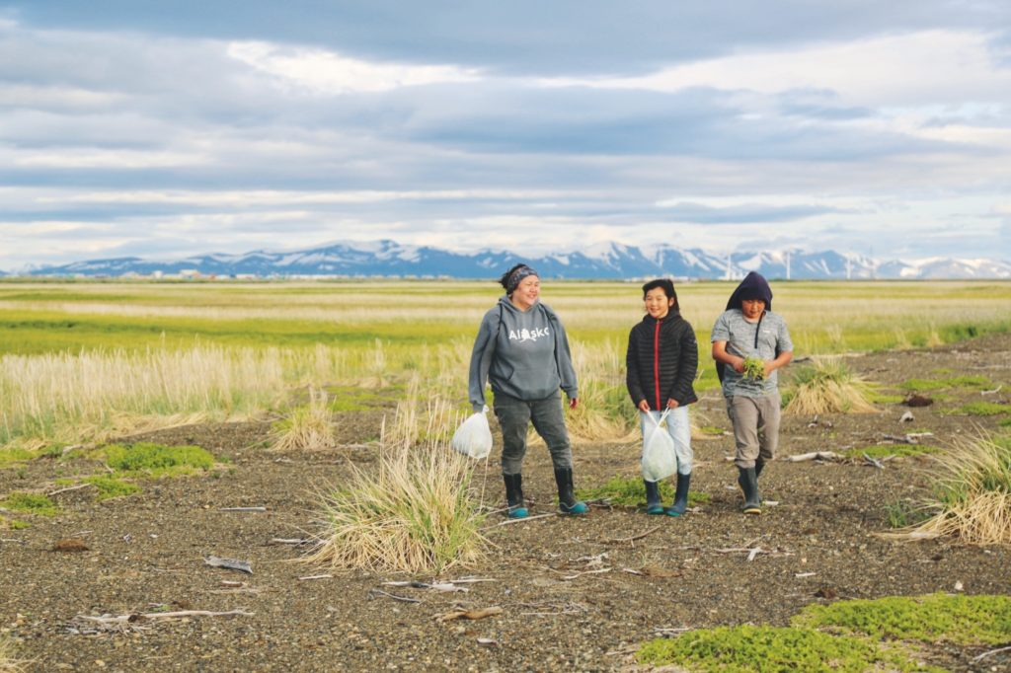
Molly Alexie and her children after a harvest of beach greens in Quinhagak, Alaska, 2018

Slide 5
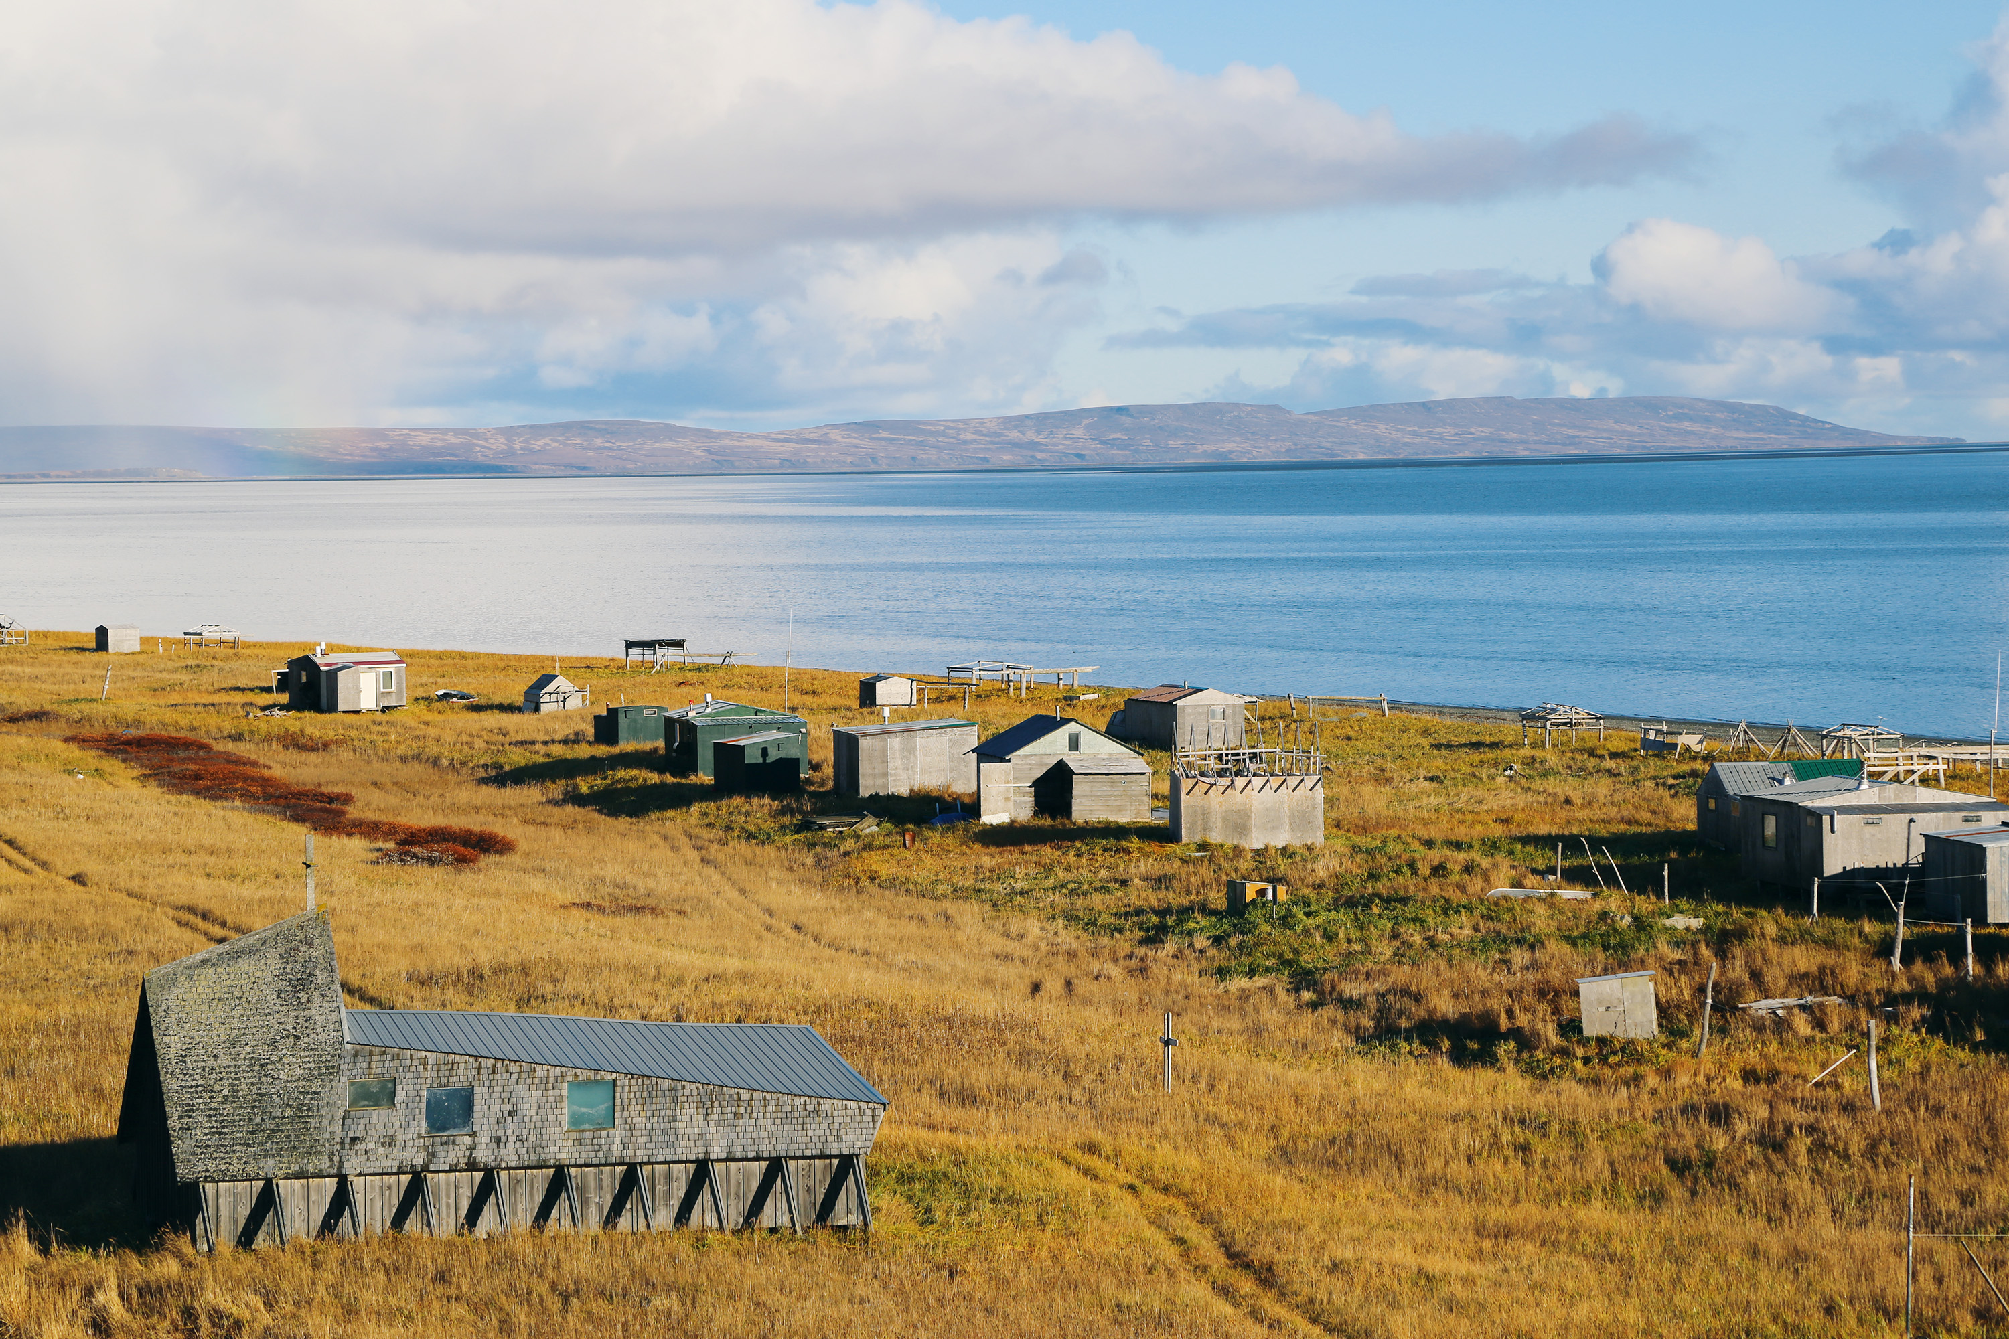
Umkumiut (People of the Cliffs) is a seasonal hunting and fishing camp situated near Toksook Bay, Alaska, 2017

Slide 6
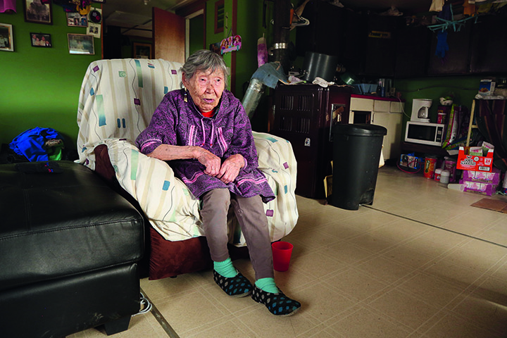
Lizzie Chimiugak Nenguryarr, age ninety, was the first person counted for the 2020 Census, Toksook Bay, Alaska, 2017

Slide 7
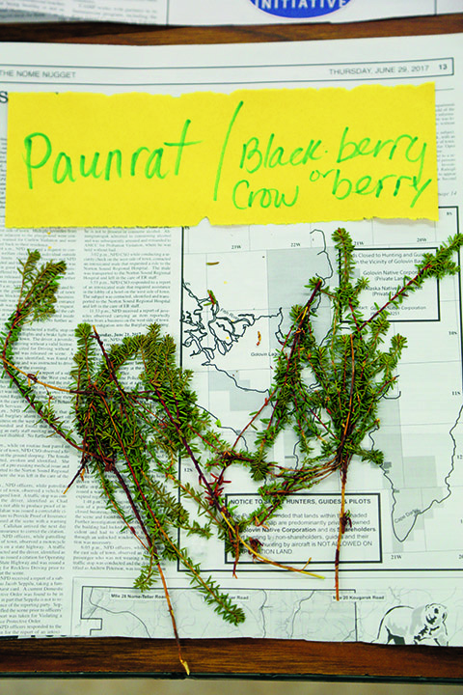
There are two main Yup’ik names for crowberries or blackberries in Alaska, paunrat and tan’gerpiit, 2017

Slide 8
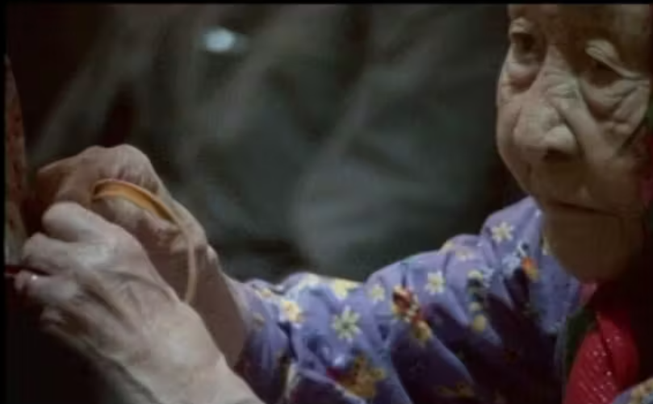
Sundown to sundown (2011)
https://vimeo.com/31221053
Notes:
Video source: https://vimeo.com/31221053
Show this documentary by Nalikutaar Jacqueline Cleveland in part (first 3-4 minutes) or whole (10 min)depending on time available.

Slide 9

Your Community
Become a photographer or videographer
Create a collection of 3-5 photos or make a 1-minute film
Be intentional of the images you create or what you choose to include in your short film. Plan what you want others to know about your community by carefully selecting your subjects and environments.

