Slide 1
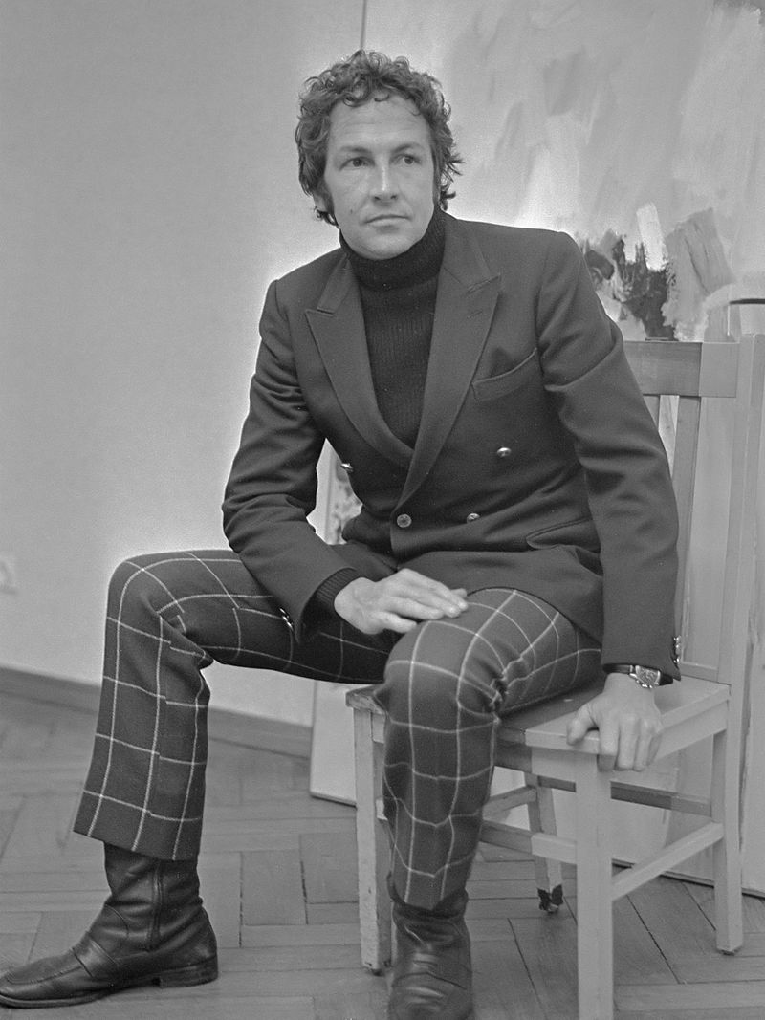
OFFSET:
Robert Rauschenberg at USF Graphicstudio
Notes:
Image source: https://commons.wikimedia.org/wiki/File:Robert_Rauschenberg_(1968).jpg
Jack de Nijs for Anefo; Robert Rauschenberg exposeert in Stedelijk Museum, Nederlands.
21 February 1968

Slide 2
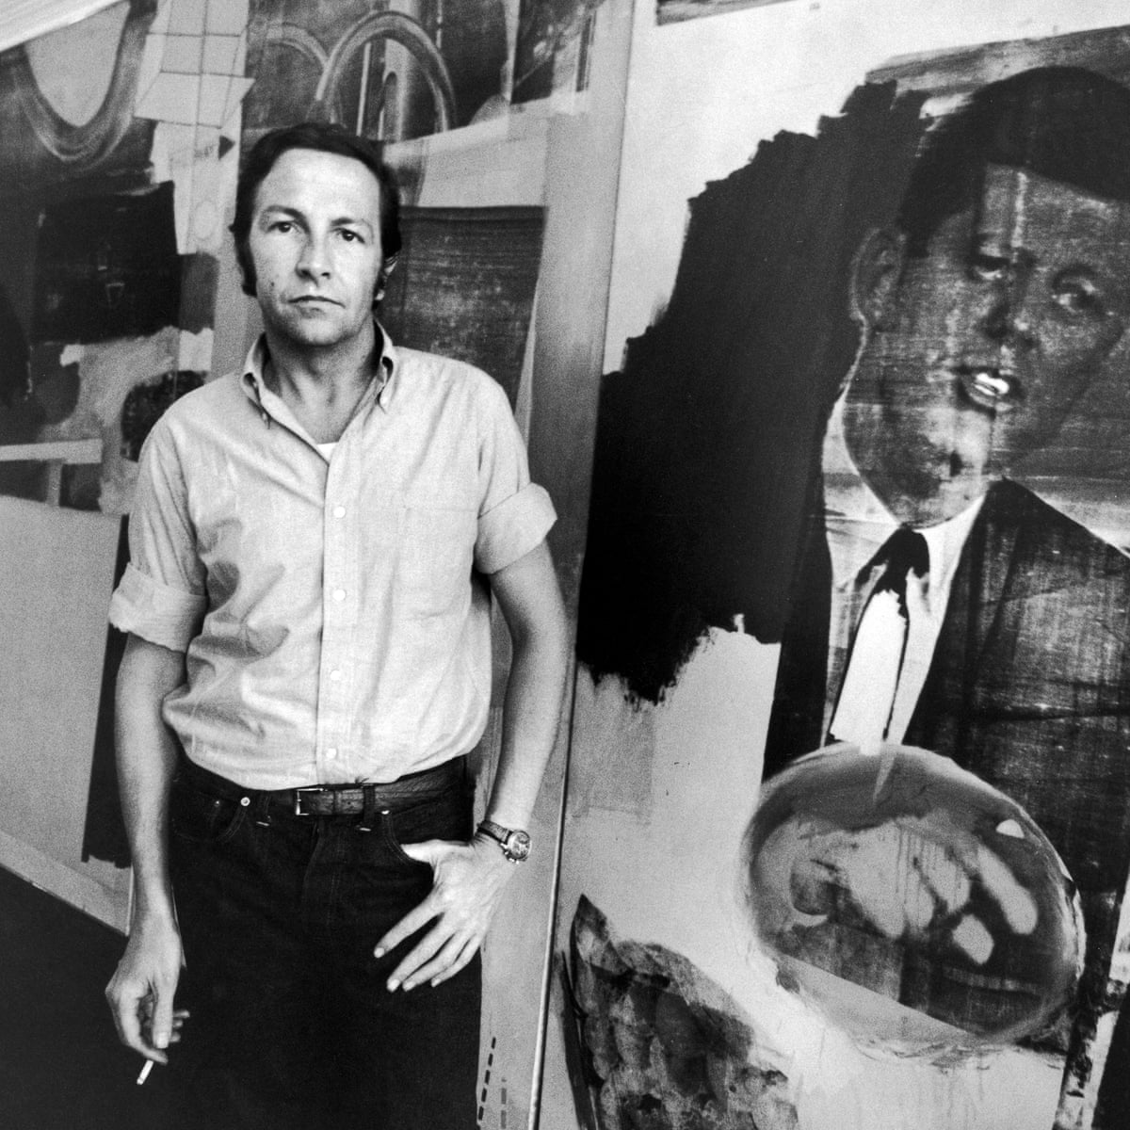
How do you interpret the artist’s quote?
“The artist's job is to be a witness to his time in history.”
Robert Rauschenberg
Notes:
Image source: https://www.theguardian.com/artanddesign/2016/nov/19/robert-rauschenberg-just-something-be-around

Slide 3
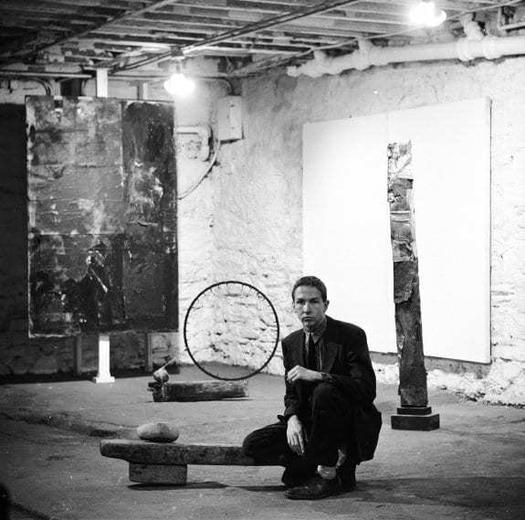
Overview
Born 1925 in Port Arthur, Texas
Lived and worked in New York City and Captiva Island, Florida
Drafted to US Navy (1944-1946)
Education:
  Kansas City Art Institute
  Académie Julian (Paris)
  Black Mountain College (North Carolina)
  Art Students League of New York
Died in 2008 at the age of 82 in FL
Notes:
Robert Rauschenberg with "Untitled [black painting with grid forms]" (1952/1953), "White Painting [two panel]" (1951), and three untitled Elemental Sculptures (all 1953) at the "Rauschenberg: Paintings and Sculpture" exhibition, Stable Gallery, New York, NY, United States, Fall 1953. Photo: Allan Grant / Life Magazine
Image source: https://www.rauschenbergfoundation.org/art/archive/stable-gallery

Slide 4
Claiming a Place in the Art World

Slide 5
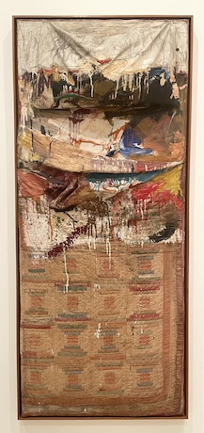
Combines (1954-1964)
a group of artworks using everyday objects as art materials
distinctions between painting and sculpture are blurred
Bed (1955)
Notes:
Rauschenberg is considered a neo-Dadaist by some, because he questioned the distinction between art objects and everyday objects (e.g., Marcel Duchamp’s famous Fountain, 1917).
Dada / Dadaism was an art movement that began in Europe in the early 20th century in response to World War I. Dada artists rejected modern capitalist society at the time and expressed this rejection through the protest of traditional art with artwork that evoked ideas of nonsense, surrealism, and absurdity.
Image:
Robert Rauschenberg Bed, 1955, Oil and pencil on pillow, quilt, and sheet on wood supports, 75 1/4 x 31 1/2 x 8 in. (191.1 x 80 x 20.3 cm), Museum of Modern Art, New York, Gift of Leo Castelli in honor of Alfred H. Barr, Jr., Object number: 79.1989.
This work is licensed under the Creative Commons Attribution 4.0 License.

Slide 6
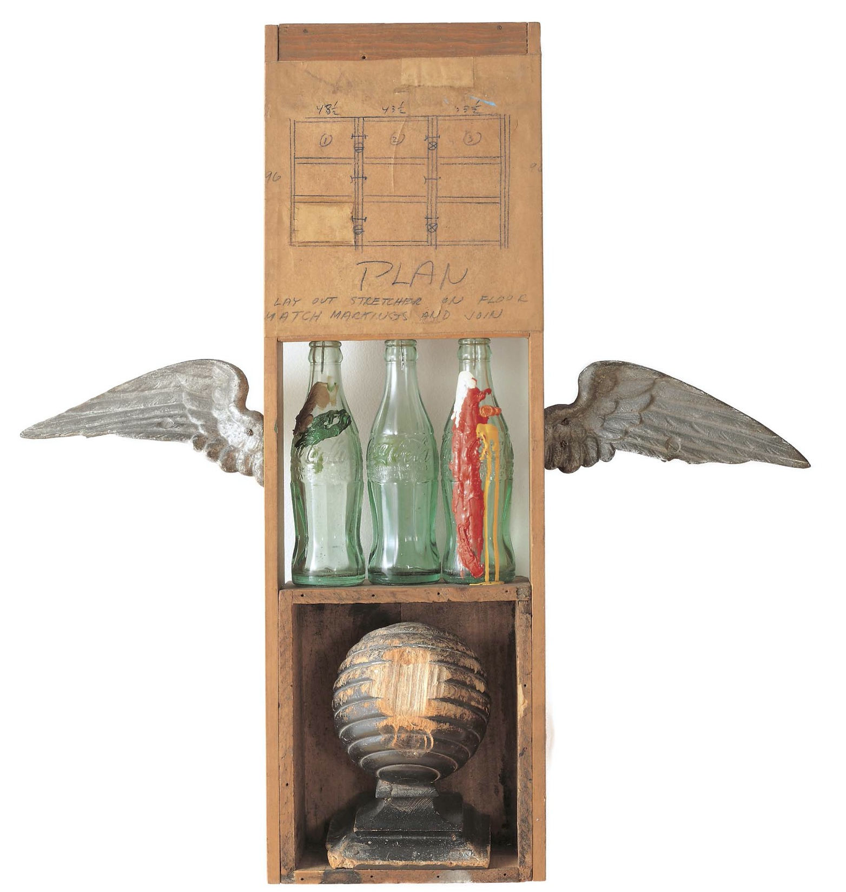
“I really feel sorry for people who think things like soap dishes or mirrors or Coke bottles are ugly, because they're surrounded by things like that all day long, and it must make them miserable.”
Robert Rauschenberg
Coca Cola Plan (1958)
Notes:
Image source: https://www.thoughtco.com/robert-rauschenberg-combines-4123111

Slide 7
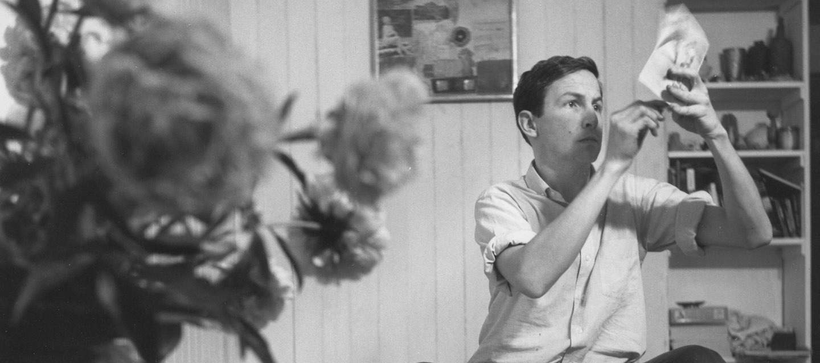
Rauschenberg, Front Street Studio, New York, 1958
Notes:
Image source: https://www.rauschenbergfoundation.org
Rauschenberg working on a solvent transfer drawing in his Front Street studio, New York, 1958. Work in background is Untitled (1955). Photo by Jasper Johns (detail)

Slide 8
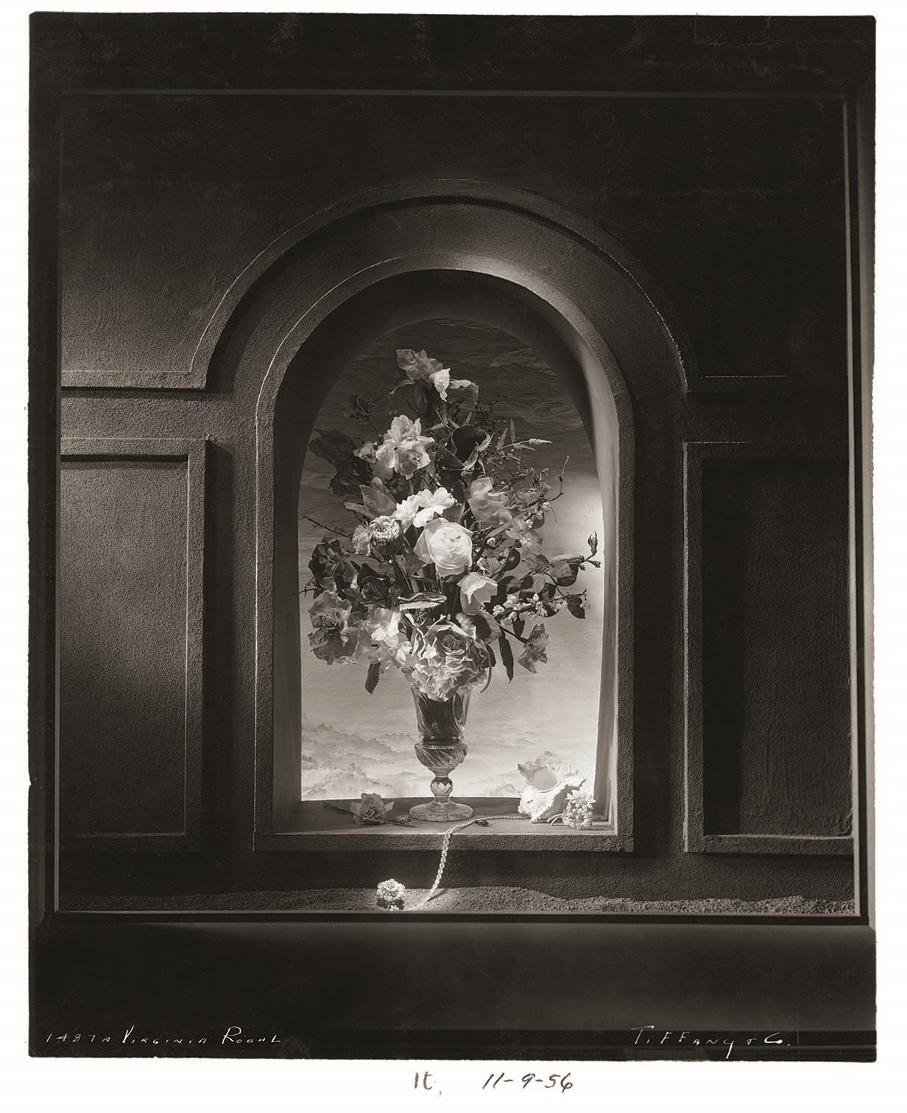
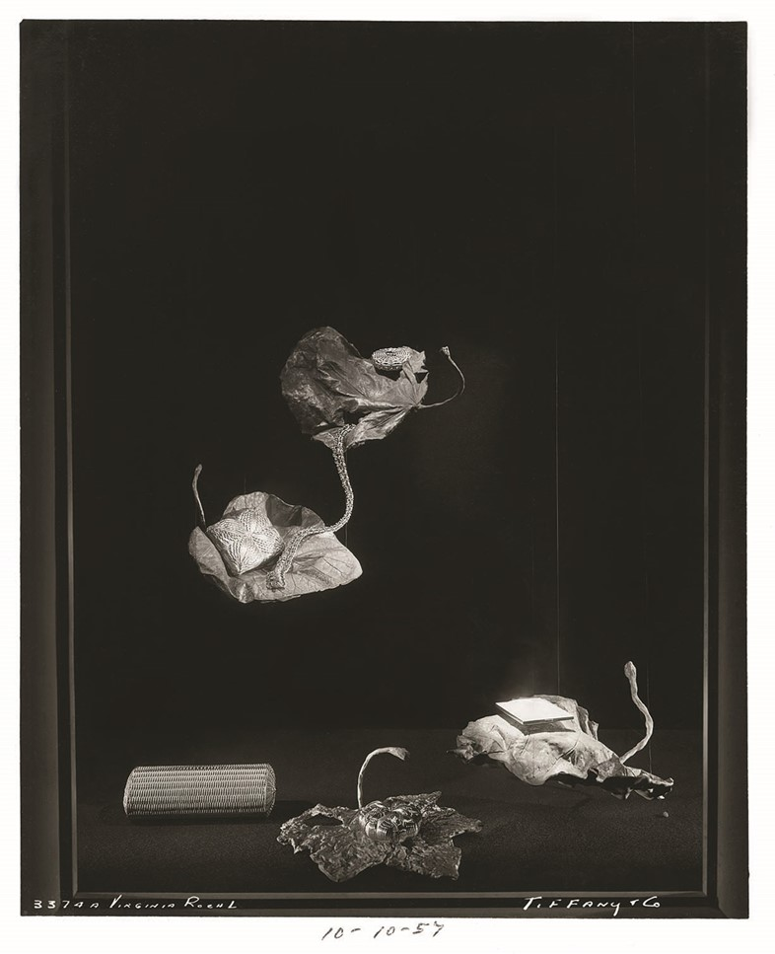
Tiffany & Co.
1956-1958
Notes:
Rauschenberg supported himself by designing storefront window displays for Tiffany & Co.
Image source: https://www.anothermag.com/fashion-beauty/8943/robert-rauschenbergs-million-dollar-window-displays

Slide 9
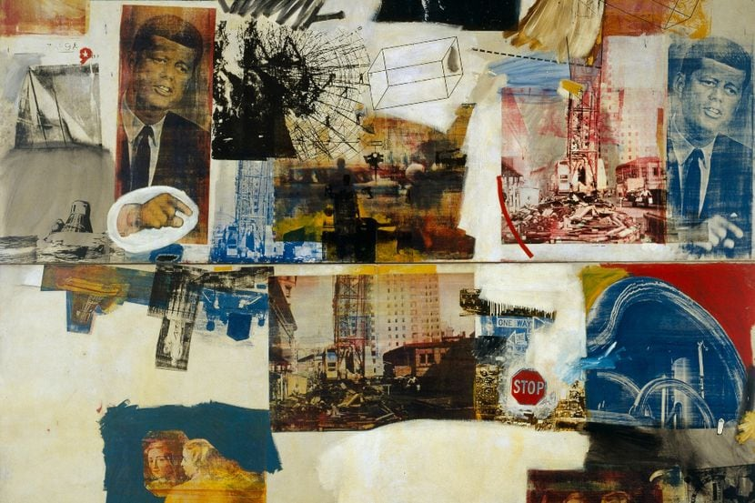
1960s
Notes:
In the 1960s, Rauschenberg began advancing his visual language through current events.
“In Skyway (1964), for example, Rauschenberg implemented a new silk-screening technique to arrange his mass-media melody: a recently-assassinated JFK, an astronaut, a fragmented painting by Peter Paul Rubens. In his own words, he unified these elements to capture the frenetic pace of daily American life, which had been changing drastically due to emergent technologies like television.”
Text source: https://www.thecollector.com/robert-rauschenberg/
Image source: https://www.dallasnews.com/event/cGVnYXN1czpldmVudA-MzE5MDYw-TXpFNU1EWXc/

Slide 10
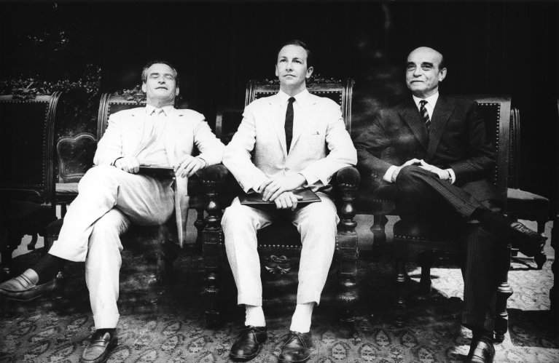
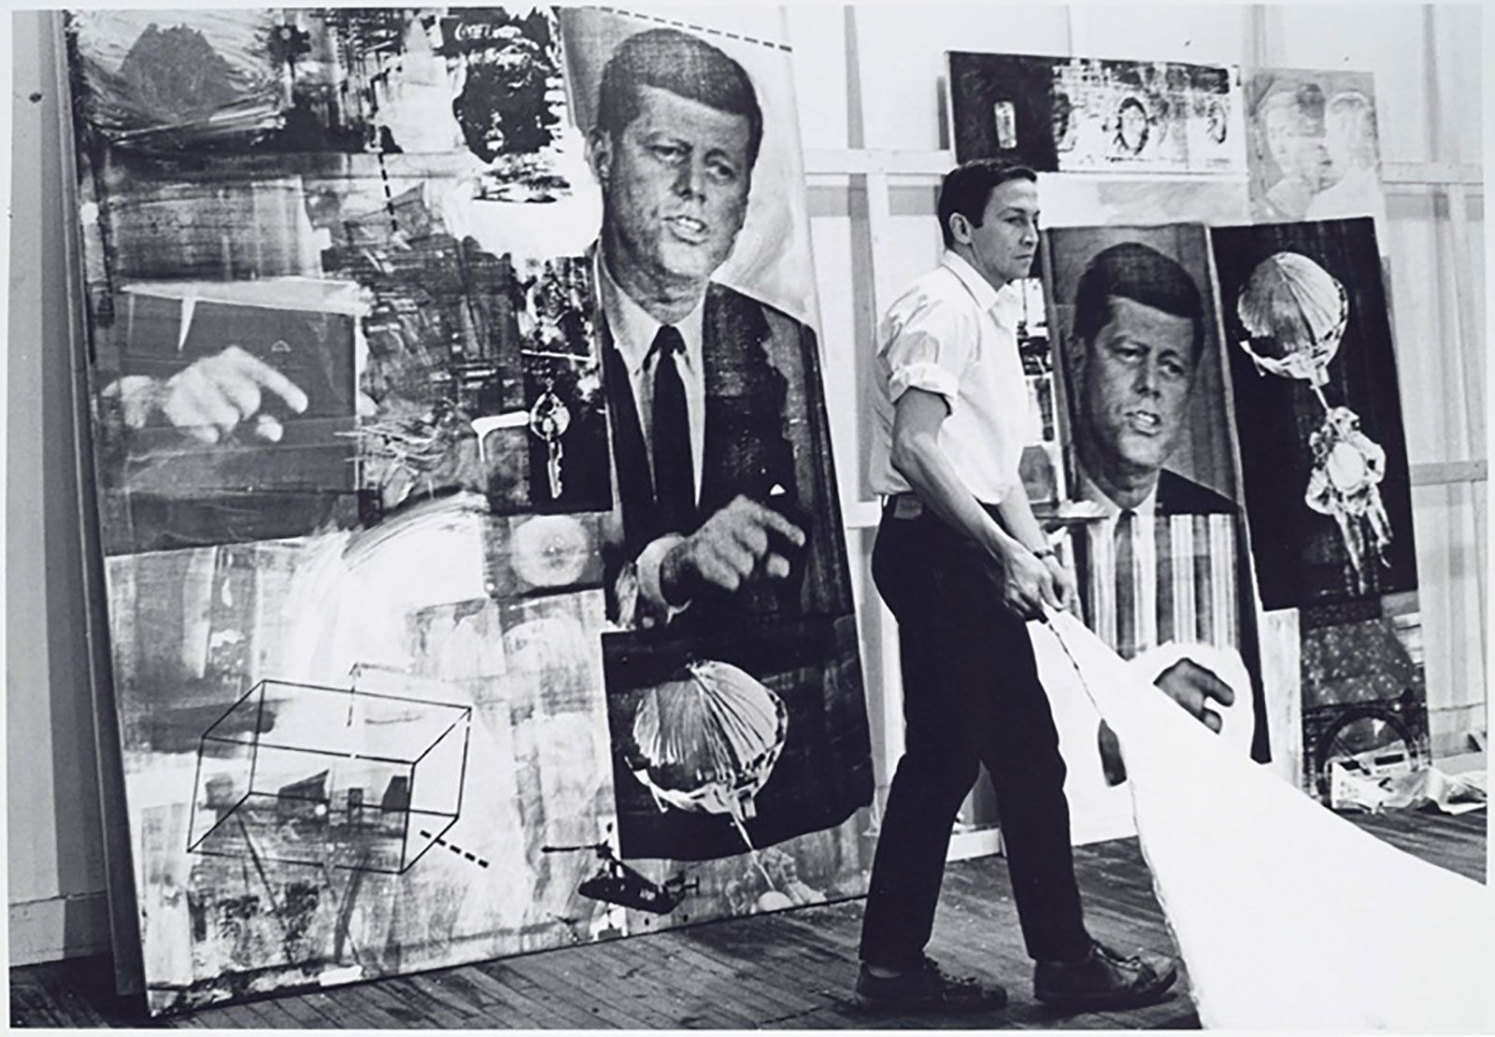
1964 Venice Biennale
Rauschenberg and Biennale officials at the Grand Prize presentation ceremony
Rauschenberg at the Venice Biennale, 1964
Notes:
The Venice Biennale is an international cultural exhibition held in Venice, Italy. Founded in 1895, it is the oldest of its kind.
In 1964, an American artist won for the first time; that artist was Robert Rauschenberg.
Image (right) source: https://cardigallery.com/magazine/pop-art-in-transfer.
Image (left) source: https://www.rauschenbergfoundation.org/artist/chronology
Rauschenberg and officials at the Grand Prize in Painting presentation ceremony, "XXXII Esposizione Biennale Internazionale d'Arte," Venice, June 19, 1964. Photo: Shunk-Kender © J. Paul Getty Trust

Slide 11
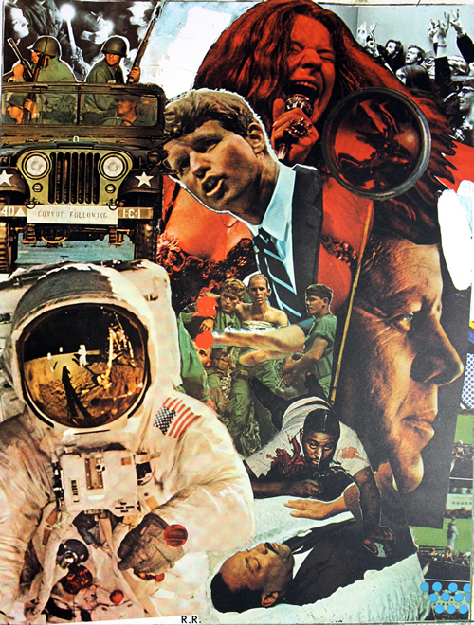
Signs (1970)
“The artist's job is to be a witness to his time in history.”
Robert Rauschenberg
Notes:
“To summarize the societal cataclysm he’d witnessed throughout the preceding decade, Rauschenberg concluded his 1960s with Signs (1970), juxtaposing a hopeful Buzz Aldrin with the traumatic deaths of popular figures like Martin Luther King Jr. and Janis Joplin.”
Text source: https://www.thecollector.com/robert-rauschenberg/
““Signs” by American Pop Artist Robert Rauschenberg, was originally created to welcome the year 1970 and was intended as an illustration for the cover of Time Magazine. This screenprint edition of the collage was published, after Time Magazine decided not to use the image in 1970.”
Text and image source: https://denisbloch.com/artworks/artists/robert-rauschenberg/signs

Slide 12
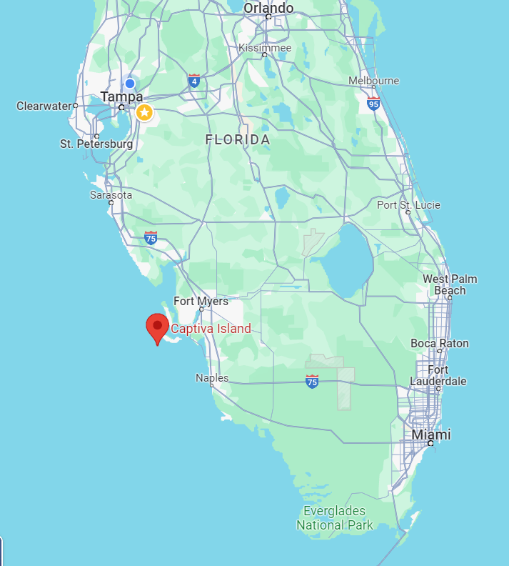
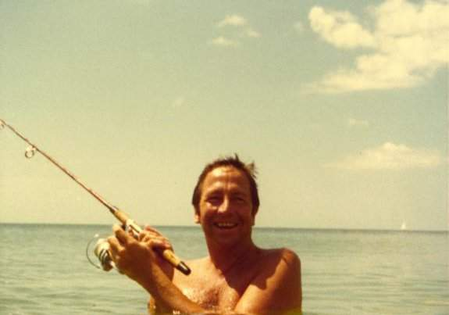
1970s:
Captiva Island, FL
“Every time I've moved, my work has changed radically.”
Robert Rauschenberg
Notes:
In the fall of 1960, Rauschenberg left his New York City studio and traveled to Treasure Island, a (then) small fishing village off the west coast of Florida, to complete his series of Dante Drawings (1958-1960) that illustrate the thirty-four cantos of Dante’s Inferno.
While there, he discovered the benefits of working in a coastal environment, which inspired his decision to ultimately leave New York City. On a trip visiting islands along the east coast of the United States searching for his new home, Rauschenberg encountered Captiva, which he described in 1970, as ”the foundation of my life and my work; it is the source and reserve of my energies.”
Text source: https://www.rauschenbergfoundation.org/rauschenberg-captiva
Image: Rauschenberg in Captiva, Florida, 1978. Photo: Attributed to Billy Klüver.
Source: https://www.rauschenbergfoundation.org/artist/chronology

Slide 13
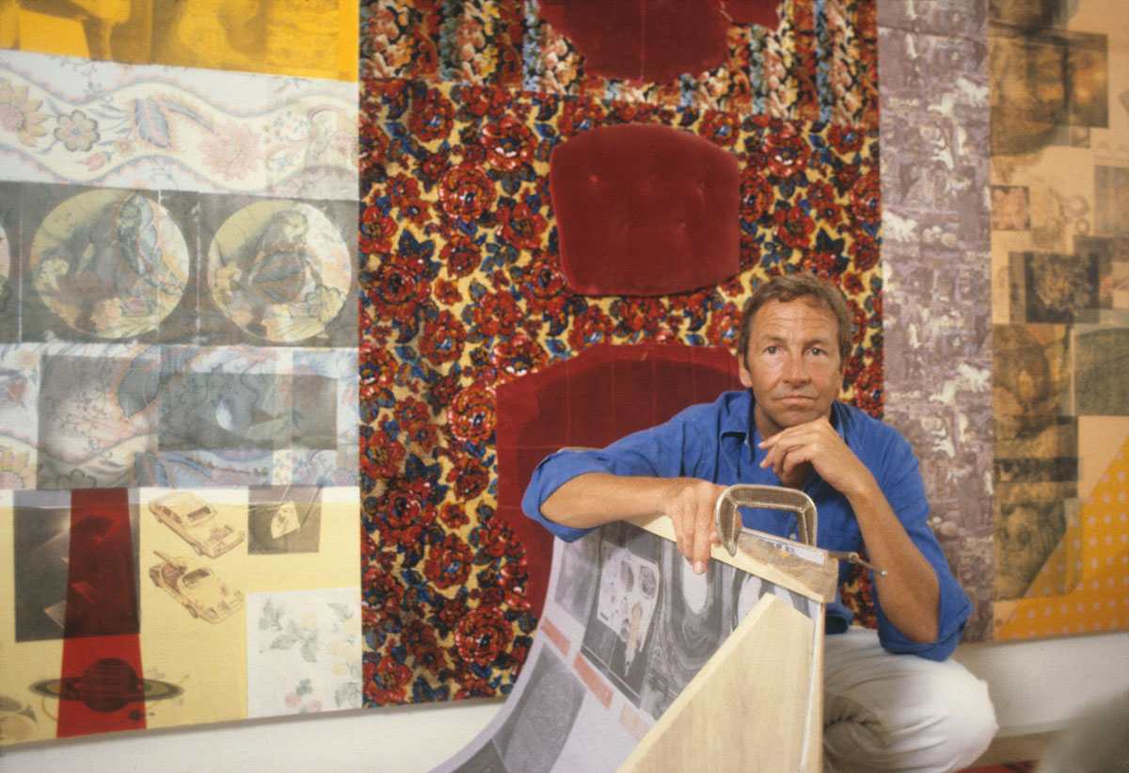
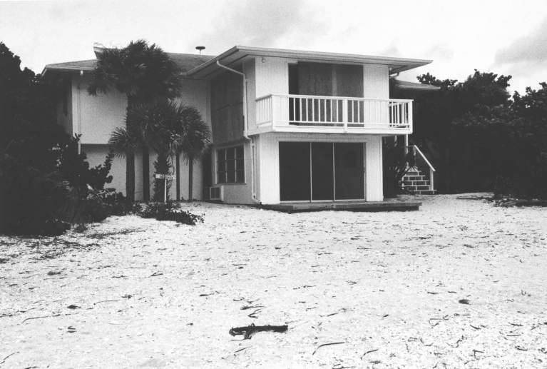
Beach House and Studio
Notes:
Image (left): Rauschenberg with Mongolian Cousin (Spread), Captiva, Florida, 1980
Source: https://www.rauschenbergfoundation.org/artist/chronology
Image (right): Rauschenberg’s beach house, Captiva, Florida, ca. 1971. Photo: Robert Petersen.

Slide 14
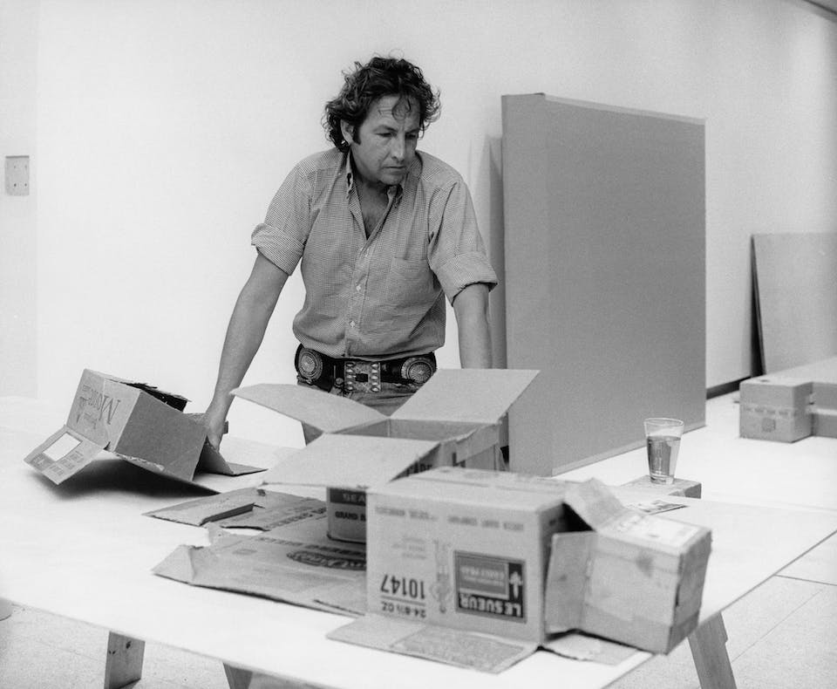
“I’ve always felt as though, whatever I’ve used and whatever I’ve done, the method was always closer to a collaboration with materials than to any kind of conscious manipulation and control.”
—Robert Rauschenberg

Slide 15
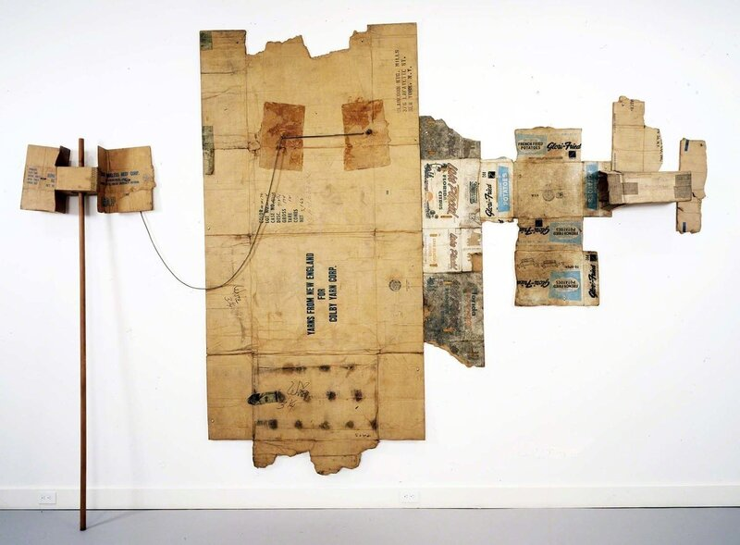
Lake Placid / Glori-Fried / Yarns from New England (Cardboard), 1971
Notes:
“On Captiva Island, his work adapted to its natural surroundings, veering toward abstraction through fibers like paper. Cardboard (1971) best communicates this mid-career interest in texture and color, a series of wall sculptures made from cut, bent, and stapled boxes.”
Text source: https://www.thecollector.com/robert-rauschenberg/
Image source: https://www.artsy.net/artwork/robert-rauschenberg-lake-placid-slash-glori-fried-slash-yarns-from-new-england-cardboard-1

Slide 16
Made in Tampa: Tampa 2
(1972-1975)
Notes:
In Tampa at the University of South Florida’s Contemporary Art Museum, staff and the Graphicstudio team of printers collaborated with Rauschenberg to produce more than thirty editions of prints and sculpture multiples over three decades. This relationship would expand the method, scope, and very idea of printmaking, producing such important series as Made in Tampa (1972-73), Crops (1973), and Airport Suite (1974).

Slide 17
Rauschenberg Overseas Culture Exchange (ROCI)

Slide 18
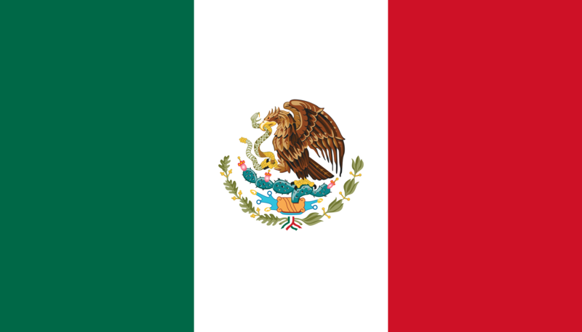

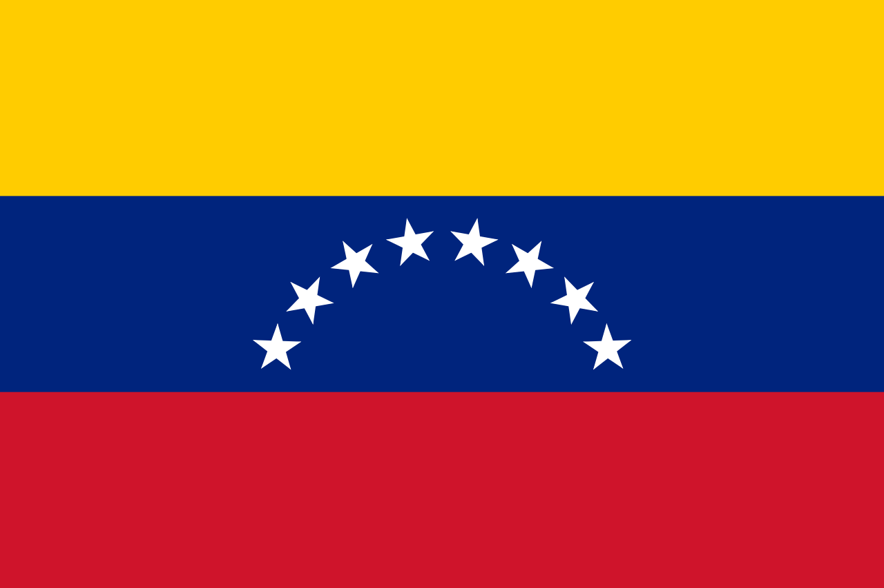




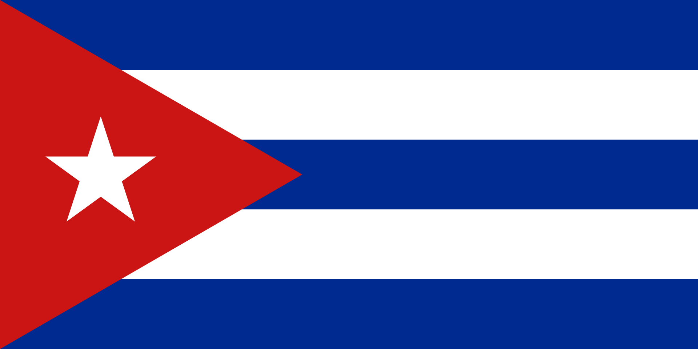
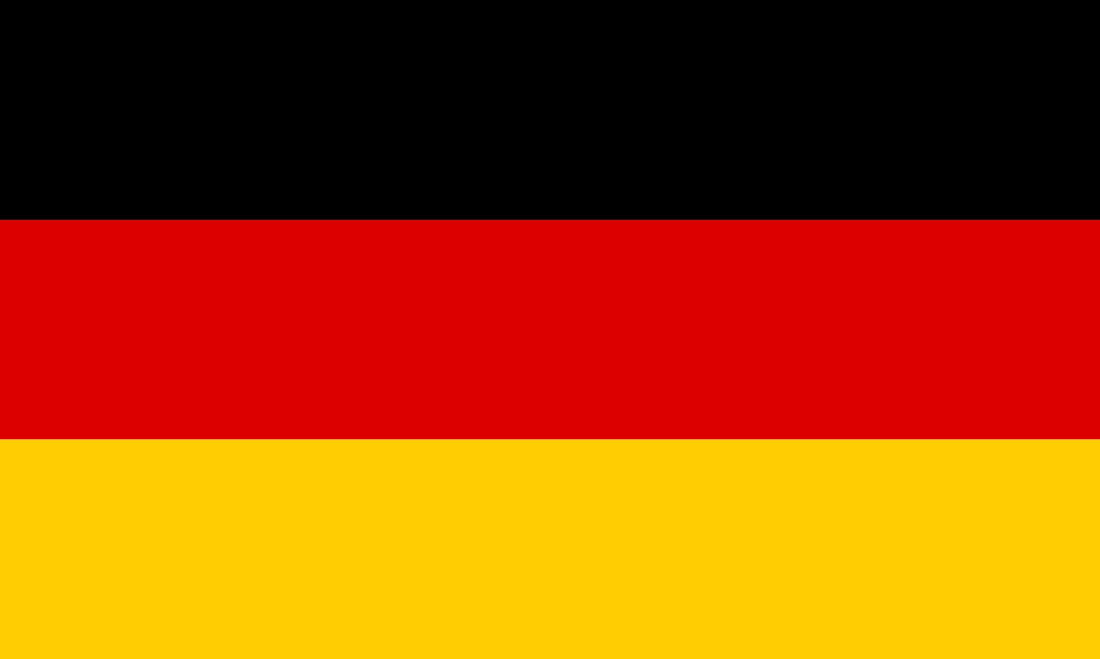
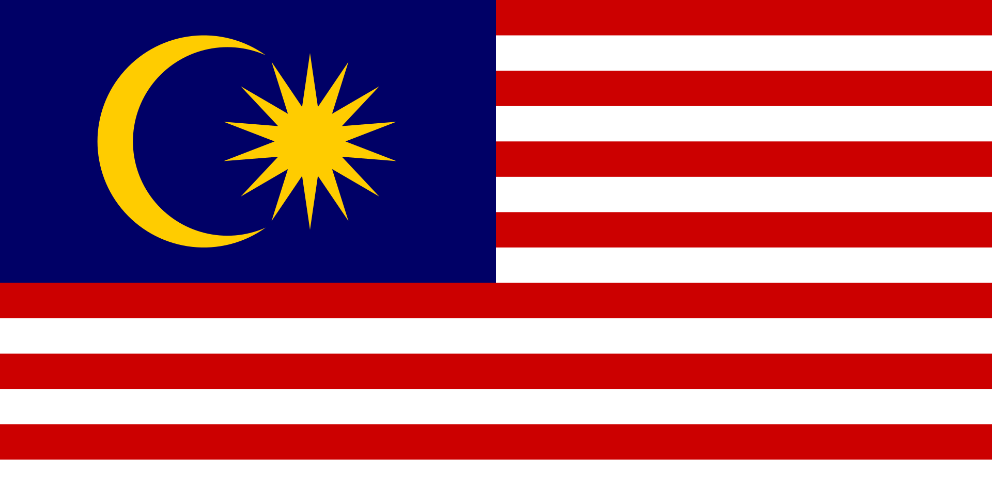
Rauschenberg Overseas Culture Exchange (ROCI)
Mexico Chile Venezuela China USSR
Tibet Japan Cuba Germany Malaysia
Notes:
The Rauschenberg Overseas Culture Exchange (ROCI) [pronounced “Rocky,” the name of the artist’s pet turtle}, was founded by Rauschenberg in 1984 (launched from Tampa), based on the artist’s belief that art can be a vehicle for positive social change.
Between 1985 and 1990, the project was realized in ten countries: Mexico, Chile, Venezuela, China, Tibet, Japan, Cuba, the Union of Soviet Socialist Republics (USSR), Germany, and Malaysia (with a final exhibition held in 1991 at the National Gallery of Art, Washington, D.C.)
ROCI was a tangible expression of Rauschenberg’s long-term commitment to human rights and to the freedom of artistic expression. Funded almost entirely by the artist, Rauschenberg traveled to countries around the world, often where artistic experimentation had been suppressed, to educate underprivileged artists as part of the ROCI project.
Source: https://www.rauschenbergfoundation.org/art/art-context/roci
Flag images: Wikimedia commons

Slide 19
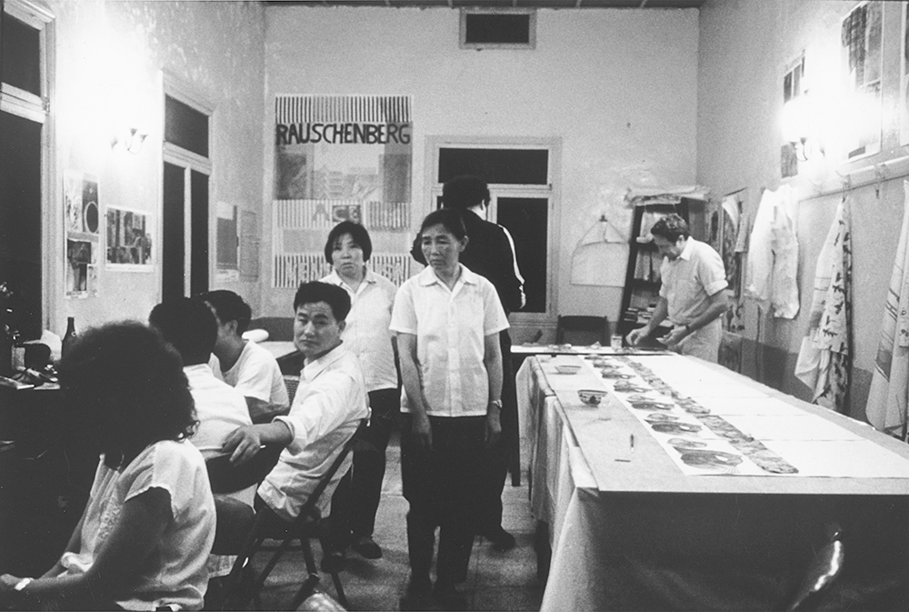
1982: Rauschenberg (right) at the Xuan Paper Mill
Jiangxian, China
Notes:
1982: While in China, Rauschenberg visited the 1,500-year-old Xuan Paper Mill in Jiangxian. There he collaborated with traditional papermakers to create his 7 Characters series.
Source: https://www.meridian.org/lookingbacklookingforward/gallery/35/

Slide 20
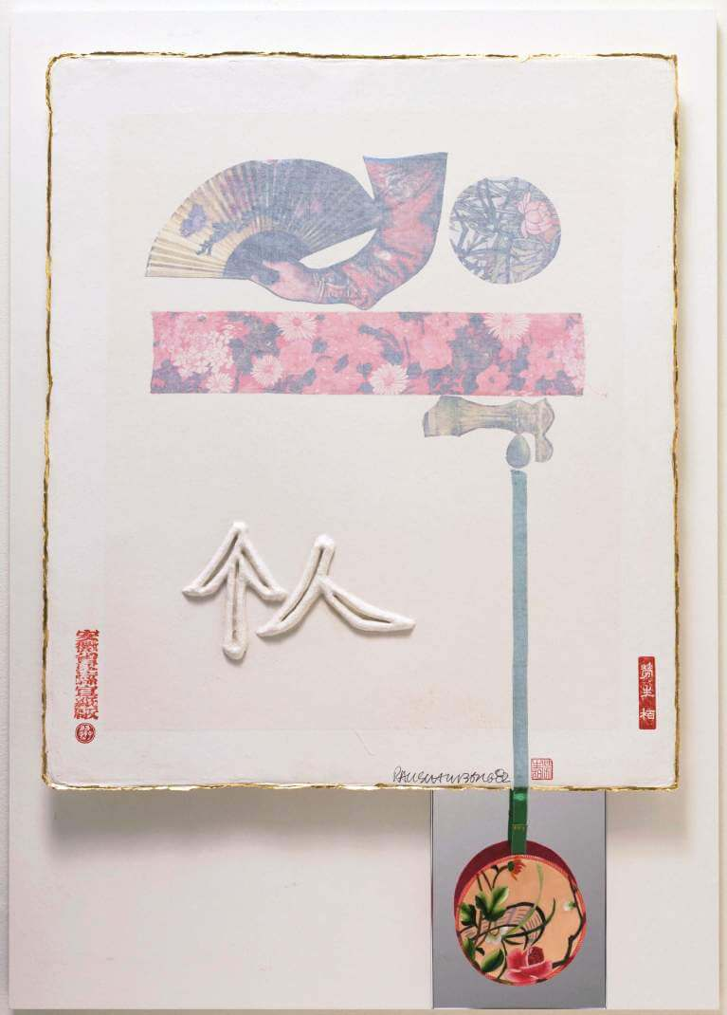
Individual
(from 7 Characters),
1982
Notes:
In 1982, Rauschenberg traveled to China. On this trip Rauschenberg took photographs that would go on to become Chinese Summerhall (1982), a 100-foot-long photographic c-print published by Graphicstudio. Also on that trip, resulting from a conversation with a cook, the Rauschenberg Overseas Culture Interchange (ROCI) was born. The tour was to serve as a catalyst for human rights and world peace in countries that would not be familiar with his work.
Source: https://www.rauschenbergfoundation.org/art/art-context/roci

Slide 21
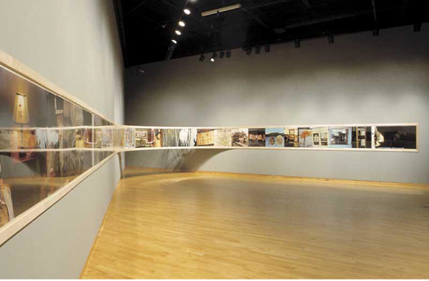
Chinese Summerhall (1983)
Notes:
Photographs from the trip to China are included in his photographic mural, Chinese Summerhall (1982–83), which was also part of the ROCI CHINA presentation.
Rauschenberg received a Certificate of Merit from the Ministry of Culture, Beijing, for the exhibition’s contribution to cultural exchange. ROCI CHINA provided a rare view of Western contemporary art. In a country where traditional media and methods were the artistic norm, Rauschenberg’s unusual choice of materials and techniques was eye-opening.
ROCI was launched from Tampa in 1984 and culminated with an exhibition at the National Gallery of Art, Washington, D.C. in 1991.
Source: https://www.rauschenbergfoundation.org/art/art-context/roci
Image:
Chinese Summerhall, 1983
chromogenic print; 30 x 1200 in.
Published by Graphicstudio, University of South Florida Collection

Slide 22
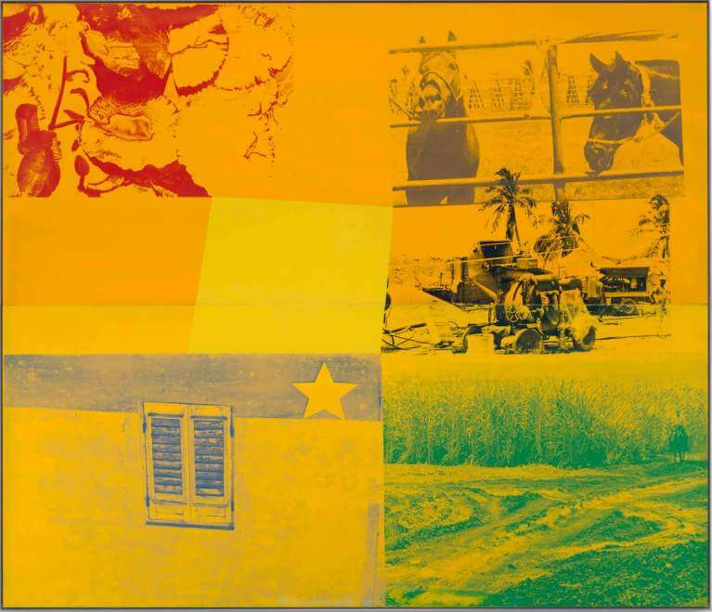
Yellow Ranch (Rancho Amarillo) /
ROCI Cuba (1988)
Notes:
Source: https://www.rauschenbergfoundation.org/art/art-context/roci
For ROCI CUBA, Rauschenberg produced a series of paintings on aluminum and steel using vivid primary colors, evoking the pre-1959 American cars commonly seen in Havana.
His works were exhibited in 1988 at the Museo Nacional de Bellas Artes, the Castillo de la Fuerza and Casa de las Américas, and at the Galleria Haydee Santamaría, Havana.
Countering criticism that his paintings did not celebrate the complete history of Cuba, Rauschenberg, during an open forum for students and the public, maintained, “To break down barriers, I think you need to see as an alien does—to get lost in the city, or in the country, to see things in Cuba that maybe you are blind to.”
Due to the U.S. embargo on Cuba, works for the exhibition were required to pass through Mexico before arriving in Cuba. On the evening prior to the exhibition opening in February 1988, Rauschenberg was honored with an official dinner at the Palacio de la Revolución, Havana.
Image:
Yellow Ranch (Rancho Amarillo) / ROCI CUBA
1988
Enamel and silkscreen ink on galvanized steel
72 x 84 inches (182.8 x 213.4 cm)

Slide 23
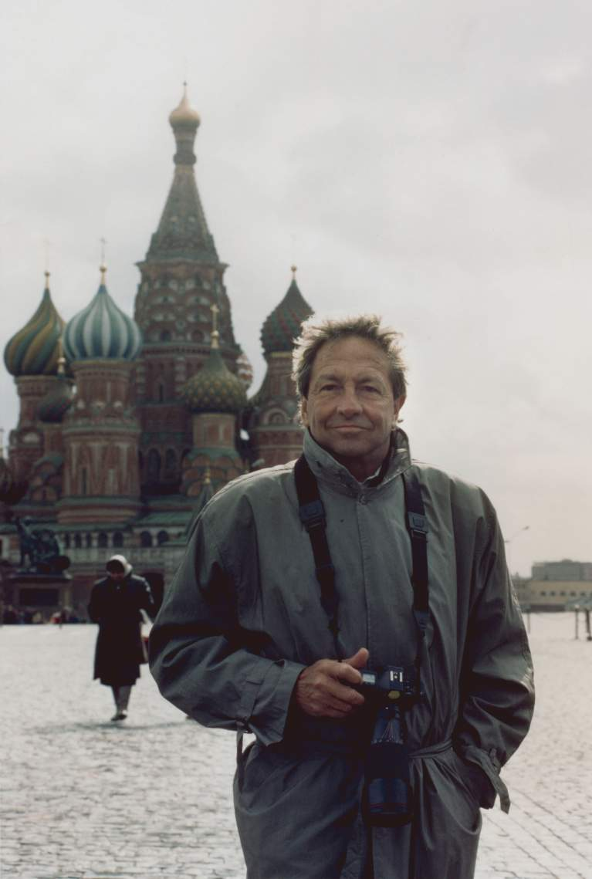
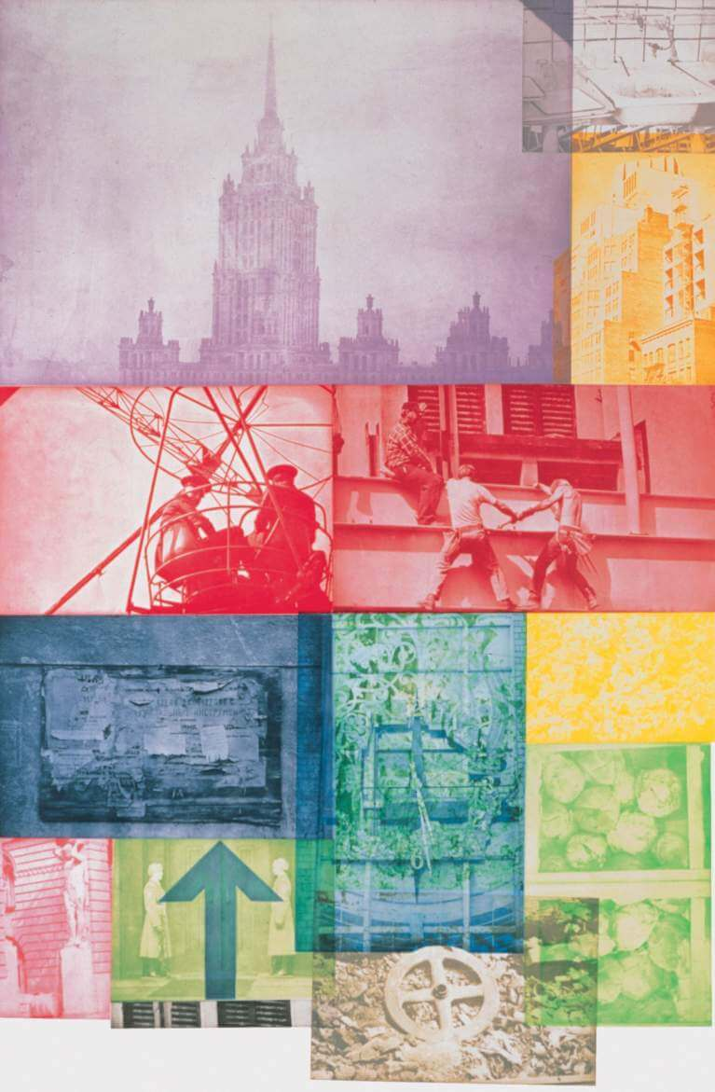
Soviet / American Array VII (1988)
Notes:
ROCI USSR was the first solo exhibition of a Western post–World War II artist in the USSR, attracting more than 145,000 visitors. Among the works included in the exhibition were examples from his Soviet/American Array (1988–90), a series of photogravures that include a combination of Soviet and American imagery,
Source: https://www.rauschenbergfoundation.org/art/art-context/roci
Rauschenberg in Red Square, Moscow, during a research trip for ROCI USSR, April 1988. Photo: Donald Saff
Source: https://www.rauschenbergfoundation.org/artist/chronology

Slide 24
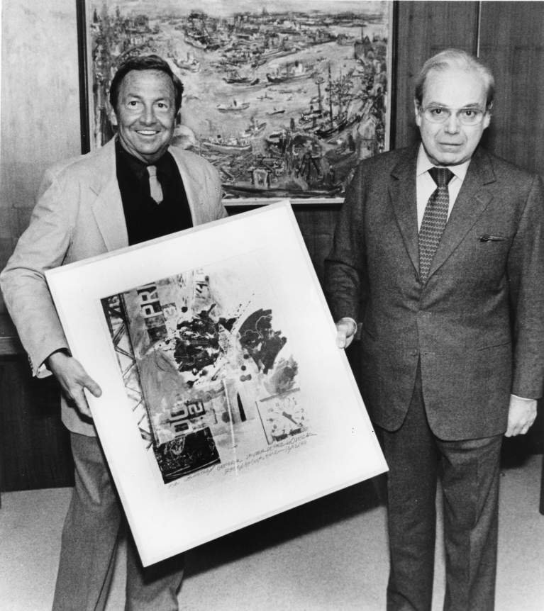
Rauschenberg presenting ROCI Announcement Print to
Javier Perez de Cuellar, Secretary General of the United Nations
New York, 1984
Notes:
Rauschenberg presenting ROCI Announcement Print to United Nations Secretary General Javier Perez de Cuellar, United Nations, New York, 1984.
Source: https://www.rauschenbergfoundation.org/artist/chronology

Slide 25
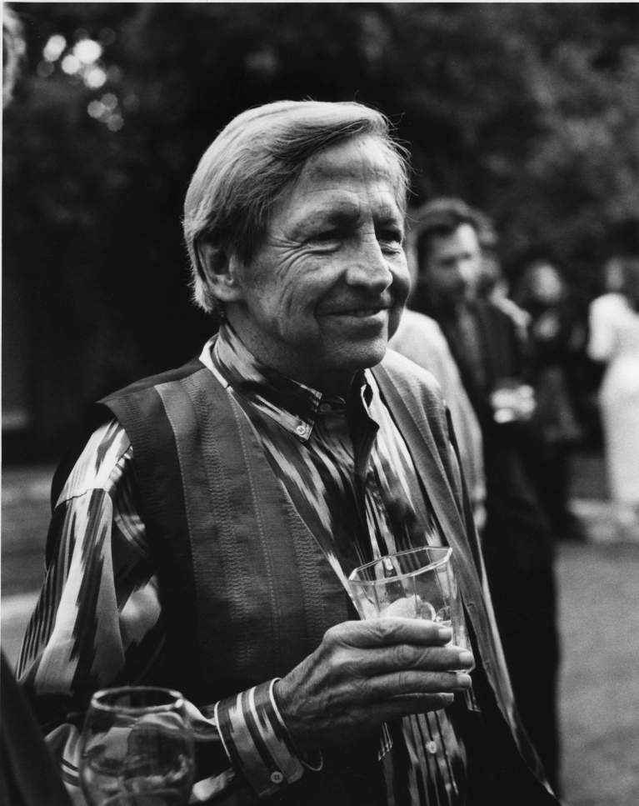
Later Years
Notes:
Rauschenberg at his seventieth birthday party, Los Angeles, October 1995. Photo: Sidney Felsen
Image source: https://www.rauschenbergfoundation.org/artist/chronology

Slide 26
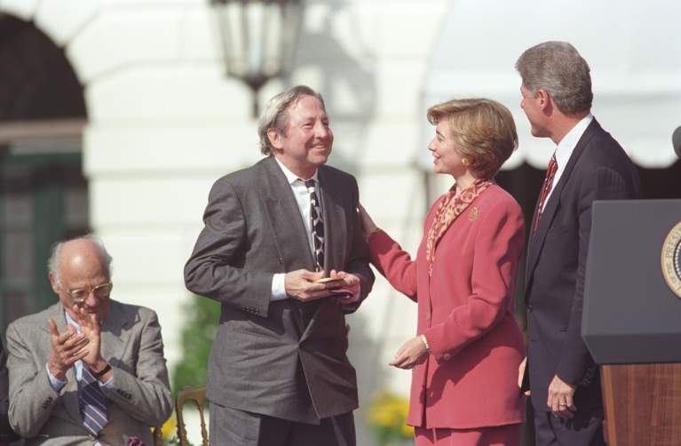
National Medal of Arts (1993)
Notes:
Rauschenberg receiving the National Medal of Arts Award, presented by President Bill Clinton and First Lady Hillary Clinton, White House Lawn, Washington, D.C., October 1993
Source: https://www.rauschenbergfoundation.org/artist/chronology

Slide 27
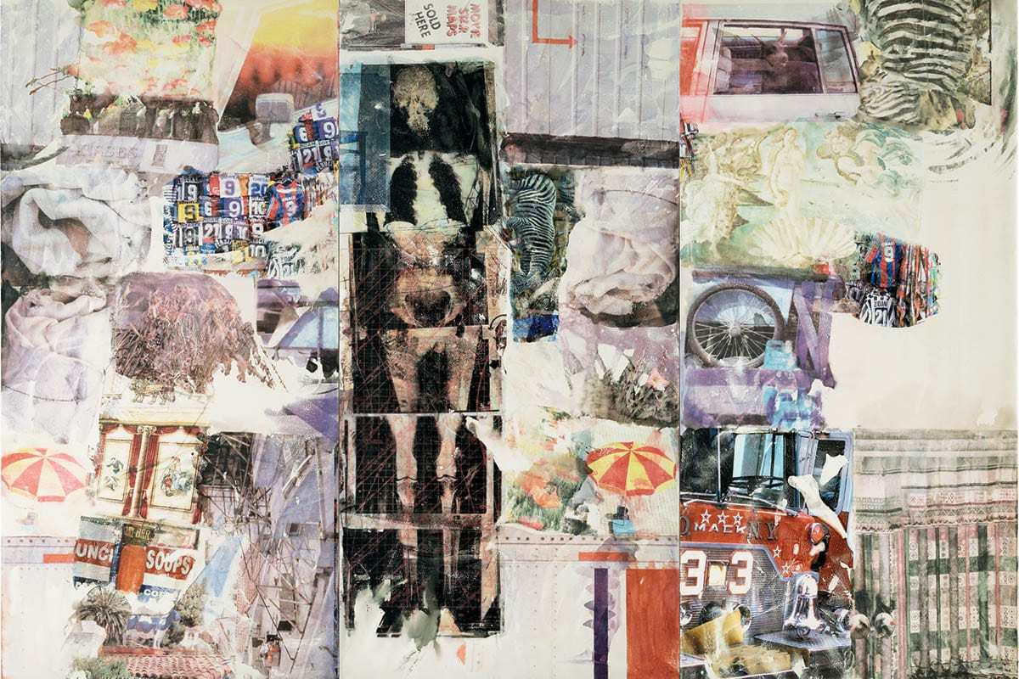
Mirthday Man (1997)
Notes:
In a digitized collage centered by his own x-ray, Mirthday Man (1997) marked the occasion of his 72nd birthday.
Text and image source: https://www.thecollector.com/robert-rauschenberg/

Slide 28
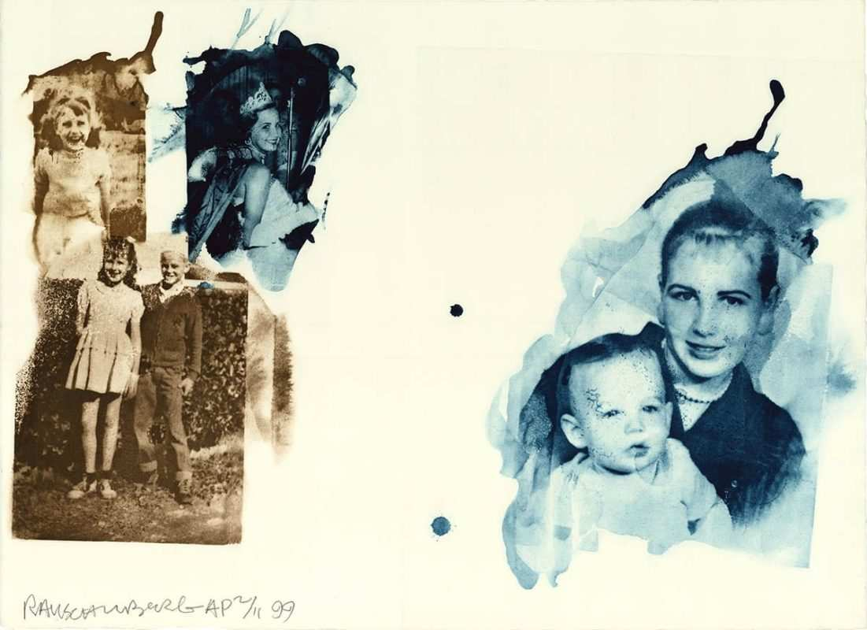
Bubba’s Sister (Ruminations)
Robert Rauschenberg(2000)
Notes:
In his later years, the artist also reflected on his life and family members.
Image source:
https://www.rauschenbergfoundation.org/art/artwork/bubbas-sister-ruminations

Slide 29
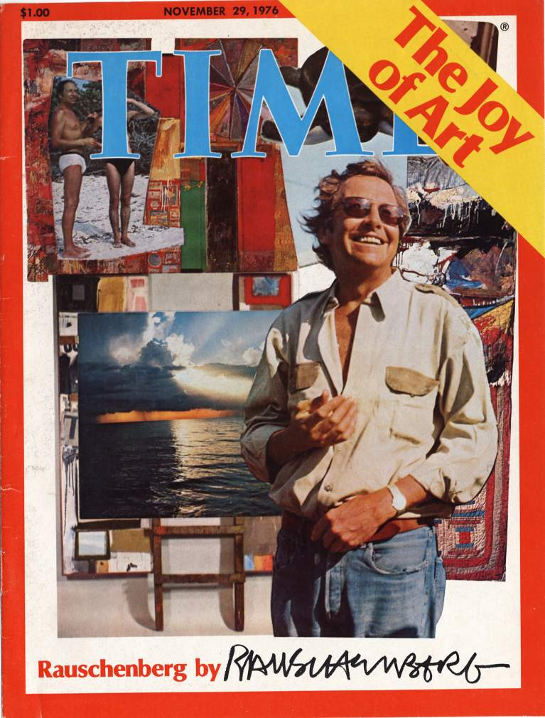
"Painting relates to both art and life. Neither can be made. (I try to act in that gap between the two.)”
Robert Rauschenberg
Notes:
Robert Rauschenberg, Cover for Time Magazine–November 29, 1976.
Image source: https://www.rauschenbergfoundation.org/artist/chronology

