Slide 1
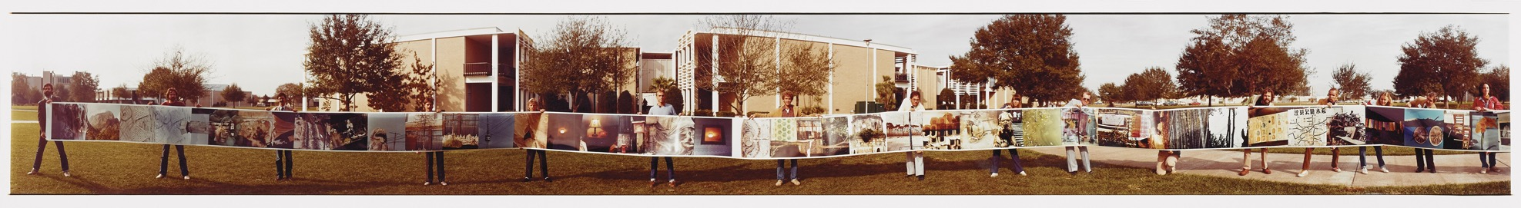
Robert Rauschenberg
(OFFSET: Robert Rauschenberg at USF Graphicstudio)
Art, Democracy, and Diplomacy

Slide 2
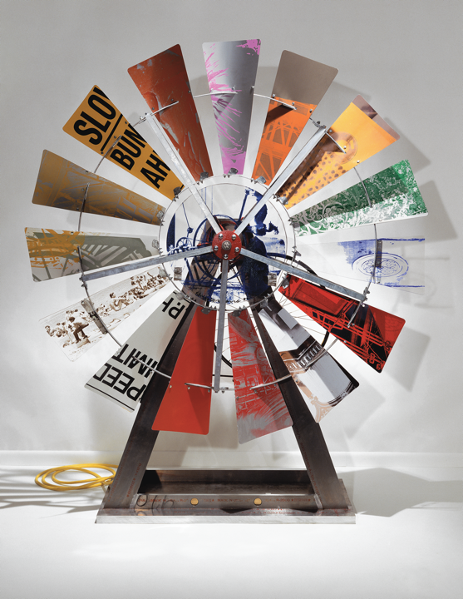
“Some artists leave an important mark; only a handful deliver the kind of legacy handed down by Robert Rauschenberg” CVF
Robert Rauschenberg worked in a wide range of materials, techniques, and disciplines. Rauschenberg is celebrated as a forerunner for nearly every art movement since Abstract Expressionism.
He was a prolific artist who inspired and influenced generations of artists all over the world
Robert Rauschenberg, Splayed (Shales), 1994. fire wax with transfer on canvas mounted on board with painted aluminum frame. 60 x 48 x 1-1/2 in. Collection of Ruth and Don Saff. Image Courtesy Saff Tech Arts, Photo: George Holzer.

Slide 3
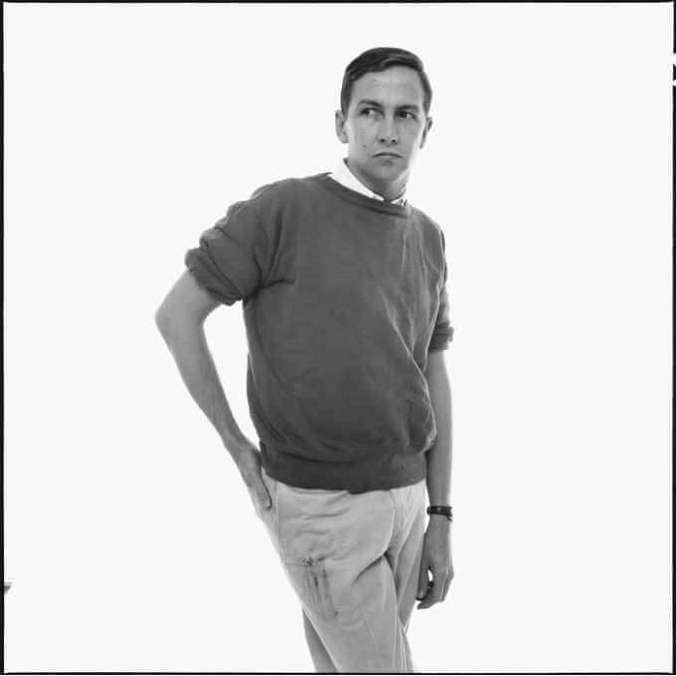
Who is Robert Rauschenberg? A Brief Biography
1925: Born in Port Arthur, Texas, Rauschenberg served in the U.S. Navy before studying art at the Kansas City Art Institute & Academie & Julian in Paris.
1948: Studied art at Black Mountain College
Was interested in an experimentalist approach to art rather than more methodical and disciplined approaches.
He experimented with a variety of mediums including printmaking, drawing, photography, painting, sculpture, and theatre; his works often featured some combination of these and blurred conventional distinctions between artistic categories.
1949: Moved to New York City and challenged the status quo with his age-defying artwork by age 25.
Robert Rauschenberg, New York, May 2, 1960. Photo: Richard Avedon © The Richard Avedon Foundation

Slide 4
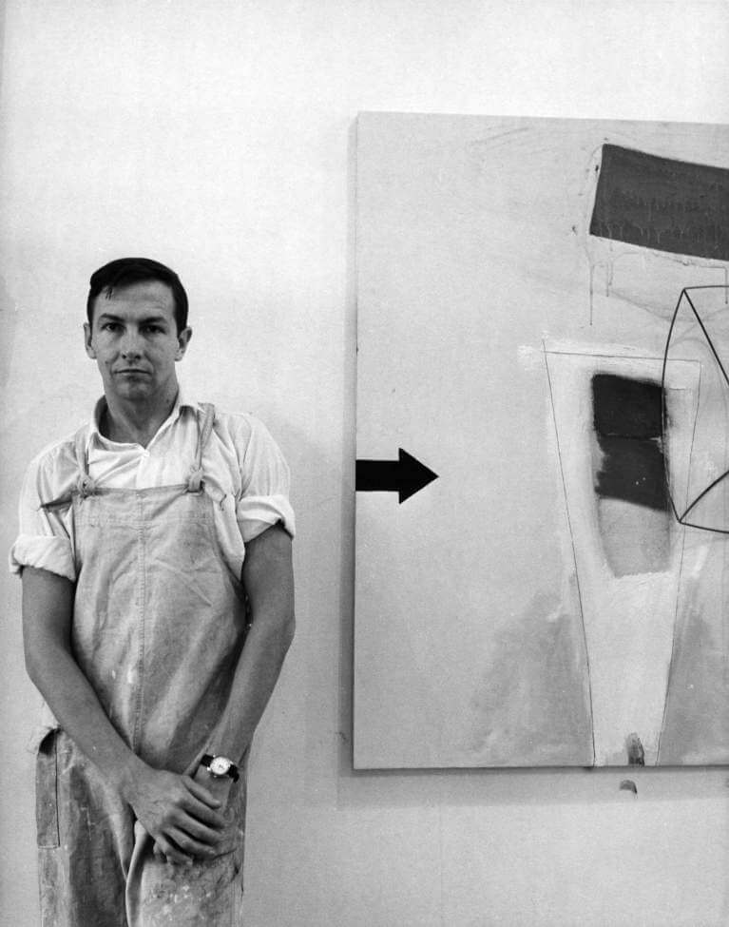
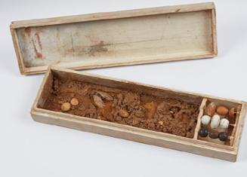
You begin with the possibilities of the material Robert Rauschenberg
Robert Rauschenberg-Material, Egalitarianism and Life
1949: Initiated a studio practice in New York City
1950: Introduced to the Abstract Expressionists and began to incorporate their free brushwork and new ideas into his paintings.
1951: Expanded on the abstract idiom with the inclusion of materials taken from his immediate environment.
1952-1953: Travelled to Italy and North Africa where he created collages, and small sculptures including Scatole Personali out of found materials
1953: Returned to New York City and began creating sculptures with found materials such as scrap metal, wood, and twine in his Lower Manhattan studio.
Rauschenberg famously stated that "painting relates to both art and life," and he wanted to work "in the gap between the two”.
He questioned distinctions between art objects and everyday objects, and his use of readymade (found) materials reinterpreted the intellectual issues raised by the Dada artist Marcel Duchamp’s Fountain
Rauschenberg with Stripper (1962) in his Broadway studio, New York, ca. 1962
Scatole Personali, 1951, painted wooden box with lid, wooden beads, fabric, soil, stones and winged insect 1 ¾ x 3 ¾ x 13 ¼ inches

Slide 5
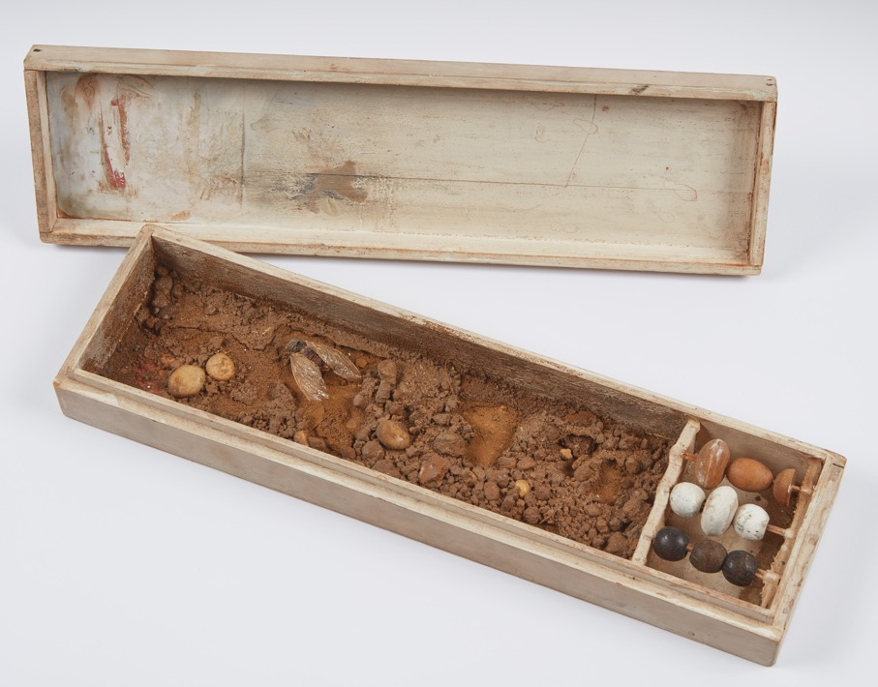
1952-1953: Rauschenberg’s collages and sculptures made while traveling in Europe and North Africa with artist Cy Twombly, introduce his method of combining different subjects and materials and contain many of his enduring motifs
Robert Rauschenberg stated: “I think a picture is more like the real world when it’s made out of the real world.”
He created collages and small sculptures including Scatole Personali out of found materials
Rauschenberg expanded the abstract idiom by including recognizable images and materials taken from his immediate environment.
The small, fetishistic assemblages made in Italy were laboratories for the later Combines
Scatole Personali, 1951, painted wooden box with lid, wooden beads, fabric, soil, stones and winged insect 1 ¾ x 3 ¾ x 13 ¼ inches

Slide 6
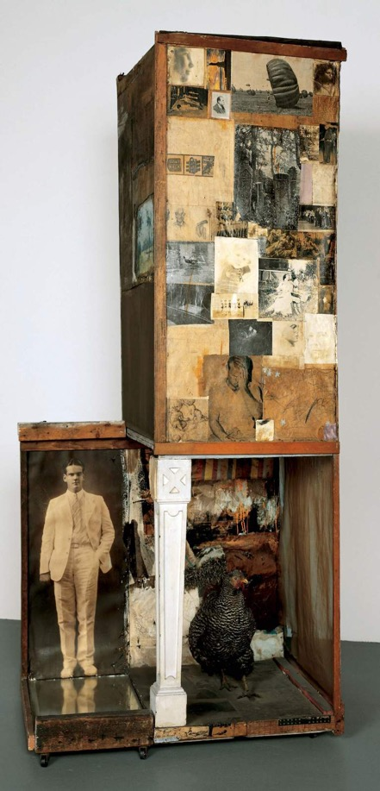
“I’ve always felt as though, whatever I’ve used and whatever I’ve done, the method was always closer to a collaboration with materials than to any kind of conscious manipulation and control.” Robert Rauschenberg
1954-55: The first, fully realized Combines were created, eliminating all distinctions between objects, painting, and sculpture
The divisions between found materials and precious art materials were dissolved
Art no longer belonged to the elite few of the art world but rather legitimately to the viewer and the public from which they came
Notes:
Artworks considered among the first Combines, including Untitled (54.021), Collection (54.001), and Charlene (54.009), date to summer 1954 and are still largely red in color. As the term “combine” implies, distinctions between painting and sculpture have all but disappeared in this series.
When the Red Paintings and Combines were first exhibited in December 1954 at the Egan Gallery, New York, where many of the Abstract Expressionist artists were represented, the critical reception was largely negative.
It was art critic Frank O’Hara, writing for Artnews, who recognized “a big talent at play”; realizing a significant departure from the earlier generation of painters, O’Hara described Rauschenberg as the enfant terrible of the New York School.
https://www.rauschenbergfoundation.org/art/lightboxes/red-paintings-combines

Slide 7
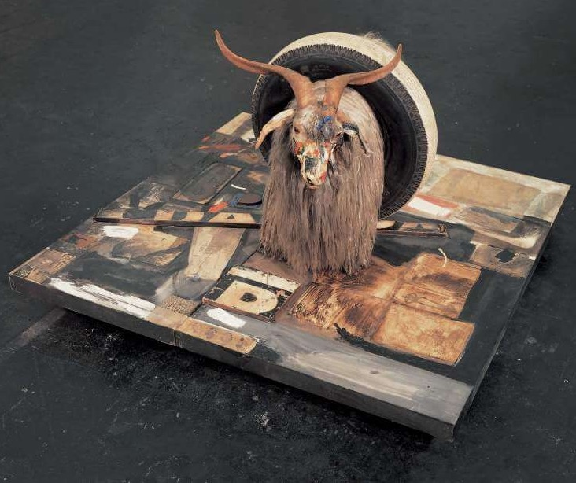
Leo Steinberg wrote: “What he (Rauschenberg) invented above all was... a pictorial surface that let the world in again.”
Combines were made from materials in the world and were both two-dimensional collages and eventually three-dimensional objects came to be part of this collaged form.
Art belonged to and represented everyone, everything, and everyday experiences from the lived world.
New ideas evolved from the juxtaposition of materials and unrelated images which imbued ordinary objects with new (sometimes unforeseen) meanings
Monogram (1955-59)
Notes:
Monogram (1955–59) belongs to the series of Combines that Rauschenberg made between 1954 and 1964.
The title is derived from the union of the goat and tire, which reminded Rauschenberg of the interweaving letters in a monogram.

Slide 8
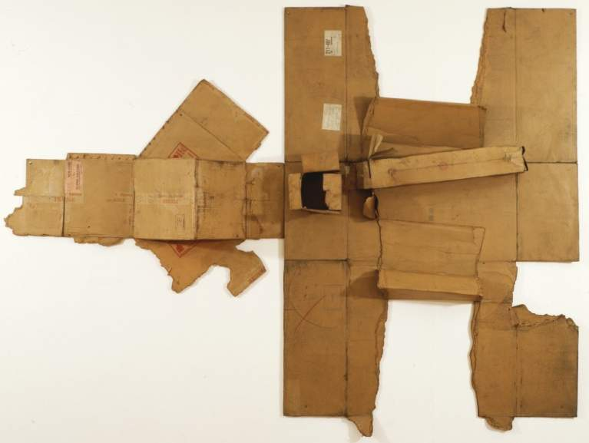
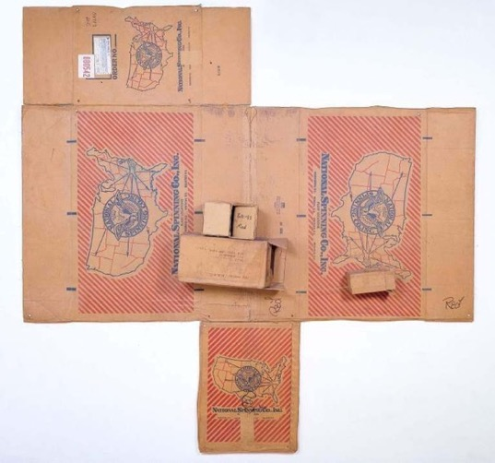
He shared his appreciation for chance and the every day by seeking to act in the “gap” between
art and life
1970: Rauschenberg moved and worked from his home and studio in Captiva Island, FL
  Retreating from urban imagery, he now favored more abstract idioms and natural fibers, such as fabric & paper.
1971–1972: The first works created in his new studio were the Cardboards.
  Cardboard was not considered an “art” material. It was a democratic material that was accessible and belonged to all-a material of people’s everyday life. Transforming the material was act between “art and life”.
Bande de Sureté / Twin City / Nipples (Cardboard), 101 x 134 1/2 x 13 3/4 inches (256.5 x 341.6 x 34.9 cm), The Metropolitan Museum of Art, New York
National Spinning / Red / Spring (Cardboard), 1971
Notes:
The Cardboards (1971–72) and the Venetians (1972–73) reveal his fascination with the inherent color, texture, and history of found materials.

Slide 9
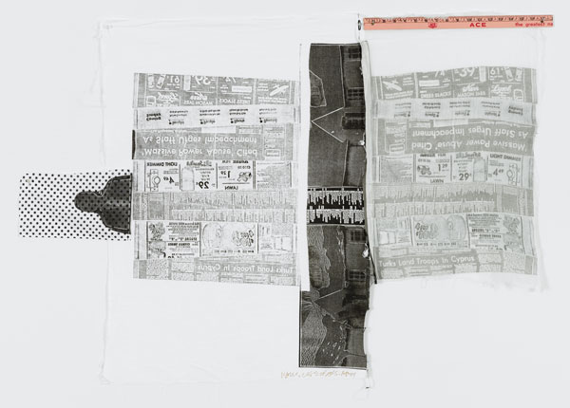
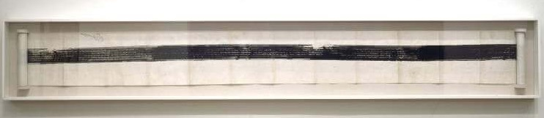
Prints and works on paper comprise some of Rauschenberg's most significant art
Collages and prints became part of Rauschenberg's visual vocabulary.
Printmaking such as:
Transfer prints
Lithography
Intaglio
Direct printing
Sometimes on, or from unusual surfaces was central to Rauschenberg's art-making practice due to the medium’s reproducibility and the wide range of effects it enabled him to achieve.
Sheephead, 1974 -Multicolor relief and intaglio print on fabric with collage of wooden ruler sewn on print., 34-1/4 x 51 x 1/8
Automobile Tire Print, 1953
Notes:
Vocabulary: What is Printmaking? Define

Slide 10
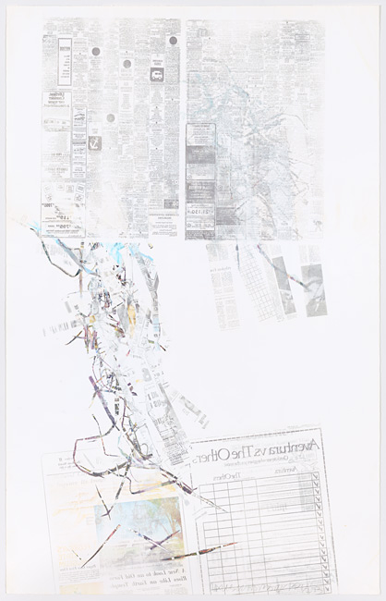
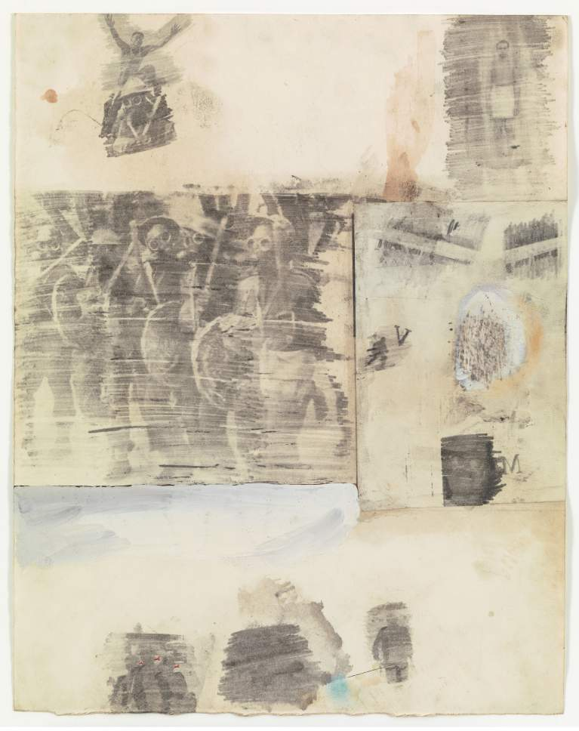
Transfer Prints (Solvent Transfer)
Robert Rauschenberg perfected his solvent transfer technique
Transfer Prints are a type of monotype
Monotype printing produces a unique print (1 image)
Transfer Prints “transfer” an image (or text) from one surface to another
In Rauschenberg’s early transfer drawings (1952–68), the artist recycles an American collective memory into alternative narratives that are disengaged from a linear history.
Canto XXI: Circle Eight, Bolgia 5, The Grafters, from the series Thirty-Four Illustrations for Dante’s Inferno, 1959–60
Crops: Peantus, 1973-Screenprint in color with Solvent transfer on woven fabric. 60”x38” Published by Graphicstudio, USF
Notes:
Rauschenberg began a dedicated exploration of his solvent transfer process in 1958 when he applied familiar motifs from his three-dimensional Combines (1954–64) to two-dimensional surfaces.
Vocabulary words: What is a Transfer Print? What is a Monotype?

Slide 11
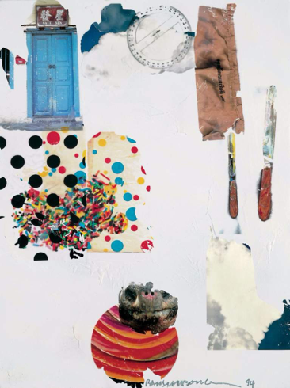
Transfer Prints
(Solvent Transfer)
Images can be transferred to almost any surface.
Rauschenberg used fabric or paper is used as a substrate (the surface to be printed)
Sometimes he combined printing techniques such as Transfer Printing with Silkscreen or Firewax printing
These prints reclaim scraps of printed media combined with hand-drawn and painted passages to make pictorial poems that subtly reflect the contemporary visual culture and comment on issues of the day.
Splayed (Shales), 1994 , 60 x 48 x 1 ½ in. fire wax with transfer on canvas mounted on board with painted aluminum frame
Crops: Peantus, 1973-Screenprint in color with Solvent transfer on woven fabric. 60”x38” Published by Graphicstudio, USF
Notes:
A tension exists between the subject of the photographic source images and the mode of transmission in Rauschenberg’s solvent transfer
John Cage once remarked, “it seems like many television sets working simultaneously all tuned differently.”

Slide 12
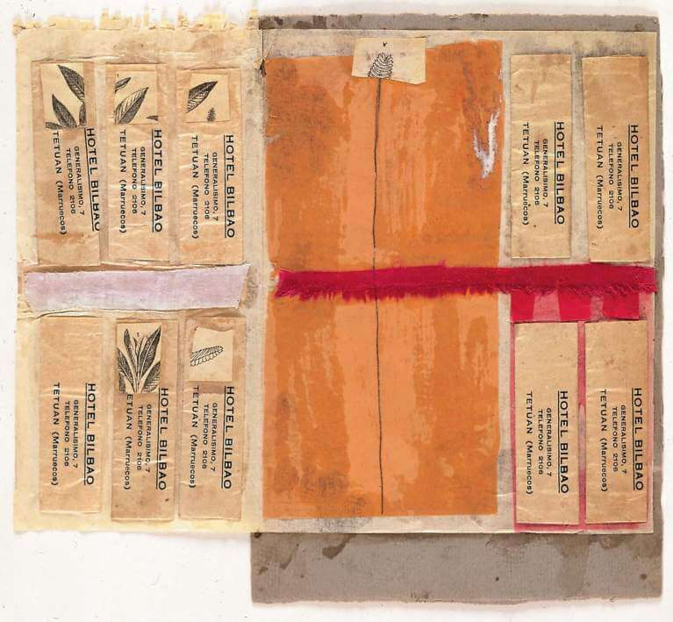
Transfer Prints-process (how to)
Newspaper or magazine images are applied to a substrate by placing them on a Lithography stone or aluminum block covered with glassine paper(a smooth, transparent glossy paper) to avoid stains.
The images are then placed face-down and sprayed with a solvent (to dissolve the ink and help it transfer).
The image is then printed onto its new surface by pressing the substrate and the image together.
The transfer has a more atmospheric and painterly look than the original.
Untitled (Hotel Bilbao), ca. 1952
Notes:
In Rauschenberg’s transfer drawings (1952, 1958–68), the artist recycles an American collective memory into alternative narratives that are disengaged from a linear history.

Slide 13
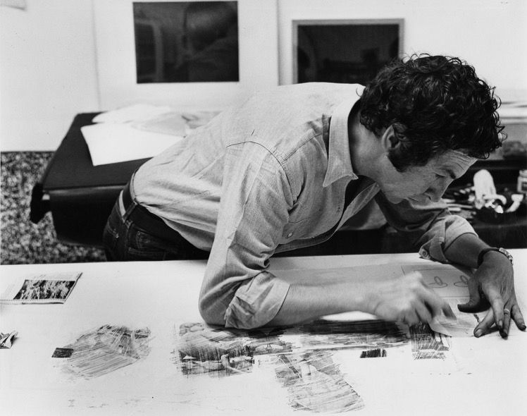
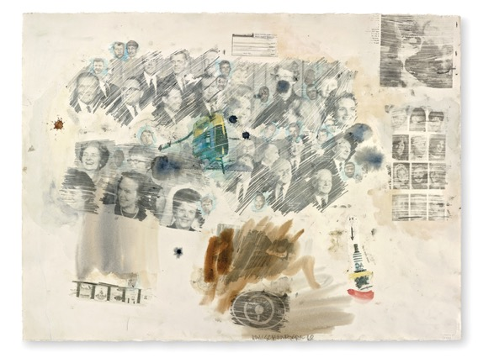
Transfer Prints (how to)
Applying Pressure
A printing press, or techniques such as
  Rubbing with the back of a wooden spoon or using a tool (which allows pressure to be controlled selectively) puts pressure on the moist image to be transferred.
Rauschenberg ran his images through a lithography press to add pressure to the back of the image and push the ink onto the substrate.
Rauschenberg also placed the image face down on paper and transferred it by burnishing the back with a series of hatch marks created by rubbing a dry pen nib across the back of the image.
The results are edgeless units bound by the artist’s mark-making.

Slide 14
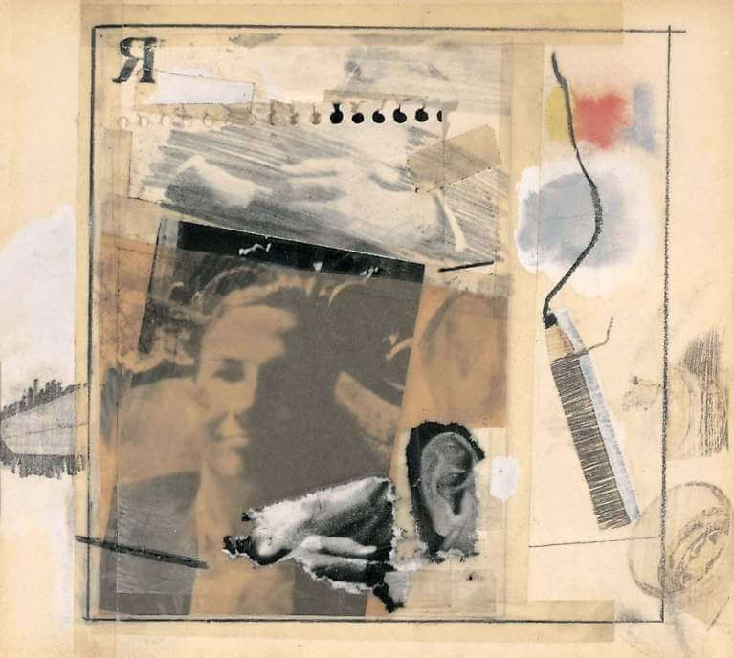
An important characteristic of the print is its identity as a “multiple”
Unlike other art forms which could be viewed only on a limited basis, prints found their way to a larger audience.
The visual and social impact of the print works were a potent media force.
Many of Rauschenberg’s prints are multi-media and have:
  Traces of newspaper clippings
  Important media images of the time
  Snapshots from the artist's life and work
Evocative juxtapositions and new meanings result that often served as statements of the political and cultural era.
Untitled (Self-portrait for Dwan poster), 1965-Solvent transfer with ink, graphite, paper, and tape on paper 8 x 9 inches (20.3 x 22.9 cm). Courtesy of Leo Castelli Gallery, New York
Notes:
Prints were utilitarian-images derived are from media and popular sources
…“The artist stitches together disparate images in an act of artistic alchemy by selecting from the quotidian and arranging an editorial of the familiar, though briefly obscured.” Mary Kate Anselmini, Stanford Arts Institute Summer Intern in Arts Administration, 2015-https://www.rauschenbergfoundation.org/art/lightboxes/transfer-drawings
Vocabulary: What is Juxtaposition

Slide 15
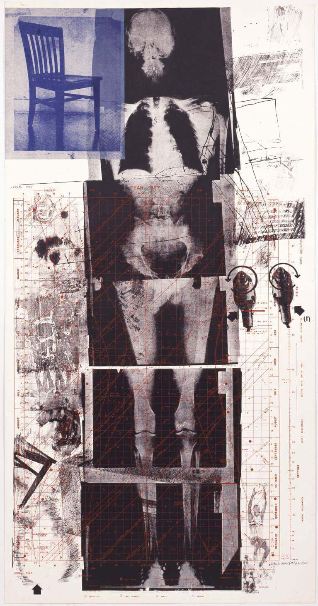
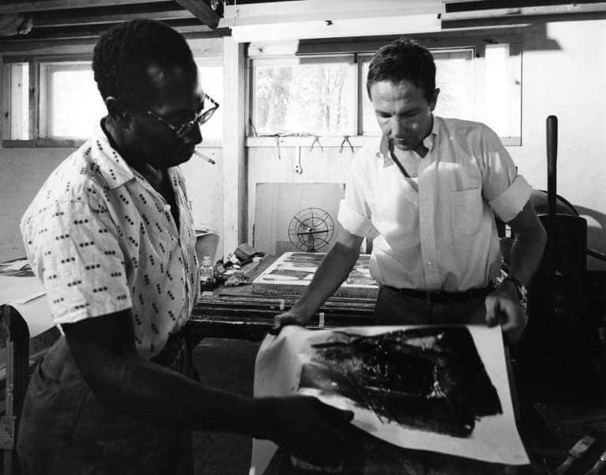
The visual and social impact of these works became a potent media force
Many of Rauschenberg’s prints are
multi-media and blurred the boundaries of conventional printmaking
Incorporated utilitarian-images derived are from media and popular sources
Made in collaboration with print ateliers and other artists.
Rauschenberg working with master printer Robert Blackburn at ULAE (Universal Limited Art Editions), West Islip, New York, 1962. Photo: Hans Namuth © 1991 Hans Namuth Estat
Booster, 1967
Notes:
Many of Rauschenbergs prints were invented, created and printed at GraphicStudio, then headed by Don Saff. More about Rauschenbergs printworks can be found on the GraphicStudio website: http://www.usfcam.usf.edu/GS/artists/rauschenberg_robert/rauschenberg.html
More about the vast bodies of Rauschenbers print work can be found on the Rauschenberg Foundation site: https://www.rauschenbergfoundation.org/art/art-context/autobiography
Terms: Collaboration, Print atelier

Slide 16
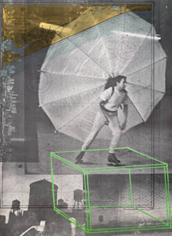
Reflections
How do the materials employed in an artwork contribute to the delivery of the concept (idea), context, overall intention, understanding, and the reception of the artwork?
Have you ever thought about how the actual materials chosen for an artwork and where they originate are not only closely tied to the intended idea and meaning, but also help to create meaning?
What happens when completely different images are juxtaposed? How does a new story evolve?
Notes:
Vocabulary: Concept, materials, juxtaposed.

Slide 17
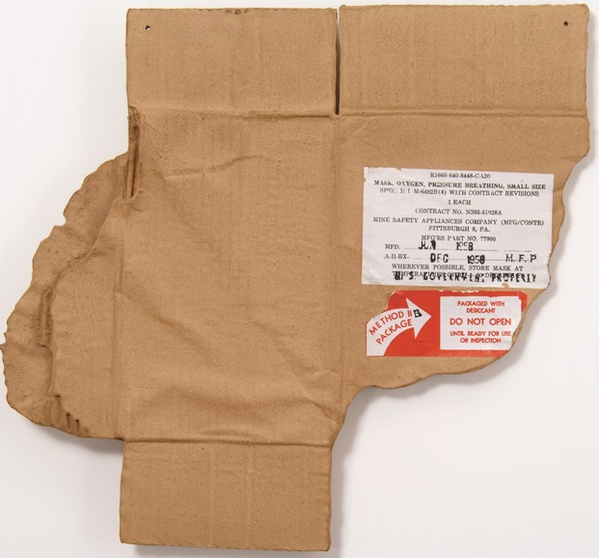
Rauschenberg’s influence has been so pervasive for so long it often appears undetectable
Yet, his multimedia approach served as a forerunner for what was to come in art in the late 20th and 21st centuries
He provided a key to a radically rich, anti-formalist openness for working between “art and life”
Rauschenberg experimented and embraced technological, conceptual, and aesthetic innovations that stretched and re-invented traditional approaches to printmaking and created new forms.
The definition of “the print” is in a constant state of evolution. It can be and often is molded to the social and aesthetic needs of a given society and to the individual expression of a particular artist.
Made in Tampa Clay Pieces 1, 1972 clay with screenprinted lacquer decals and soil patina. 14 ½ x 15 ½ x ¾ in.
For Rauschenberg, his expression foreshadowed an entirely new type of society and cultural aesthetic.
Notes:
Made in Tampa Clay Pieces 1, 1972 clay with screenprinted lacquer decals and soil patina. 14 ½ x 15 ½ x ¾ in.

Slide 18
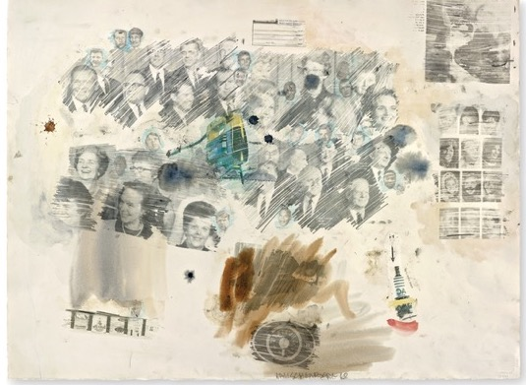
Activity 1: Create a Wintergreen Oil Solvent Transfer Collage from photocopies to Tell A Story
Rauschenberg created Solvent Transfer Prints to make collages from images and words he found in magazines, newspapers and his own archives that had a handmade, painterly quality.
What kind of imagery can you combine to tell the story of:
You
Place
Your time
Or your culture?
TO BEGIN:
Look Closely at Rauschenberg’s Transfer Print Collages
Notice what kind of imagery the artist combines, how the sizes relate, and what kind of marks are made by burnishing.
When you are ready to create your own artwork, look for images in magazines, historical books, text in newspapers, and your family photo albums or photographs on your phone that when combined tell the narrative you want to convey.
Choose at least five images you would like to use. Don’t overthink
Decide how big or small you want your work to be
Decide the size you would like to print each image
Then photocopy each of your images, text or print your photographs
*TIPS*:
Cheap photocopy’s work best for Solvent Transfers
You can also print your images from a printer.
***Don’t worry if the color and printing are not perfect, this will add to the originality of your artwork
Notes:
Activity 1: Is appropriate for beginning and advanced projects

Slide 19
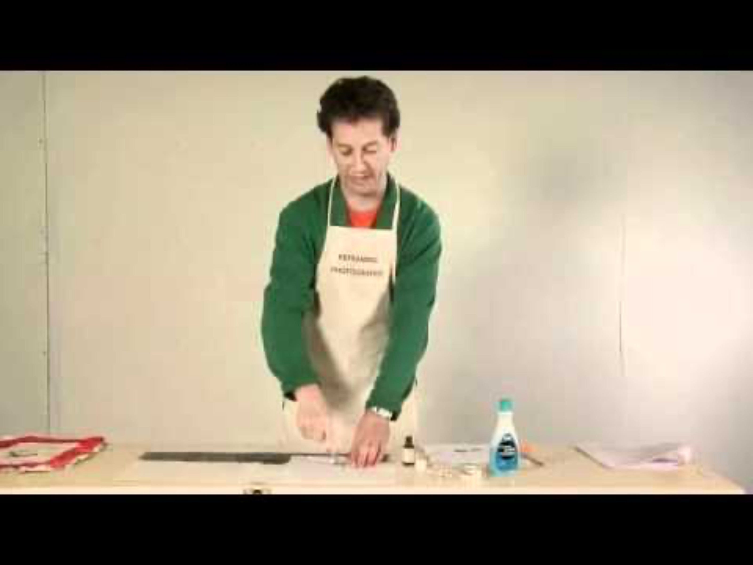
Activity 1: Create a Wintergreen Solvent Transfer Collage
MATERIALS:
A piece of smooth print-making paper such as BFK Rives or smooth watercolor paper
  You can use any paper, but your artwork will have a more substantial finished look if you choose good paper.
Wintergreen oil (as a solvent)
Wooden or metal spoon
Photocopies of your images
Qu-tips
Paper towels
Ventilated area
HOW TO:
Watch the video tutorial created by University of Michigan School of Art & Design faculty Rebekah Modrak in conjunction with her new book, Reframing Photography
CONSIDERATIONS:
How much of the image do you want to transfer.
What kind of burnishing lines (or any) do you want?
How can you vary scale of the images for visual interest
Is it important that all text is readable?
What orientation do you want to place your images?
All the same direction, diagonally, upside down, etc.?
https://www.youtube.com/watch?v=mscXiGUqrtE&t=219s

