Slide 1
Robert Rauschenberg
(OFFSET: Robert Rauschenberg at USF Graphicstudio)
Art, Democracy, and Diplomacy

Slide 2
Democracy and Art

Slide 3
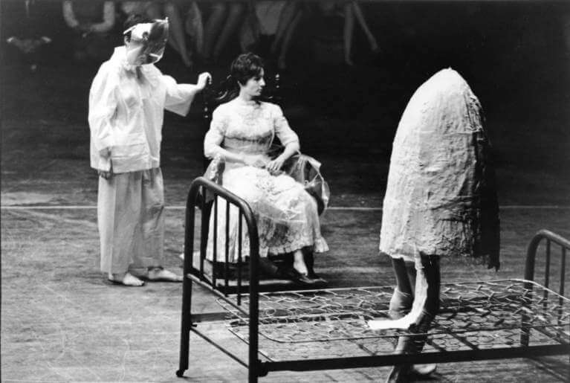
Rauschenberg was a gifted collaborator, breaking disciplinary boundaries by experimenting with scientists, performers, composers, and visual artists.
Artist collaborations were multidisciplinary and rallied around notions of social change
Closing the “gap” between art and life included all the senses: sound, dance, theater, and a mashup of materials and images.
For Rauschenberg, Art functioned as a way of “working WITH other people.” Exploration was paramount
The collaborations were egalitarian giving equal attention and treatment to ideas, mediums, and their exchange.
Deborah Hay, Alex Hay, and Simone Forti in Robert Rauschenberg’s “Linoleum” (1966) at the NOW Festival, National Arena roller-skating rink, Washington, D.C., United States, April 26, 1966. Photo: Peter Moore © Barbara Moore. Photograph Collection. Robert Rauschenberg Foundation Archives, New York
Notes:
Rauschenberg’s earliest explorations of avant-garde dance and performance can be traced to his education at Black Mountain College, North Carolina, where many artists experimented with groundbreaking forms of theater.
From 1954 to 1964 Rauschenberg also served as a lighting, set, and costume designer for the Merce Cunningham Dance Company, collaborating on more than twenty dances.
In the early 1960s, he participated in Robert Dunn’s experimental dance workshops held at Cunningham’s New York studio (1960–62)—a course that would become the basis for the pioneering Judson Dance Theater (1962–64).

Slide 4
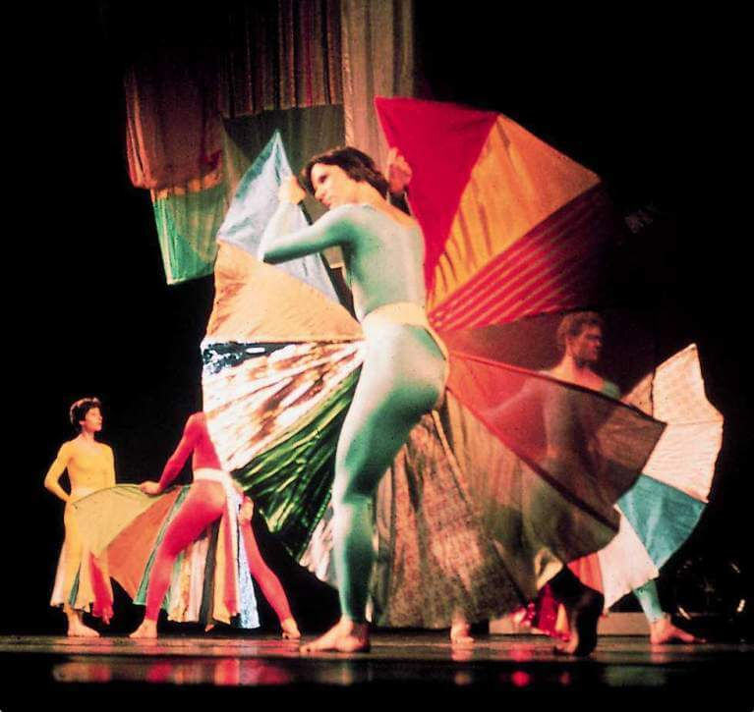
“Rauschenberg’s method of collaboration proceeded an exploration of the unknown and uncharted.” Don Saff
Costumes and set, entitled Tantric Geography were designed by Rauschenberg for Merce Cunningham Dance Company’s performance Travelogue (1977)
Cunningham provided little information, only that the dancers “were going to travel around the stage at different points and in different ways”.
The soundtrack, “Telephones and Birds,” was composed by John Cage and was not revealed to the dancers before the performance.
Each component of the collaboration was an integral and inventive part of the larger experimental, multidisciplinary, creative endeavor
Tantric Geography Photo: Charles Atlas
Notes:
Rauschenberg’s collaborative relationship with choreographer Merce Cunningham began in 1952 when they participated in an untitled event, referred to as Theater Piece No. 1, organized by composer John Cage at Black Mountain College, North Carolina.
Rauschenberg officially began working with the Merce Cunningham Dance Company in 1954, and throughout the next decade, he contributed to over twenty performances, providing lighting, set, and costume designs.
Heeding Cunningham’s unusual approach to collaboration, Rauschenberg often worked independently with little guidance.
John Cages soundtrack consisted of “non-music” such as telephone recordings and Australian bird calls.

Slide 5
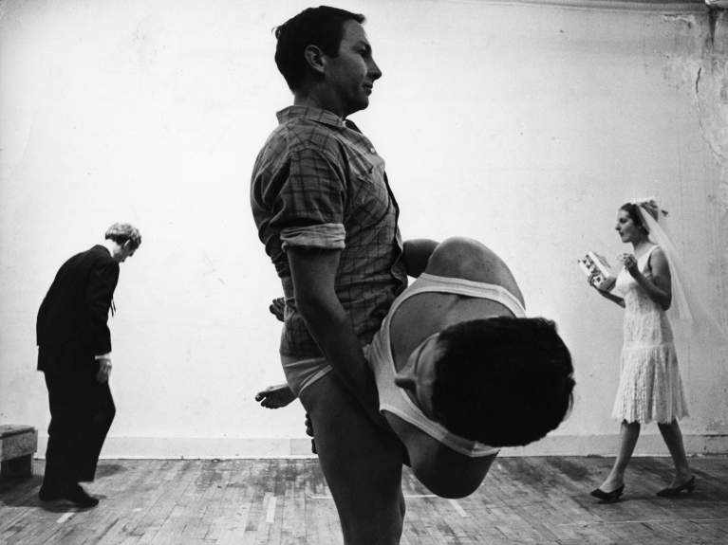
Rauschenberg strongly believed that artists could serve as catalysts for social change. His collaborations were multidisciplinary.
Rauschenberg was a pioneer who believed artist collaborations and the exchange of ideas could be a way to assert social change.
“Working with other people” as a catalyst for social change was a multidisciplinary approach to reach a broader public.
Rehearsal for Rauschenberg’s Spring Training (1965) in his Broadway studio, New York, 1965. Pictured: Alex Hay, Rauschenberg, Steve Paxton, and Trisha Brown. Photo: Ugo Mulas © Ugo Mulas Heirs. All rights reserved
Notes:
Vocabulary: Collaboration

Slide 6
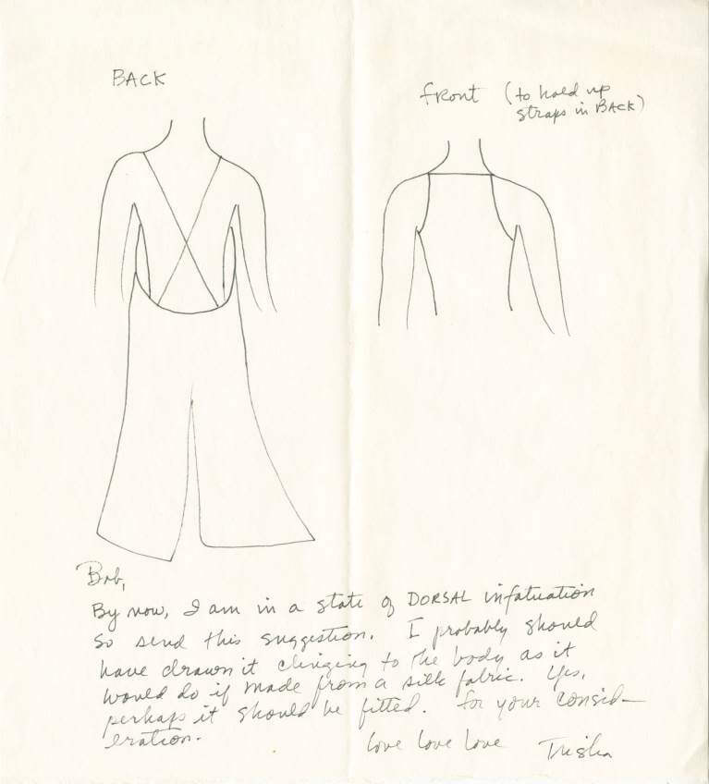
Rauschenberg closely collaborated with many innovative forward-thinking artists of the time
Some of these artists become tremendous world talents like Jasper Johns and Cy Twombly, composers John Cage and Morton Feldman, and choreographers Merce Cunningham and Trisha Brown.
Part of working within the “gap” between art and life was removing the barriers between creative practices and thus remove the barriers between the art world and life.
These collaborations were a multidisciplinary approach that often addressed pertinent issues within of their day.
Letter from Trisha Brown to Rauschenberg, undated, with Brown’s costume sketch probably for If you couldn’t see me (1994), undated. Creator: Trisha Brown. Robert Rauschenberg papers. Robert Rauschenberg Foundation Archives, New York
Notes:
Choreographer Trisha Brown and Rauschenberg were both pivotal figures in the development of Postmodern dance, each pushing the boundaries of form and movement.
Collaboration was central to their investigations of the visual and the kinetic, and over the course of five decades,
Brown and Rauschenberg deeply influenced one another. Brown spoke of their “uncanny connection” that cemented their life-long friendship and propelled their numerous performance collaborations.
Brown met Rauschenberg during the 1960s, when she was a work-study student at Merce Cunningham’s New York studio.
Brown and Rauschenberg maintained a remarkable creative dialogue, mutually influencing one another for nearly half a century until Rauschenberg’s death in 2008

Slide 7
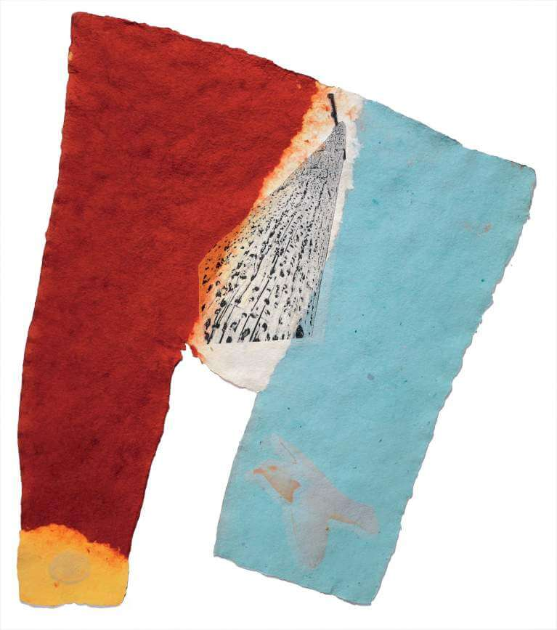
In the 1970s-early 1980s, Rauschenberg collaborated with papermakers in France, India, and China, as well as with artisans at a ceramic factory in Japan.
During his travels, Rauschenberg collected materials to use including photographs, local objects, textiles, and printed matter.
The resulting works were informed by his new understanding of another culture, yet the admixture of imagery and materials was distinctly Rauschenbergian.
Link (Fuses), 1974
Notes:
Collaborations at paper mills in France and India resulted in works where paper pulp was elevated to an art form.

Slide 8
Diplomacy and Art

Slide 9
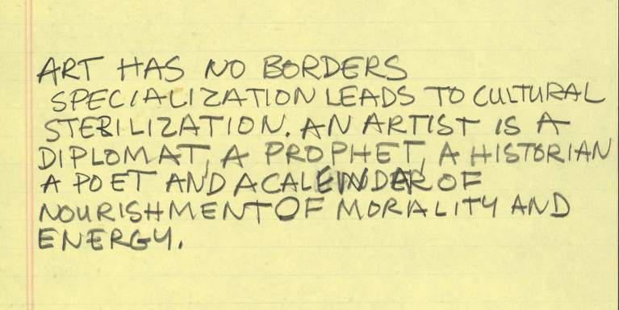
Statement by Rauschenberg, undated, Robert Rauschenberg Foundation

Slide 10
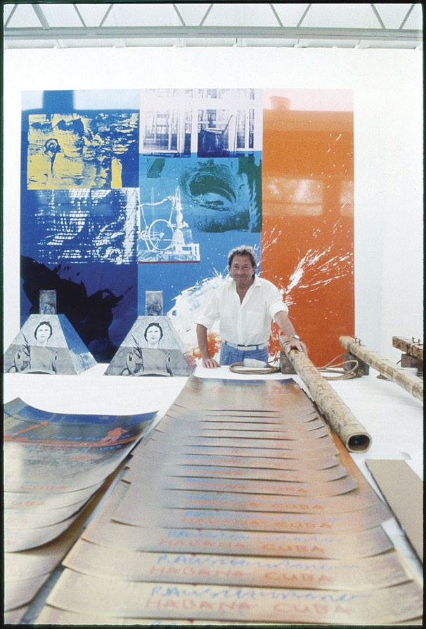
Rauschenberg’s belief in the power of art as a catalyst for positive social change and collaboration was at the heart of his participation in international projects in the 1970s and early 1980s
Diplomacy and Art
Rauschenberg Overseas Culture Interchange (ROCI)
A trip to China was the catalyst for this large-scale exhibition (ROCI) that toured the world with the goal of a peace-making interchange between cultures.
ROCI (pronounced Rocky) was a tangible expression of Rauschenberg’s long-term commitment to human rights and to the freedom of artistic expression.
Notes:
Rauschenberg Overseas Culture Interchange (ROCI)—was the most tangible expression of Rauschenberg’s belief in the power of art and artistic collaboration to bring about social change on an international level.
More about the ROCI project can be found on the Rauschenberg Foundation Website: https://www.rauschenbergfoundation.org/art/art-context/roci

Slide 11
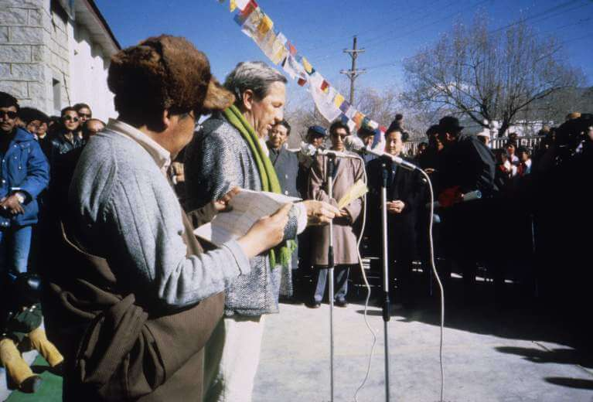
ROCI occurred as the Cold War began to end, coinciding with a time of radical change in the world order
Diplomacy and Art
Rauschenberg Overseas Culture Interchange (ROCI)
1984: ROCI was announced at the United Nations in New York
ROCI was organized by Donald Saff (Director of USF Graphic Studio) as the Artistic Director in collaboration with Rauschenberg.
Notes:
Rauschenberg Overseas Culture Interchange (ROCI)—was the most tangible expression of Rauschenberg’s belief in the power of art and artistic collaboration to bring about social change on an international level.
More about the ROCI project can be found on the Rauschenberg Foundation Website: https://www.rauschenbergfoundation.org/art/art-context/roci
USF Graphic Studio: Graphicstudio was founded in 1968 as an experiment in art and education at the University of South Florida, Tampa. At Graphicstudio, research into art-making techniques works in tandem with new aesthetic expressions by leading and emerging artists. The constant push by collaborating artists and studio staff to create new possibilities for artistic practice is the backbone of the atelier, and the impetus that has kept it at the forefront of international fine art publishing.

Slide 12
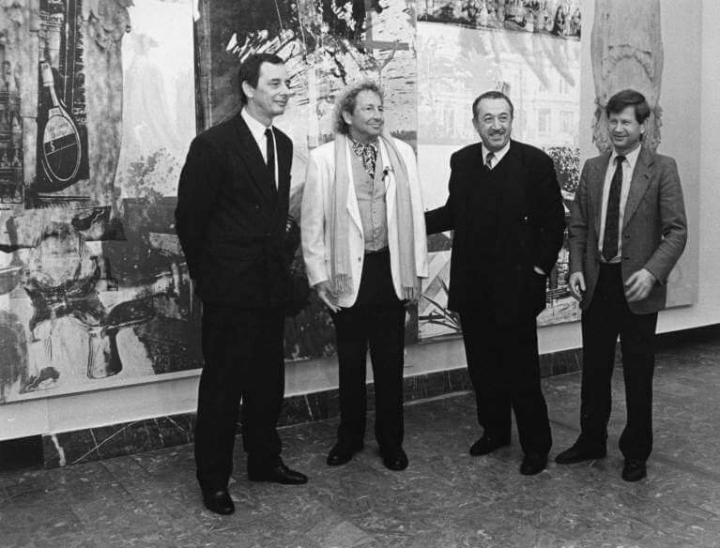
Rauschenberg traveled to countries where artistic experimentation had been suppressed, with the purpose of sparking a dialogue and achieving a mutual understanding through the creative process.
Saff visited “sensitive” countries, directors, curators, poets, writers, cultural leaders and totalitarian figures where freedom of expression was limited, evaluating their relevance to Rauschenberg’s desire to make the ROCI tour a peace-making enterprise that would function as an interchange with local artists and cultures.
The exchange of art and facts was a central tenant of the project
Rauschenberg with Dr. Dietmar Keller, Minister of Culture of the German Democratic Republic (left), and Tahir Salakhov (right), and unidentified man, ROCI BERLIN, Neue Berliner Galerie im Alten Museum, March 1990. Work in background is Caryatid Cavalcade I/ROCI CHILE (1985). Photo: Elfriede Schönbor
Notes:
Donald Saff is an artist, art historian, and educator. In 1968 Saff founded the printmaking workshop Graphicstudio at the University of South Florida, Tampa, where he served as a Distinguished Professor and Chair of the Visual Arts Department, and as Founding Dean of the College of Fine Arts.
In 1984, Rauschenberg asked Saff to serve as the Rauschenberg Overseas Culture Interchange (ROCI)’s artistic director.
Saff worked closely with Rauschenberg and was responsible for many aspects of the research, planning, and implementation of the project.
The archives and Saff’s notes about ROCI can be found in the Rauschenberg Foundation Archives at the following link:
https://www.rauschenbergfoundation.org/sites/default/files/2021-08/RRFA_10%20Finding%20Aid%20Public_2.3.pdf

Slide 13
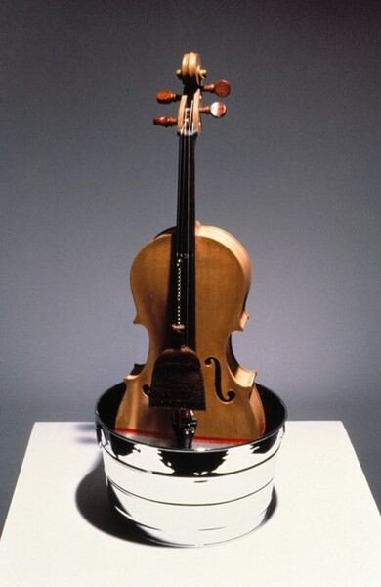
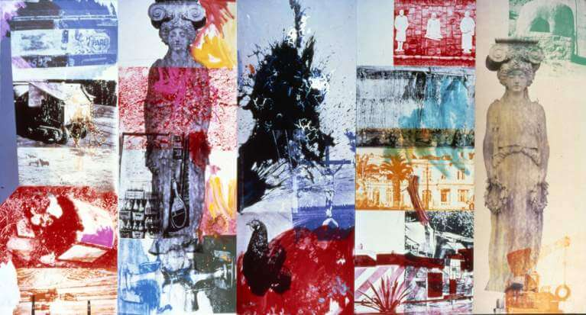
1985-1990: The ROCI tour was realized in ten countries:
Mexico
Chile
Venezuela
China
Tibet
Japan
Cuba
The Union of Soviet Socialist Republics (USSR)
Germany
Malaysia
1991 The final exhibition was held at the National Gallery of Art, Washington, D.C.
Robert Rauschenberg, Tibetan Garden Song, 1986. Chinese cello, chrome washtub, Chinese scrollmaker’s brush. Published by Graphicstudio
Caryatid Cavalcade I / ROCI CHILE, 1985
Notes:
Traveling around the world for ROCI, Rauschenberg’s exploration of diverse cultures and local art-making practices gave rise to an extraordinarily diverse body of work.
The catalyst for the metal painting and sculpture series was ROCI CHILE, where he painted and screened on copper in 1985.
The works and writing from the individual countries can be found on the Rauschenberg Foundation website: https://www.rauschenbergfoundation.org/art/art-context/roci

Slide 14
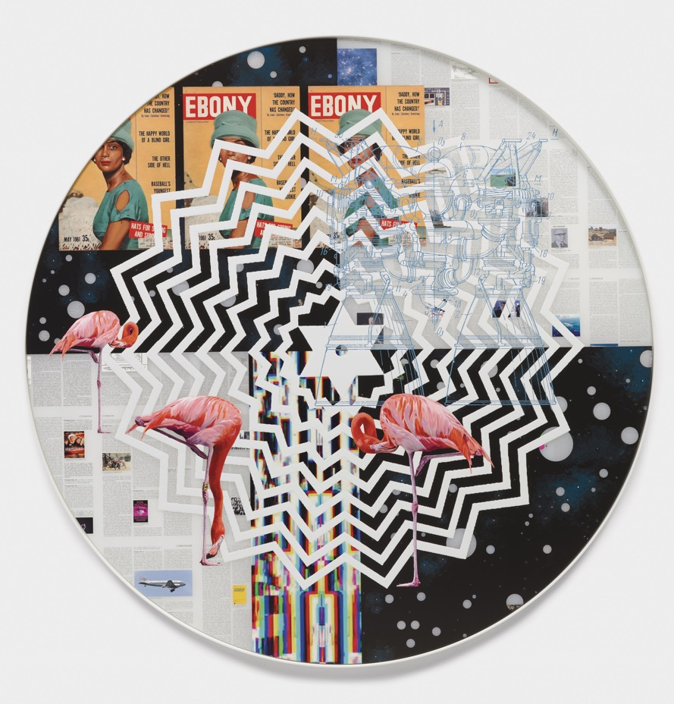
Aftershock
Taveres Strachan, Happy World, 2022. Oil, enamel, pigment, acrylic. 47 ½ “. diameter, 2” depth.
Notes:
Taveres Strachan, Happy World, 2022. Oil, enamel, pigment, acrylic. 47 ½ “. diameter, 2” depth.

Slide 15
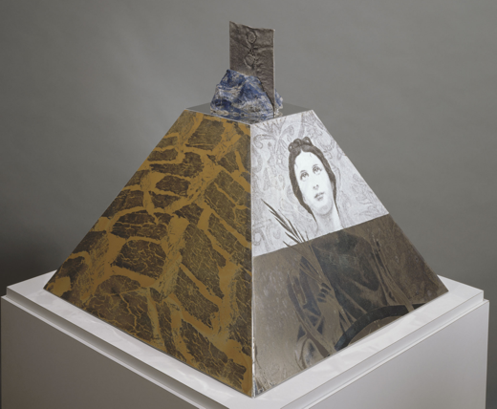
Rauschenberg was the 20th century’s art-spreading, medium-challenging, style-switching creative pioneer
Rauschenberg’s oeuvre evokes “a pre-history of contemporary practice. “So many of the things that you see in his work…a performative bent, interdisciplinary practice, an egalitarian approach to a pair of socks or a brushstroke—are all ways of working that Rauschenberg made possible.” MoMA curator Leah Dickerman
Non-compliance was his signature style
Araucan Mastaba/ROCI Chile, 1986, screenprinted enamel with painted editions on polished natural aluminum over a plywood substructure, with sterling silver and lapis lazuli, 20-5/8 x 22 x 22 in. Published by Graphicstudio, USF Collection

Slide 16
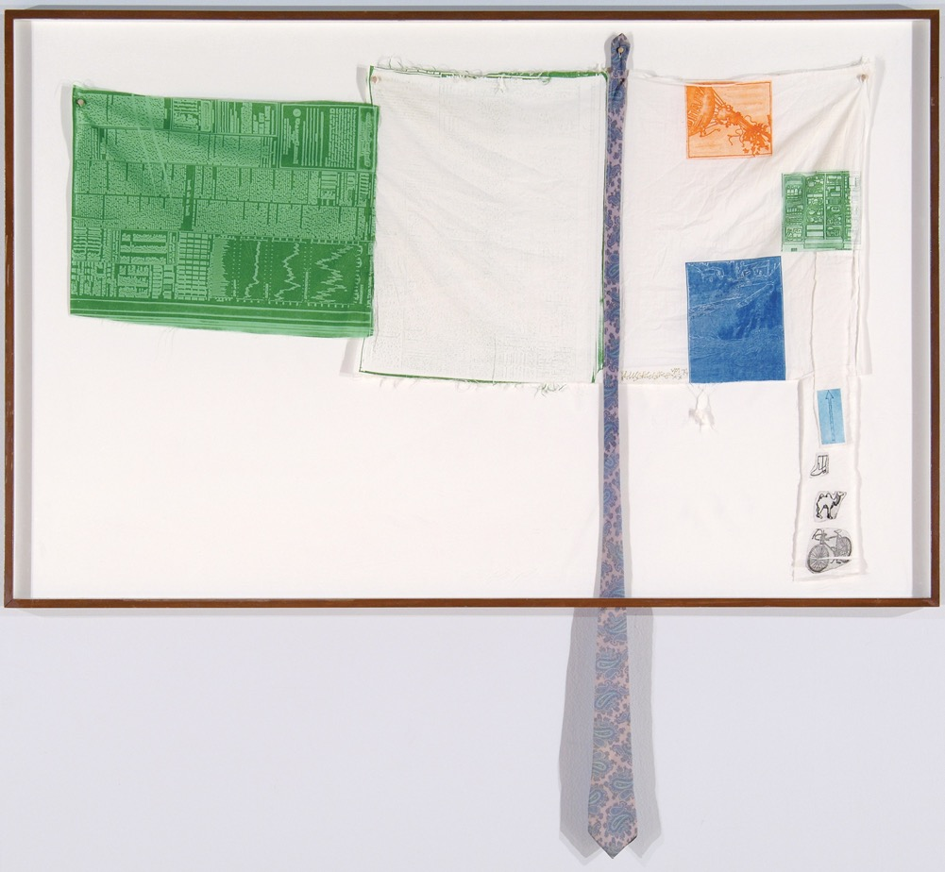
Rauschenberg is known today both for being spectacularly influential and for possessing an immense vision
Generations of artists (including those in OFFSET) have decided to work under Rauschenberg’s medium and material radicality, experimentation, and legacy of the anti-formalist way of working between art and life.

Slide 17
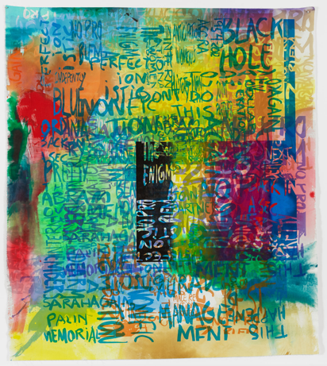
Rochelle Feinstein
Feinstein’s unique hand-painted screen-prints recall Rauschenberg’s love of vernacular speech and accessible media
“His work stood as a model for engagement with event, with material, with life and lives, through uncensored art making.” Rochelle Feinstein
Research Park Project (2014)
17 USF Graphicstudio collaborations
Involved both an expansive grasp of the language of painting, expressed in overlapping multicolored phrases, slogans and figures of speech.
And conversations encountered, overheard, and recorded.
Rochelle Feinstein, Research Park Project Ee, 2014. handpainting and screenprint on canvas. 80 x 71-1/2 in. Published by Graphicstudio, USF Collection. Photo: Will Lytch.

Slide 18
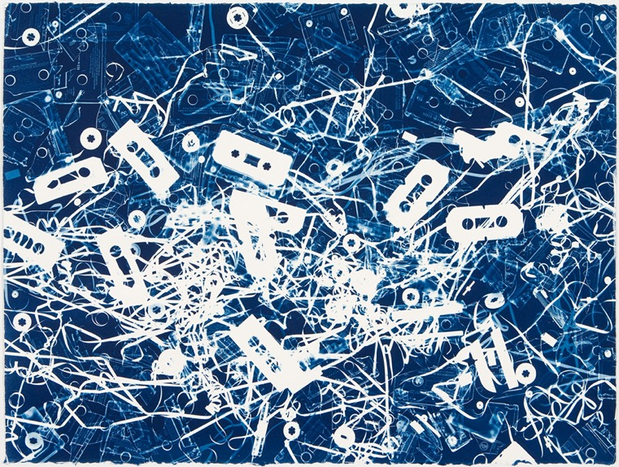
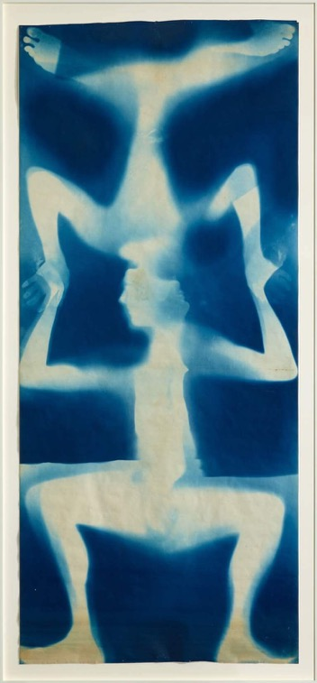
Christian Marclay
Rauschenberg’s experiments with photography and printmaking can be seen in Christian Marclay’s cyanotypes
The compositions resemble powerful collage works by Rauschenberg and the abstract expressionist paintings of Jackson Pollack.
Hundreds of thrift store cassettes and tape are laid across large sheets of prepared blueprint paper.
After exposing the sheets to a high-powered ultraviolet lamp abstract images are created, not unlike the photograms Rauschenberg made in the 1950’s.
Untitled (Studio Floor). 2008, Unique Cyanotype 22-1/2 x 30 inches
Untitled [double Rauschenberg], 1950, Cyanotype, 82 1/2 x 36 1/4 inches. Collection Cy Twombly Foundation

Slide 19
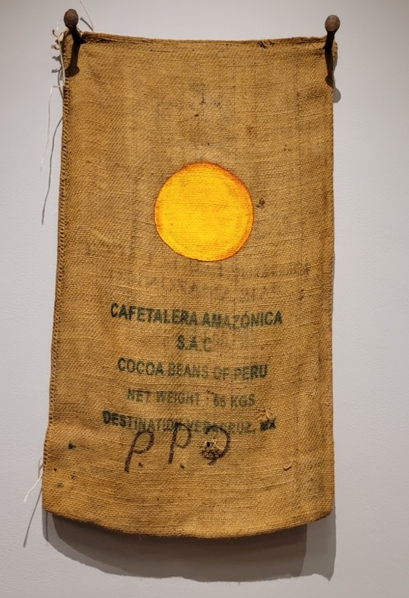
Bosco Sodi
“I think a picture is more like the real world when it’s made out of the real world.” Robert Rauschenberg
This statement manifests in the work of two contemporary Mexican artists, Bosco Sodi and Narsiso Martinez
Bosco Sodi approaches Rauschenberg’s democratic spirit through an engagement with ordinary materials
His 2020 Sun Paintings were made in Oaxaca when canvas was unavailable during the global pandemic
Red and orange orbs are painted on recycled burlap chili sacks in a gesture both thrifty and cosmological
Their economy of means and democratic use of material bears a likeness to Rauschenberg’s Cardboards
Untitled from Sun Paintings, 2021, oil paint on old dry chile sack, 45-1/4 x 24-3/4 inches. Gift of the artist, USF Collection

Slide 20
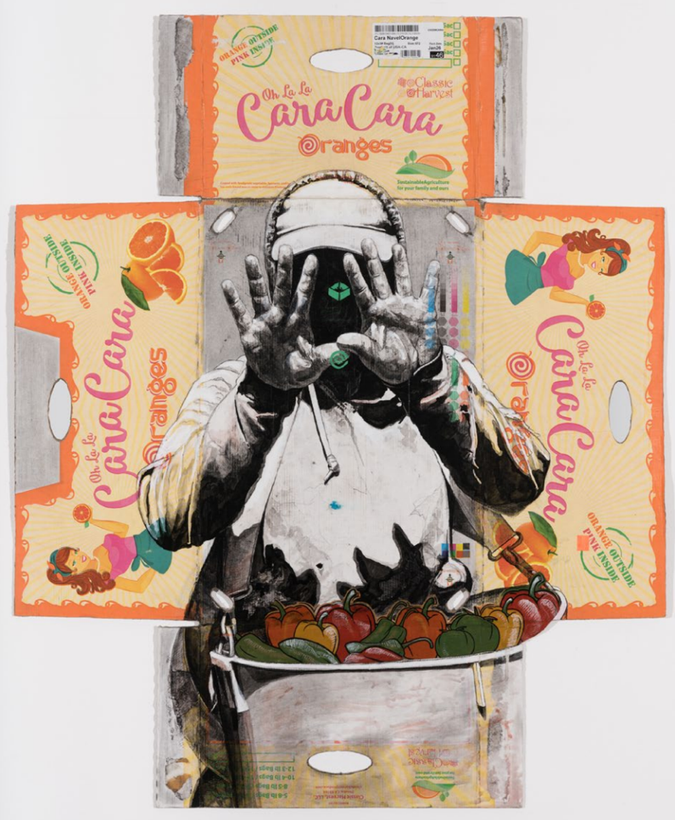
Narsiso Martinez
Martinez draws on his own experience as a migrant farmworker.
The Oaxaca-born painter’s imagery focuses on the people he met and describes as “the men and women who toil in the fields picking the produce we consume,” making visible the working conditions of the American farmworker
Martinez’s compositions are rendered on discarded cardboard produce boxes with the commercial graphics showing through.
Martinez’s channels Rauschenberg’s collages, cardboards and Combines liberating art from standard art materials and exemplifying the “gap between art and life.”
Cara Cara, 2021, ink, charcoal gouache, collage, and matte gel on produce cardboard box, 43 x 35 inches
The Edelman Ontiveros Family Collection

Slide 21
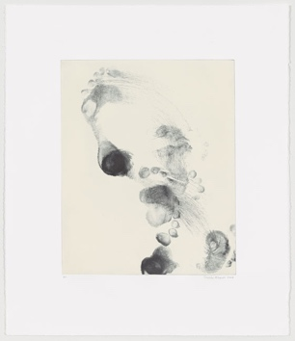
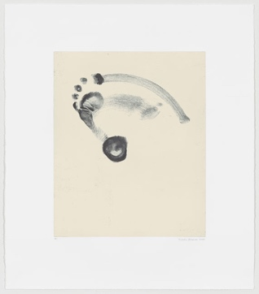
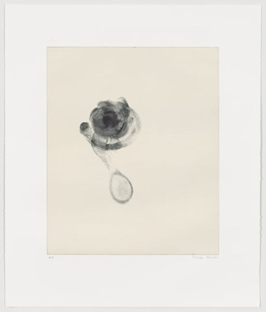
Trisha Brown
Few works encompass Rauschenberg’s conception that art should provide “a record of the immediate environment and time” as much as:
Compass, Untitled (Set One)
Untitled (Set Two)
Untitled (Set Three)
A group of etchings by Rauschenberg's frequent collaborator and friend Trisha Brown.
Produced at Graphicstudio in 2006 these prints conjure the collaborations the choreographer shared with Rauschenberg
By placing her feet directly on the plate, Brown rendered her marks as both footprints and dance movements; impressions that are not just timely but improvisational.
softground etching with relief roll, 25-1/2 x 22 in
Notes:
Choreographer Trisha Brown and Rauschenberg were both pivotal figures in the development of Postmodern dance, each pushing the boundaries of form and movement.
Collaboration was central to their investigations of the visual and the kinetic, and over the course of five decades,
Brown and Rauschenberg deeply influenced one another. Brown spoke of their “uncanny connection” that cemented their life-long friendship and propelled their numerous performance collaborations.
Brown met Rauschenberg during the 1960s, when she was a work-study student at Merce Cunningham’s New York studio.
Brown and Rauschenberg maintained a remarkable creative dialogue, mutually influencing one another for nearly half a century until Rauschenberg’s death in 2008

Slide 22
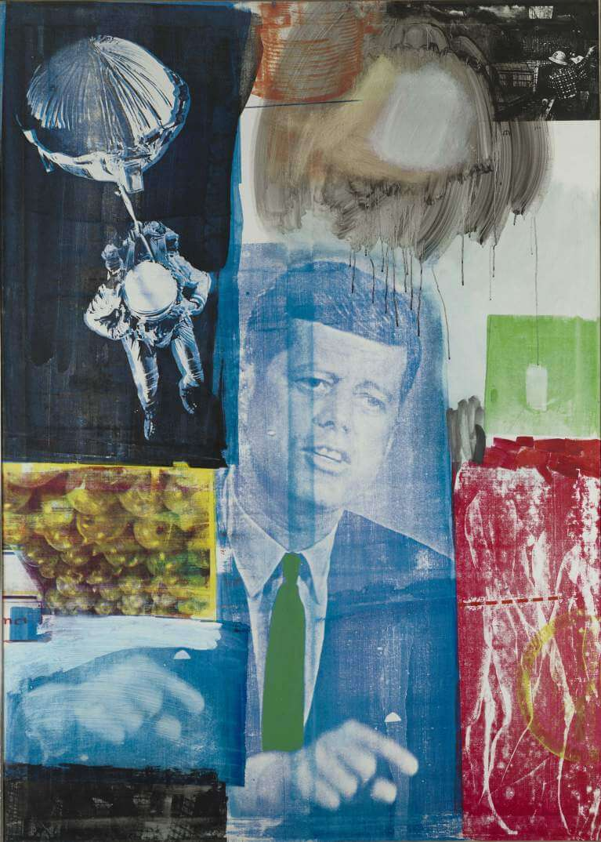
Reflections
Do you believe that artists could serve as catalysts for social change?
How so?
Do you feel that ART can spark a dialogue with the goal of achieving a mutual understanding through the creative process?
Can ART be part of a peace-making enterprise and exchange between people, countries and/or nations?
How so?

Slide 23
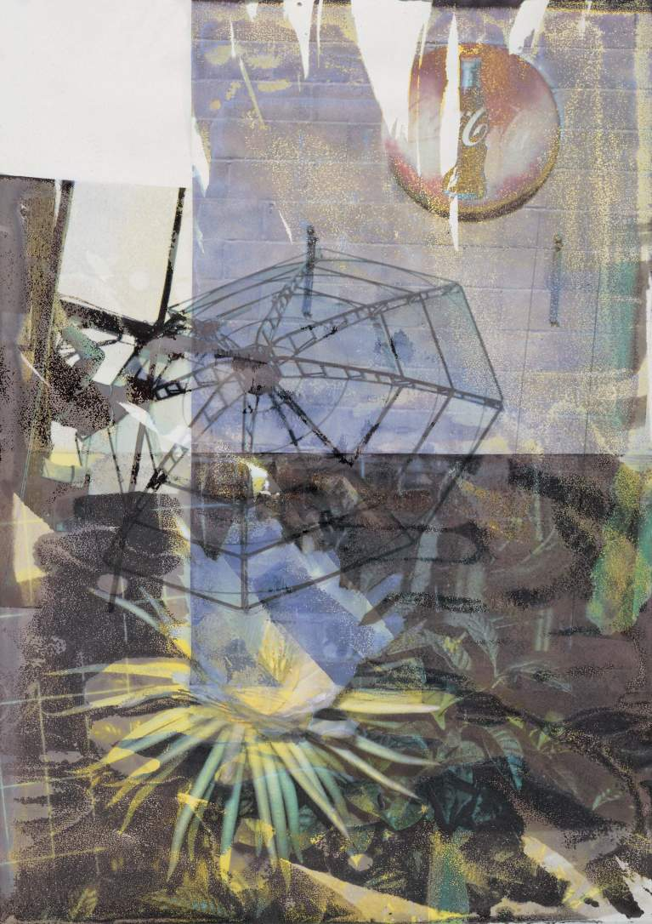
Robert Rauschenberg’s art has always been one of thoughtful inclusion and invention
Rauschenberg’s later work continued the spirit of invention and the quest for new materials and new technologies that were characteristic of his work throughout his career.
Following a stroke in 2002 that left his right hand partially paralyzed, Rauschenberg continued to work, but now with his left hand.
During his final decade, he continued the collaborations with performers and printmakers and furthered his commitment to humanitarian causes.
Rauschenberg changed the art world forever and with this made an indelible mark in the entire world

Slide 24
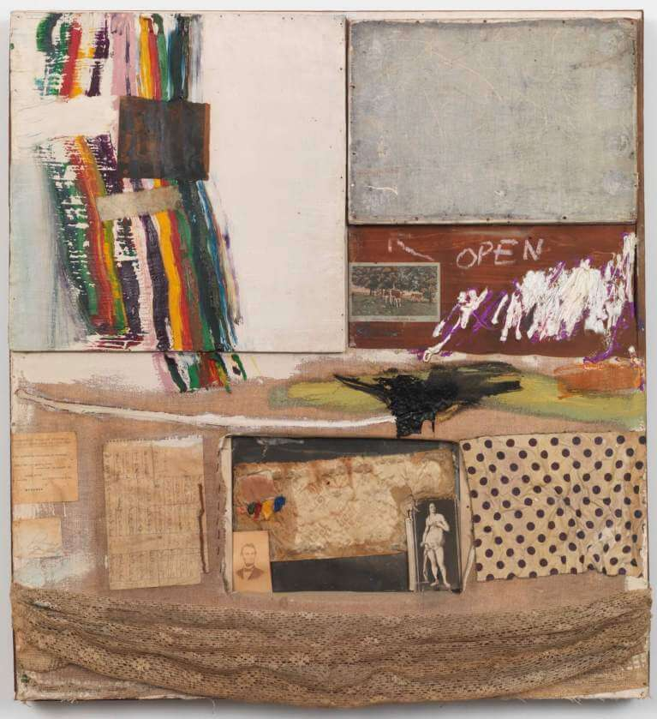
Activity 2: Create a COMBINE inspired by someone important to you and as a collaboration with materials
Rauschenberg reinvented the collage that was begun by Braque and Picasso, as well as that of Dadaist assemblage. Rauschenberg gave these practices new impact in his Combines.
A Combine is a term coined by Rauschenberg. Combines merged aspects of painting and sculpture to become an entirely new artistic category.
CONSIDERATIONS for a Subject:
To make a unique work of art:
Think about who inspires or is important to you.
Gather objects, images, and other materials inspired by that individual.
It could be a friend, a family member, a favorite artist, a personal hero, a pet, or a character. You are “metaphorically” collaborating with this being.
Think also about your collaboration with the materials(what kind of meaning do your materials bring) rather than any consciously manipulating or controlling the materials or the imagery.
Let each element and image maintain its integrity without obscuring the others.
Notes:
Activity 2 is appropriate for younger or beginning and advanced or older students
For beginning students: find available, safe, tools and materials-Avoid adding the solvent transfer unless there is more than one project and sessions.
Combine: oil, fabric and paper on wood supports and cabinet with two hinged doors containing a painting by Susan Weil and a reproduction of a Jasper Johns Flag painting by Elaine Sturtevant
40 3/4 x 37 1/2 x 4 1/4 inches

Slide 25
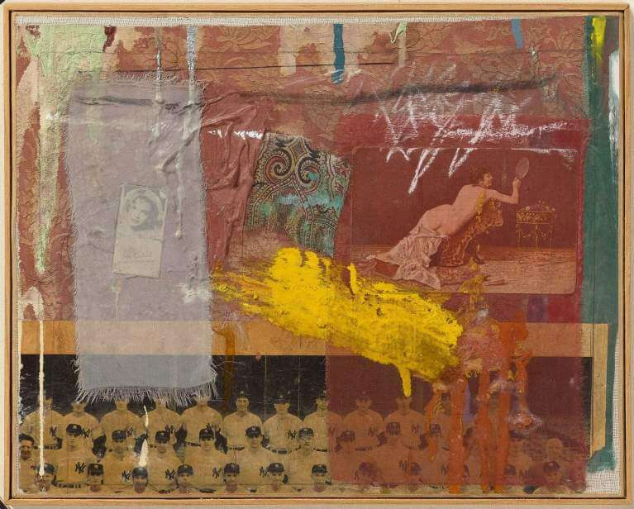
Activity 2: Create a COMBINE inspired by someone important to you and as a collaboration with materials
TO BEGIN:
Look closely at Rauschenberg’s Combines.
Let your eyes wander across the artwork. What do you see?
Describe the materials, the shapes, and the colors.
Are there any items that look familiar to you?
How many different materials and/or processes were used?
For Bantam (Combine)-1955
Rauschenberg used: Oil, paper, printed reproductions (solvent transfers), cardboard, fabric , and graphite on canvas
MAKE IT:
Gather your materials: As you gather materials, think about the individual you are making the work for or about and find colors, images, and objects related to them. Take one last scavenger hunt to find a combination of materials!
Notes:
Activity 2 is appropriate for younger or beginning and advanced or older students
For beginning students: find available, safe, tools and materials-Avoid adding the solvent transfer unless there is more than one project and sessions.

Slide 26
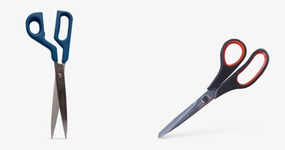
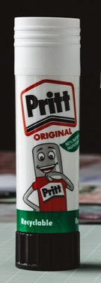
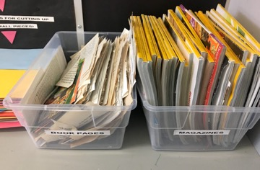
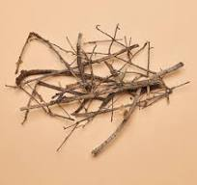
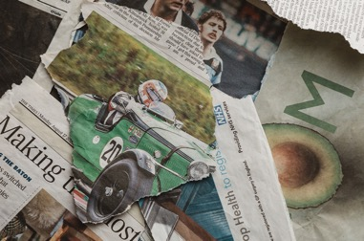
Activity 2: Create a COMBINE inspired by someone important to you and as a collaboration with materials
MAKE IT
Gather your materials: As you gather materials, think about the individual you’re making the work for or about and begin with your colors, images, and objects related to them.
Some materials you may need:
A surface for your artwork (like a large poster board, piece of cardboard, canvas board and/or paper)
Scissors, glue, and tape
Found objects: items from your junk drawer, playing cards, old toys, fabric, sticks, and other natural objects
Found images: magazine images, old greeting cards, newspaper clippings, photographs
Materials that connect objects: string, twigs, chopsticks, small details or pieces of furniture
Materials that bend or move: paper chains, wire, rubber bands
Personal materials: drawings and paintings you’ve made, doodles on scrap paper
Paints, inks, markers, pencils, colored pencils
Solvent if you want to create a solvent transfer
Notes:
Activity 2 is appropriate for younger or beginning and advanced or older students
For beginning students: find available, safe, tools and materials-Avoid adding the solvent transfer unless there is more than one project and sessions.

Slide 27
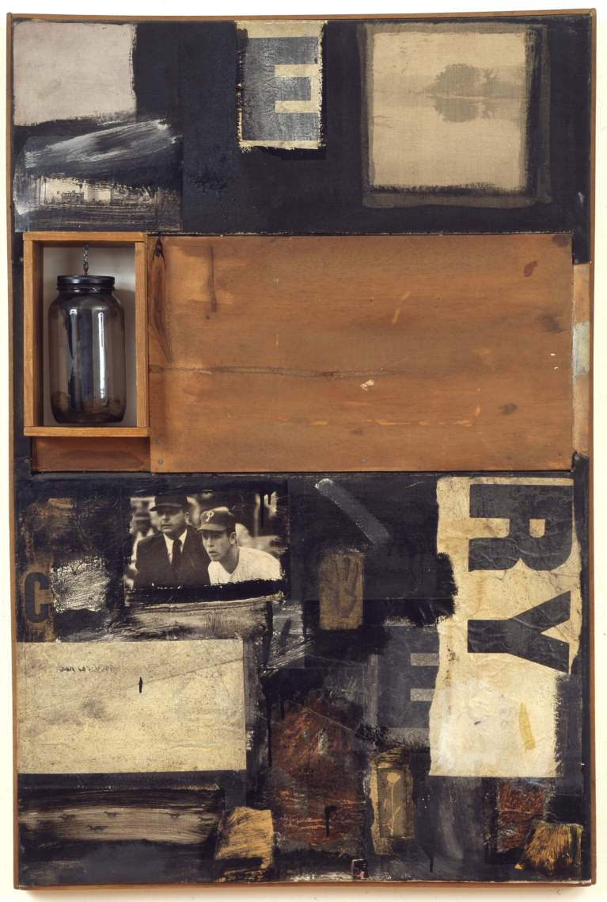
Activity 2: Create a COMBINE inspired by someone important to you and as a collaboration with materials
MAKE IT
Plan your composition
Experiment with the placement of your materials.
Sometimes it helps to draw out your ideas
How is your composition inspired by the person you have in mind
How are the materials and images working to tell the story you desire
Cut out your images and text
Plan where or if you want to add a solvent transfer (advanced technique)
Create your Combine
Once you have your composition in mind begin to collage your materials together to the substrate and/or to each other
Use your glue and tape to attach your pieces to the substrate
Let some things join through overlapping
Remember you can paint over any portion, rip something or make visual connections through your materials, images, lines, or color
Keep working until you’re happy with your Combine!
Talisman-1958-Combine: oil, paper, printed paper, printed reproductions, wood, glass jar on metal chain and fabric on canvas
Notes:
Activity 2 is appropriate for younger or beginning and advanced or older students
For beginning students: find available, safe, tools and materials-Avoid adding the solvent transfer unless there is more than one project and sessions.

