Slide 1
Jill Freedman
Photographer of the People, photographing social unjustice
1939-2019

Slide 2
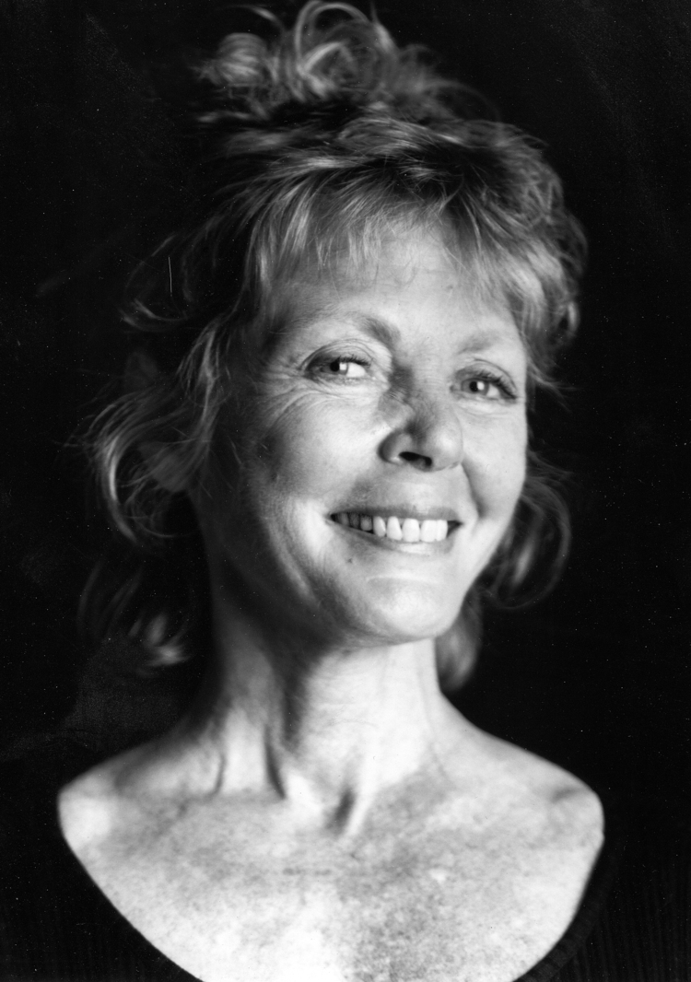
“I put a lot of time into being invisible,” she said. “When I was a kid, I always wished I had one of those rings or cloaks that made you invisible. Then I realized years later, I am invisible behind a camera. I am a camera.”
--Jill Freedman
Notes:
Image source: https://www.nearbycafe.com/artandphoto/photocritic/2019/10/15/jill-freedman-1939-2019-a-farewell/
Quote can retrieved from: https://www.nytimes.com/2019/10/09/arts/jill-freedman-dead.html
Think-Pair-Share: Using the quote below, ask students to individually think about what Jill Freedman is trying to express. Have students pair up and discuss their ideas. Then, have each pair share out and engage in a class discussion. Quote:
“I put a lot of time into being invisible,” she said. “When I was a kid, I always wished I had one of those rings or cloaks that made you invisible. Then I realized years later, I am invisible behind a camera. I am a camera.”
--Jill Freedman

Slide 3
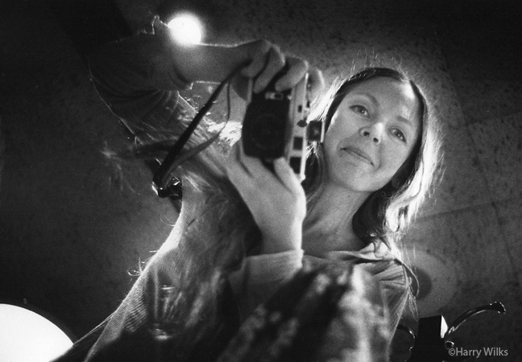
Jill Freedman: Background
1939: b. in Pittsburgh
In 1964 came to New York City, living and working on the Upper West Side
discovered photography while experimenting with a friend’s camera
published seven books
her work is in the permanent collections of The Museum of Modern Art, the International Center of Photography, George Eastman House, the Smithsonian American Art Museum, the New York Public Library, among others
Notes:
http://www.jillfreedman.com/about

Slide 4
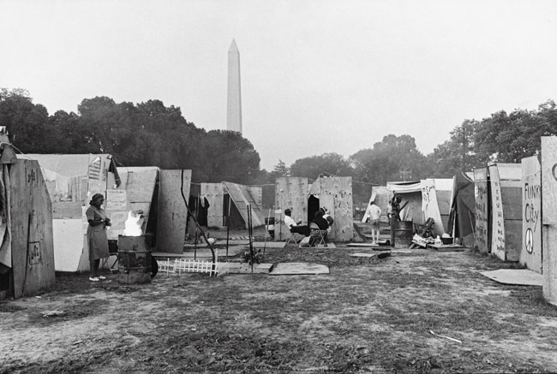
Spring of 1968, the young street photographer Jill Freedman quit her day job in NYC to join the Poor People’s March on Washington.
Freedman lived in Resurrection City photographing the daily life of its residents as they rallied, made speeches, protested in front of government buildings, confronted police, built makeshift kitchens, organized clothing swaps and dealt with flooding, petty crime, and illness.
Washington, DC, 1968
Notes:
One of the most important postwar documentary photographers, and one of the few women shutterbugs of the era, Freedman captured it all, with a artist's eye and a passionate interest in the individuals she depicted.

Slide 5
Notes:
Video: https://www.youtube.com/watch?v=HGrKEBq7kiI
Have students watch the interview from NY1 News in 2008.

Slide 6
Notes:
Website: https://www.youtube.com/watch?v=hDlgWQOxo68&t=105s
Have students watch the video highlighting Jill Freedman’s work photographing firefighters in New York City.
Then, in pairs, have students take turns reading aloud to their partner the article titled, “Firehouse.” https://gothamtogo.com/firehouse-the-photography-of-jill-freedman-at-nyc-fire-museum-in-soho/

Slide 7
Images of Firehouse
View at: http://www.jillfreedman.com/firehouse/ktg2wr227oc7v6ujimdqzmpuitevev
Notes:
Website: http://www.jillfreedman.com/firehouse/ktg2wr227oc7v6ujimdqzmpuitevev
VTS: Draw Students’ attention to the screen as you click through a series of photographs taken by Jill Freedman as part of her Fireman series located on the following website: http://www.jillfreedman.com/firehouse/ktg2wr227oc7v6ujimdqzmpuitevev
Stop on a picture of your/student choice and engage the class in the Visual Thinking Strategy protocol. Ask:
What’s going on in this picture?
What makes you say that?
What more can you find?
Once you go through multiple images, ask student pairs to discuss what they believe Jill Freedman is attempting to capture and communicate in this collection of work (e.g., the way she conducted her work, the artistic elements, social issues). Have pairs share their responses with the class.

Slide 8
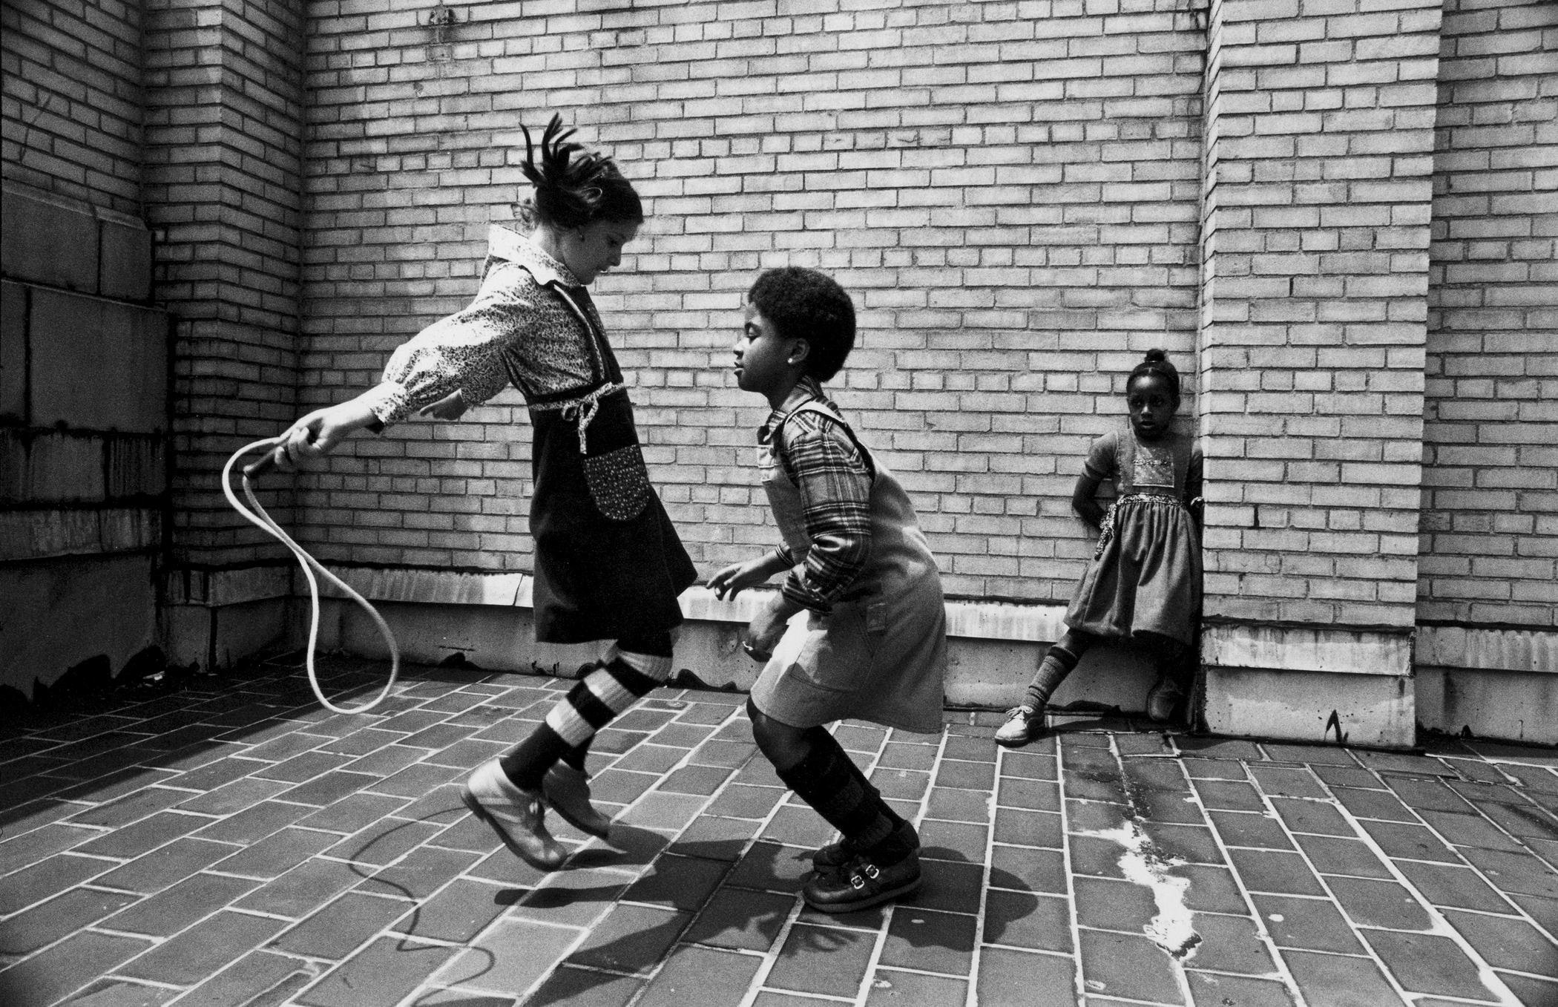
“Photography is magic. You can stop time itself. Catch slivers of moments to savor and share time and again. Tell beautiful silver stories, one photo alone, or many playing together to form a book. A photograph is a sharing, it says “Hey, look at this!”, it’s a miracle, is what it is. And when you’re going good and you get a new picture you love, there’s nothing better. That’s the joy of photography, and the fun.”
--Jill Freedman
Notes:
Image source: http://www.jillfreedman.com
Quote can retrieved from: http://www.jillfreedman.com/about-1
Think-Pair-Share: Based on the what students have learned about Jill Freedman so far, ask students to individually think about what Jill Freedman is trying to express about photography in the quote below. Have students pair up and discuss their ideas. Then, have each pair share out and engage in a class discussion. Quote:
“Photography is magic. You can stop time itself. Catch slivers of moments to savor and share time and again. Tell beautiful silver stories, one photo alone, or many playing together to form a book. A photograph is a sharing, it says “Hey, look at this!”, it’s a miracle, is what it is. And when you’re going good and you get a new picture you love, there’s nothing better. That’s the joy of photography, and the fun.”

Slide 9
Exit Card:
Jill Freedman describes photography as “magic.” What are your thoughts about this artistic medium? Do you find taking photography is fun? Why or why not?
Homework:
Gather or take a collection of photographs (4-8) that focus on something significant to your life and/or community that is inspired by the style of Freedman’s work. Bring these photographs in to share with your peers.
Notes:
Exit Card: Jill Freedman describes photography as “magic.” What are your thoughts about this artistic medium? Do you find taking photographs fun? Why or why not?
For homework, have students gather or take a collection of photographs (4-8) that focus on something significant to their life and/or community that mimics the style of Freedman’s work.

