Slide 1
Miguel Luciano
The People’s Pulpit and
the Young Lords

Slide 2
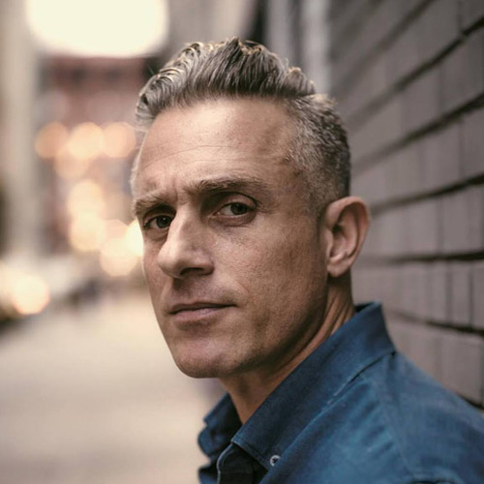
Artist: Miguel Luciano
multimedia visual artist
work explores themes of history, popular culture, social justice and migration
media: sculpture, painting, and socially engaged public art projects
born in Puerto Rico and lives in New York
Notes:
Miguel Luciano: Bio

Slide 3
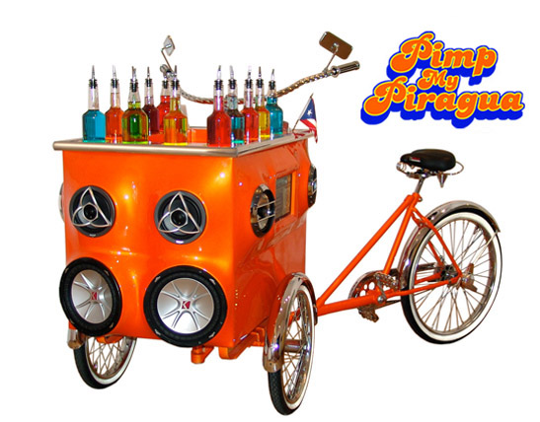
Constant Storm
(Fall 2021)

Slide 4
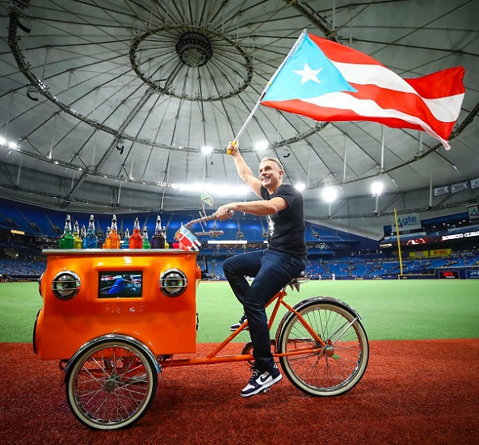
Notes:
Exhibition artist Miguel Luciano was in residence at USF September 16-19.
In the photo above, he is shown riding “Pimp My Piragua” at Tropicana Field, St. Petersburg, before throwing out the ceremonial first pitch of the Tampa Bay Rays Game, on Roberto Clemente Day, September 17, 2021.
Roberto Enrique Clemente Walker^{[a]} (Spanish pronunciation: [roˈβeɾto enˈrike kleˈmente (ɣ)walˈkeɾ]; August 18, 1934 – December 31, 1972) was a Puerto Rican professional baseball right fielder who played 18 seasons in Major League Baseball (MLB) for the Pittsburgh Pirates.
Clemente was involved in charity work in Latin American and Caribbean countries during the off-seasons. He often delivered baseball equipment and food to those in need. In 1972, he died in a plane crash at the age of 38 while en route to deliver aid to victims of the Nicaragua earthquake.

Slide 5
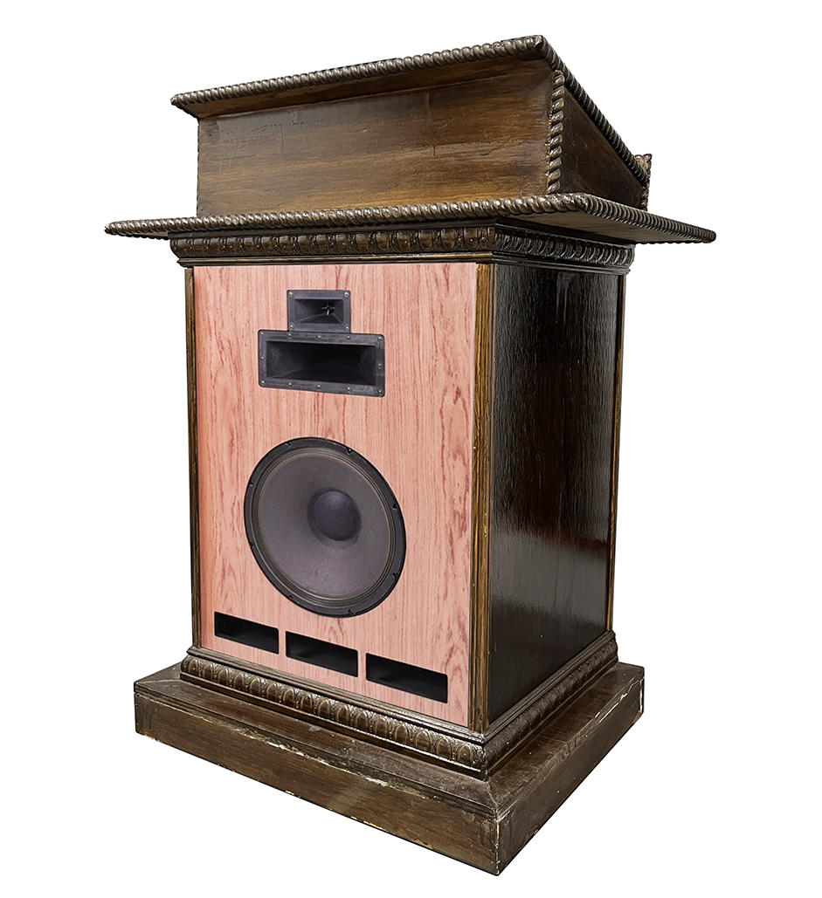
Notes:
One of the art works you will be seeing in the exhibition uses this structure as the work’s centerpiece.
What is this?
What is its purpose/function?
Where might this be found?
In order to make sense of this, we have to go back in history about 50-60 years…

Slide 6
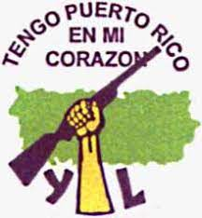
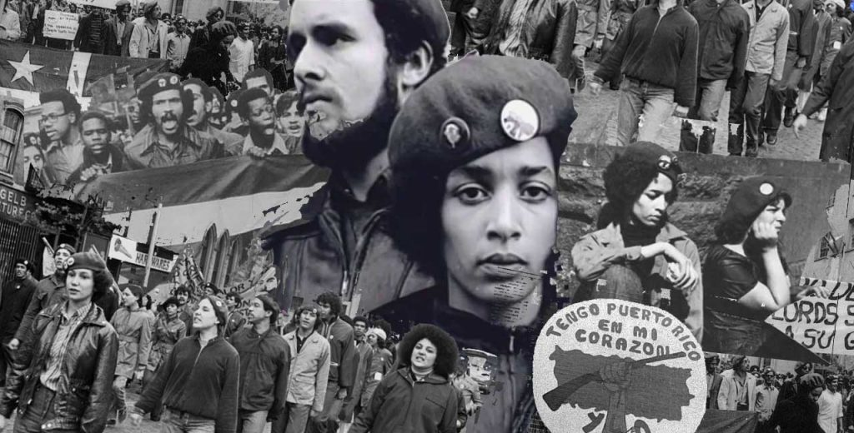
The Young Lords
Origins: Chicago gang civil rights organization
Goals: self-determination for Latinos, Puerto Rico
Inspiration: Black Panthers & student movements
Strategies: education, community programs, occupations, press conferences, protests
Years active: 1968-1976
Notes:
The Young Lords included African-Americans as well as Dominicans and other Latinos. But many were the children of migrants from Puerto Rico.
Originally a Chicago-based street gang, the Young Lords turned to community activism, inspired by the Black Panthers and by student movements in Puerto Rico. A Young Lords chapter in New York soon formed, agitating for community control of institutions and land, as well as self-determination for Puerto Rico. Their tactics included direct action and occupations that highlighted institutional failures.
The Young Lords in New York eventually broke off ties with the Chicago group. For their first campaign in Spanish Harlem, the Young Lords swept sidewalks, piled trash into the middle of the street and set it on fire. That's how they got city officials to improve trash collection.

Slide 7
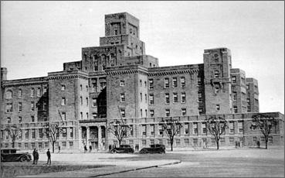
Lincoln Hospital, South Bronx, 1970
Notes:
On July 14, 1970, members of the Young Lords occupied Lincoln Hospital in the South Bronx — known locally as “the Butcher Shop.”
From https://www.wnyc.org/story/lab-coat-afro-and-shades-taking-lincoln-hospital: "I mean, there was a joke in the neighborhood," said CBS reporter Pablo Guzman, "that if you got stabbed on this side of the street, crawl over to the other side so the ambulance wouldn't take you to Lincoln."

Slide 8
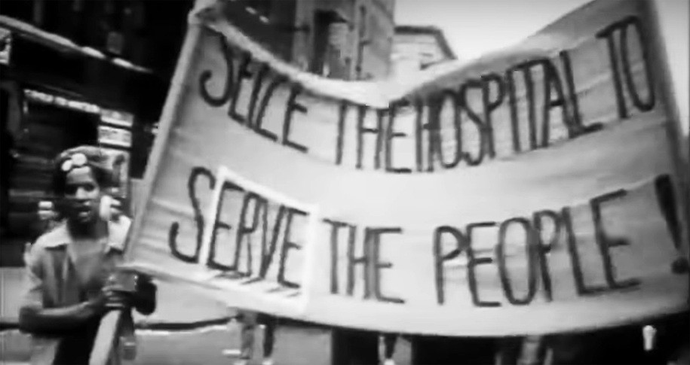
1970
Notes:
The group of activists, many of them in their late teens and early 20s, barricaded themselves inside the facility, demanding safer and more accessible health care for the community. Image source: https://www.dailykos.com/stories/2021/6/11/2034731/-The-Young-Lords-health-care-fights-of-the-1970s-rage-on-today

Slide 9
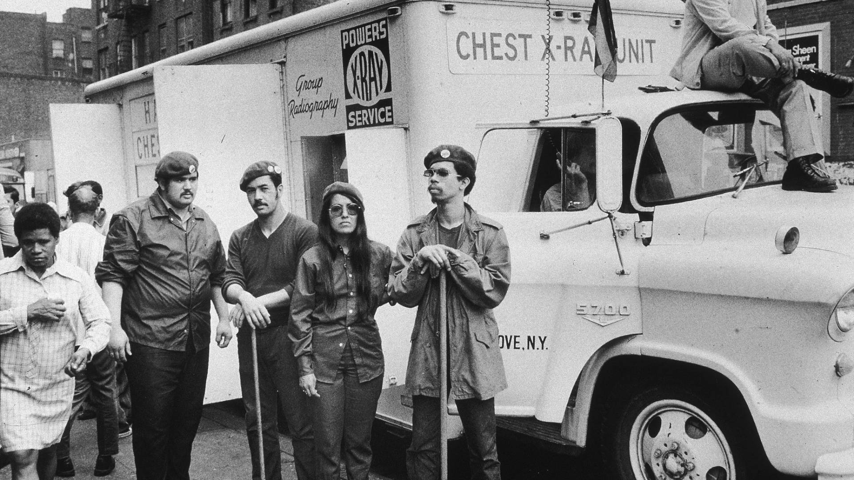
Notes:
Image source: https://www.democracynow.org/2021/6/9/takeover_young_lords_peoples_hospital

Slide 10
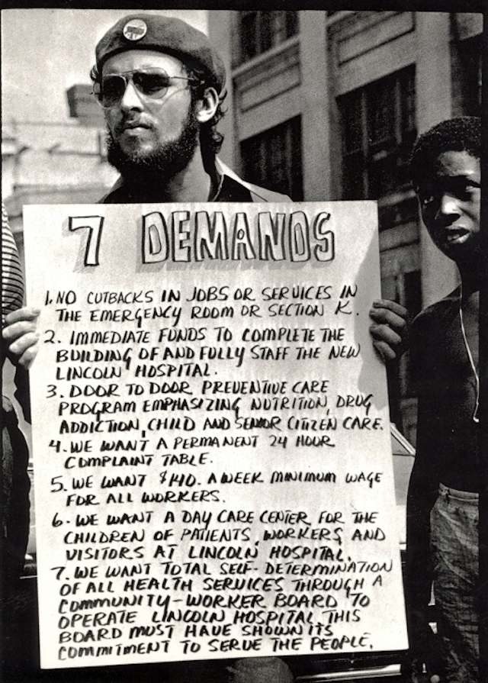
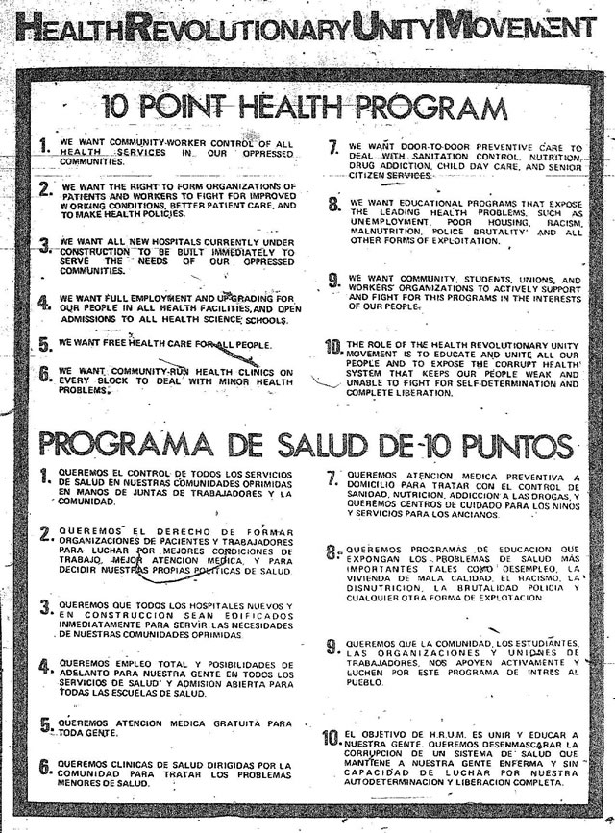
Notes:
Images source: https://twitter.com/takeoverthefilm/status/1438501008120897540

Slide 11
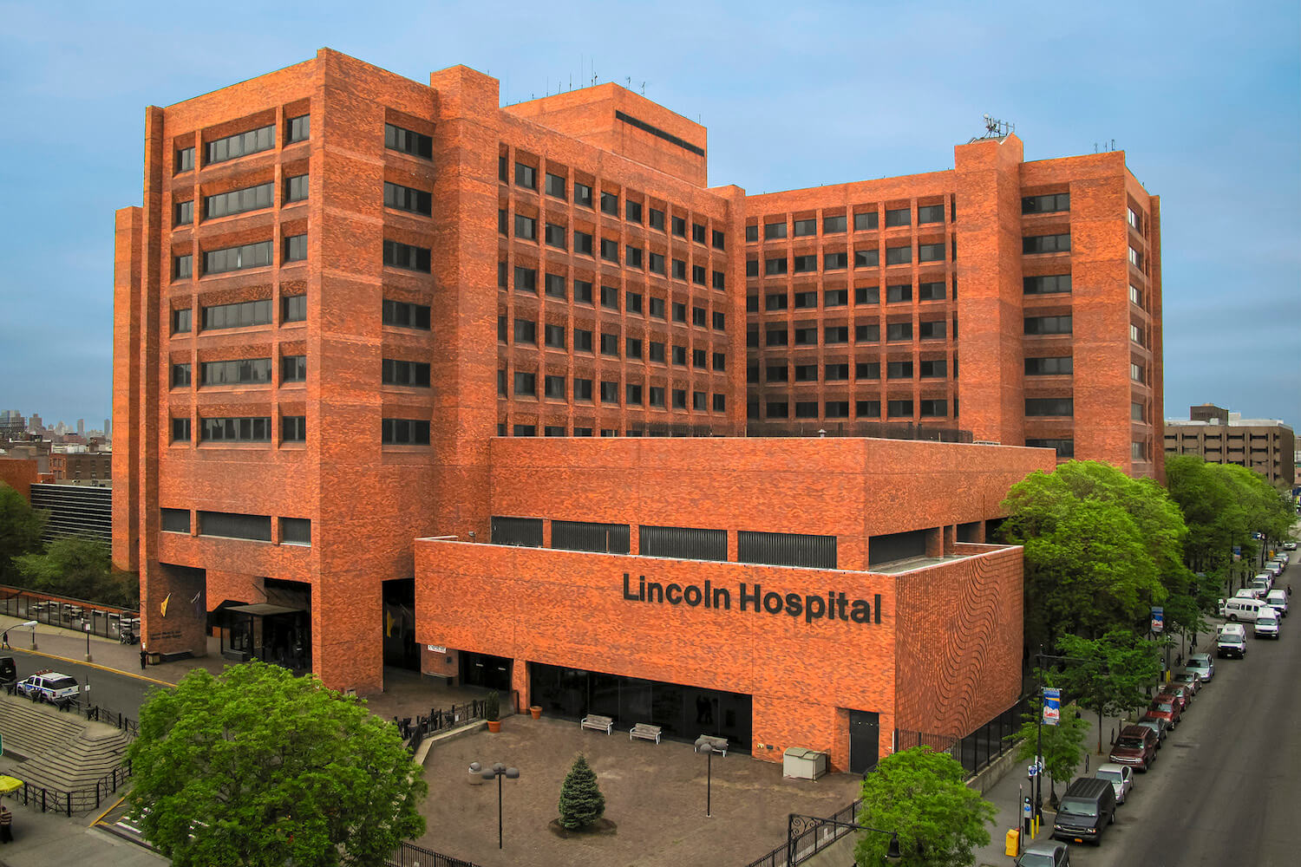
Notes:
Lincoln Hospital today. Many credit the Young Lords with changing the trajectory of the hospital and the healthcare services they provide to the community.

Slide 12
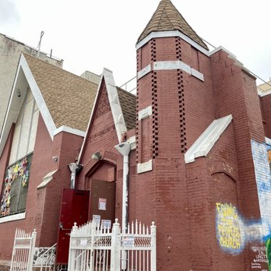
1969
The First Spanish Methodist Church,
East Harlem
(El Barrio)
Notes:
In 1969, the group took over The First Spanish Methodist Church in East Harlem, fighting police and the city to turn the location into The People's Church.
They took over the church, ran a free breakfast program for children, and co-founder Felipe Luciano held a press conference outside. "This is going to happen to any institution in any oppressed community that does not respond to the needs of the people!" he said. The crowd around him cheered, "Right on!"

Slide 13
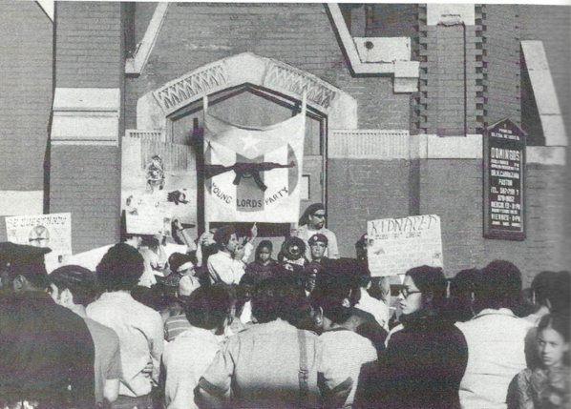
Notes:
In December of 1969, after months of failed negotiations with church leadership, the New York Chapter of the #YoungLords occupied the First Spanish Methodist Church in East Harlem, renamed it "The People's Church," and for eleven days hosted community programs within its walls.
Image source: https://twitter.com/unionseminary/status/1116728749729382408

Slide 14
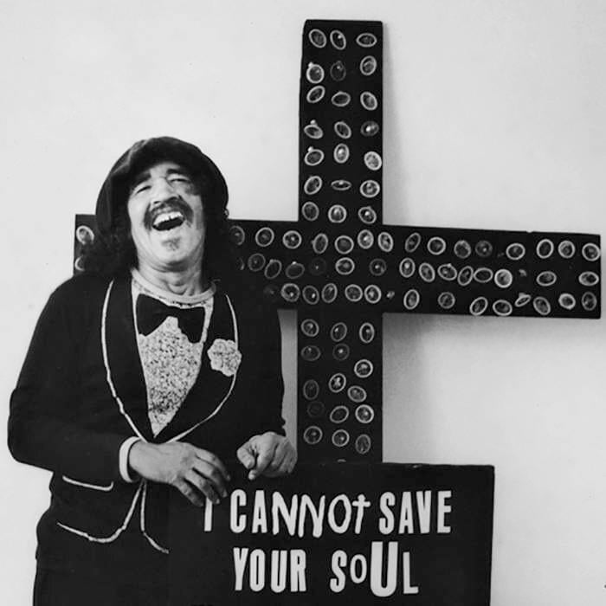
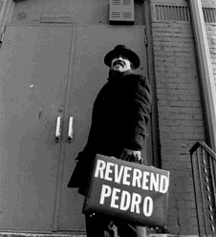
Pedro Pietri
(1944-2004)
Notes:
Nuyorican poet and playwright Pedro Pietri was born in Ponce, Puerto Rico, and raised in Manhattan. A few years after graduating from high school, he was drafted into the Army and served in the Vietnam War. Upon his return to New York, Pietri joined the Young Lords, a Puerto Rican Civil rights activist group. In the early 1970s, he cofounded the Nuyorican Poets Café with Miguel Piñero, Miguel Algarín, and others.

Slide 15
Pedro Pietri Mini-Bio
1944: born in Ponce, Puerto Rico
1947: family moves to Harlem, Manhattan
Influenced by his aunt, a poet and amateur thespian
1966-1968: drafted and fights in the Vietnam War
Upon return to NYC, joined the Young Lords, taking part in their activities
1969: read Puerto Rican Obituary in public for the first time
1970s: cofounded the Nuyorican Poets Café
1973: formally published Puerto Rican Obituary
2004: dies from stomach cancer; funeral held at The People’s Church
Notes:
Pedro was greatly influenced by his aunt, who often recited poetry and on occasions put on theatrical plays in the First Spanish Methodist church in El Barrio.
Pietri was diagnosed with stomach cancer in 2003. He went to Mexico to receive an alternative treatment for a year. On March 3, 2004, Pietri died en route from Mexico to New York. Funeral services were held in East Harlem at the historic First Spanish Methodist Church, which was taken over in 1969 by the Young Lords and renamed at the time as "The First People's Church" to provide free breakfast and other programs to the poor and working people of El Barrio. This is where, fittingly, Pietri first read in public his classic poem, "Puerto Rican Obituary", in support of the Lords' takeover of the church.^{[8]}

Slide 16
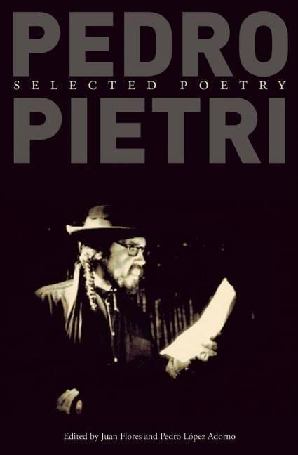
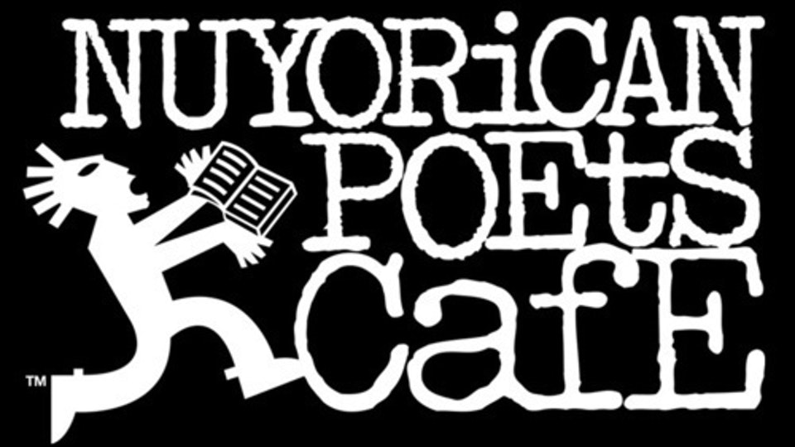

Slide 17
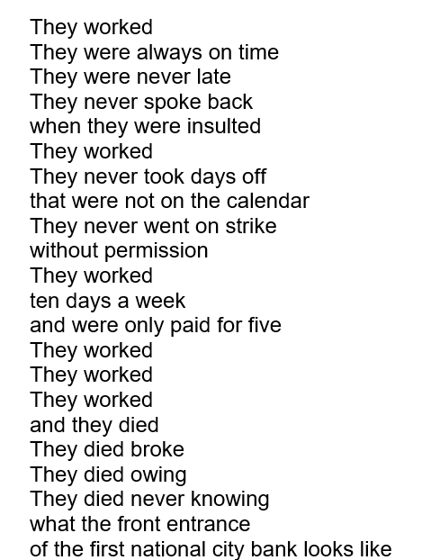
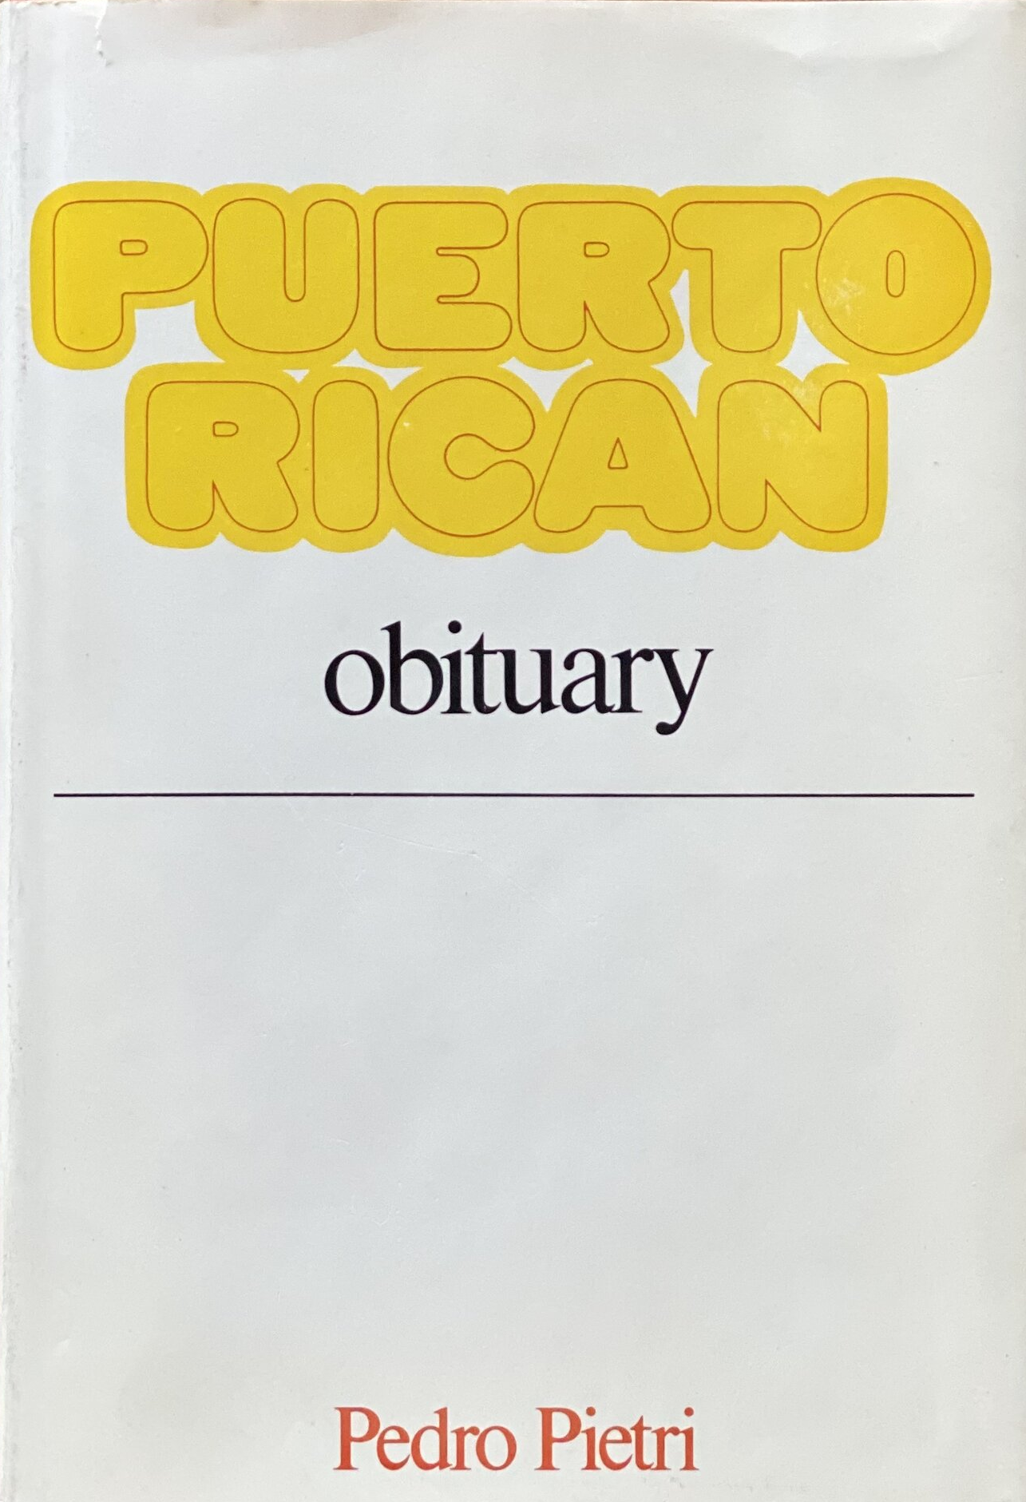
Puerto Rican Obituary (excerpt)

Slide 18
Miguel Luciano,
The People’s Pulpit (2022)
Vintage pulpit from The First Spanish United Methodist Church (The People’s Church), East Harlem.
Speakers; microphone; audio: Puerto Rican Obituary (1969) by Pedro Pietri
Notes:
Luciano’s second contribution in the exhibition is the sculpture The People’s Pulpit (2022)—a repurposed vintage pulpit taken from the First Spanish Methodist Church in East Harlem. The Young Lords famously took over the church in 1969 and renamed it “The People’s Church”; they hosted free breakfast programs there, along with clothing drives, health screenings, and other community services.
In this exhibition, The People’s Pulpit features an historic recording of Nuyorican poet Pedro Pietri reciting the celebrated poem Puerto Rican Obituary during
the takeover of The People’s Church.
Miguel Luciano, The People’s Pulpit, 2022 . Vintage pulpit from The First Spanish United Methodist Church (The People’s Church), East Harlem, speakers, microphone. audio: Puerto Rican Obituary (1969) by Pedro Pietri, courtesy of The Estate of Pedro Pietri and Third World Newsreel from the documentary El Pueblo Se Levanta (1971).

Slide 19
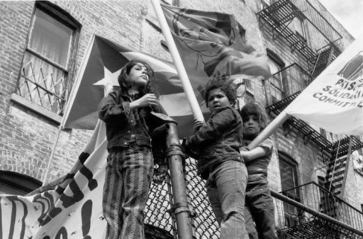
Notes:
Source: https://darrylrobertson3491.medium.com/a-history-of-the-young-lords-revolution-part-one-bdafa45f3ffb
In the winter of 1969 the Young Lords took over the 1st Spanish United Methodist Church, using the space to provide services to the underserved community. For 11 days, the Young Lords ran a breakfast program for children, offered basic health testing, ran a daycare with Spanish language lessons and taught Puerto Rican history, and held adult events with discussion groups and performances at night. On the 8th of January the Young Lords peacefully evacuated the church and were arrested. They subsequently staged a longer occupation of the church from October to December of 1970, working to call attention to alleged police brutality and the poor conditions of New York City jails. While the Young Lords undertook many activities in East Harlem and the Bronx, their actions at 1st Spanish United Methodist allowed their ideas and platform to reach decision makers not only within their direct community, but throughout the city and state.

Slide 20
Mapping Resistance: The Young Lords in El Barrio (2019)
Image: Young Lords Member with Pa’lante Newspaper (1970) by Hiram Maristany
Notes:
Miguel Luciano revisits the history of the Young Lords, a revolutionary group of young Puerto Rican activists who, inspired by the example of the Black Panthers, organized for social justice in their communities beginning in the late 1960s.
His first contribution to the exhibition is a vinyl banner from the public art project “Mapping Resistance: The Young Lords in El Barrio (2019).” It features the photograph Young Lords Member with Pa’lante Newspaper (1970) by Hiram Maristany, the official photographer of the Young Lords and also one of the founding members of the New York chapter. This banner, along with nine other enlarged photographs by Maristany, were installed throughout East Harlem at the same locations where their history occurred 50 years prior.

Slide 21
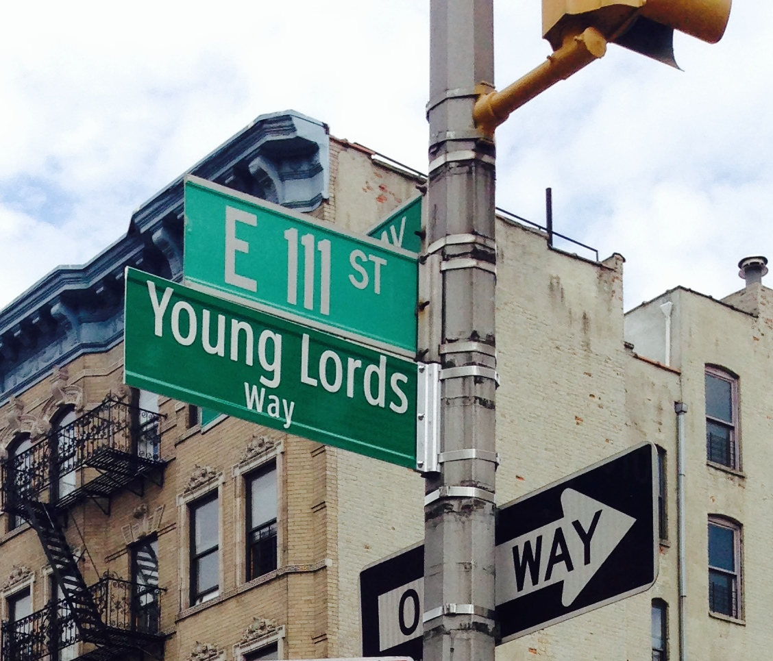
2014
Notes:
In 2014, the corner of E. 111th St. and Lexington Ave. was changed to Young Lords Way, honoring the Puerto Rican group that fought for social justice in the sixties. A huge crowd lined the sidewalk on both sides of the street in front of the First Spanish Methodist Church. In 1969, the group occupied the site for 11 days, creating cultural programs that provided free breakfast, clothing and other services for the community.
Source: https://amsterdamnews.com/news/2014/08/28/el-barrio-street-changed-young-lords-way/

