Slide 1
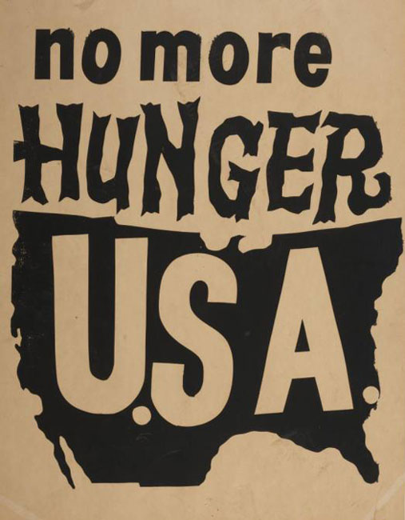
Narsiso Martínez
POOR PEOPLE’S ART:
A (SHORT) VISUAL HISTORY OF POVERTY IN THE UNITED STATES

Slide 2
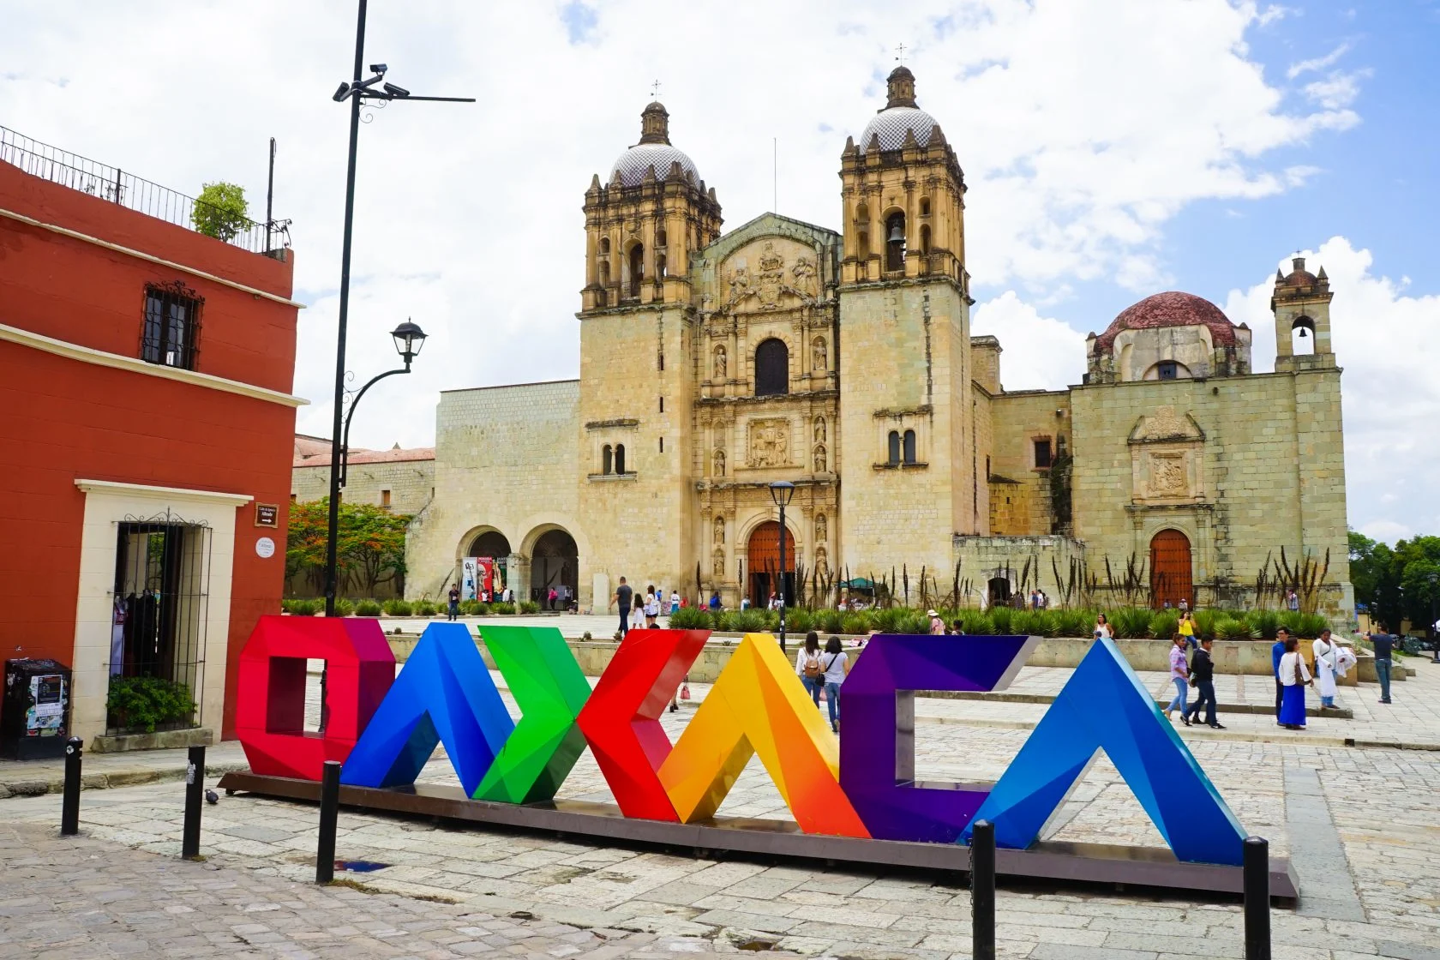
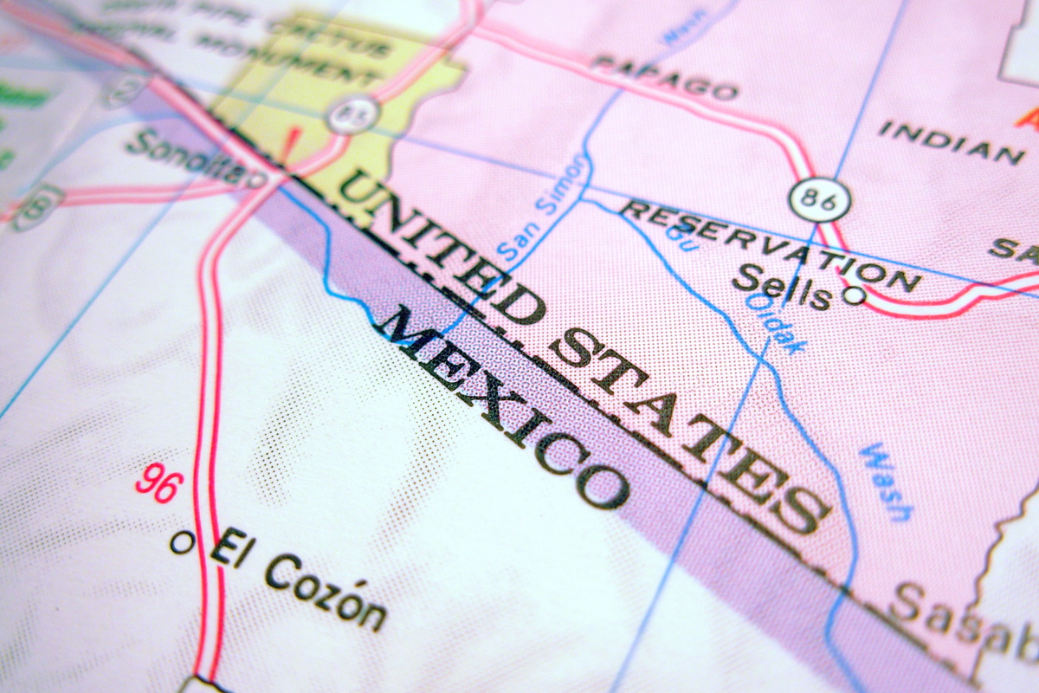
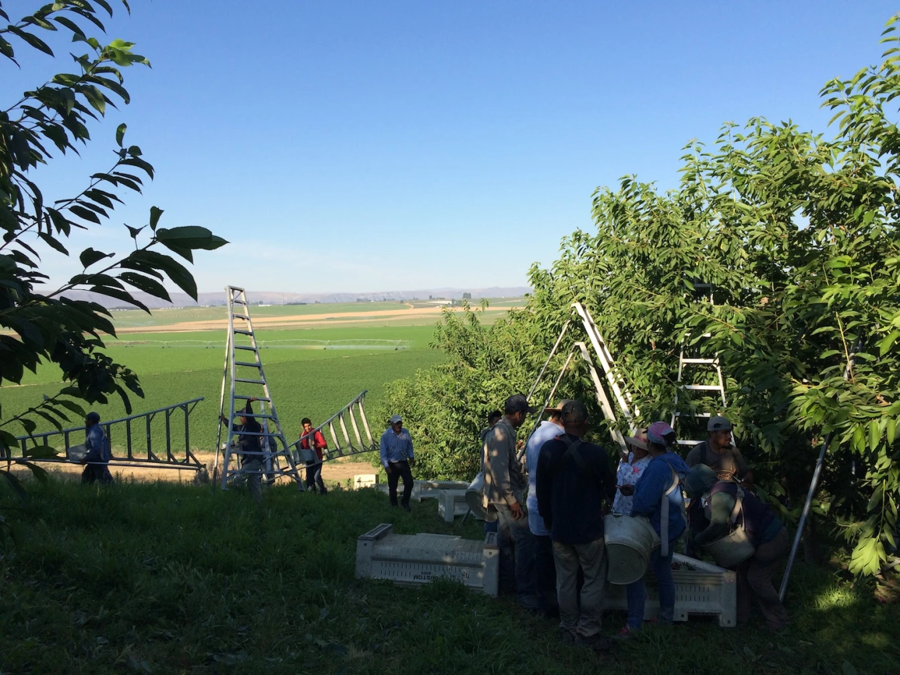
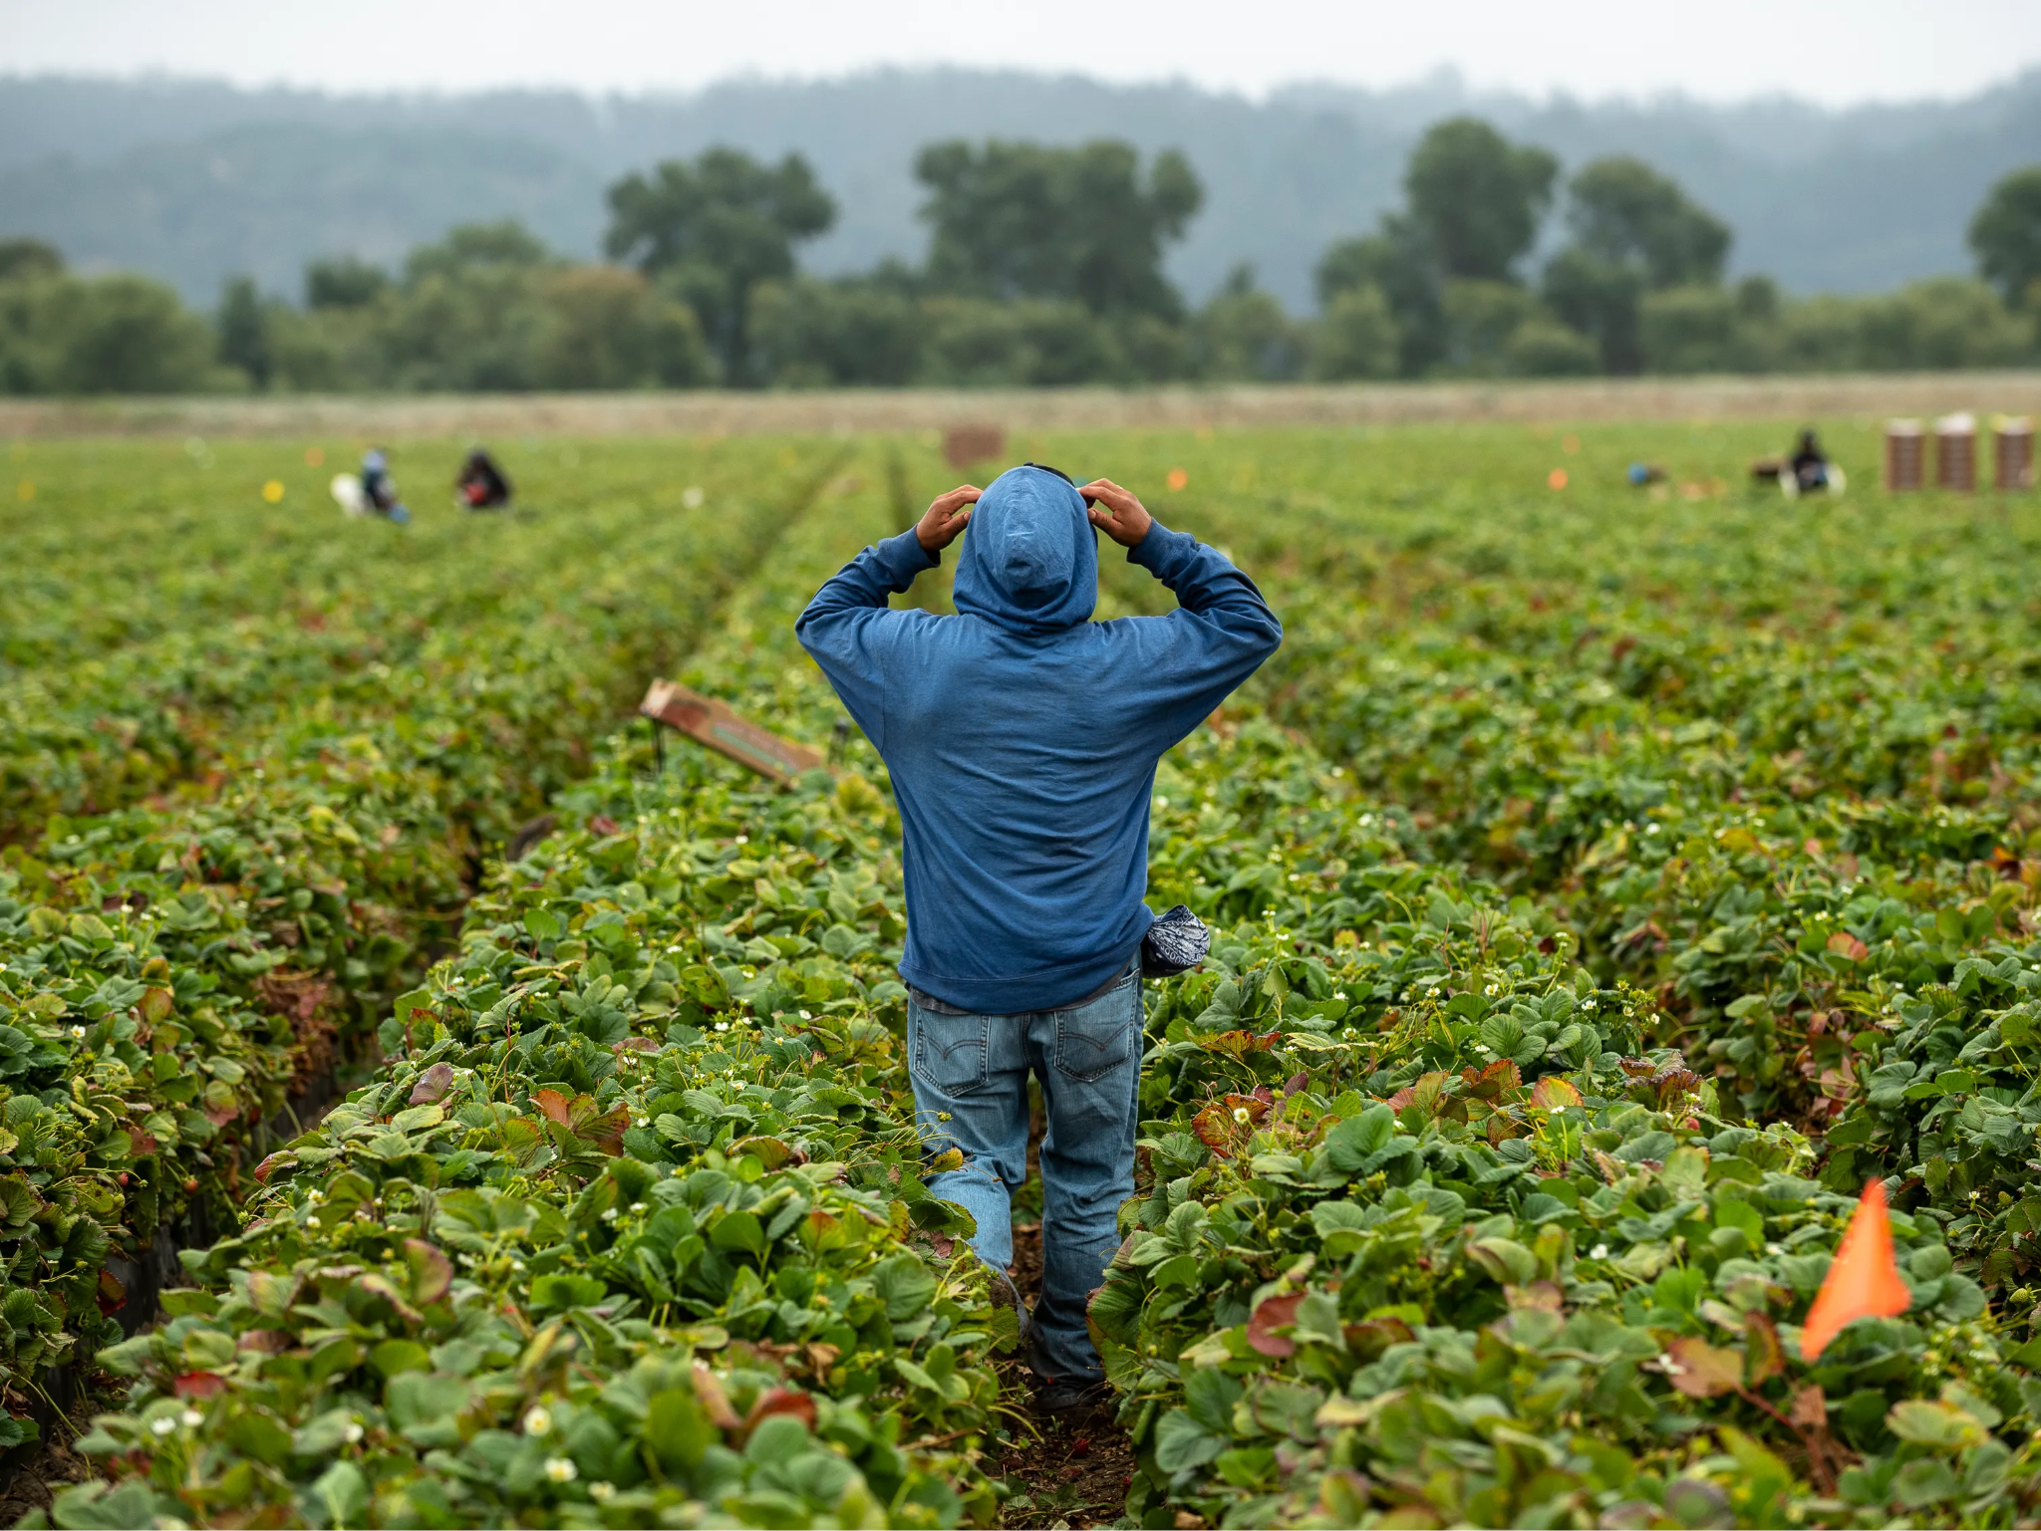
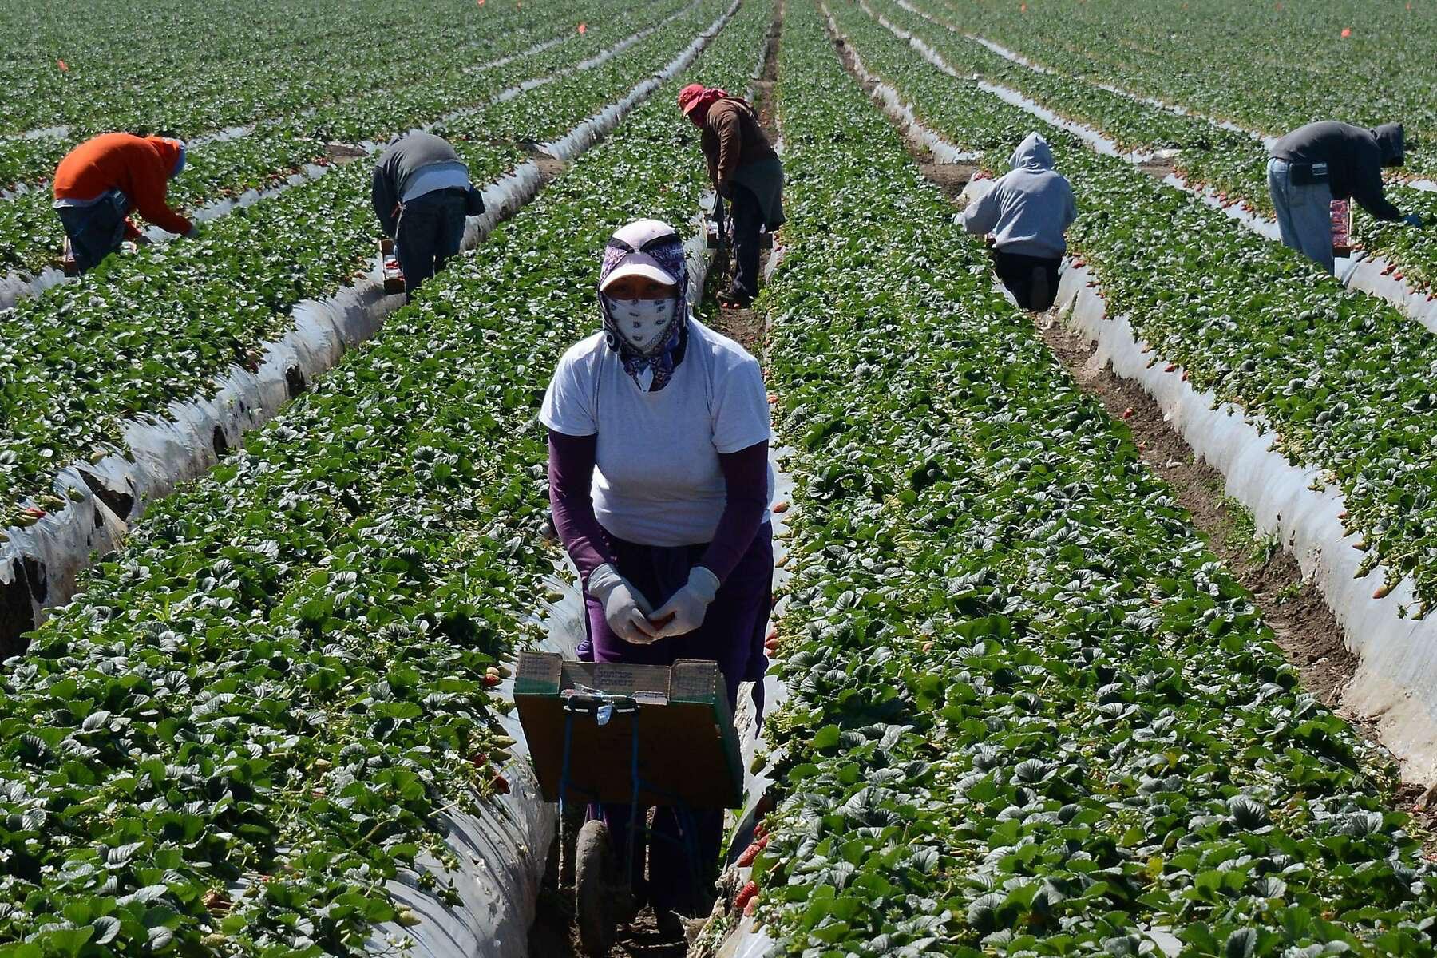
About the artist
Notes:
*Narsiso was born in a small town, Santa Cruz Papalutla, Oaxaca, Mexico in 1977. He says migrant farm work was part of his hometown’s culture — it was normal to see young people traveling to the United States for work. So when he was just 20 years old, Narsiso left Oaxaca and followed one of his brothers to Los Angeles. “The first thing I wanted to do was to learn the language. I was like, I want to learn English. I want to know what the songs are about and the movies” he says.
*For a few years he worked a number of jobs: changing tires at a mechanic shop; unloading trucks at a plastic warehouse, and at night, he went to school. Narsiso earned his GED and then enrolled in community college, where he took his first art history class.
*In order to afford art school, Narsiso joined some family members who worked picking fruit in the orchards of Washington State. Narsiso would work during the summers, save all of his paychecks, and return to school in the fall. for nine years.
*He attended Evans Community Adult School and completed high school in 2006 at the age of 29. He earned an Associate of Arts degree in 2009 from Los Angeles City College. In the fall of 2012 Narsiso earned his Bachelor of Fine Arts from California State University Long Beach. In the spring of 2018 he received a Master of Fine Arts degree in drawing and painting from California State University Long Beach, and was awarded the prestigious Dedalus Foundation MFA Fellowship in Painting and Sculpture.
*Narsiso Martinez's artwork takes an introspective look into the experience of being a migrant farm worker.
*Narsiso Martinez’s drawings and mixed media installations include multi-figure compositions set amidst agricultural landscapes. Drawn from his own experience as a farmworker, Martinez’s work focuses on the people performing the labors necessary to fill produce sections and restaurant kitchens around the country.
*Martinez’s portraits of farmworkers are painted, drawn, and expressed in sculpture on discarded produce boxes collected from grocery stores. In a style informed by 1930s-era Social Realism and heightened through use of found materials, Martinez makes visible the difficult labor and onerous conditions of the “American farmworker,” itself a compromised piece of language owing to the industry’s conspicuous use of undocumented workers.
Examples of his work will be featured on the next two slides.

Slide 3
Mini-Bio
1977: born in Oaxaca, Mexico in 1977
1997: migrates to the US when we is 20 years old
Completes high school at the age of 29
Works as an agricultural worker to fund his college education
2009: earns A.A. degree from Los Angeles City College
2012: earns Bachelor of Fine Arts degree from California State University Long Beach
2018: earns Master of Fine Arts degree from California State University Long Beach
Lives and works in Long Beach, California
Notes:
Source: https://www.arts.wa.gov/artist-collection/?request=record;id=12060;type=701
This mini-bio may be augmented with information in the Notes View of the previous slide.

Slide 4
2.4 Million
44%
$22,000
Farmworkers work on farms and ranches
Undocumented immigrants who lack work authorization
The average personal income
Notes:
*Based on the National Agricultural Workers Survey (2019-2020)
*The results on immigration status may be skewed, with lower undocumented percentages due to a fear of self-reporting undocumented status. Other sources estimate that the proportion of undocumented farmworkers may be much higher. Regardless, even under the NAWS estimates, more than one million farmworkers are undocumented.
*A decreasing number of farmworkers are “migrant workers,” meaning that they traveled “at least 75 miles during a 12-month period to obtain a farm job.” Only 15% of farmworkers in 2019-2020 were migrants, compared to 42% in 2001-2002.
*83% of farmworkers reported that they were employed by a single employer throughout the year. However, a farm labor contractor that brings a crew of workers to several farms during a year can count as a single employer.
*Farmworkers’ average personal income was in the range of $20,000 to $24,999 while their family income was $25,000- $29,999.
*20% of farmworkers’ family incomes fall below the poverty level.

Slide 5
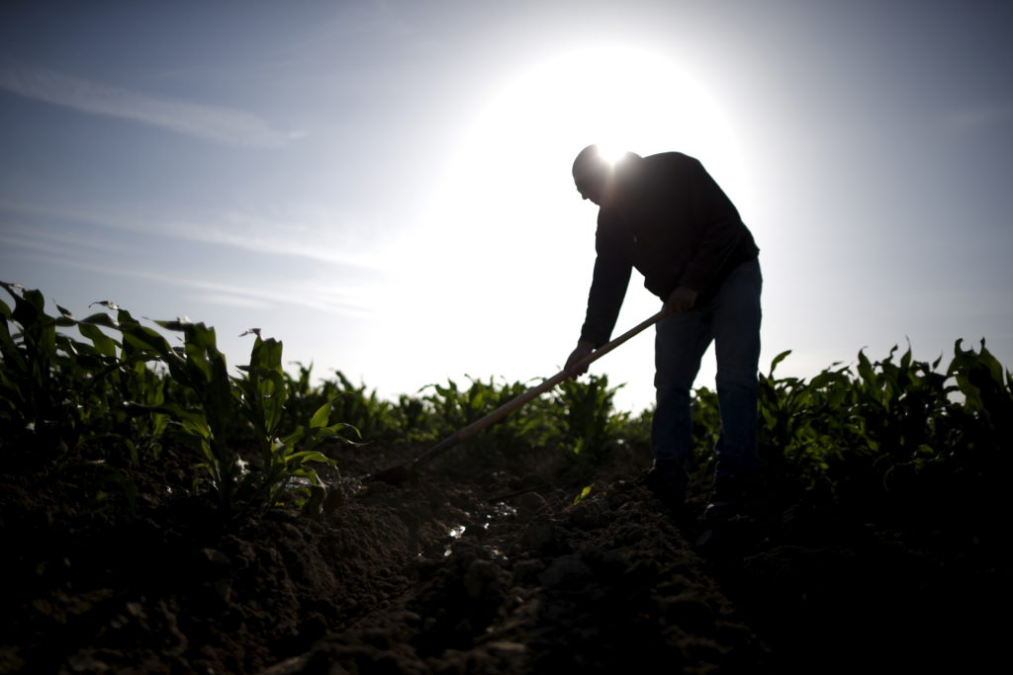
FARMWORKERS
Working Conditions
Poverty
Wages
Health
Notes:
Information all from the National Farm Worker Ministry, Farmworker Justice, USDA Farm Labor Survey
Wages and Poverty
*Many farm workers are paid based on how many buckets or bags they pick of whatever crop they harvest which is known as the “piece rate”
*The average farmworkers wage is $12.47
*Farm work is among the lowest paid jobs, it is an undervaluing of the physically difficult and dangerous works out there
*Farm workers have the lowest annual family incomes of any U.S. wage and salary workers
*30% of farmer workers live below the poverty line
*many factors such as immigration status and indigenous heritage can place workers at a particularly high risk of poverty
*undocumented migrant farm worker families are also more than twice as likely to live below the poverty line
Working Conditions
*Many farm workers are day laborers
*Most farm workers lack benefits that labor laws guarantee to workers in other industries
*Migrant farm workers must chase crops to make a living
*Farm workers are also constantly at the mercy of variable condition like natural disasters and bad weather
Health
*Less than ½ of farm workers have health insurance, and even when they do they may not have transportation to travel to a physician or lack the awareness to know when those services are needed.
*Farm workers perform repetitive picking motions, bend over for hours at a time, lift heavy buckets of produce, and operate machinery like tractors, pesticide applicators, and fruit pickers that can lead to mishaps and injuries on the job
*According to the CDC, 410 farmers and farm workers died from a work-related injury in 2019, resulting in a fatality rate of 19.4 deaths per 100,000 workers. The CDC also reported that farmworkers die from heat-related illness at a rate 20 times grater than the rest of the U.S. civilian workers.
*Other issues that affect farm workers’ health are green tobacco sickness and toxic pesticides
*Migrant farm work is sometimes viewed as modern-day slavery, due to the working conditions, low wages/earnings, and the disregard for their health and safety by the companies they work for. The Fairness for Farm Workers Act that was passed in 1983 to provide overtime and additional minimum wage protections for farm workers. However, very little improvements in wages have been made but there have been groups such as the Farmworkers Justice group that aims to improve all of these issues for the farm workers.
https://nfwm.org/farm-workers/farm-worker-issues/low-wages/#:~:text=The%20average%20farm%20worker%20family,different%20factors%20that%20affect%20income
https://www.farmworkerjustice.org/blog-post/farmworkers-low-wage-rates-have-risen-modestly-now-congress-may-pass-a-law-to-lower-them/
https://nfwm.org/farm-workers/farm-worker-issues/health-safety/

Slide 6
Narsiso Martínez gives a presence to the invisible workers who are essential in our agricultural system.
Martínez’s work is deeply rooted in his personal experience as a farmworker and informed by historical painters.
Taking inspiration from artists such as Jean-Francois Millet, Thomas Hart Benton and more, Martinez portrays the largely invisible group of people responsible for putting food on America’s tables --- the disenfranchised immigrant farmworkers.
Process and Influences
Notes:
Source: p. 24, USF CAM catalog.

Slide 7
Notes:
The fact that Martinez represents these essential workers on discarded produce boxes harvested from local grocery stores amplifies his critique.
It encompasses not just the U.S. food industry but American society at large.

Slide 8
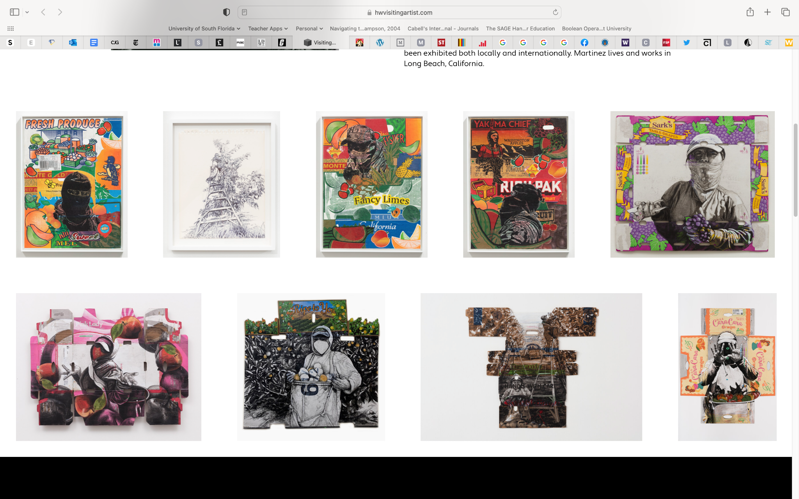
Notes:
[Narsiso remembers falling in love with the work of Vincent Van Gogh — particularly with his depictions of farm workers — and how those depictions inspired him to study art. “I think that those images took me back when I was in Mexico,” he says. “Maybe it was the nostalgia that I felt for my family that I left when I came. I don’t know what it was, but I was like, you know, I think I am just gonna study art.”]
Drawing on the inspiration of past master artists as diverse as Jean-Francois Millet, Vincent van Gogh, and David Alfaro Siqueiros, Mr. Martinez offers a critique of the food industry by contrasting symbols of corporate agribusiness with images of its laborers. He deftly juxtaposes charcoal portraits of agricultural workers on reclaimed produce boxes to illuminate the socioeconomic disparities of agribusiness.
Going back and forth between the orchards and Cal State Long Beach, Martinez often found himself code-switching when interacting with farmworkers versus grad students. He wants his art, however, to translate to everyone — not just an elite crowd of art lovers. At one point in Martinez’s graduate education, some suggested he take a more abstract approach to his creations, zooming in on just the farmworkers’ skin. He went against their advice.

Slide 9
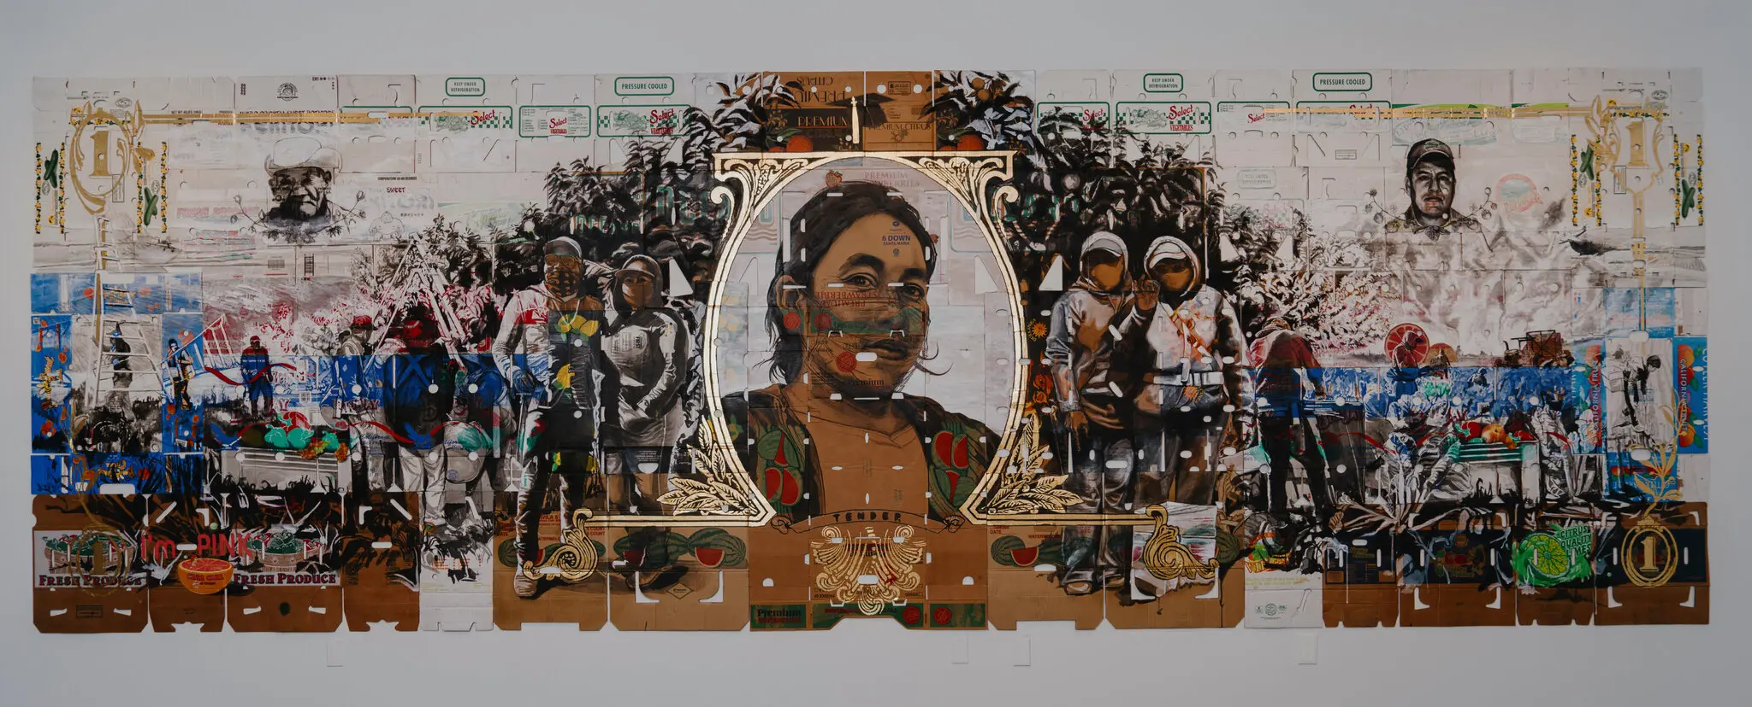
Legal Tender (2022)
Museum of Latin American Art
Notes:
In a very recent November 2022 NYT article by Jori Finkel, this piece was described as his most ambitious artwork to date. The painting looks like an enormous dollar bill issued by an imaginary country that actually values its working class. Filling most of a wall of his current show at the Museum of Latin American Art, it has roughly the same proportions as U.S. paper currency and some of the same symbols, with decorative medallions in the corners and a framed portrait in the center.
Only the subject of this portrait is not an American founding father but a hero of another kind: a California farmworker from Mexico, shown in semi-profile with her thick, black hair tied back and her gaze strong and direct. At either side are farmworkers in full gear: masks to protect them from pesticides, hats to shield them from the sun, and goggles or sunglasses for both.
He said the central figure in “Legal Tender” is based on an undocumented California farmworker from Guerrero, Mexico, whom he met and photographed — and paid for her time.
Other scenes complete the artwork, which draws on the Mexican muralist tradition in its narrative scope and celebration of physical labor and on Dada collage and assemblage in its use of found objects. The entire painting, done in gouache, ink, charcoal and gold leaf, was made not on canvas but on flattened produce boxes — the kind used for oranges, strawberries, watermelons and the like — which come with punchy corporate logos and sunny illustrations that add color to the scene. The produce boxes point to the big business of American agriculture, which depends so heavily on — and often exploits — undocumented Mexican immigrants who have little leverage when the work is dangerous or wages too low.

Slide 10
— Narsiso Martinez
“I feel my work is an extension of the peasantry, the landscapes, and the themes of social economic inequity that are the legacy of these [past] masters… I wish for these drawings on boxes to be the common ground for conversation between the rich and the less fortunate.”

Slide 11
Brainstorming and Designing
Identify: an issue important to you and your own life story.
Brainstorm: How might you tell your life story through art? Which aspects of your life would be most important to note?
Design: Create an artistic display of your life story in a form similar to Martínez’s artistic approach.
Notes:
Point out to students:
Representationalism, painting on the actual produce boxes as a strategy to both highlight the commercialism of the agri- business and also the people who picked the food, collaging boxes as if creating a collective community of shared experiences, cheerful commercial designs in opposition to the folks who filled the boxes with produce, etc.

