Slide 1
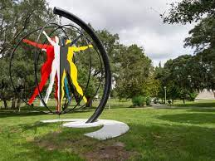
Public Art
What is it and what counts as public art?

Slide 2
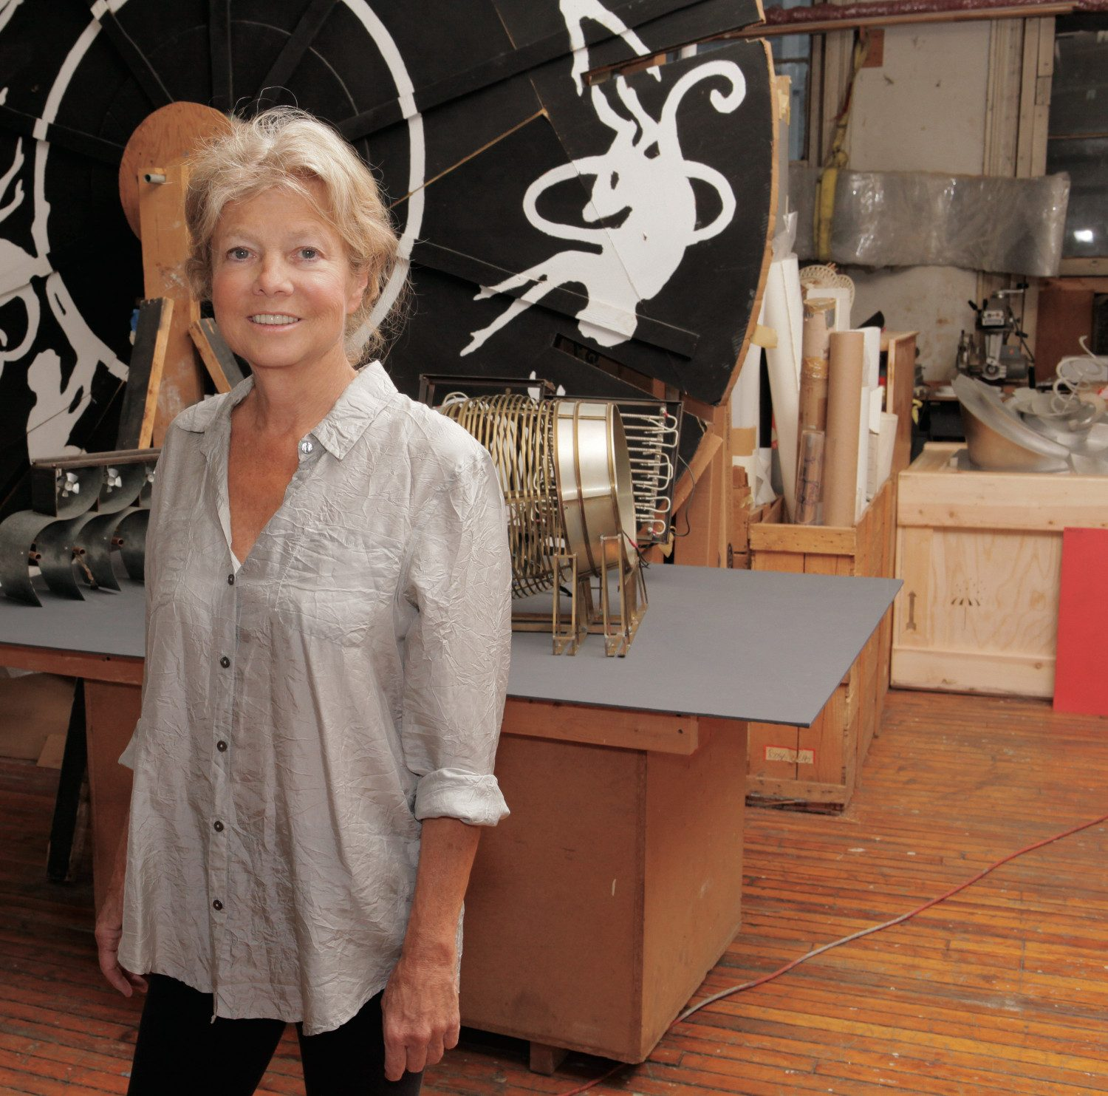
Alice Aycock

Slide 3
Alice Aycock: Brief Biography
Born in Pennsylvania in 1946
B.A., Douglass College, New Jersey
M.F.A., Hunter College in New York
Her work can be found throughout the world, including Museum of Modern Art, the Guggenheim Museum of Art, the Metropolitan Museum, the Whitney Museum of American Art, the Los Angeles County Museum, and numerous cultural institutions throughout Europe

Slide 4
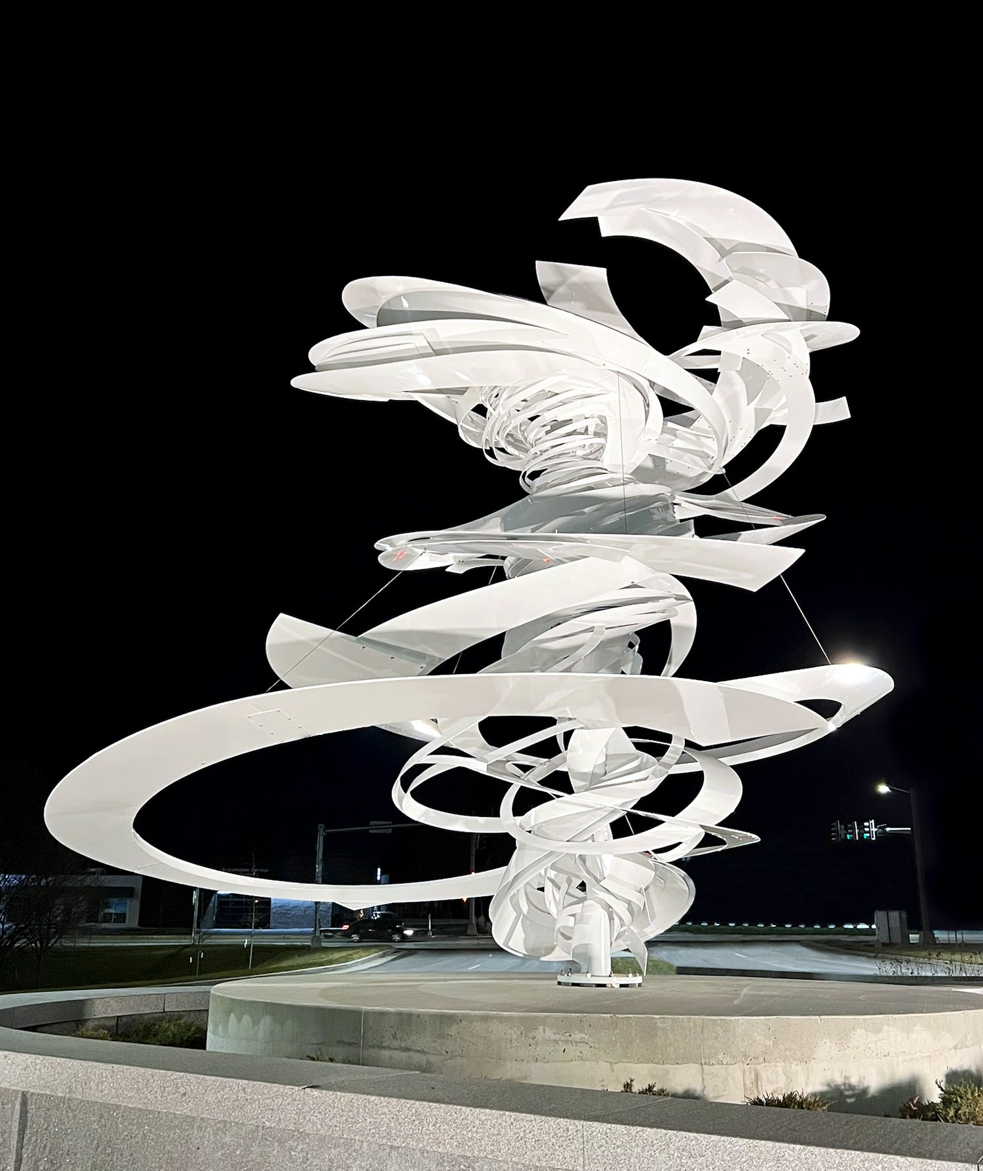
Alice Aycock: Artistic approach
Early work focused on associations with the environment
In the 1990s, Aycock switched to more advanced engineering and permanent sculpture
Recent work are often large-scale sculptures based on natural forms, using high-tech materials
Liftoff (2022)
Notes:
Image: Moines, IA
Commissioned by the Greater Des Moines Public Art Foundation in honor of Johnny Danos
High performance white gloss powder coated aluminum, galvanized/structural stainless-steel interior column with isolators for dissimilar materials
21’ tall x 21’10” wide x 16’ deep
Photo: M. Jessica Rowe, EES Design

Slide 5
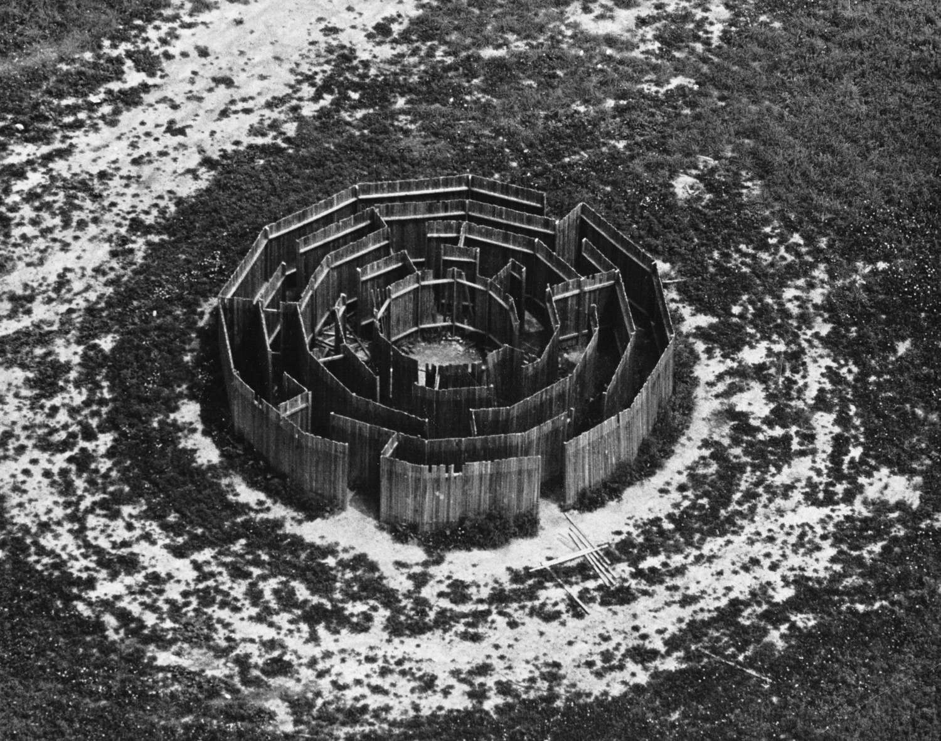
Maze (1972)
  “Originally, I had hoped to create a moment of absolute panic—when the only thing that mattered was to get out.”
Notes:
Maze, 1972
12-sided wooden structure of 5 concentric dodecagonal rings, broken by 19 points of entry and 17 barriers
32’ diameter x 6’ high
Originally sited at Gibney Farm near New Kingston, Pennsylvania
Photo: Silver Spring Township Police Department, Mechanicsburg, PA (aerial); Alice Aycock

Slide 6
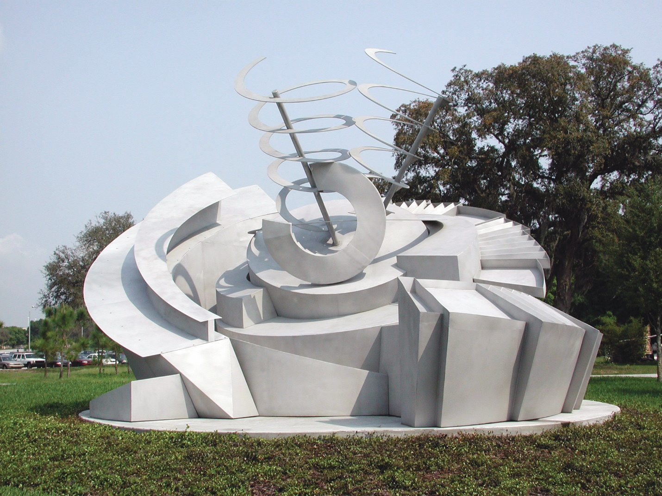
Alice Aycock, Maze 2000 (2002)
Designed to serve as a landmark to commemorate the first architectural footprint of USF’s new Interdisciplinary Campus
Links the Medical Campus to the Academic Campus both geographically and intellectually
Celebrates the union of interdisciplinary study and research
Notes:
Maze 2000 was designed to serve as a landmark to commemorate the first architectural footprint of USF’s new Interdisciplinary Campus, Psychology and Communication Sciences & Disorders.
Links the Medical Campus to the Academic Campus both geographically and intellectually.
Celebrates the union and elaborates on the meaning and ambition of the interdisciplinary study and research that is the focus of the new campus

Slide 7
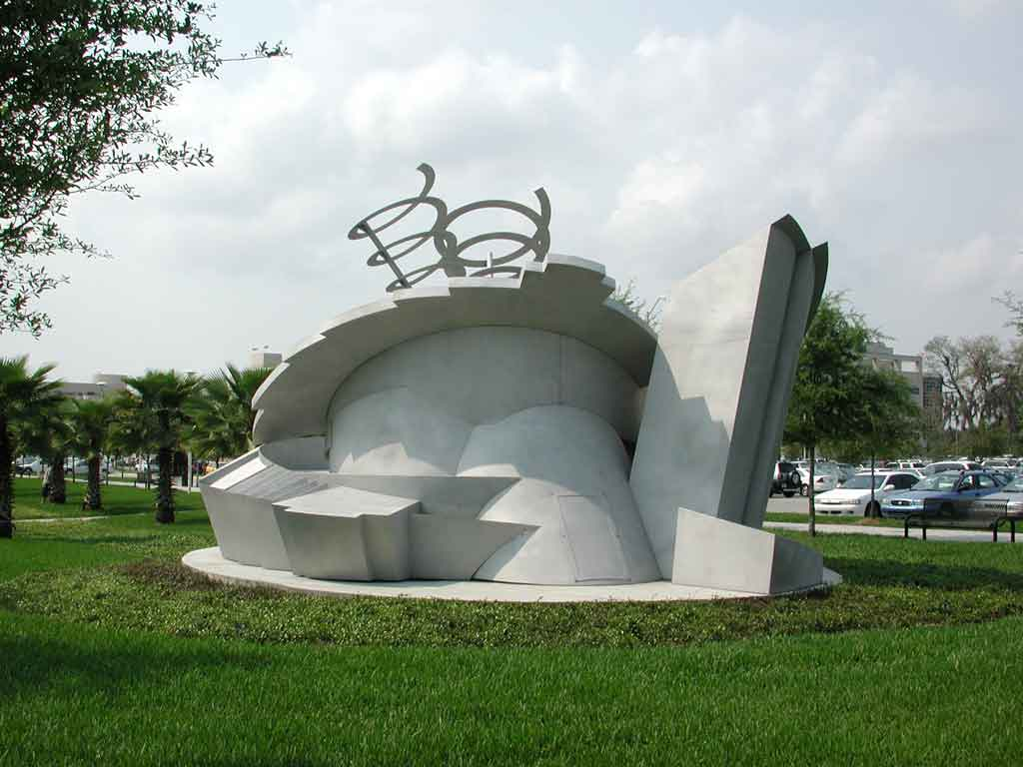
Side view of Maze 2000
Functions as a sort of compass.
As the viewer moves around the piece, they access ever-changing facets of the work.
The work evokes concerns, which are at the heart of psychology.
Thoughts are never at rest. In the swirling and layered presence of the piece --- like a thought or idea --- finds no place to rest.
Notes:
Maze 2000 functions as a sort of compass; but this is a compass whose needle quivers, suggesting a non-permanence of direction, which she felt underlies the reality of one’s life.
As the viewer moves around the piece, they access ever-changing facets of the work, engaging their memory as a tool in understanding the sculpture.
The viewer must deal with the work in a fashion similar to the way they deal with their lives; organizing it through the use of a mental construct.
In this sense, the work is evocative of concerns, which are at the heart of psychology.
Aycock talked about thoughts never being at rest. In the swirling and layered presence of the piece, the viewer’s eye, like a thought or idea, finds no place to rest.

Slide 8
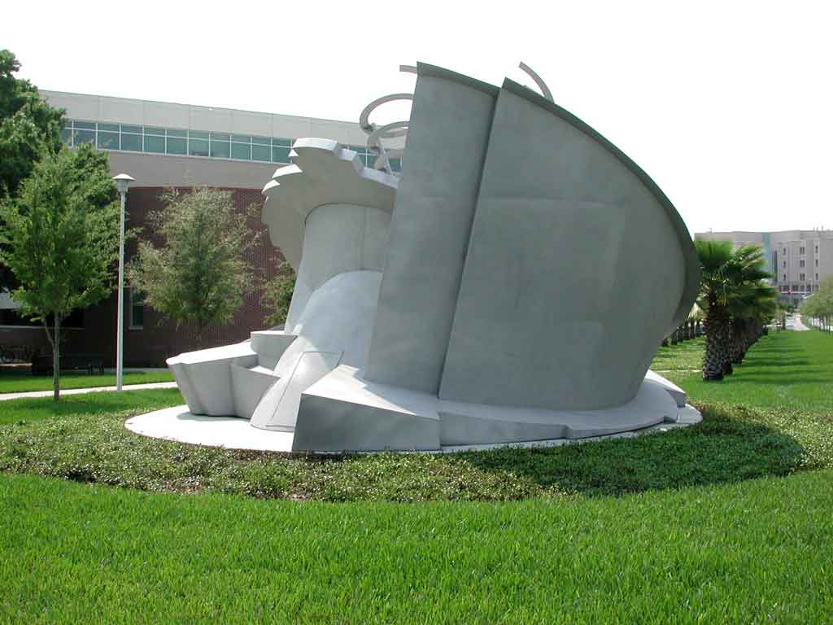
Side view of Maze 2000
Maze 2000 is layered and non-linear, like the quest for knowledge.
Just as a viewer considers the work from various vantage points, so the student seeks knowledge from different perspectives.
In the swirling and layered presence of the sculpture, the viewer’s eye, like a thought or idea, finds no place to rest.
Notes:
Maze 2000 is layered and non-linear. Aycock likened this aspect of the piece to the quest for knowledge.
Just as a viewer would be pursuing understanding of the work from various vantage points, so the student seeks knowledge from different perspectives and from different layers.
In the swirling and layered presence of the sculpture, the viewer’s eye, like a thought or idea, finds no place to rest.

Slide 9
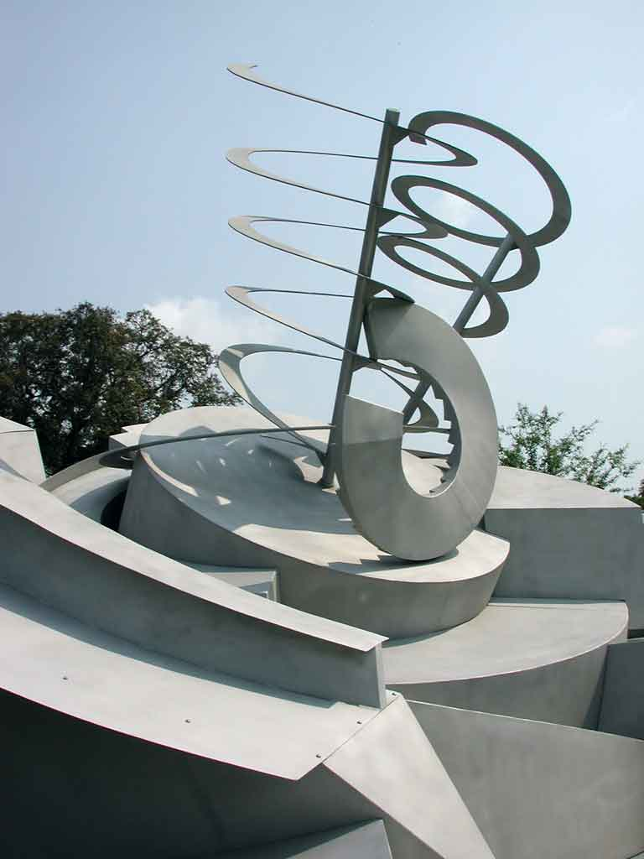
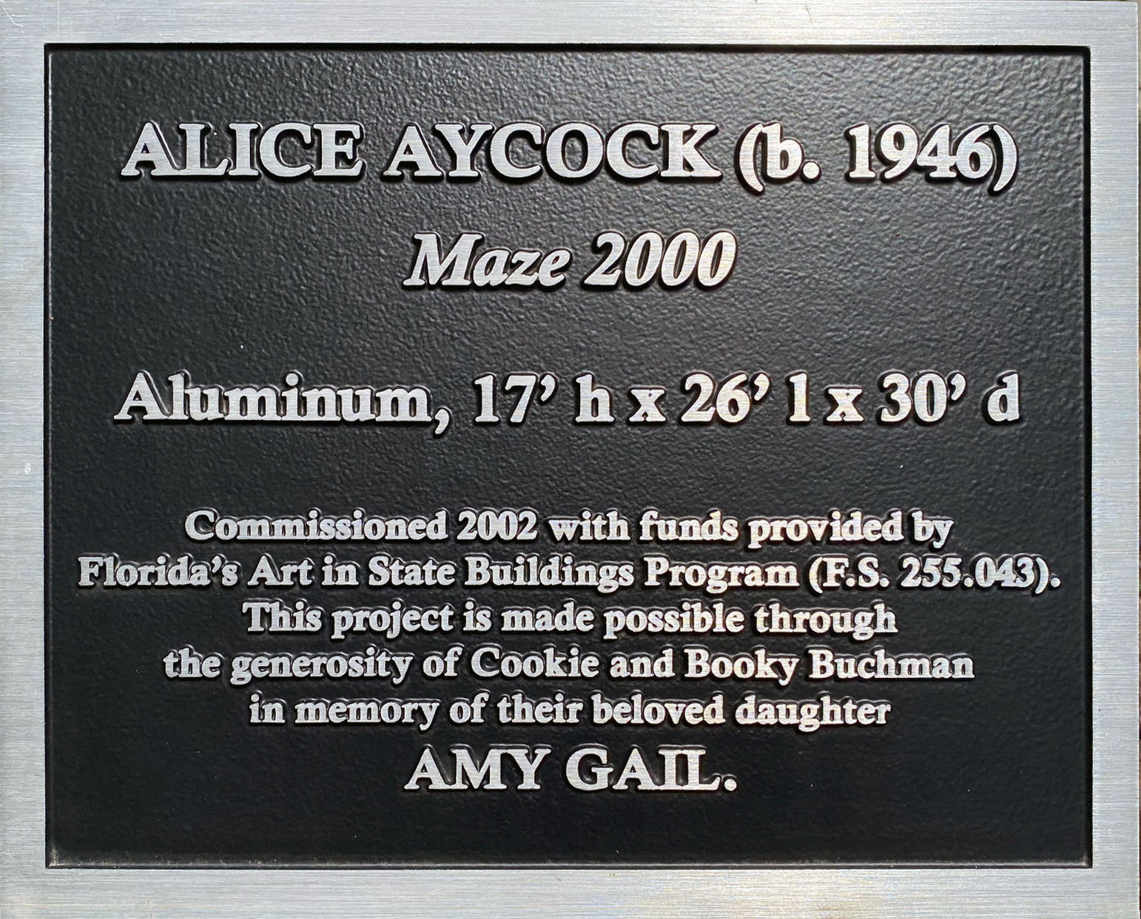
Detail of Maze 2000

Slide 10
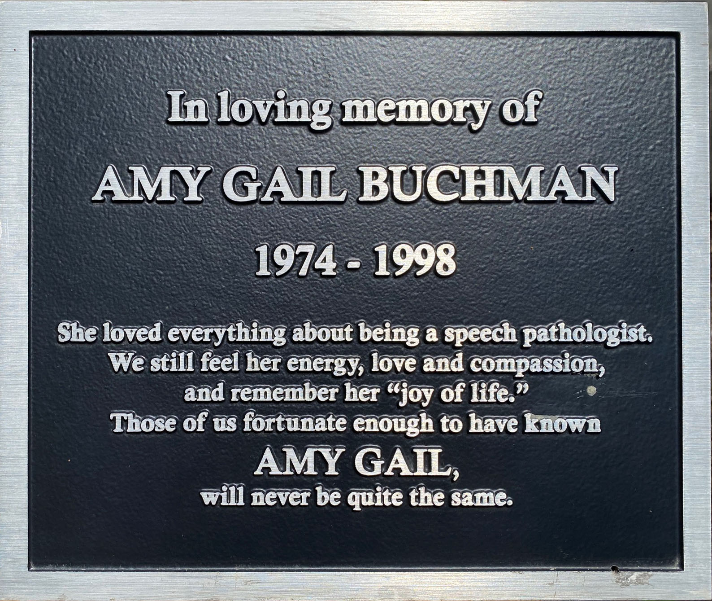
In Loving Memory of
AMY GAIL BUCHMAN
1974–1998
She loved everything about being a speech pathologist. We still feel her energy, love and compassion, and remember her "joy of life." Those of us fortunate enough to have known AMY GAIL, will never be quite the same.
Notes:
Who was Amy Gail Buchman?
Eventually someone will ask: "who was Amy Gail Buchman?" The answer is simple. Amy was a special woman who loved learning. She studied hard and became an outstanding speech therapist. She was loving, sweet and vivacious with a goal to bring happiness to others. Amy could make a day brighter or a room glow with her natural charm and enthusiasm. She was nice to everyone. Who was Amy Gail Buchman? Amy was the kind of person all of us should want to be like. If we follow her example, we will help complete the good work she began. Amy lost her life in a car accident at age twenty-four, but the beauty of her short life will never be lost to us.
Maze 2000 made possible by Florida's Art in State Buildings Program and the generosity of Cookie and Booky Buchman in memory of their daughter Amy Gail.

Slide 11
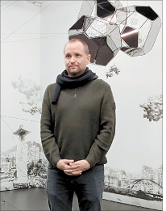
Tomás Saraceno

Slide 12
Tomás Saraceno: Brief Biography
Born in Argentina in 1973
Currently lives and works in Berlin
Trained as both an architect and a visual artist, he works in the crossroad of art, physics, biology, astronomy, and engineering
In 2015, he achieved the world record for the first and longest fully-solar manned flight
His work is included in the collections of The Museum of Modern Art, New York; SFMOMA, San Francisco; Walker Art Center, Minneapolis; Nationalgalerie, Staatliche Museen zu Berlin, Berlin; among others.

Slide 13
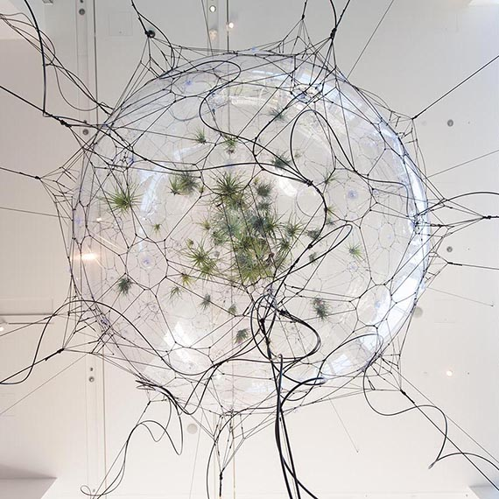
Tomás Saraceno: Artistic approach
Ecological crisis at the center of much of his work
The “ethical collaboration with the atmosphere”
Arachnophilia, a not-for-profit research community, focuses on spider/web research
Spider webs serve as a metaphor for the Universe --- the interconnected galaxies, stars, and planets --- the cosmic web
Biosphere 02 (2009)

Slide 14
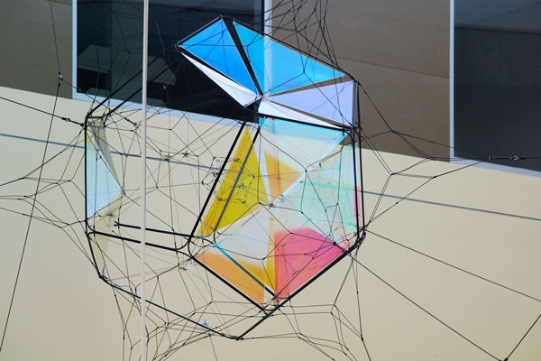
Tomás Saraceno, Caelum Dust (2016)

Slide 15
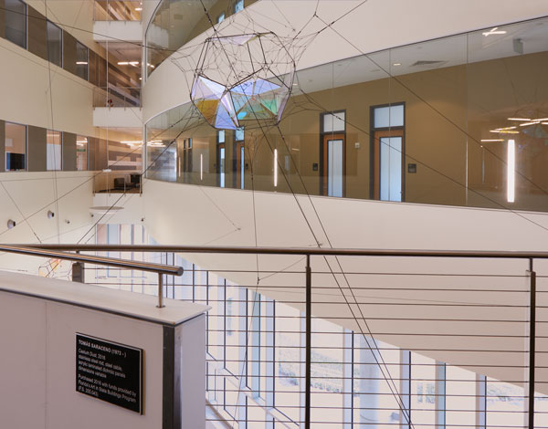
Tomás Saraceno, Caelum Dust (2016)

Slide 16
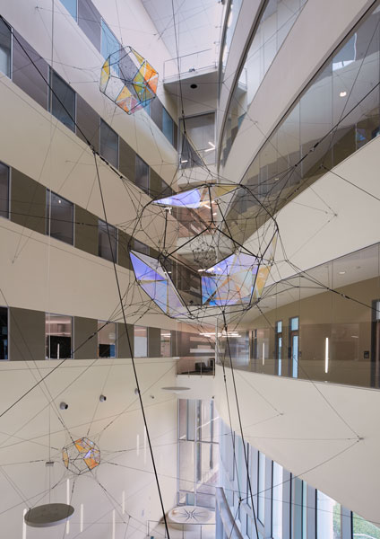
Caelum Dust (2016)

Slide 17
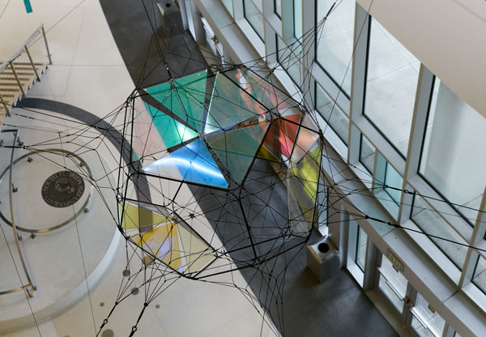
Tomás Saraceno, Caelum Dust (2016)

Slide 18
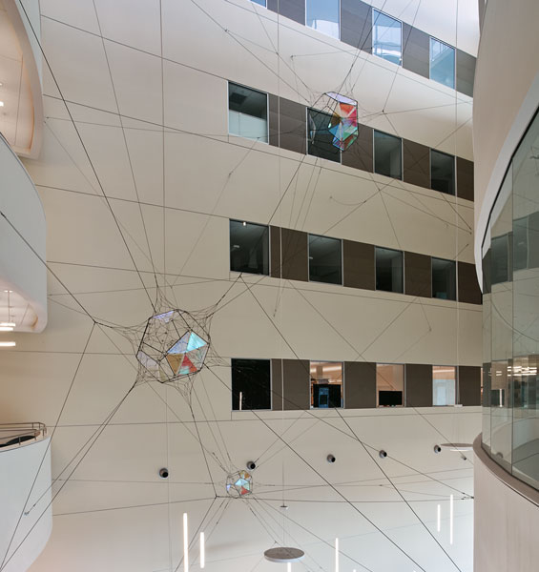
Caelum Dust (2016)

Slide 19
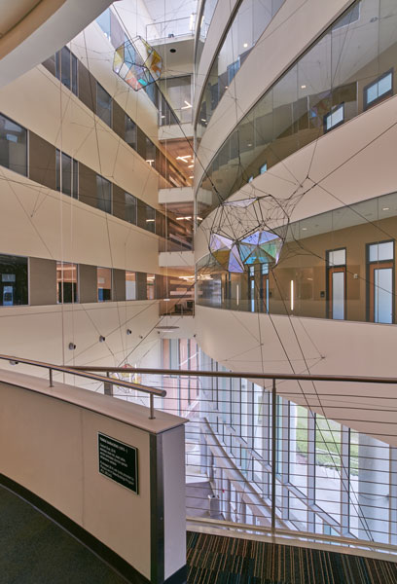
Caelum Dust (2016)

