Slide 1
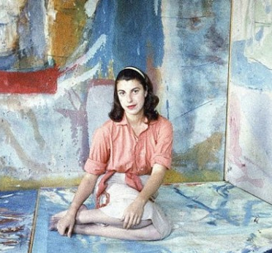
Helen Frankenthaler:
No Rules
Notes:
28-year-old Helen Frankenthaler in her West End Avenue studio for LIFE article, “Women Artists in Ascendance” (May 13, 1957)
Photographer: Gordon Parks

Slide 2
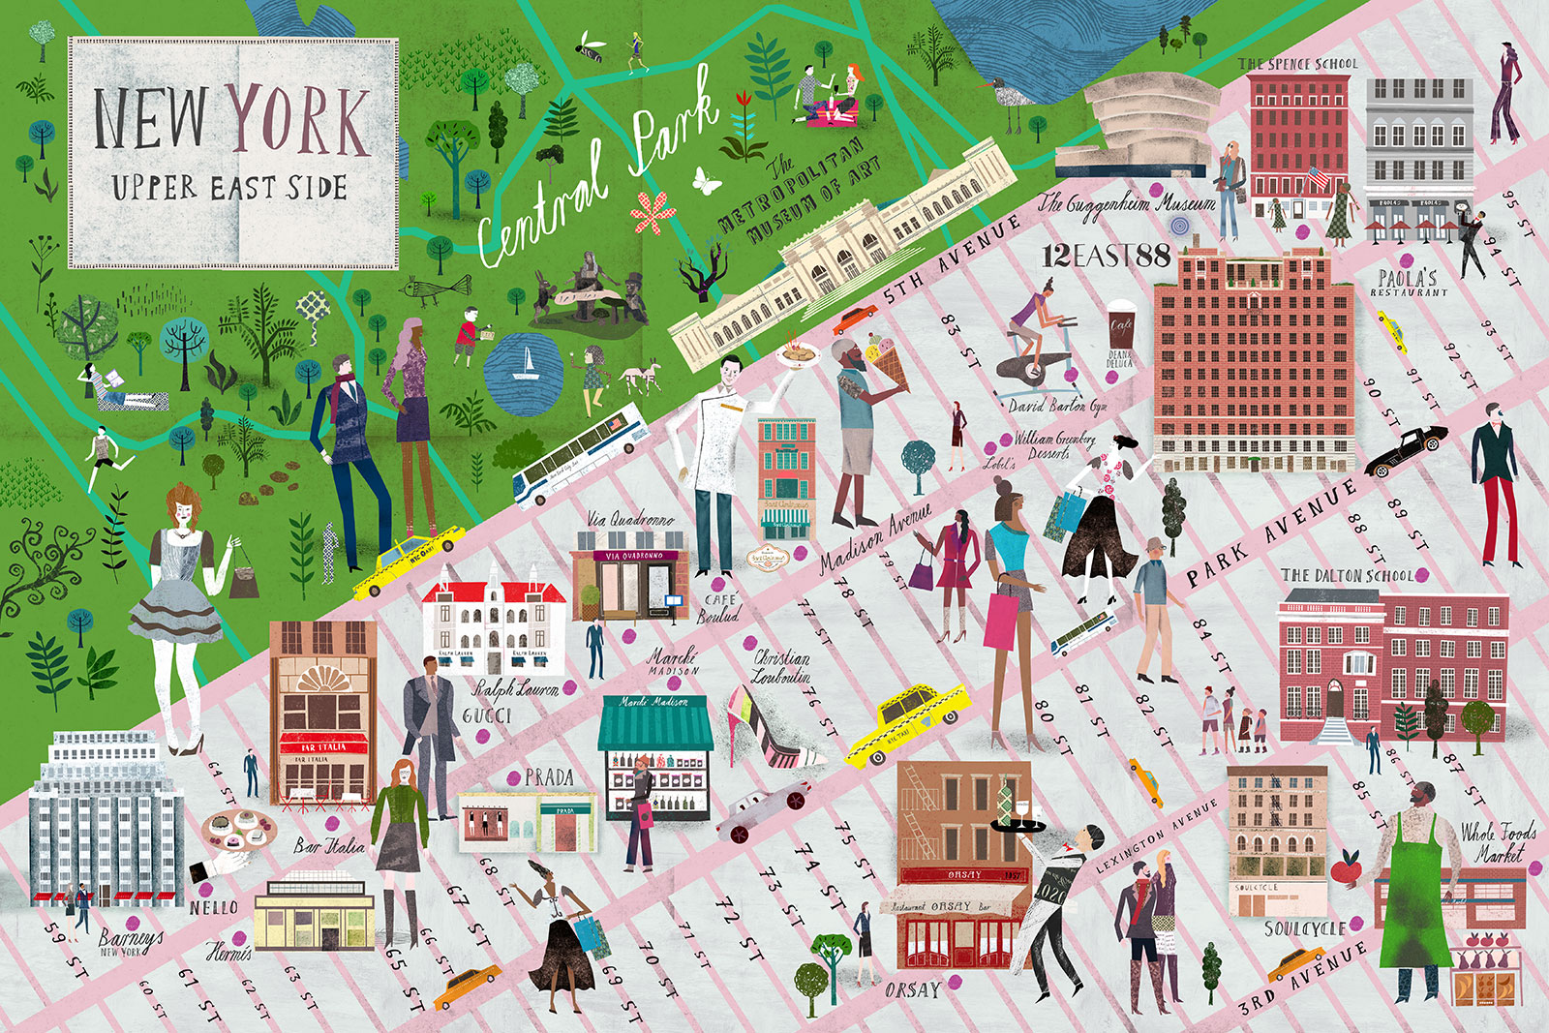
1928
Notes:
Youngest of 3 girls. Privileged background; progressive and intellectual Jewish family.
One of her nannies remembers the young Helen using a piece of chalk to trace her route on the sidewalk from the Metropolitan Museum of Art (82nd St & 5th Ave) to her home (74th St & Park Ave), all the while bent over and drawing the line while amused adults looked on. (Source: Ninth Street Women.)
“She was born in 1928, the daughter of a much admired New York State Supreme Court justice, and grew up on Park Avenue. The youngest and the prettiest of three daughters, she was very much her father’s favorite; she had a haunted relationship with her imposing mother, Martha, herself an unfulfilled artist. (Martha, caught in depression by Parkinson’s, committed suicide, decades later, by jumping from her apartment window.)”
Source: https://www.newyorker.com/magazine/2021/04/12/helen-frankenthaler-and-the-messy-art-of-life

Slide 3
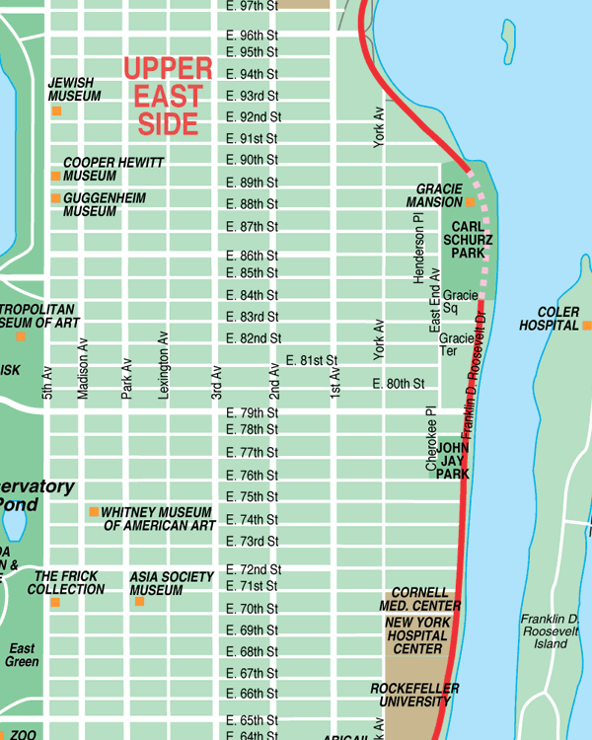
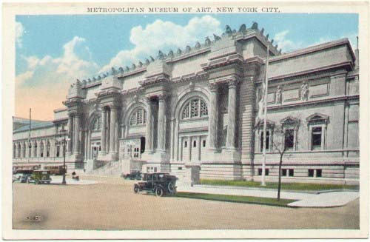
Childhood
Notes:
“Frankenthaler delighted in drawing a single line of chalk tracing her route from the Metropolitan Museum to the family’s apartment blocks away…and loved to take her mother’s red nail polish and spill it in the sink, just to see the patterns it made.”
Source: https://www.newyorker.com/magazine/2021/04/12/helen-frankenthaler-and-the-messy-art-of-life
Childhood and later privilege through her associations: “Gifted with privilege and connections and unashamed to use them, Frankenthaler put her image to work and was criticized for it. “Easy for Helen to be the fairy princess,” the painter Grace Hartigan wrote in her journal in 1950. “She hasn’t seen the dragon yet.”
Source: https://www.latimes.com/entertainment-arts/books/story/2021-02-17/artist-helen-frankenthaler-bio

Slide 4


Early Schooling
Notes:
Exclusive, private, all-girls school. Curriculum based on the liberal arts.
Located on Park Avenue, just a handful of blocks away from Helen’s home.
Helen thrived there.

Slide 5
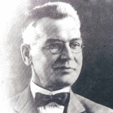
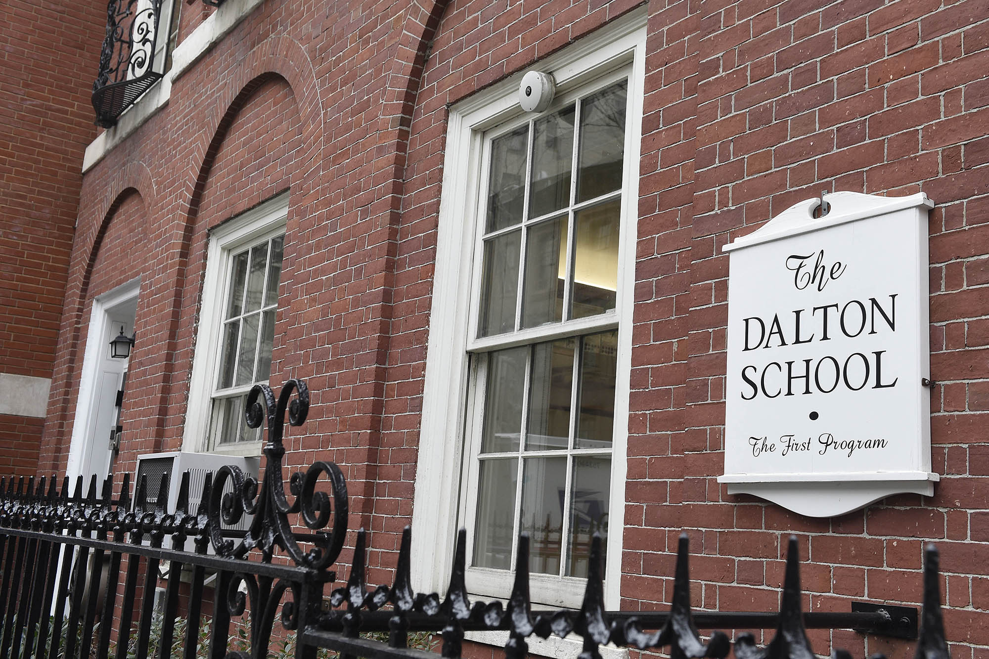
1940
Notes:
1940, when Helen is 12 years old, her dear father Alfred, dies of cancer.
Helen is sent to The Dalton School in 1943, partly as an antidote to her sadness over the loss of her father.
It is here when Helen decides definitively that she wants to make a career of art.
Image of Alfred Frankenthaler: https://prabook.com/web/alfred.frankenthaler/933158

Slide 6
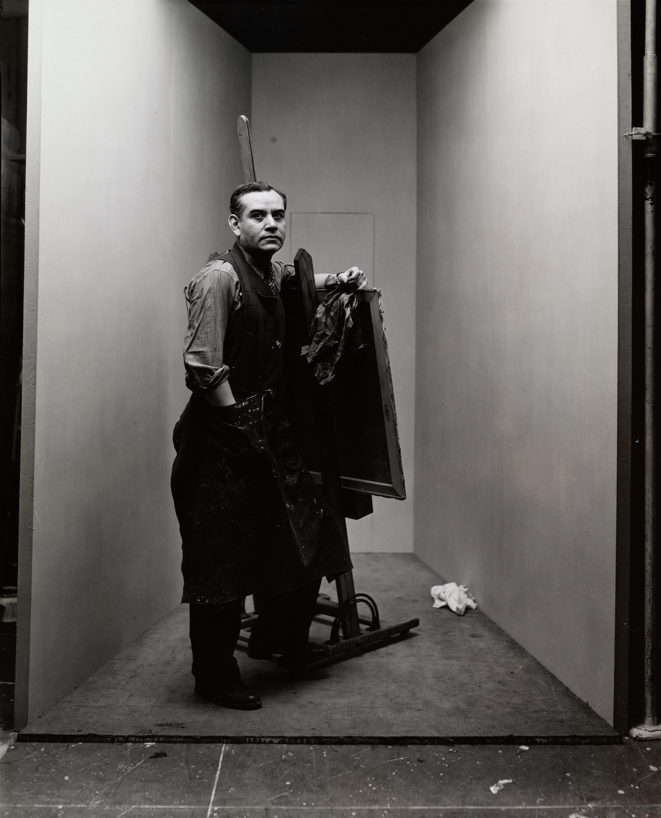
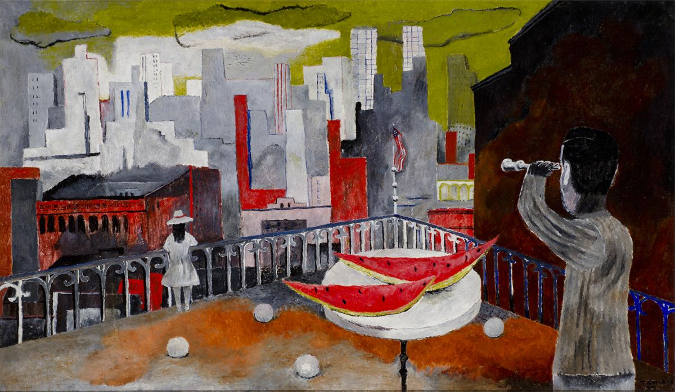
Ruffino Tamayo
New York Seen from the Terrace [Nueva York desde la terraza], 1937
Notes:
Image (right): Irving Penn portrait of Rufino Tamayo, https://irvingpenn.org/portraits
Image (left): Rufino Tamayo, New York Seen from the Terrace [Nueva York desde la terraza], 1937, oil on canvas, 20 3/8 x 34 3/8 in. FEMSA Collection. © Tamayo Heirs/Mexico/Licensed by VAGA, New York, NY. Photo by Roberto Ortiz , https://americanart.si.edu/exhibitions/Tamayo
Tamayo encourages Helen to pursue art and suggests Bennington College in Vermont.

Slide 7
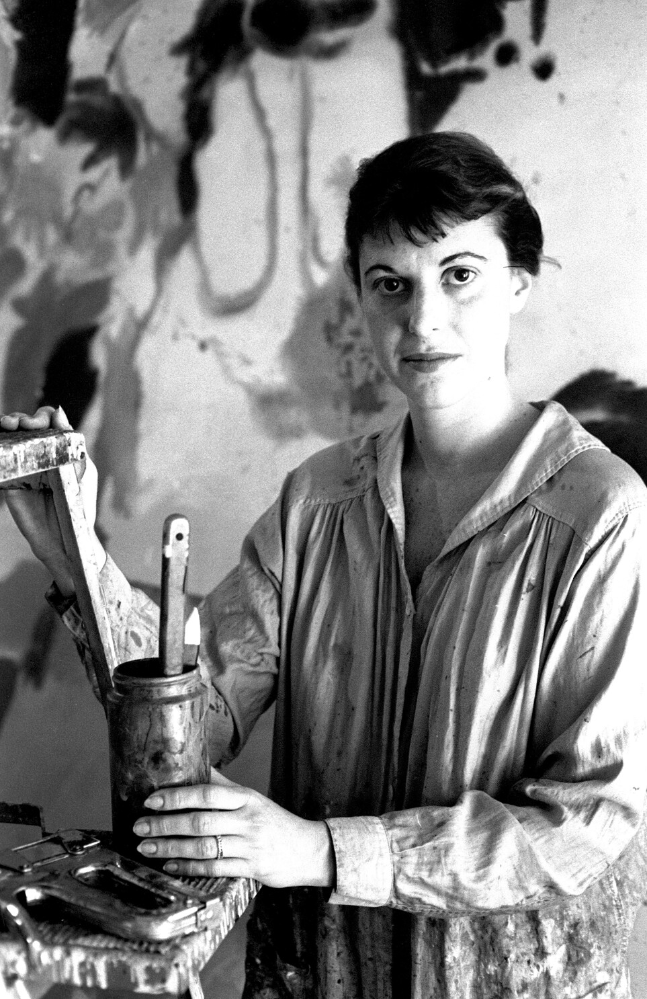
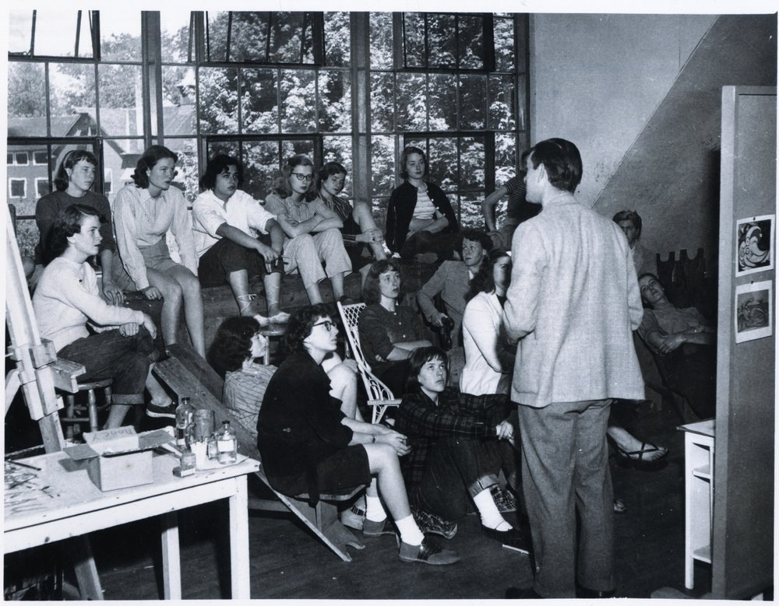
1949: Bennington College, VT
Notes:
Graduates from Bennington College in Vermont. Studied under Paul Feeley (an admirer of Picasso), whom she credits for her understanding pictorial composition and cubism.
Feeley encourages Helen to go to Provincetown to study with Hans Hofmann.
Image (right): Paul Feeley at Bennington College; source: https://www.paulfeeley.org/
Image (left): Helen Frankenthaler, Abstract Expressionist painter, in her studio in May 1960.
(Ben Martin / Getty Images) https://www.latimes.com/entertainment-arts/books/story/2021-02-17/artist-helen-frankenthaler-bio

Slide 8
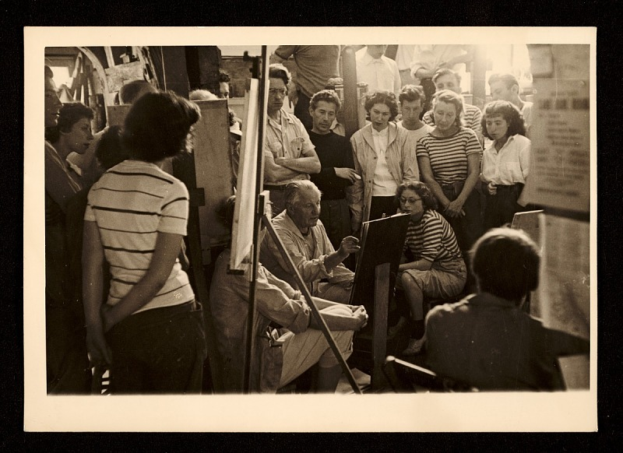
Hans Hofmann School of Fine Arts, Provincetown, summer 1950
Notes:
HANS HOFMANN
http://www.hanshofmann.org
Hans Hofmann (1880-1966) was a pivotal figure in Abstract Expressionism and stands as one of the most important characters of post-war American art.
Image: Class at the Hans Hofmann School of Fine Arts, Provincetown
Class at the Hans Hofmann School of Fine Arts, Provincetown, ca. 1945. Hans Hofmann papers, circa 1904-2011. Archives of American Art, Smithsonian Institution.
Record number(DSI-AAA)9471
Source: https://www.si.edu/object/class-hans-hofmann-school-fine-arts-provincetown%3AAAADCD_item_9471

Slide 9
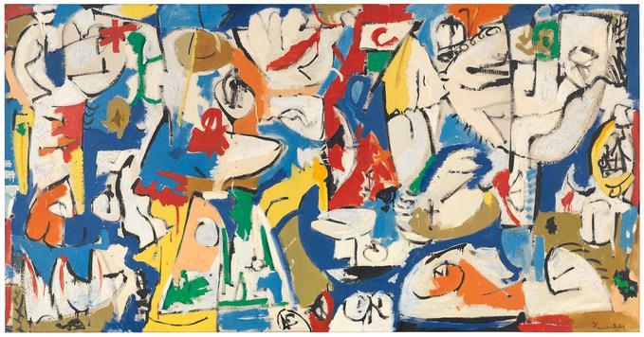
The Jugglers
Notes:
Some of Feeley’s and Hofmann’s influence can be seen in this early work by Frankenthaler.
The Jugglers (1951)

Slide 10
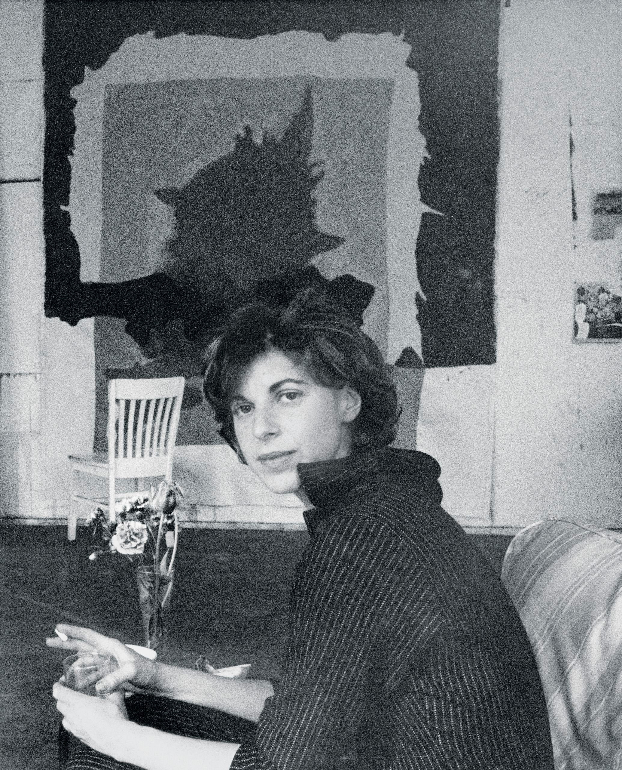
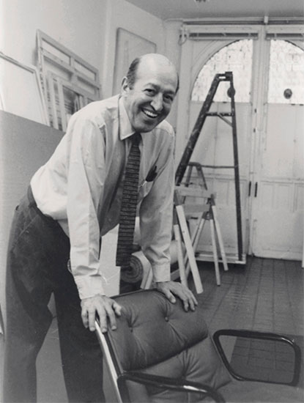
1950
Notes:
Image source: https://www.newyorker.com/magazine/2014/09/22/pours
Meets Clement (Clem) Greenberg (19 years Helen’s senior), the most influential art critic at the time, who introduces her to the professional art scene. Has a 5-year relationship with him.

Slide 11
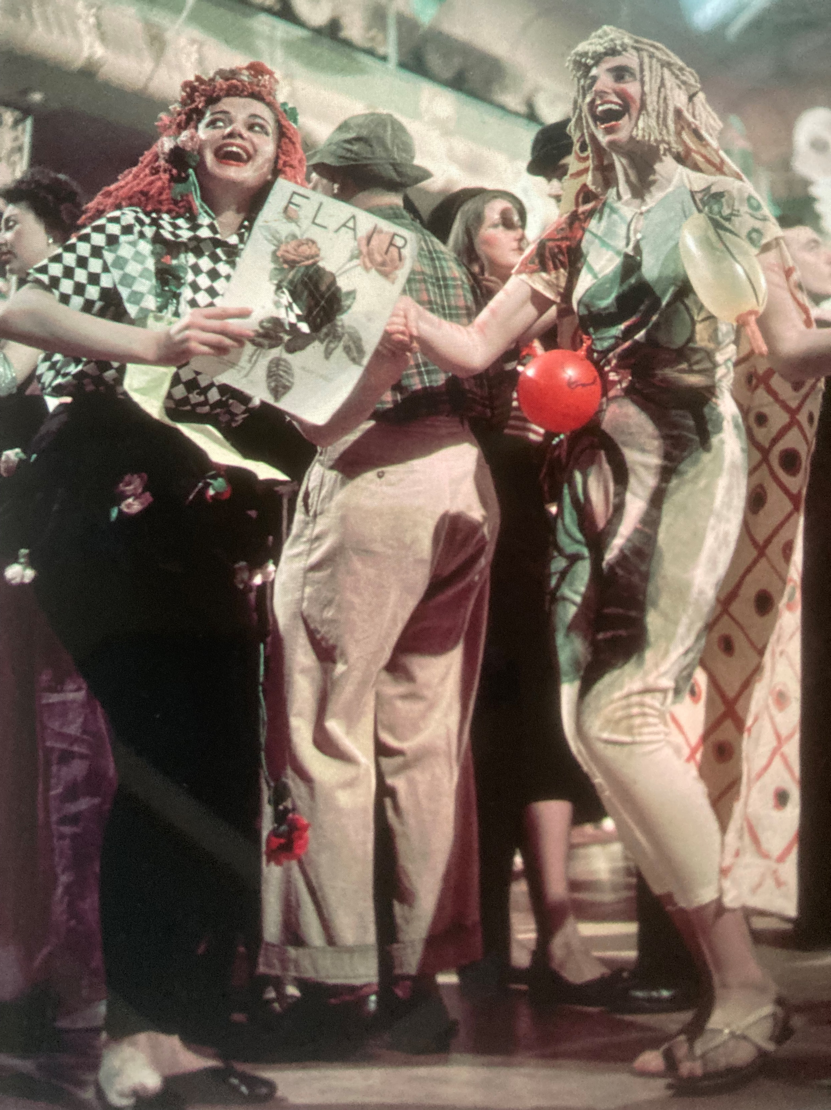
Helen Frankenthaler (R.) & friend Gaby Rodgers (L.) Beaux Arts Ball, Astor Hotel New York (1950)
Notes:
Helen Frankenthaler and her friend Gaby Rodgers at the Beaux Arts Ball, Astor Hotel, New York, May 19, 1050.
Photograph originally appeared in LIFE magazine, June 12, 1950.

Slide 12
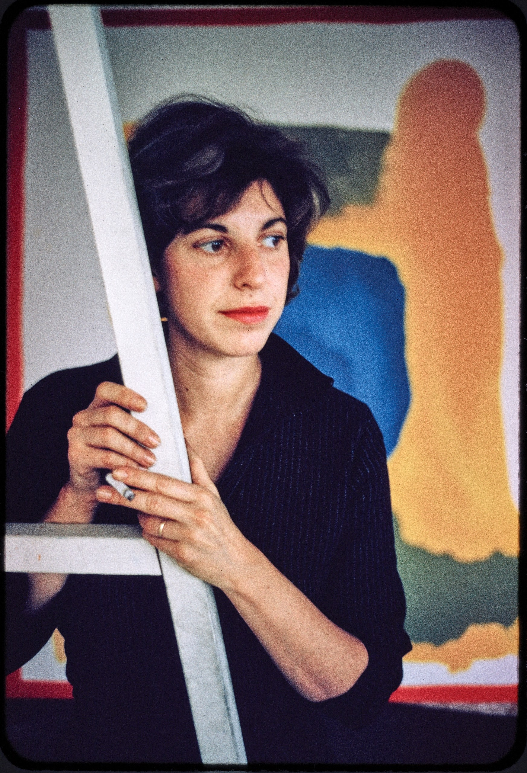
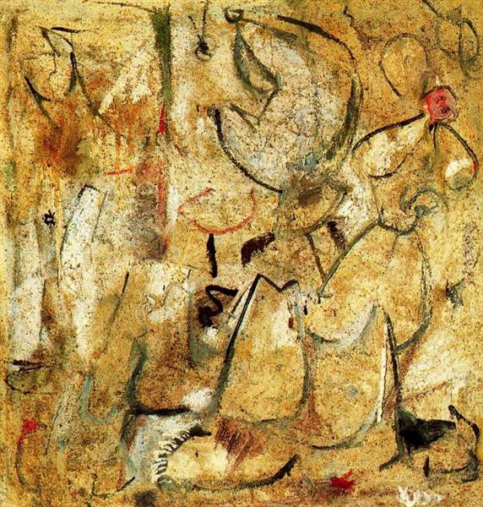
Beach (1950)
Notes:
Frankenthaler’s professional exhibition career began in 1950, when Adolph Gottlieb selected her painting Beach (1950) for inclusion in the exhibition titled Fifteen Unknowns: Selected by Artists of the Kootz Gallery.
Source: https://www.frankenthalerfoundation.org/helen/biography
Image: https://www.newyorker.com/magazine/2021/04/12/helen-frankenthaler-and-the-messy-art-of-life

Slide 13
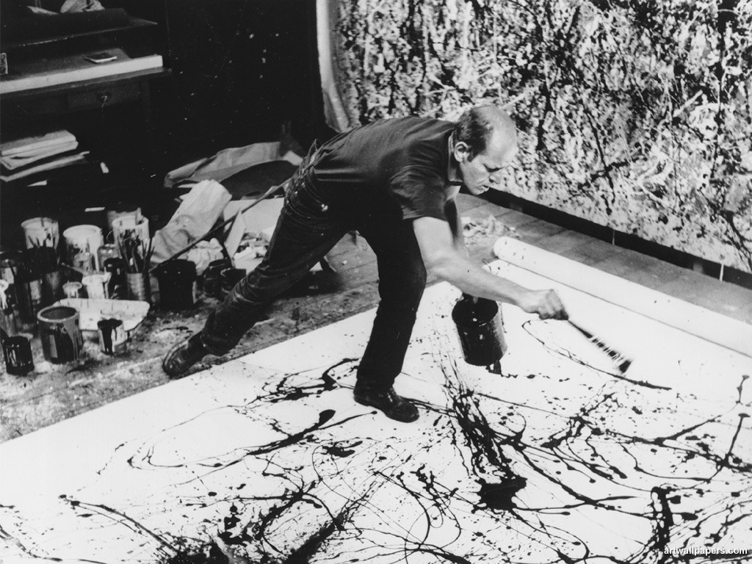
1950: Jackson Pollock
Notes:
Sees Jackson Pollock’s work for the first time.
Frankenthaler described her first encounter with Jackson Pollock’s work in 1950 as “a beautiful trauma.”
Frankenthaler was influenced by “Jackson Pollock's pouring technique, in which she likewise poured paints onto enormous canvases placed on the floor. But while Pollock used enamel paints, which remain on the surface of the canvas when dried, Frankenthaler poured oil paints that she had thinned with turpentine that then soaked into the fabric of the canvas. Frankenthaler's soak-stain process created luminescent, misty compositions dominated by large areas of color that seemed to have emerged onto the canvas naturally and organically.”
Source: https://www.theartstory.org/artist/frankenthaler-helen/

Slide 14
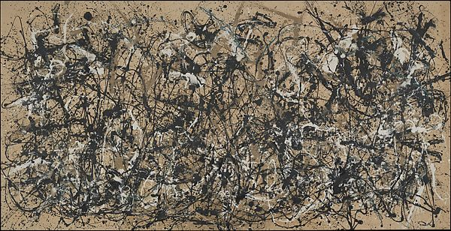
Autumn Rhythm, Number 30, 1950 (1950)
“It was all there. I wanted to live in this land. I had to live there, and master the language.”
Notes:
“The first Jackson Pollock show Frankenthaler saw was at the Betty Parsons Gallery in 1950. She had this to say about seeing Pollock's paintings Autumn Rhythm, Number 30, 1950 (1950), Number One,1950 (Lavender Mist) (1950):
It was all there. I wanted to live in this land. I had to live there, and master the language.”
Source: https://en.wikipedia.org/wiki/Helen_Frankenthaler

Slide 15
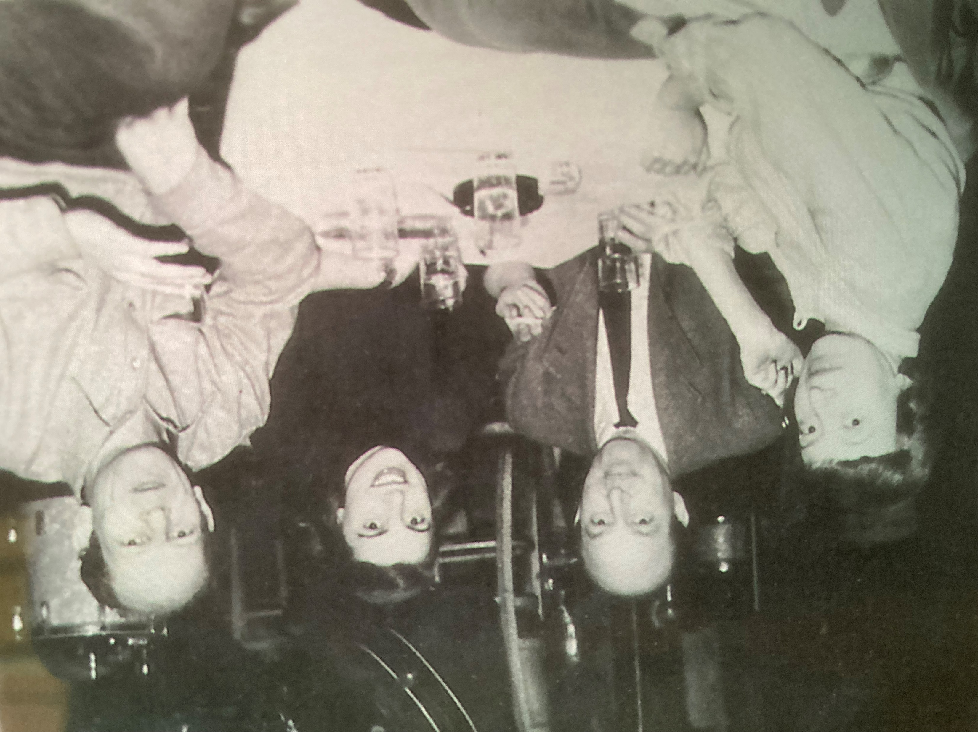
Krasner, Greenberg, Frankenthaler, & Pollock (1951)
Notes:
Lee Krasner, Clem Greenberg, Helen Frankenthaler, & Jackson Pollock at the nightclub Eddie Condon‘s, New York (January 1951)
Photographer unidentified.
Helen Frankenthaler Foundation Archives.

Slide 16
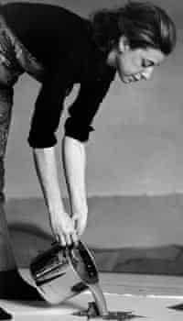
1952
Soak Stain Technique
Notes:
“On October 26, 1952, that breakthrough took place when, from a “combination of impatience, laziness, and innovation,” as Frankenthaler later recalled, she decided to thin her paints with turpentine and let them soak into a large, empty canvas.”
Source: https://www.newyorker.com/magazine/2021/04/12/helen-frankenthaler-and-the-messy-art-of-life
“She invented the "soak-stain" technique, in which she poured turpentine-thinned paint onto canvas, producing luminous color washes that appeared to merge with the canvas and deny any hint of three-dimensional illusionism. Her breakthrough gave rise to the movement promoted by the influential art critic Clement Greenberg as the "next big thing" in American art: Color Field Painting, marked by airy compositions that celebrated the joys of pure color and gave an entirely new look and feel to the surface of the canvas.”
Source: https://www.theartstory.org/artist/frankenthaler-helen/
“Frankenthaler often painted onto unprimed canvas with oil paints that she heavily diluted with turpentine, a technique that she named "soak stain." This allowed for the colors to soak directly into the canvas, creating a liquefied, translucent effect that strongly resembled watercolor. Soak stain was also said to be the ultimate fusing of image and canvas, drawing attention to the flatness of the painting itself. The major disadvantage of this method, however, is that the oil in the paints will eventually cause the canvas to discolor and rot away.”
Source: https://en.wikipedia.org/wiki/Helen_Frankenthaler
Image: https://www.theguardian.com/artanddesign/2011/dec/28/helen-Frankenthaler

Slide 17
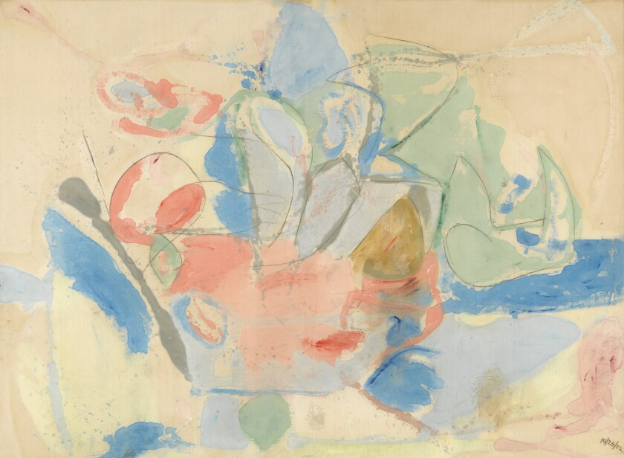
Mountains and Sea (1952)
Notes:
“In Mountains and Sea, her first professionally exhibited work, Frankenthaler made use of the soak stain technique. The work itself was painted after a trip to Nova Scotia, which partly questions the extant of its non-representational status. Although Mountains and Sea is not a direct depiction of the Nova Scotia coastline, elements of the work suggest a kind of seascape or landscape, like the strokes of blue that join with areas of green.”
Source: https://en.wikipedia.org/wiki/Helen_Frankenthaler
“She was just twenty-three when she poured puddles of paint, in palely glowing colors, onto a cotton canvas to produce "Mountains and Sea" (1952), which is the Rosetta stone of color-field (it's in the National Gallery of Art, in Washington),” And: “If color-field were a nation, that day would be its Fourth of July.”
Source: Peter, S. (2014, September 22). When It Pours. The New Yorker, 90(28), 110.
https://link.gale.com/apps/doc/A383456685/AONE?u=tamp44898&sid=bookmark-AONE&xid=34827276

Slide 18
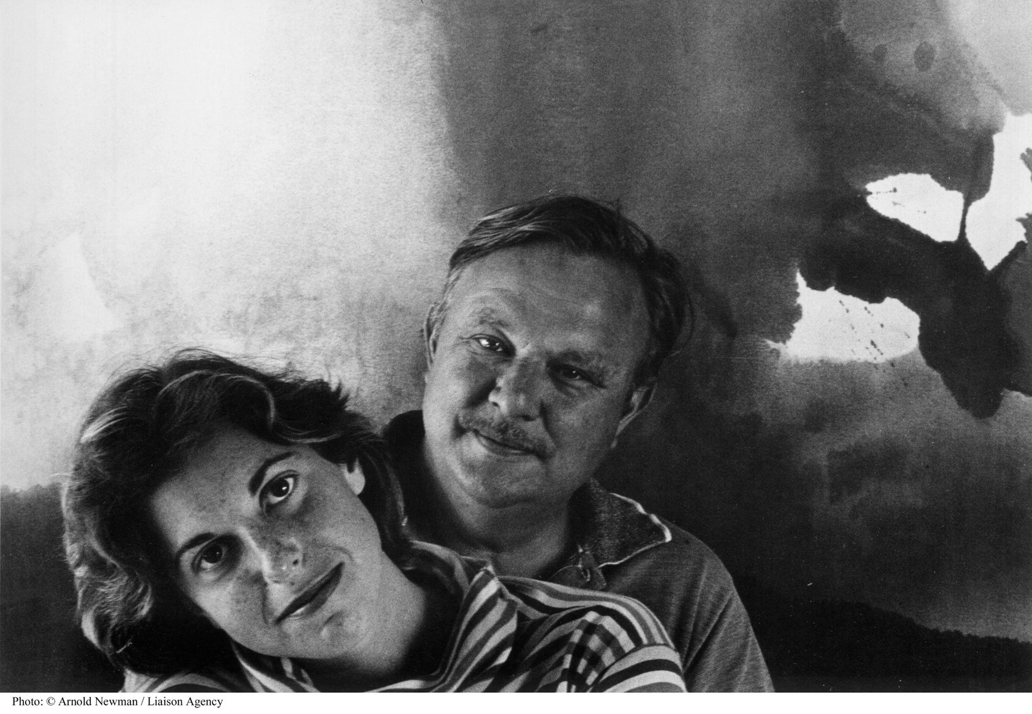
Frankenthaler & Motherwell
1957-1971
Notes:
Frankenthaler and Robert Motherwell, a New York power couple of abstract painting, in 1963.Photograph by Arnold Newman / Getty
Image source: https://www.newyorker.com/magazine/2021/04/12/helen-frankenthaler-and-the-messy-art-of-life

Slide 19
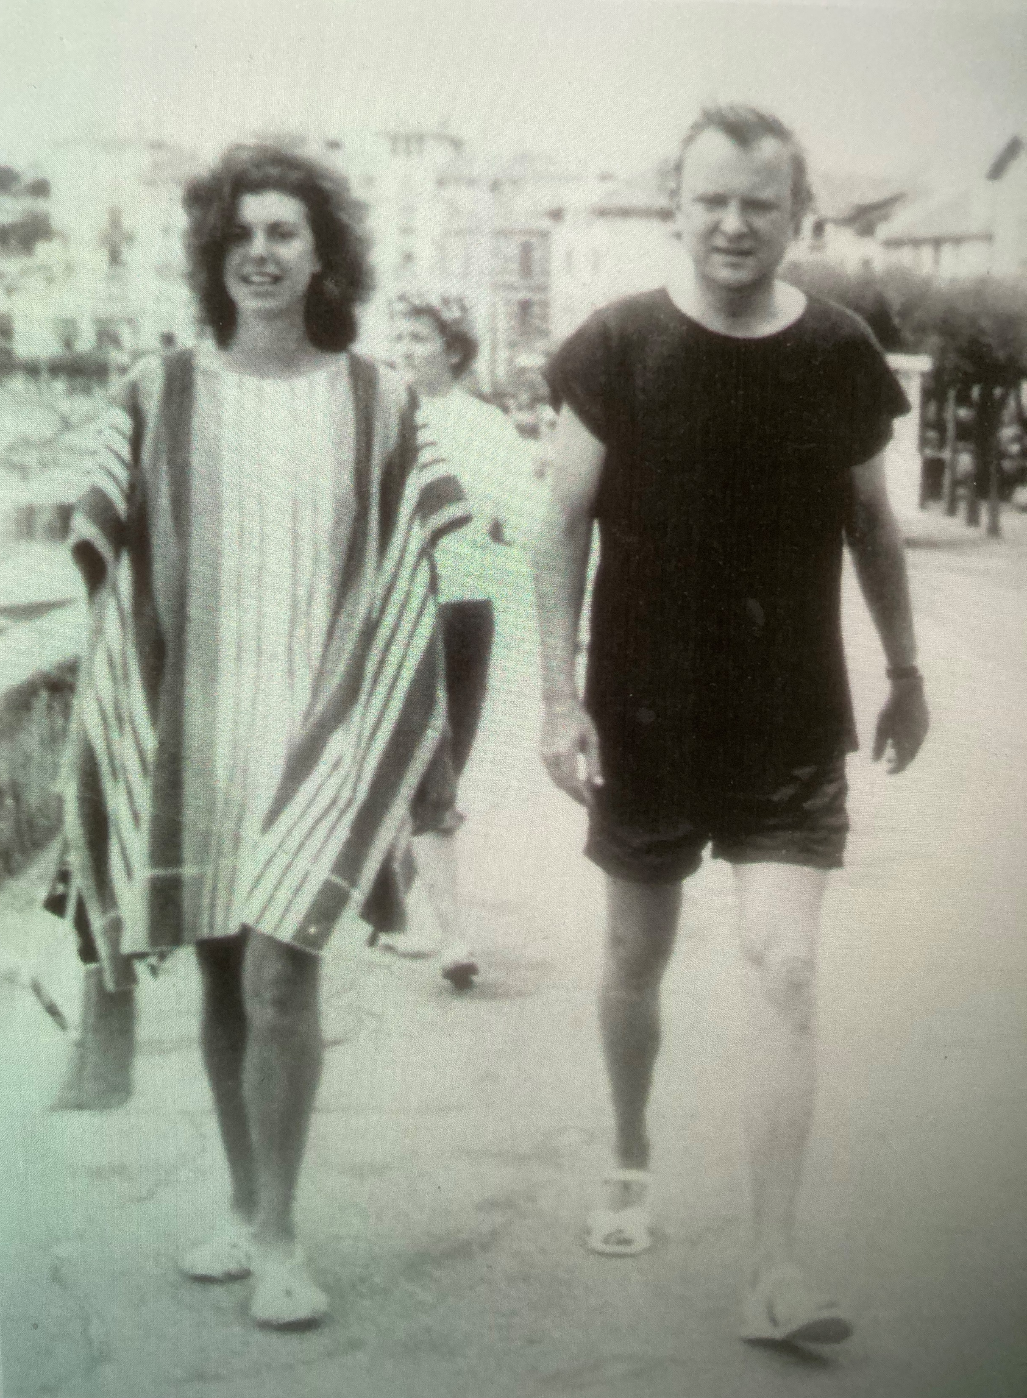
Frankenthaler & Motherwell honeymooning in France (summer 1958)
Notes:
Helen Frankenthaler and Robert Motherwell on their honeymoon, Saint Jean-de-luz, France (summer 1958)

Slide 20
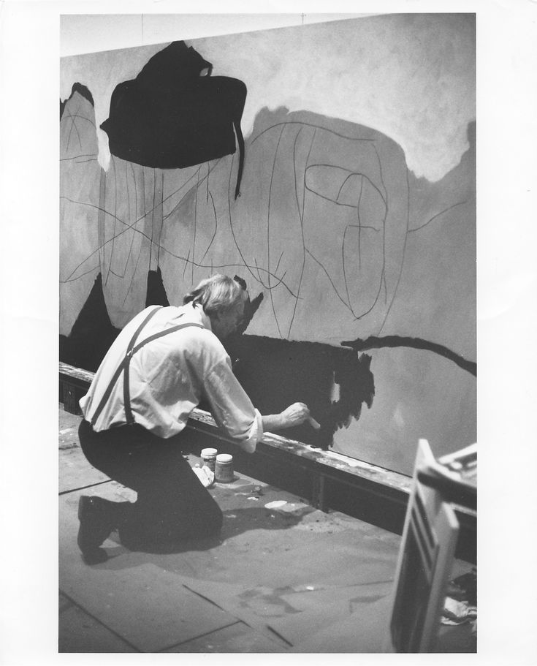
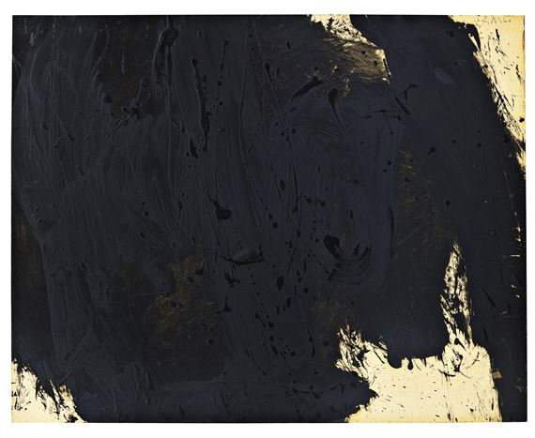
In Black and White (1960)
Notes:
Image: https://emuseum.mfah.org/objects/47427/black-on-white;jsessionid=1DD3B55E3431892656F335F8F8AD180A
Motherwell was a member of the New York School (many credit Motherwell for coining the term), which also included Philip Guston, Willem de Kooning, Jackson Pollock, and Mark Rothko.
Source: https://www.formidablemag.com/robert-motherwell/

Slide 21
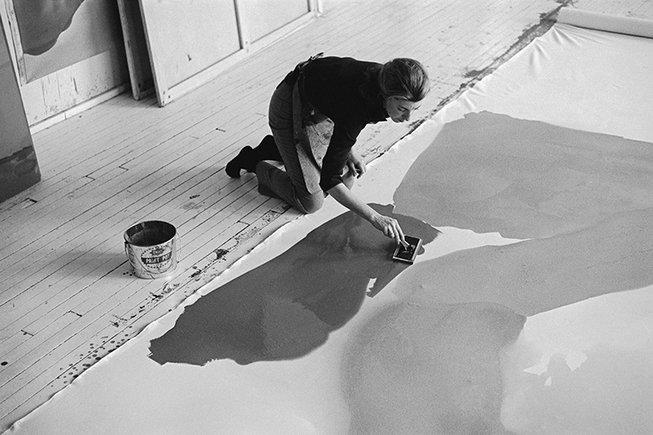
1960:
Color Field
Notes:
Image: Helen Frankenthaler in her studio. Photo: Ernest Haas. https://newcriterion.com/blogs/dispatch/the-women-of-abstract-expressionism-10110
Frankenthaler developed her own technique of pouring diluted paint directly onto canvas, then manipulating it with mops and sponges to create vivid fields of color.
Source: https://www.npr.org/2011/12/27/144323377/abstract-artist-helen-frankenthaler-dies-at-age-83

Slide 22
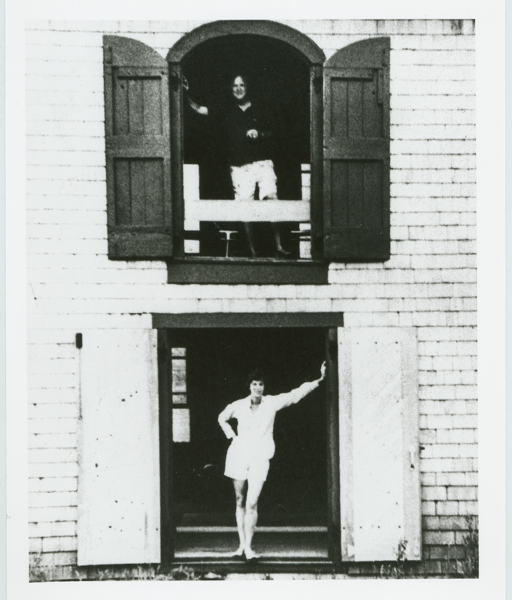
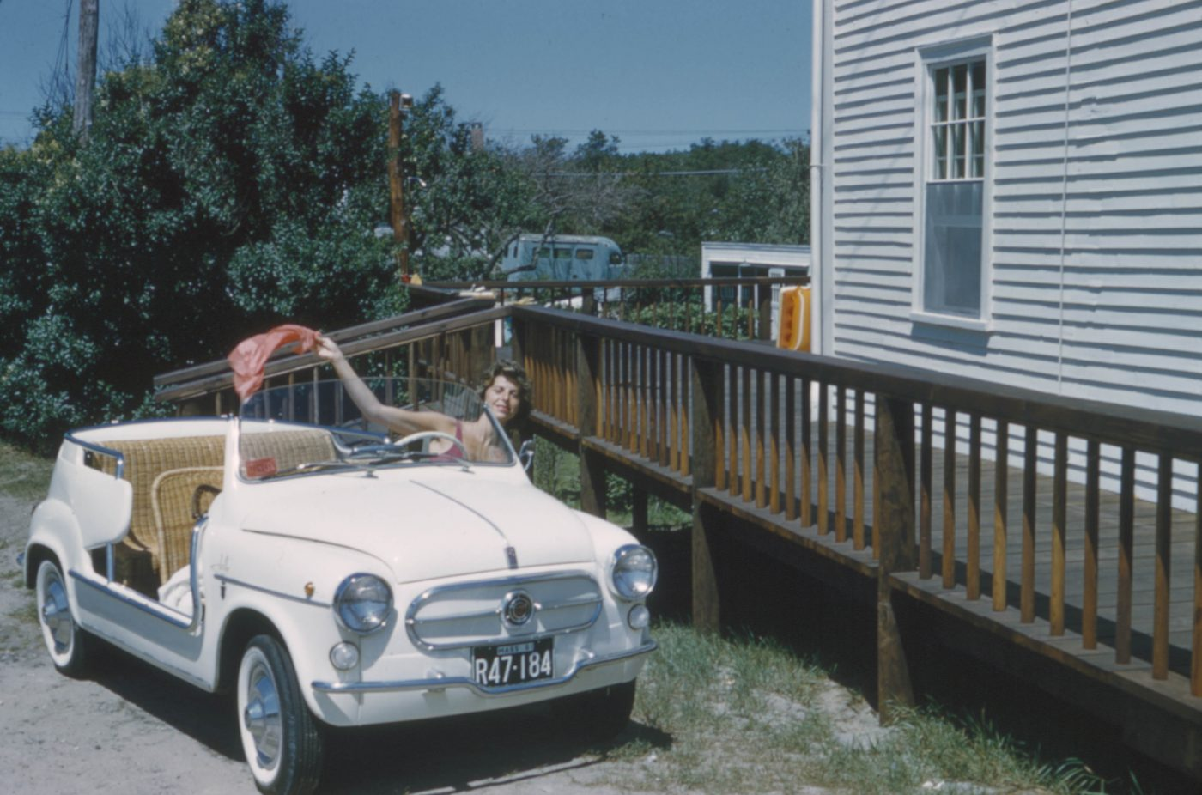
Provincetown
Notes:
Left: Frankenthaler in Fiat “Jolly,” 622 Commercial Street, Provincetown, summer 1961. Courtesy The Dedalus Foundation, Inc.
Source: https://parrishart.org/exhibitions/abstract-climates/
Right: Motherwell and Helen Frankenthaler in Provincetown, summer of 1961.
Source: https://www.dedalusfoundation.org/blog/category/uncategorized

Slide 23
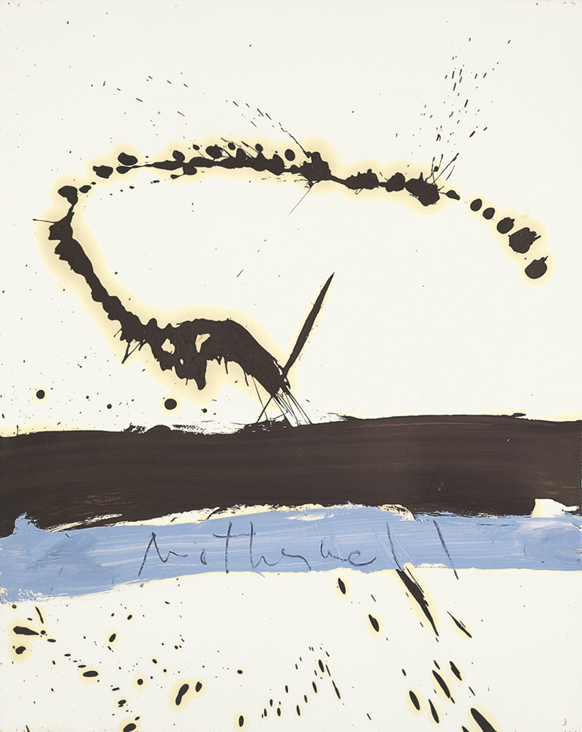
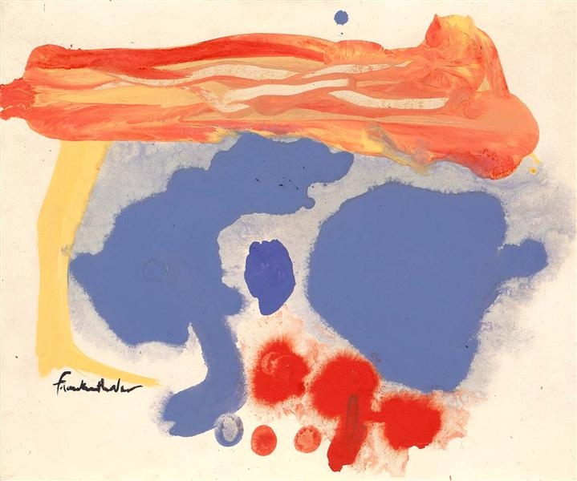
Summer Scene: Provincetown (1961)
Beside the Sea (1962)
Notes:
Left: Motherwell’s Beside the Sea, 1962. Oil on paper, 28 ¾ x 22 ¾”
Right: Fankenthaler’s Summer Scene: Provincetown (1961)

Slide 24
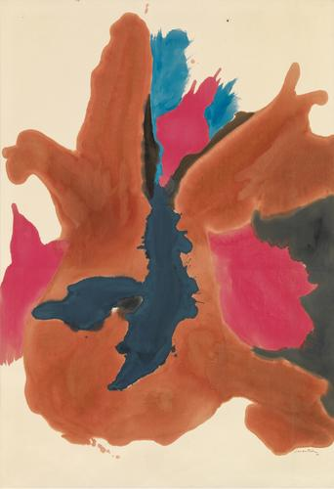
Pink Lady
(1963)
"What evolved for me had to do with pouring paint and staining paint. It's a kind of marrying the paint into the woof and weave of the canvas itself, so that they become one and the same."
Notes:
Image Source: https://www.frankenthalerfoundation.org/artworks/pink-lady/details/all
Quote Source: https://www.npr.org/2011/12/27/144323377/abstract-artist-helen-frankenthaler-dies-at-age-83

Slide 25
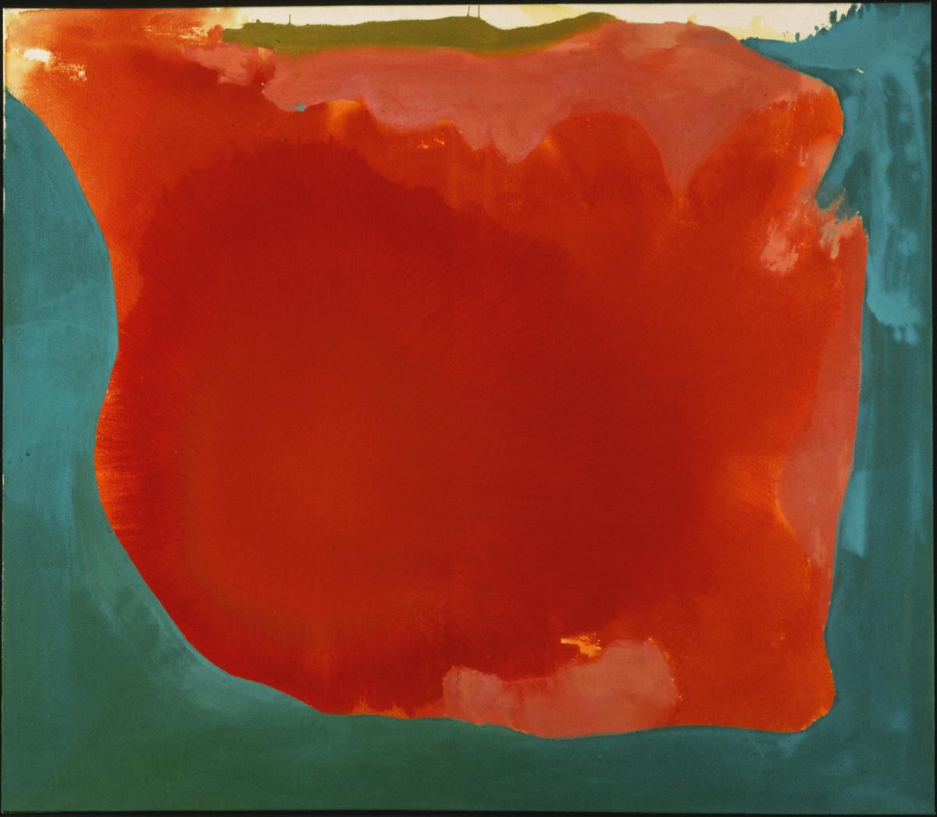
Canyon (1965)
“A really good picture looks as if it's happened at once. It's an immediate image. For my own work…[I try] to produce one really beautiful wrist motion that is synchronized with your head and heart, and you have it, and therefore it looks as if it were born in a minute.”
Notes:
Full quote:
A really good picture looks as if it's happened at once. It's an immediate image. For my own work, when a picture looks labored and overworked, and you can read in it—well, she did this and then she did that, and then she did that—there is something in it that has not got to do with beautiful art to me. And I usually throw these out, though I think very often it takes ten of those over-labored efforts to produce one really beautiful wrist motion that is synchronized with your head and heart, and you have it, and therefore it looks as if it were born in a minute.
— In Barbara Rose, Frankenthaler (New York: Harry N. Abrams, Inc. 1975, p. 85)

Slide 26
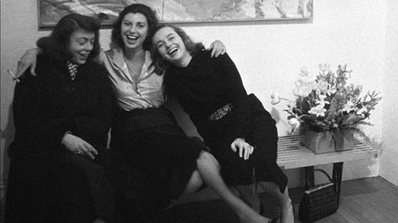
L-R: Joan Mitchell, Helen Frankenthaler, Grace Hartigan
Notes:
Painters Joan Mitchell (left), Helen Frankenthaler (center), and Grace Hartigan (right) at the opening of an exhibition of Frankenthaler paintings. New York City. USA. 1957. © Burt Glinn | Magnum Photos
Image source: https://www.magnumphotos.com/arts-culture/art/in-the-studio-helen-frankenthaler-bohemian-beat-generation-burt-glinn/
Joan Mitchell: called Frankenthaler the “Kotex painter,” referencing the smears in her work.
Grace Hartigan: “Easy for Helen to be the fairy princess,” the painter Grace Hartigan wrote in her journal in 1950. “She hasn’t seen the dragon yet.” And also: that her pictures seemed “made between cocktails and dinner.”
Source: https://www.latimes.com/entertainment-arts/books/story/2021-02-17/artist-helen-frankenthaler-bio

Slide 27
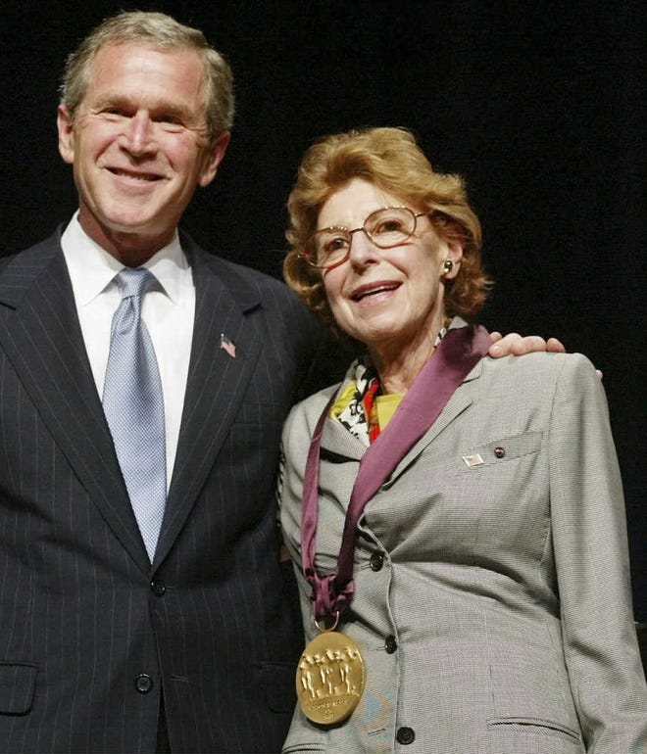
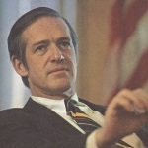
1994
Stephen M. DuBrul, Jr. (1929-2012)
2001
Notes:
Stephen M. DuBrul, Jr. (1929-2012)
He was an investment banker who served under the Gerald Ford administration.
2001: She was awarded the National Medal of Arts. From 1985 to 1992, she served on the National Council on the Arts of the National Endowment for the Arts.
Source: https://www.telegram.com/story/news/local/north/2011/12/28/abstract-painter-helen-frankenthaler-dies/49788812007/

Slide 28
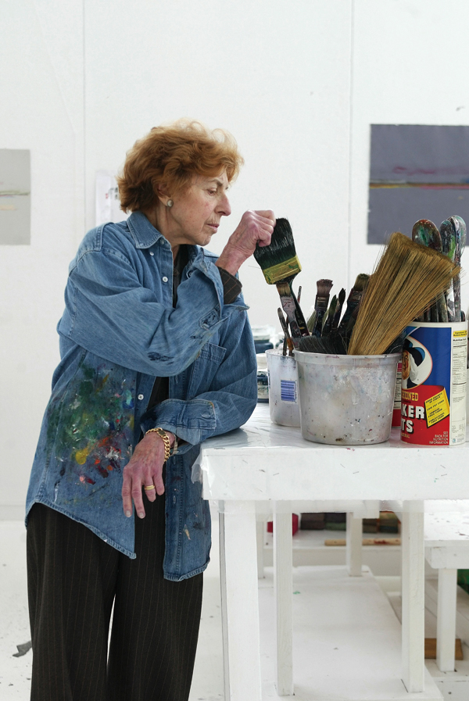
2011
“There are no rules... that is how art is born, that is how breakthroughs happen.
Go against the rules or ignore the rules, that is what invention is about.”
Helen Frankenthaler
Notes:
In 2011 she died after a long and undisclosed illness.
Source: https://www.frankenthalerfoundation.org/helen/biography
Image: https://www.taiwannews.com.tw/en/news/1801113

